Slide 1
Facebook As Graveyard
Quite a few years ago now I began to have a recurrent flash of seeing my Facebook page as my funeral. It sounds very morbid, but in fact Facebook, beyond morbid, is autothanatographic.
Carolyn Shapiro
Senior Lecturer
Falmouth School of Art &
School of Communication Design

Slide 2
autothanatography
“We can speak of a textual event there, in which a new regime of signification is emerging… Two incongruent logics converge without synthesis: On the one hand, the text points to the death of the speaking I, to self-writing as autothanatography… on the other hand, a new sort of subjectivity emerges here…”
—E.S. Burt, 26.
“…the encounter of the I with its own death [is] the practice of autothanatography.”
--(E.S. Burt, Regard for the Other: Autothanatography in Rousseau, DeQuincey, Baudelaire & Wilde,
New York: Fordham University Press, 2009, 27.)

Slide 3
Autothanatography realises the relation between writing, death and the Self
Thanks to the 18th century philosopher Jeremy Bentham, we can add the icon into the equation.

Slide 4
“The word auto has been made familiar to English ears by its use in autobiography (why should there not be auto-thanatography?) autograph, etc. Auto-Icon will be soon understood for a man who is his own image.” (J. Bentham, 1832)

Slide 5
Jeremy Bentham, “Auto-Icon, or, Farther Uses of the Dead to the Living,” (London, 1832)

Slide 6
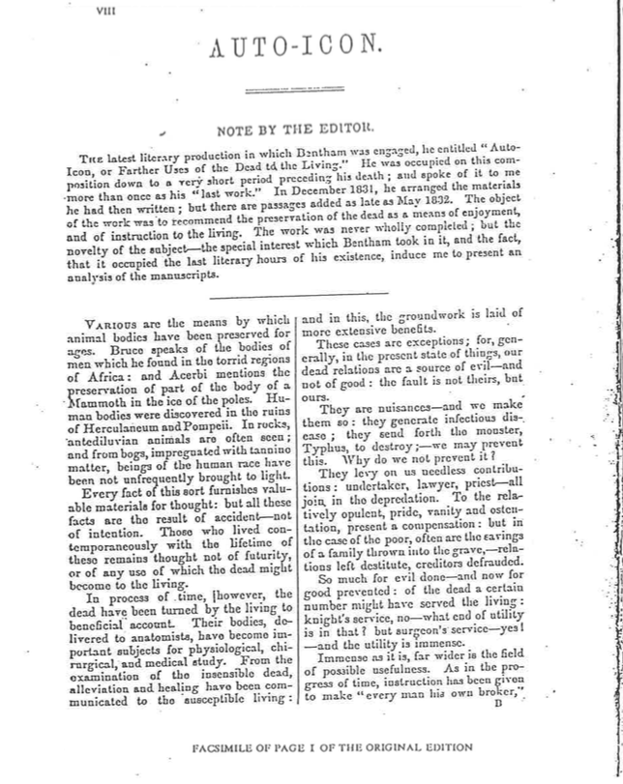

Slide 7
An extract of this last, and quirky, essay of Bentham’s (which was never published because his editor did not approve):

Slide 8
I think that Bentham undoes his own logic. In his desire to present a real, indexical, “auto” icon, he teeters into the fictional realm of the figure* (*That “figure” is also word for face has not escaped me):

Slide 9
prosopopoeia
n. [L, fr. Gk prosōpopoiia, fr. Prosōpon mask, person (fr. Pros- + ōps face + poiein to make—more at EYE, POET]
1: a figure of speech in which an imaginary or absent person is represented as speaking or acting
2: PERSONIFICATION
3: the trope of address
4: “But prosopo-poein means to give a face and therefore implies that the original face can be missing or nonexistent.” (Paul de Man, “Hypogram and Inscription,” in The Resistance to Theory, Minneapolis: U of Minnesota Press, 1986, 44)

Slide 10
Paul de Man, “Autobiography as De-Facement,” in The Rhetoric of Romanticism (New York: Columbia University Press, 1984
“Prosopopeia is the trope of autobiography, by which one’s name…. is made as intelligible and memorable as a face…. The dominant figure of the epitaphic or autobiographical discourse is… the proposopoeia, the fiction of the voice-from-beyond-the-grave…” (76, 77)

Slide 11
Philippe Lacoue-Labarthe, Ending and Unending Agony: On Maurice Blanchot (New York: Fordham University Press, 2015)
“…the mode of all supposedly ‘autobiographical’ enunciation…is decidedly autothanatographical, since the ‘subject’ evidently must somehow be dead already in order for it to begin to say itself and write itself as an other: so that it many accept to summon ‘itself’ or contest ‘itself,’ thereby summoning or contesting death (or the dead one) in himself…” (Lacoue-Labarthe, 54)

Slide 12
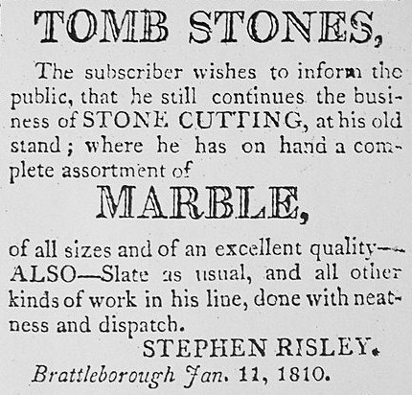
Epigraph as Autobiography
According to Paul De Man, Wordsworth’s endeavour to write his Essays Upon Epitaphs (1810), ended up being Wordsworth’s own epitaph: “his own monumental inscription or autobiography.”
--(Paul de Man, “Autobiography as De- Facement,” in The Rhetoric of Romanticism (New York: Columbia University Press, 1984, 72)

Slide 13
Epitaph
1: an inscription on or at a tomb or a grave in memory of the one buried there
2: a brief statement commemorating or epitomizing a deceased person or something past

Slide 14
persona
--from the Etruscan phersu and Greek root prósōpa, respectively, meaning face or mask.
Perhaps Facebook exemplifies all online persona in its autothanatographic discursivity and performativity.

Slide 15
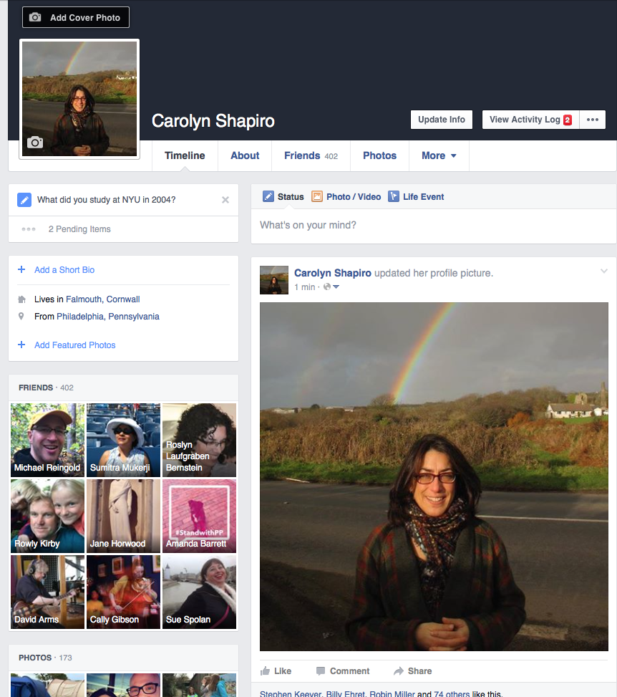

Slide 16
Whether the Facebook person is publicly mourning someone else, posting the dead into an eternal tombstone,

Slide 18
or whether we, the living persona, see before us the accumulation of “friends” who comprise our life from beyond our inevitable grave,

Slide 19
or, whether a “friend” who is no longer alive still functions identically as a “friend” who is alive,

Slide 20
the utterances of Facebook, prosopopaic, perform automatically, and autothanatographically, quite removed from the metaphysical presumptions of autobiography.

