Slide 1
Deconstructive Tendencies in Bentham’s Philosophy of Language
Reading the (per)happiness in Bentham’s Felicific Calculus
University College London
11 March 2015
Dr Carolyn Shapiro, Falmouth University

Slide 2
Starting points:
  A working definition and characterisation of “Deconstruction” and a proposition about why it is so generative for reading Bentham’s philosophy of language
  Bentham’s resistance to some metaphysical presumptions from the very beginning of his writing career– a “deconstructive” perspective
  Bentham might not entirely have embraced many of the deconstructive approaches to language– despite fully recognizing them.

Slide 3
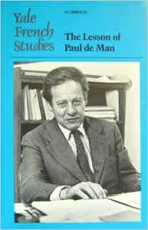
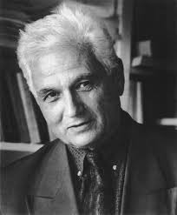
Jacques Derrida; Paul DeMan
Jacques Derrida (Algerian, 1930-2004)
Paul de Man (Belgian, 1919-1983)

Slide 4
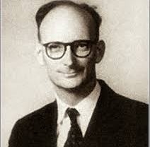
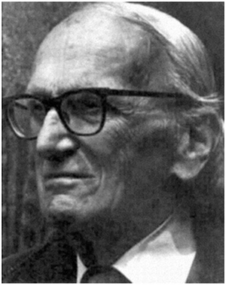
J.L. Austin; H.L.A. Hart
J.L. Austin, Oxford University, 1911-1960
H.L.A. Hart, Oxford University, 1907-1992

Slide 5
A working definition of “deconstruction”:
Resolutely not a method, philosophy, or application
A strategy of reading and writing which strives to undo metaphysical presumptions which otherwise go unquestioned, by
“locating inherent dilemmas” and “identifying symptoms of a repressed impurity” within
any given structure– which are actually structural conditions.”
(Mark Wigley, “Deconstructivist Architecture”)

Slide 6
Derrida’s exemplary site of wedging into the foundations of Metaphysics: WRITING
Of Grammatology (1976): Derrida first identifies Writing as radical departure from “self-presence”:
“For Saussure, as for Plato, Hegel, Kant, and most other Western philosophers, writing is a “nuisance”, because it gets in the way of the privileged relation between voice and self-present thought.”
--- C. Norris, Derrida, 88.
“Speech draws on interior consciousness, but writing is dead and abstract. The written word loses its connection to the inner self. Language is set adrift, untethered from the speaking subject. In the process of embodying language, writing steals its soul. Deconstruction views writing as an active rather than passive form of representation.”
---E. Lupton, ,“Typography and Deconstruction,” 1.

Slide 7
Writing: foregrounds the figurality and performative machination of language
Deconstruction pushes a “radicalization of language’s figurative aspect.”
— Christopher Norris
“To write is to produce a mark that will constitute a sort of machine which is productive in turn, and which my future disappearance will not, in principle, hinder its functioning…” (Derrida, Limited Inc, 8)

Slide 8
Bentham’s anti-metaphysics
Bentham’s Felicific Calculus would contradict the following:
The moral individual, self-present to himself; corresponds to the law “being” (as opposed to the temporally-disjunctive and anti-ontological “ought to be”)
The anterior and inaugurative standing of the Origin
(where “anteriority” might comprise morality, natural law, idea, or Truth)

Slide 9
Bentham would reject “self-presence” because it:
Denies variable conditions;
denies transferability of sovereignty;
is deflective of the primacy of measuring and testing against criteria; and
hybridizes “presence” with the conscious, de-materialized entity, as opposed to with the physical entity.

Slide 10
“The radical ontological question is: ‘What exists?’ Bentham’s answer is: substance.”
              (Phillip Schofield, Bentham: A Guide for the Perplexed, 2009, 51.)

Slide 11
The principle of Utility: founded upon an ontology based within a physical theory of logic and language.
Language is worked towards the physical, away from the metaphysical through:
phraseoplerosis, “whereby the phrase which includes the noun requiring exposition is ‘filled up,’” then translated and moved into the operations of paraphrasis;
and
paraphrasis, the translation of one phrase or sentence into another phrase or sentence whose words are real entities or at least close to them.
(Schofield, 52-53)

Slide 12
The ultimate paraphrasis:
Auto-Iconism
Whereby the name, the intention, the will– all otherwise fictional entities, are annexed to dead body
The dead body is equivalently Utilitarian as the living body– quite deconstructive.

Slide 13
Fiction as “automaton”
(Bentham allegorises Fiction as automaton in a footnote to The Theory of Fictions)
Fictional language is like an automated being which moves of its own causation; untethered from anterior cause:
“[accounting for]…the motion of such bodies as are in motion, …certain fictitious entities are, by a sort of innocent falsehood, the utterance of which is necessary to the purpose of discourse, feigned to exist and operate in the character of causes…”
(Ogden, xlii)
an artful creature which looks identical to the real thing;
a fictional entity is used in discourse as if it were a real entity– and gets away with it.

Slide 14
Paul de Man on Fiction and language
  “…a random or mechanical dimension of language exists that cannot be assimilated to a system of intentions, desires, or motives… the random arbitrary functioning of language as ‘fiction’—that is, ‘in the absence of any link between utterance and a referent,… governed by any…conceivable relationship that could lend itself to systematization’… is mechanical, is the functioning of a machine (‘…l’effet machinal de mon embarras’)…”
  ---Cynthia Chase citing Paul de Man citing Rousseau

Slide 15
That “truth” may sometimes be purely performative – by its very constitution in language
Upon the beholding of the automaton figure, [fictional language], “constructed for that purpose [of acting as if it were real] by the ingenuity of the mechanist”,
“How should it be otherwise, when on the very occasion on which, and by every person by whom it is spoken of at all, it is spoken of as if it were a real entity?”
(Ogden, citing Bentham, xliii)

Slide 16
All language has potential to be automatic; to moving/acting on its own because it is non-referential, self-operating:
as revealed by the motion of the automaton, which serves as an allegory for a part of speech (Ogden, xliii)
“Communicating, in the case of the performative, ... would be tantamount to communicating a force through the impetus [impulsion] of a mark.”
(J. Derrida describing the speech-act theory of J.L. Austin, Limited Inc, 1988, 13).

Slide 17
Bentham warns us of the dangers of the hyper-performativity of language even at the level of the word (operating catechristically):
“In a play or a novel, an improper word is but a word: and the impropriety, whether noticed or not, is attended with no consequences. In a body of laws... an improper word would be a national calamity: and civil war may be the consequence of it: out of one foolish word may start a thousand daggers.” (Ogden, cxlviii)

Slide 18
The worst case scenario: law as automaton
Legislation: linguistically performative (whether towards the greater good or towards mischief):
“A fiction of law…may be defined a willful falsehood, having for its object the stealing legislative power, by and for hands which durst not or could not, openly claim it; and, but for the delusion thus produced.” (Ogden,xviii)

Slide 19
“automaton”: highly discursive figure in the 18th century; ambivalent:
automata constructed by Vaucanson (mechanical digesting duck, etc. 1730s/40s)
La Mettrie: L’Homme-Machine (1747): “The human body is a self-winding machine, a living representation in perpetual motion.”; Discourse on Happiness (1748) (a materialist view on Happiness)
Bentham and others: the automaton possesses a dangerous “mind” of its own.
anxiety: that Man becomes automaton: “L’effet machinal” --(Rousseau, Confessions)– becomes the DeManian prototype for the mechanical operation of text through troping; text-as-machine, automatic and dynamic.
“…l’effet machinal is responsible for effects of meaning generated by sheer contingency, elements of uncontrol and improvisation.” (A. Ronell, Stupidity, 2002, 98.

Slide 20
However, parallel to the disparaged automaton, Bentham revolutionizes the efficacy of sovereignty.
As argued by Guillaume Tusseau,
Sovereignty for Bentham is not, as in the philosophy of John Austin, a single monolithic power that makes law;
Sovereignty is confer-able, adoptable, and divisible.
--can be shared by several masters
--works only in conjunction with what its subjects do with it
--”…a law is defined … by the soveereign’s trusting on the expectation of certain events that should act as a motive.”
(G. Tusseau, “Positivist Jurisprudence Confronted: Jeremy Bentham and John Austin on the Concept of a Legal Power,” 2007, 12)

Slide 21
Legal positivism
  “the simple contention that it is in no sense a necessary truth that laws reproduce or satisfy certain demands of morality, though in fact they have often done so.”
    (H.L.A. Hart, The Concept of Law, 1961, 181-182)
    the main question of legal positivism: is law autonomous [from morals]?

Slide 22
J.L. Austin’s How to do Things with Words (series of lectures delivered at Harvard University in 1955)
Austin lays out conditions, categories, and philosophical implications of the performative utterance
often used law as example
Primary point: that the referential structure of the Statement has always been the presumed approach in the philosophy of language.
philosophy has proceeded from metaphysical investments in the Truth behind all representation.
Austin’s program: for the “performative” utterance to de-throne abstract Truth to replace it with something material (language).

Slide 23
JL Austin’s notion of sovereignty:
sovereignty is constituted linguistically, through the performance of speech acts and inter-subjective, concomitant acceptance of those speech acts within a given community.

Slide 24
J.L. Austin on the performative utterance:
an act which takes place through, and because of, language; words themselves either perform an act in their very utterance: “illocution”, or, they inscribe a consequential action (perlocution).
The performative utterance is “happy” if the action is successfully performed.
felicitous/ infelicitous replaces true/ false

Slide 25
Crossovers between Bentham and Austin on “happiness”
Both philosophers theorise “happiness” as linguistic operation, in particular, successful operation.
Bentham: sovereignty entailed a successful uptake of what the sovereign legislated in order for that law to bring about “happiness.”
Felicific calculus: fundamentally performative in these consequential modes of operation

Slide 26
Linguistic performativity in Bentham and JL Austin
For Bentham, more pleasure is tallied if an object or law is “conducive” to happiness;
performative “springs to action” effect legislation.
A positivist activation of the law through linguistic performativity

Slide 27
The play of mischief: Bentham and Austin
Bentham: mischievousness
JL Austin: misfires, abuses, misapplications, misinvocations, insincerities, misexecutions, flaws, hitches
Footnote: Jacques Lacan’s “missed encounter” might be an interesting correspondence to the above as he aligns “encounter” with happiness -that hardly -ever -happens (explicitly making that etymological connection for us )

Slide 28
Bentham on the high probability of mischievousness
From the Preface to the Fragment on Government:
“…with respect to actions in general, there is no property in them that is calculated so readily to engage… as the tendency they may have to or divergency… from that which may be styled the common end of all of them… Happiness; and this tendency in any act is what we style its utility; as this divergency is that which we give the name mischievousness…

Slide 29
(continued...)
… the mischievousness is the only way to make him see clearly that property of them which every man is in search of; the only way in fact to give him satisfaction.”
(Warnock citing Bentham, 5)

Slide 30
Mischievousness: an “inherent dilemma” that is constitutive
“[in deconstructive architecture]…Flaws are intrinsic to
the structure. They cannot be removed without destroying it; they are, indeed, the structure.” (M. Wigley, 1988)
  Derrida characterises the dérive of writing: “[t]his essential drift [dérive] bearing on writing as an iterative structure…” (LI, 8)
  “…unable to score, language is engaged in a permanent contest; it tests itself continually in a match that cannot even be said to be uneven or altogether futile because oh fact remains that this match is ongoing…The contestatory structure, yielding no more than a poor score, paradoxically depends upon failure for its strength and empowerment.” (A. Ronell, Stupidity, 2002, 99.)

Slide 31
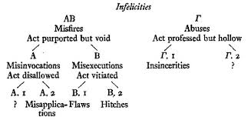
Austin’s
“Doctrine of the Infelicities” (from How to do things with Words)

Slide 32
By their very nature, performative acts entail failure or infelicity.
Says Austin,
“Acts...necessitate, since they are the performing of actions, allowance being made for the ills that all action is heir to. We must systematically be prepared to distinguish between ‘the act of doing x, i.e. achieving x, and ‘the act of attempting to do x.’” (Austin, 1975, 105.)

Slide 33
Happiness is perhaps.
Achieving Happiness is a matter of avoiding misfire, mischief, et. al., surviving a gauntlet of inherited debilitations and divergences.

Slide 34
Objective well-being
Deconstructs “Subjective Well-being”
Outsources happiness to external conditional factors which might perhaps, happen
Bentham: law must be tested against criteria and calculated for the greater good, and when it passes the test, Happiness is achieved; a theory of law which operates “at the level of the object language.”
  (G. Tusseau, 13)
JL Austin: Happiness/Felicity happens, linguistically, and also in terms of successful uptake (highly conditional)

Slide 35
“αγαθόν and εύδαιμία in the Ethics of Aristotle” (J.L. Austin, 1939)
Austin’s reading:
Eudaemonia does not refer to “feeling happy” or “feeling pleasure.”
Aristotle is identifying “not the nature of happiness but the conditions of its realization.” (Austin, 1979, 10).
eudaemonia would be, “a complete life of activity of a certain kind”; or “success”. (ibid, 17)

Slide 36
Happiness object-ified
etymology of eudaemonia: a life being “prospered by a deity” (Austin, 17).
Eudaemonic: a happiness, though describing a man’s life, tends to be measured from one’s death:
“...hence the saying ‘call no man εύδαίµων until he is dead’(I.x.i).... and it would be silly to say ‘call no man pleased until he is dead.’” (ibid,18)

Slide 37
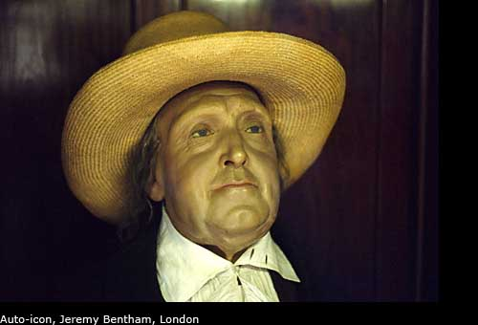
Auto-icons: eudaemonic?

Slide 38
According to J.L. Austin, eudaemonia, according to Aristotle,
Does NOT, as Prof. Pritchard argues so misguidedly, referring to “a feeling of pleasure.”
It does refer to “a certain kind of life”; achieved; the word is related to congratulation on a life’s activity.
A less mis-led understanding of eudaemonia would be to understand it as “success.”
(Austin, 18 et. al)

Slide 39
Derrida on “perhaps”
A radical uncertainty and undecidedness
Related in English (hap, perchance) to the notion of chance– what may happen
Classical philosophy disdains the recourse to the ‘perhaps’– Derrida citing Rodolph Gaschḗ--because “perhaps” as a modality lies outside of truth, veracity, and certainty.
(Derrida, The Politics of Friendship, 2005, 30; citing R. Gaschḗ, “Perhaps– A Modality? On the Way with Heidegger to Language,” 1993.

Slide 40
Further directions of enquiry
Bentham and semiotics (Ogden’s recognition of the history, starting with Bentham, of “geographers of Symbolic Distance”; Bentham’s Semiotics of Law)
Bentham and structuralism more broadly (Jacques Lacan on Benthan’s Theories of Fiction)
Autothanatography as discourse
Bentham and “the Romantic performative”– (book of this title by Angela Esterhammer, Stanford UP)
The felicific calculus as “testing site” (Avital Ronell)

Slide 41
THE END!
THANK YOU VERY MUCH!

