Slide 1
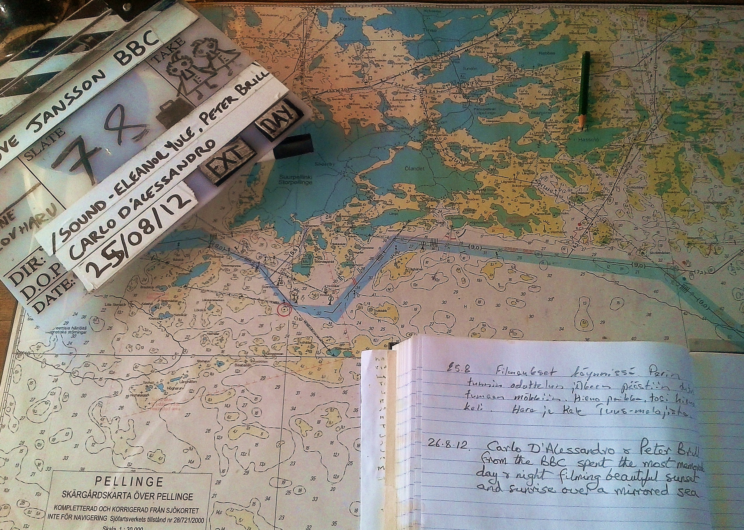
Ethnography or auto- ethnography?
The process of biographical construction in, the film, 'Moominland Tales - The Life of Tove Jansson’

Slide 2
Definitions:
Bio, life
Graphia, to write,
= Life –writing.
“an account of someone’s life written by someone else”
Oxford English Dictionary (2001)

Slide 3
“The impulse behind the thirst for these books seems to be that we are getting close to the real truth of a person, and that this is a closer connection with the mind and heart of the person …the desire behind the impulse is that of knowing how other – usually famous – people have conducted their lives, and the readiness to learn from these lives how ordinary mortals might conduct their own’
James Noonan () Biography and Autobiography

Slide 4
Sigmund Freud
‘…anyone who writes a biography is committed to lies, concealment, hypocrisy, flattery and even to hiding his own lack of understanding, for biographical truth does not exist, and if it did we could not use it’.
Letter to James Strachey (1928)

Slide 5
“Biographies are only fictional statements with varying degrees of ‘truth’, about ‘real’ lives. True stories are stories that are believed in.”
Norman. K. Denzin (1989) Interpretive Biography

Slide 6
The Director – Auteur or collaborator?

Slide 7
The film crew as a collective

Slide 8
Moomin Film Crew

Slide 9
Ethnography
“ A collection of diverse ways of thinking and writing about culture’, from an outsiders perspective.
James Clifford,(1988), The Predicament of Culture.

Slide 10
Biography
…’when a writer writes a biography, he or she writes him or herself into the life of the subject written about. When the reader reads a biographical text, that text is read through the life of the reader. Hence, writers and readers conspire to create the lives they write and read about. Along the way, the produced text is cluttered by the traces of the real person being written about’.
Wendy Lesser (1988) Autobiography and the I of the beholder

Slide 11
Penguin Books
“Tove Jansson was born in Helsingfors, Finland, in 1914. Her mother was a caricaturist and designed 165 of Finland’s stamps and her father was a sculptor. Tove Jansson studied painting in Finland, Sweden and France. She lived alone on a small island in the Gulf of Finland, where most of her books where written.Tove Jansson died in June 2001.”

Slide 12
transparency

Slide 13
“I felt I had no right to be there, for it wasn’t now the house of Elise acting by proxy for some unknown people. It was the house of a famous modern poet. The thought that at any moment he and his family might walk in and find me there terrified me. I insisted that Elise should open the bathroom door and tell me to my face that there was no possible chance of their returning for many days to come.
Then I began to think about the house itself, which Elise was no longer accountable for. Its new definition, as the house of a poet whose work I knew well, many of whose poems I knew by heart, gave it altogether a new appearance.”

Slide 14
Muriel Spark ‘House of the Famous Poet’
To confirm this, I went outside and stood exactly where I had been when I first saw the garden form the door of the taxi. I wanted to get my first impression for a second time.
And this time I saw the absolute purpose in the overgrown garden, which since then, I have come to believe existed in the eye of the beholder. But at that time the room we had first entered, and which had riled me, now began to give back a meaning, and whatever it was, was right. The caked up bottle of ink, which Elise had put on the mantelpiece. I replace don the table to make sure. I saw a photograph I hadn’t noticed before, and I recognised the famous poet.”

Slide 15
Textural turning points:
“The notion that lives are turned around by epiphanies, is deeply entrenched in Western thought…this means that biographical texts will typically be structured by the significant, turning point moments in a subjects life.”
Norman. K. Denzin(1989) Interpretive Biography

Slide 16
ROUGH STRUCTURE
1. INTRODUCTION: Who is she? We need to look into work to find out Love and work
2. SUCCESS :– the peak (Interweave this)
3.EARLY LIFE AND CHILDHOOD 1914 – 1936
4.THE WAR AND BIRTH OF THE MOOMINS 1938 - 1946
(Comet – fin family - Garm) 1944 studio
5.VIVICA AND THE THEATRE (MOOMIN SUMMER MADNESS) 1947
6.FAME - midpoint 1953 - 1957 (comic books and Sutton)
7. ENTER T0O – TICKY AND THE ISLAND – (1964 construction starts) Tootie (fair play)1958 – 1964
8. TONAL CHANGE (MID WINTER) 1957 – 1968 And death of the father Moominpapa books – The Sulptors daughter (68)
9. DEATH OF THE MOTHER AND MOOMINS AND BIRTH OF THE ADULT AUTHOUR 1970 – 1980 (November – summer book – sun city)
10. WRITERS BLOCK AND RECLUSE at 80 (1994) 1982 - 2001True deceiver – the toll of fame - messages
11. Re- birth and celebration. 2004 onwards

Slide 17
Recce

Slide 18
TOVE
“…she herself is the subject of her work. She represents version of herself in literature, painting, diaries and letters, ‘the present her, conceal her and document her is different roles and contexts”.
Prof Boel Westin, A Painters Reflection

Slide 19
Film with 5 segments
The Sculptors Daughter
Moomin
The Lover
The Celebrity
The Hermit

Slide 20
Prologue:
EXT. PELINGE PENISULA – FINLAND
We look across the stormy sea towards tiny, pine-clad atolls peppering the horizon line. A tern screams before it dives stealthily towards a wave.
CAPTION: PELINGE PENISULA – FINLAND
Behind an old wooden boat shed is a cottage built lovingly from planks of red painted wood.
Inside, 92-year-old Greta mounts the stairs with the help of a stick. She gets to the top and enters a small attic room. The room is empty apart from a single bed and a desk and chair, facing a window with a view of a meadow surrounded by old pines. Spartan, like a monk’s cell
NARRATOR:
In 1970 Tove Jansson wrote the last book in the Moomintroll family series, a series she had started in the closing months of the World War Two and one that would become so popular it would rank her among the most successful children’s authors of all time.
We see Tove Jansson in a photo hanging on the wall of the attic room. Her hair grey and face gaunt, she wears an enigmatic smile, a cigarette poised between her fingers.
Greta Gustafsson: (family friend – speaking Swedish)
‘I remember Tove sitting at that desk and writing ‘Moominvalley in November’. It was a sad time for her, her mother had just died, and after that she felt she could no longer write about the Moomin family, so she was saying goodbye to them here.’
Greta stares out across the lush green meadow. The small room is lost in silence but for the sound of distant sea wash.

Slide 21
FILMING

Slide 22
Visual style

Slide 23
Interviews

Slide 24
Locations

Slide 25
Tove’s island

Slide 26
Final voice over script
10:08:07
Finland is the home of the Moomins.
The Moomins are the peace-loving, philosophical, family of Moominpappa, Moominmamma and their son Moomintroll.
Conceived in the 1940s as a series of children’s books, the Moomins are now a global phenomenon making their creator Tove Jansson one of the most successful children’s authors of all time.
10:00:41
And yet she remains eclipsed by the success of her work. She is known, if at all, for her supposed hermit-like existence on a remote island in the Gulf of Finland and not for the lyrical, adult fiction she wrote here, nor the career as a painter she pursued so ardently throughout her life.
Like her work, Tove Jansson’s own story has many other sides and transformations. From her birth in 1914 to her death in 2001, her life was as colourful, complex and as stormy as her greatest creations.

Slide 27
Preview
“Affectionate and beautifully shot survey of the life and works of Finnish author and illustrator Tove Jansson, creator of the enduring Moomins series of children's books. The picture that emerges is much as might be expected: the curiosity and humanity – or Moominity – of her famous creations seem to have been all hers, but the writerly need for solitude was expressed in her eventual retreat to an island in the Gulf of Finland. Features the recollections of friends and peers, and unprecedented access to Jansson's personal archive.”
Guardian Review 21/ 12/ 12

