Slide 1
Will Internets Eat Brain? ‘Will Internets eat brain?’ comprises a moving image work and essay that presented in a number of locations and iterations in the UK, The Hague and Paris between 2016 and 2018.
Researcher’s Name: Gillian Wylde
Research Programme: Inequality & Storytelling

Slide 2
Page 3
Page 4
Page 5
Page 9
Page 10

Slide 3
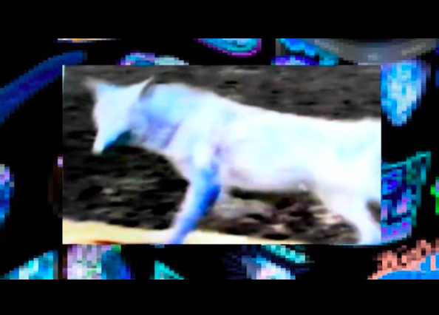
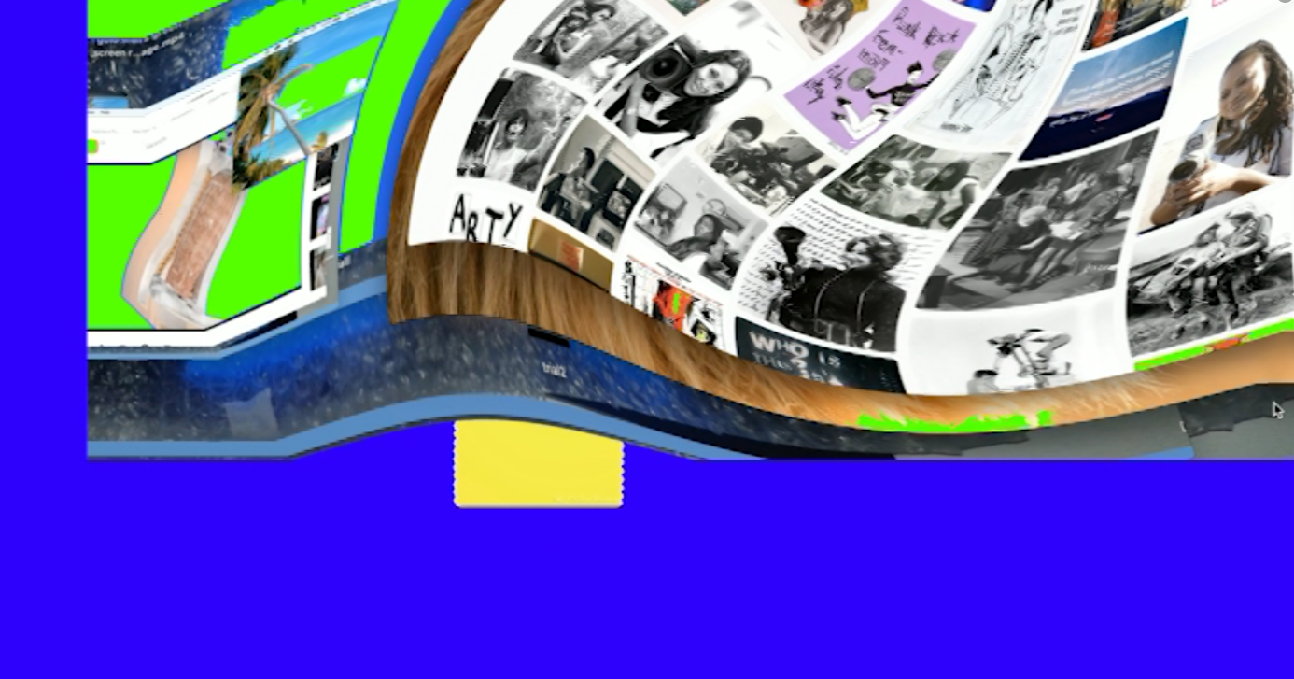
Will Internets Eat Brain is a video and performance presentation that was commissioned by MAP Magazine and funded by Creative Scotland and Arts Council England
It was presented at the 13th Glasgow Film Festival, CCA, 2017. Running time 1hr 30 mins followed by an audience discussion.
Collaborators/ key people Intellect Books, MAP Journal, Glasgow Film Festival, CCA Glasgow.
Images: video stills from Will Internets Eat Brain.
Page 58 - https://glasgowfilm.org/assets/files/GFF-Brochure-2017.pdf
https://mapmagazine.co.uk/map-presents-gillian-wylde-will-internets-eat-brai

Slide 4
Will Internets Eat Brain, is a video and text work that investigates digital entanglements and interrelationships between the body, storytelling, inequalities and ‘post’ internet cultures. Research asks how search engines and information retrieval systems define and replicate, and how the ‘past’ circulates rapidly and widely online intermixing with the ‘contemporary’. The research takes up queer feminist practices and dynamics as a method to make new relationalities, curious proximities and colligations that might bring into being something other than themselves. Imagery, sounds and words are sourced via search engine algorithm and accumulative browser digital foraging. Sourced material is adapted, mutate and reassembled as a series of cut ups and mashups. The work asks how the canonical and chronological become entangled with viral meme, listicle and the recorded online are copied and shared by internet users.
Processes of performative assemblage(s) is used as a working method that articulate activities of accumulation, and emergence and that call to attention improvisatory, multi modal or unpredictable methods. Any sense of linearity or chronological space/time logic is upset - bending any singular discursive argument that recontextualises and intermixes to bring about speculative, performative and material outcome/mashup.
Research wilfully considers undisciplined and unruly approaches that centralise iteration and otherness to give voice to the otherwise marginal. Making visible working methods invites failure, malfunction and otherwise thinking. As David Getsy has written, when ‘queer’ is used as transitive verb (to queer), it allows for strategies for the ‘undercutting of the stability of identity and of the dispensation of power that shadows the assignment of categories and taxonomies’ (David Getsy, Queer London: Whitechapel Gallery, 2016). To queer runs the risk that established normative power structures and essentialist hierarchical protocols may also be put under scrutiny.

Slide 5
The research process led to the publication of a visual essay for the Journal of Writing in Creative Practice published by Intellect in 2018, edited by Susannah Thompson and Laura Edbrook.
The publication featured texts by Katrina Palmer, Laurence Figgis, Gillian Wylde, Joanne Tatham, Lindsay Seers, Elizabeth Reeder, Amanda Thomson, Laura Edbrook and Susannah Thompson.
The Journal was launched with the event: Art Writing, Paraliterature & Intrepid Forms of Practice on Thursday 22nd November 2018, 6-7.30pm, CCA, Glasgow.
https://www.cca-glasgow.com/programme/journal-launch-art-writing-paraliterature-and-intrepid-forms-of-practice
Images: JCWP contents page, back cover and artist pages

Slide 6
Earlier iterations of the research were conducted for the conference panel (Re)volting data - critical accounts of artistic acts with data that arouse aversion or disgust presented at ISEA2016HK, City University’s Creative Media Centre.
I presented the work as a performative lecture and video installation at ‘Writing’ Society for Artistic Research (SAR) International Conference on Artistic Research, University of the Arts, The Hague 28 & 29 April 2016.
This led to the work being developed for the commission by MAP for Glasgow Film Festival and developed into a visual essay for the publication Journal of Writing in Creative Practice published by Intellect in 2018. https://www.sarconference2016.net/rc/index.html
Images: ISEA, SAR publicity

Slide 7
I was invited by digital collective KEIEKEN to present ‘Will Internets eat brain?’ as a video essay performance as part of Palace of Culture 2: House of Questions at Newlyn Art Gallery 2017. Funded by Arts Council England.
The video work was selected for the group exhibition Corrupting Data @ Falmouth Art Gallery 2017. Artists included: ϟℙ∀ℳℳ▁ℙϴШ€ℜ Rosa Menkman, Mario Klingemann, Gillian Wylde, Oliver Scott, Sam Hains Curator Magda Tyżlik-Carver.
I presented a performative lecture and video as part of ReFrag #4 Cradle-to-Grave, The New School, Parsons Paris School of Art, Media and Technology 2018 https://vimeo.com/265428189
http://www.recyclism.com/refrag18.html
Images: Corrupting Data, Falmouth Art Gallery installation. Reading and screening @ Refrag

Slide 8
I presented a performative lecture and video installation at Artistic Research Will Eat Itself Society for Artistic Research (SAR) International Conference on Artistic Research, April 11th 4pm - 13th 6pm 2018 at University of Plymouth.
Within the conference panel the video works are screened using a laptop. All videos are open on the desktop and played at various points in time as the text is being read aloud. Videos are fast forwarded, paused, rewound, left open creating unexpected juxtapositions, coincidence or confusion.
The video installation for the conference was exhibited in the Roland Levinsky Building throughout. https://sarconference2018.org/ARWEI.Booklet.pdf
‘Will Internets eat brain?’ was exhibited as a multi-screen video installation at: British Film Institute as part of Women with a Movie Camera festival 2018.
http://codeliberation.org/news/2018/08/01/BFI.html
Images from top Twitter screen grabs: Artistic Research Will Eat Itself conference presentation and video installation. Bottom images: BFI installation.

Slide 9
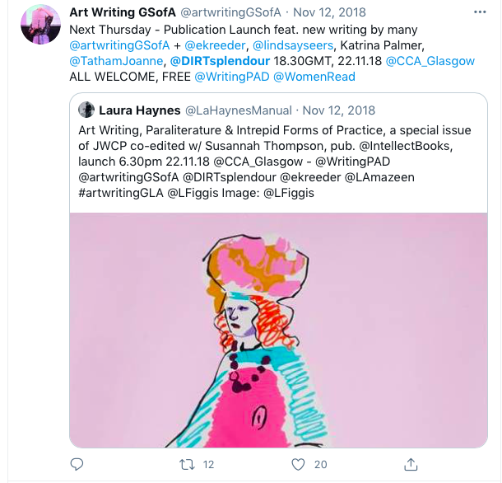
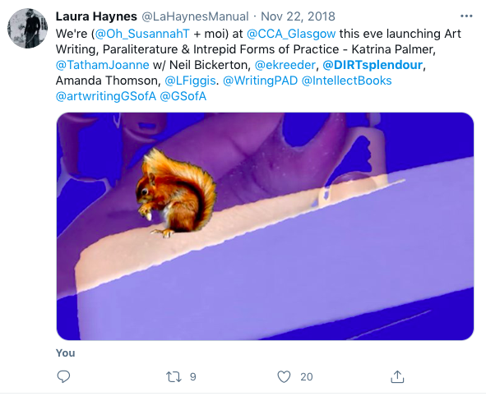
The research process led to the publication of a visual essay for the Journal of Writing in Creative Practice published by Intellect in 2018, edited by Susannah Thompson and Laura Edbrook.
The publication featured texts by Katrina Palmer, Laurence Figgis, Gillian Wylde, Joanne Tatham, Lindsay Seers, Elizabeth Reeder, Amanda Thomson, Laura Edbrook and Susannah Thompson.
The Journal was launched with the event: Art Writing, Paraliterature & Intrepid Forms of Practice on Thursday 22nd November 2018, 6-7.30pm, CCA, Glasgow.
https://www.cca-glasgow.com/programme/journal-launch-art-writing-paraliterature-and-intrepid-forms-of-practice
Images: Twitter screen grabs, launch event @ CCA

Slide 10
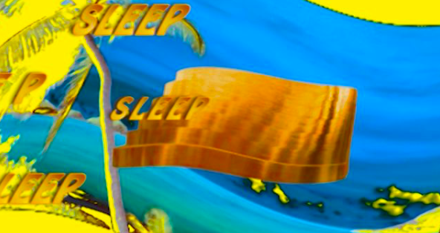
Journal of Writing in Creative Practice
The Journal of Writing in Creative Practice is the official organ of the Writing Purposefully in Art and Design (Writing PAD) network.
ISSN 1753-5190 (Print); ISSN 1753-5204 (Online)
Volume 10, Number 1, 1 September 2017
pp. 137-158(22)
https://www.ingentaconnect.com/content/intellect/jwcp/2017/00000010/00000001
Images: video stills from Will Internets Eat Brain?

