Slide 1
Intertextuel Sapphic Vaporwave
Exhibition and Publication
Part of a larger research project highlighting the contributions to modernism of women in general and queer, Black women in particular.
Researcher’s Name: Gillian Wylde
Research Programme: Inequality & Storytelling

Slide 2
Page 3
Page 4
Page 5
Page 7
Page 8

Slide 3
Video work [16 min 39, colour and sound] made for Group Exhibition - ‘Resist: be modern (again)’ 25 May 2019 - 17 August 2019 John Hansard Gallery Southampton
Funders: Arts Council England, Middlesex University, Southampton University, Mondriaan Fund, Federal Chancellery of Austria BKA
Partners: John Hansard Gallery, Southampton University.
Collaborators/ key people: Alice Maude-Roxby and Stefanie Seibold

Slide 4
‘Intertextuel Sapphic Vaporwave’ is a video and text work inspired by the life and work of playwright and political activist, Lorraine Hansberry (1930-1965). Hansberry wrote many articles and essays on racism, homophobia, feminisms and class and was the first black female author to have a play performed on Broadway in 1959, winning the New York Drama Critics' Circle Award at the age of 29. Hansberry inspired Nina Simone's song "To Be Young, Gifted and Black". The video work connects modernist forms with queer identities, technologies and language to explore the many feels of the digital present and the before the internet world that keeps going. Networked fur, VHS degradation, and escapee horses glint and vibrate on screens as they mesh with deleted, omitted and left out lives.
The work centralises work by women that due to either gender, sexuality or ethnicity, have been censored out, devalued or marginalised over time. This exhibition brings their practice and contribution out of the archives and into the foreground. Contemporary artists reactivate and represent these early practices through mapping, transcribing, sampling, referencing, reciting, re-telling or re-making, reclaiming their lasting value and importance for today’s art world and beyond.
The work considers how can the post internet digital age learn from queer black feminist thinkers and writers from the pre-digital world in an attempt to decolonisation the Internet asking as Langston Hughes and Hansberry did “What happens to a dream deferred?

Slide 5
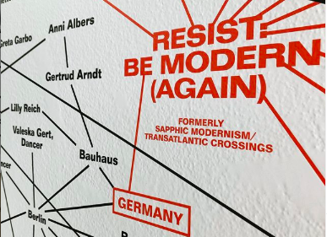
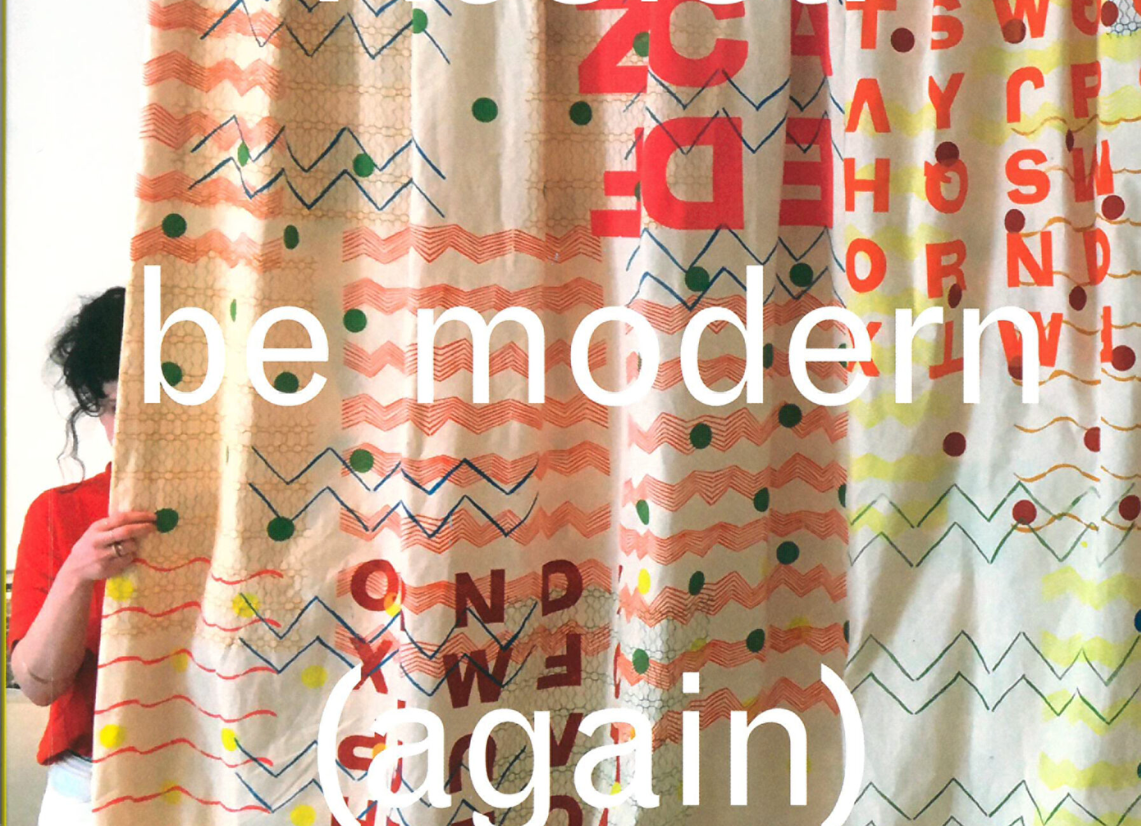
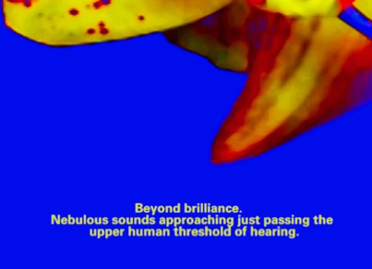
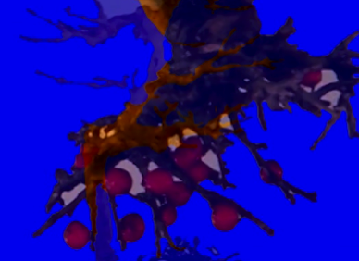
Image details - top left clockwise:
Speculative Map
Publication: Book Cover
Video still
Video still

Slide 6
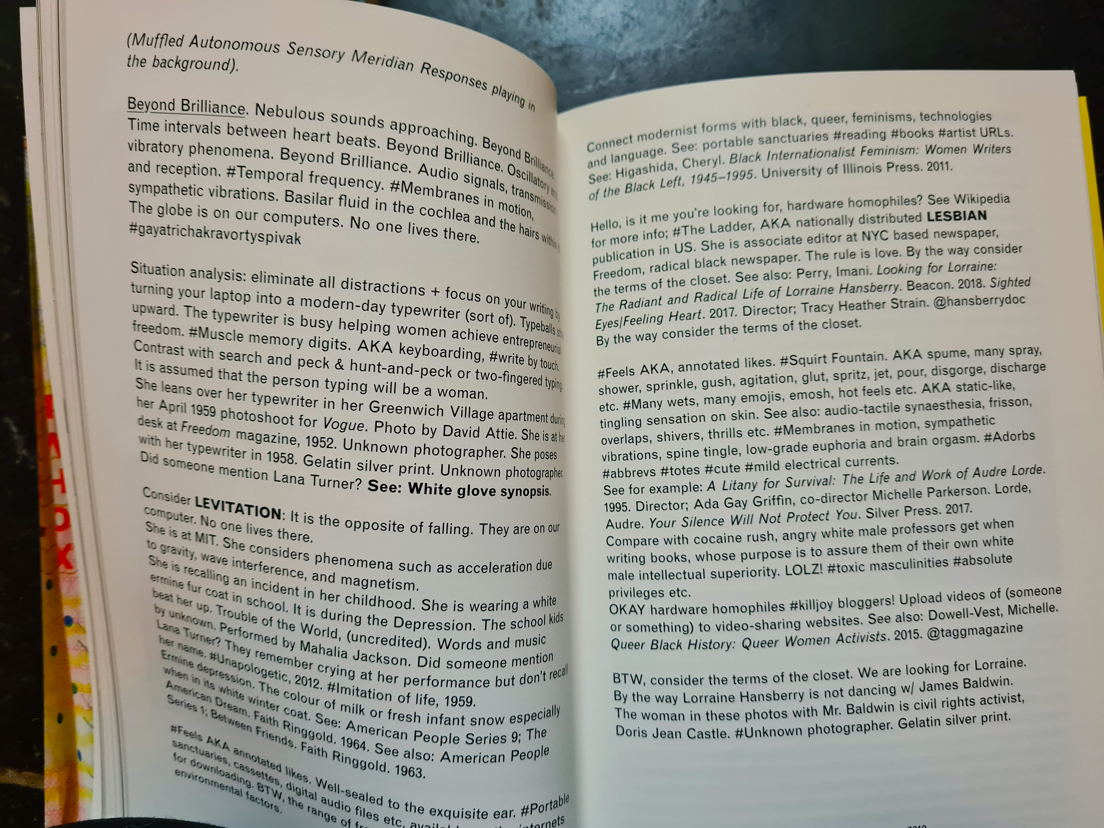
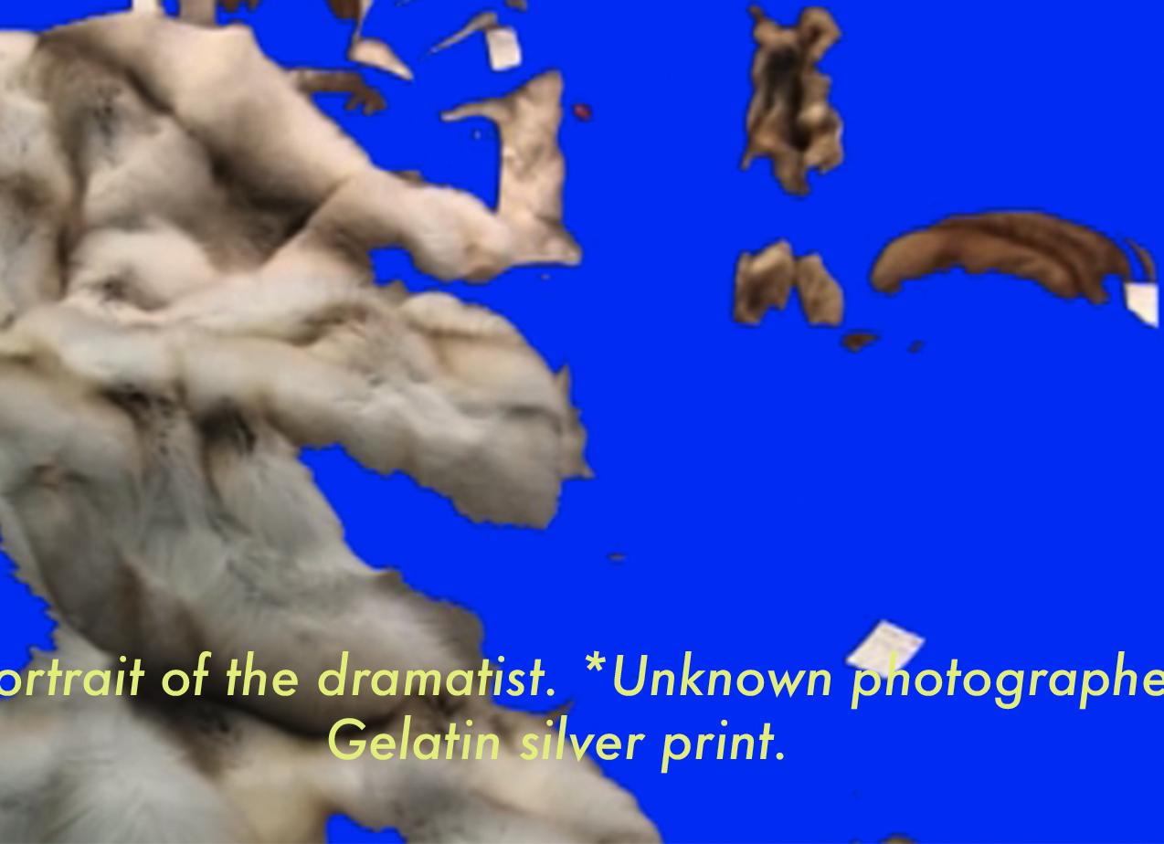
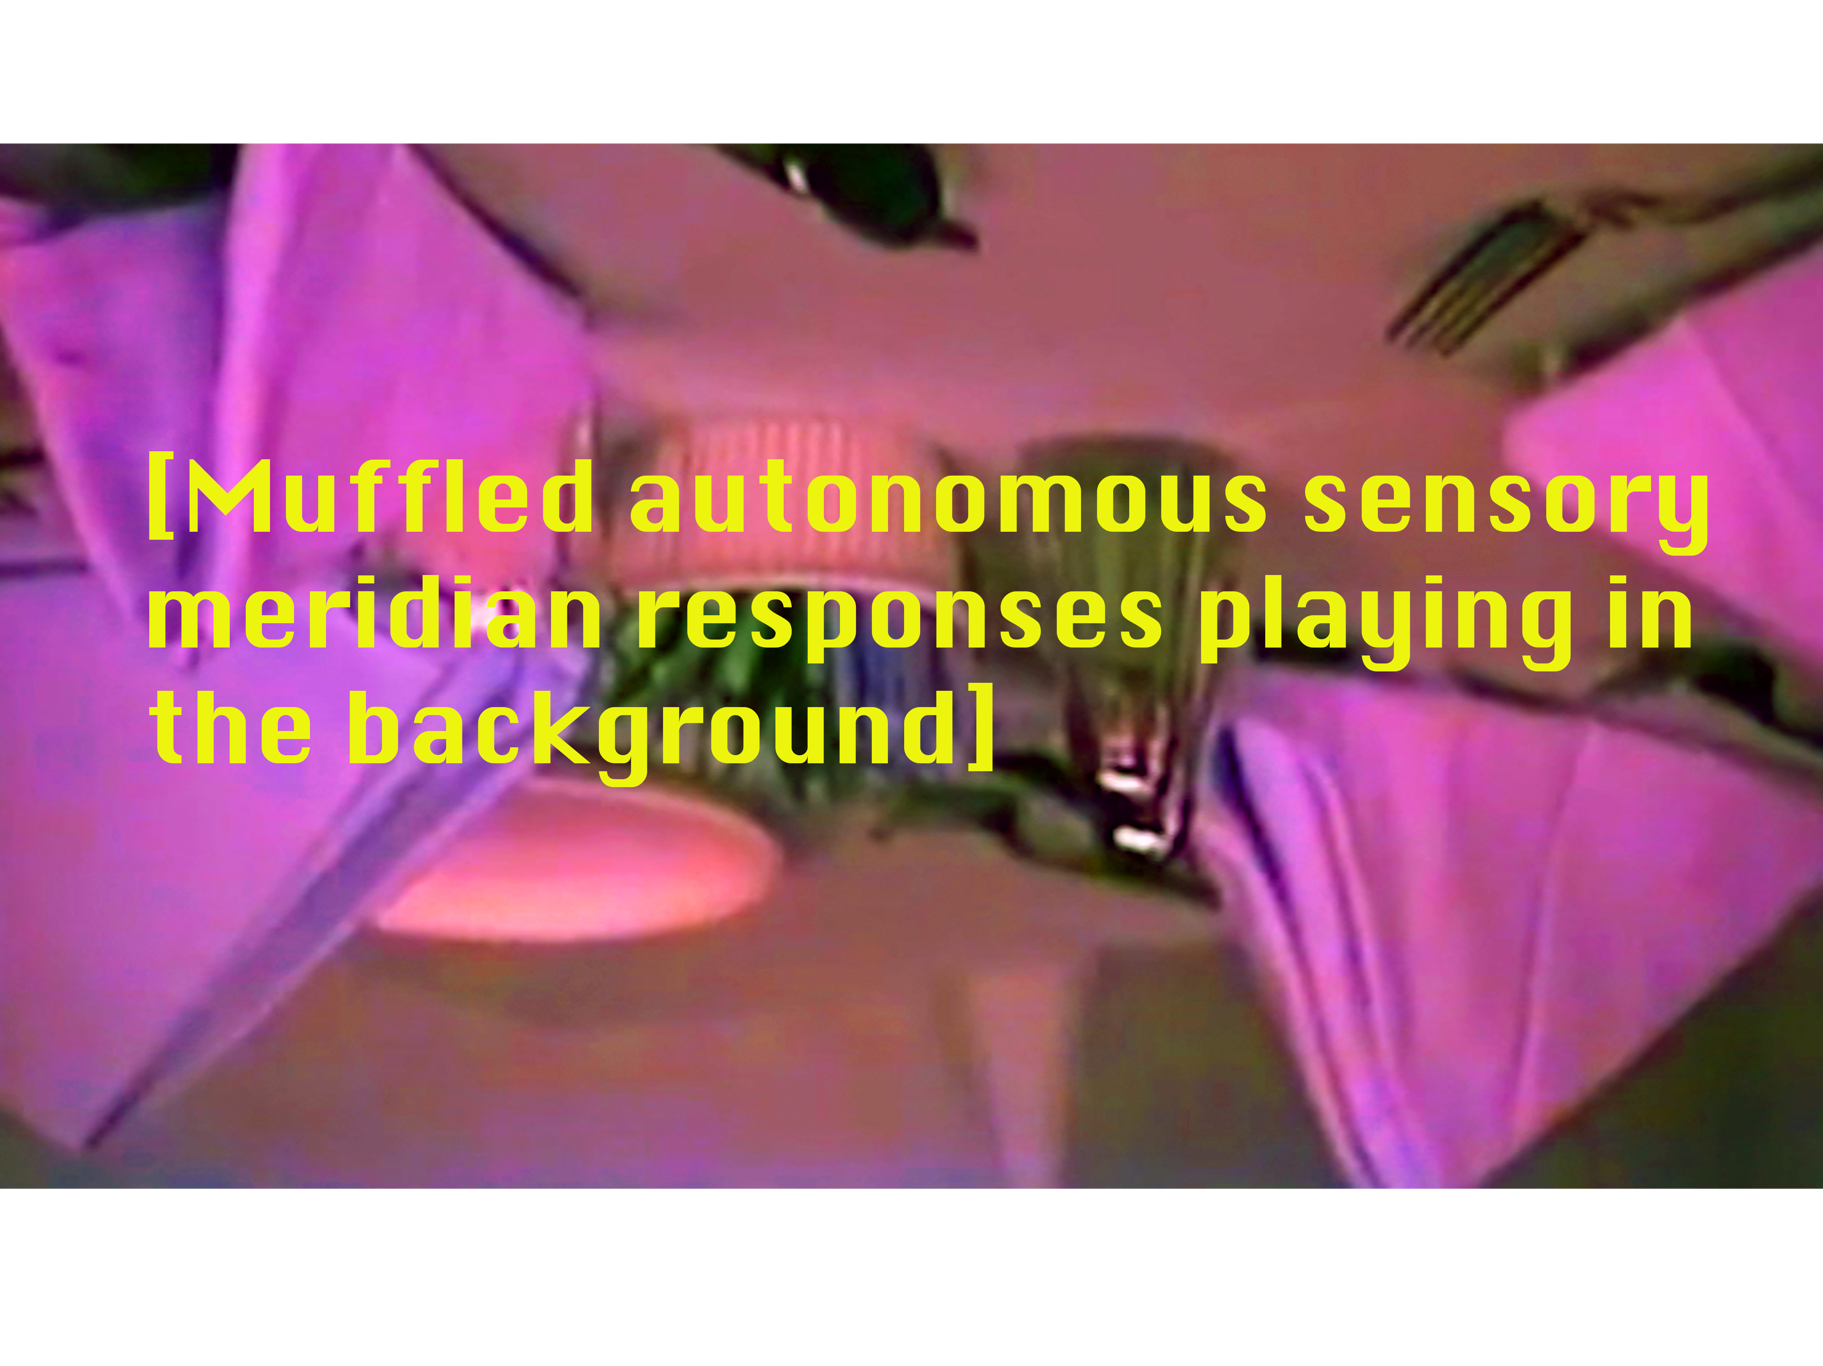
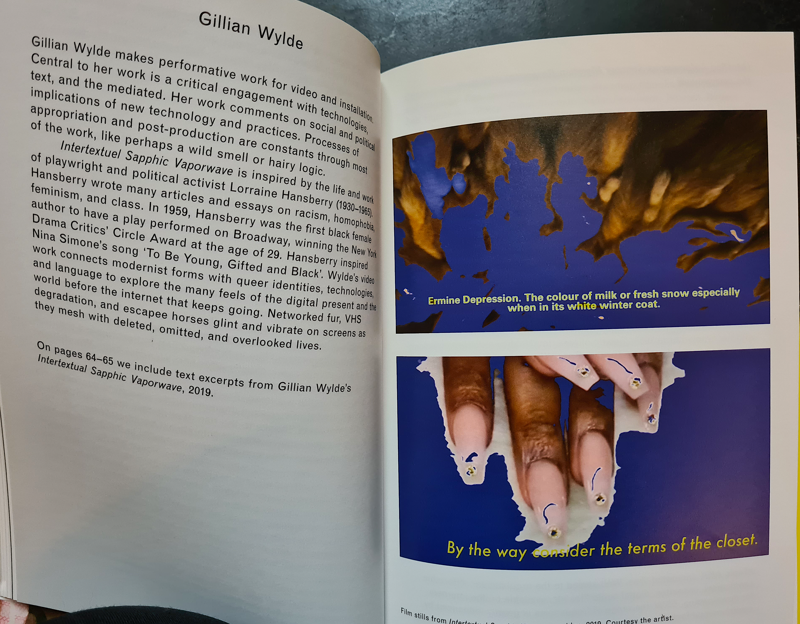
Image details - Top Left clockwise:
Publication pages
Video still
Video still edit
Publication pages

Slide 7
Exhibition: 25 May 2019 - 17 August 2019 John Hansard Gallery Southampton
Publication: Text work: ‘Beyond Brilliance’ developed for Performance, Talk and Screening
John Hansard Gallery Southampton 27 July 2019
‘Beyond Brilliance’ was developed for the Publication:
Resist: be modern (again) 2019 edited by Alice Maude-Roxby and Stefanie Seibold
Printed by Kopa, distributed by Cornerhouse Publications Manchester, UK.
Press: https://jhg.art/events/resist-be-modern-again/

Slide 8
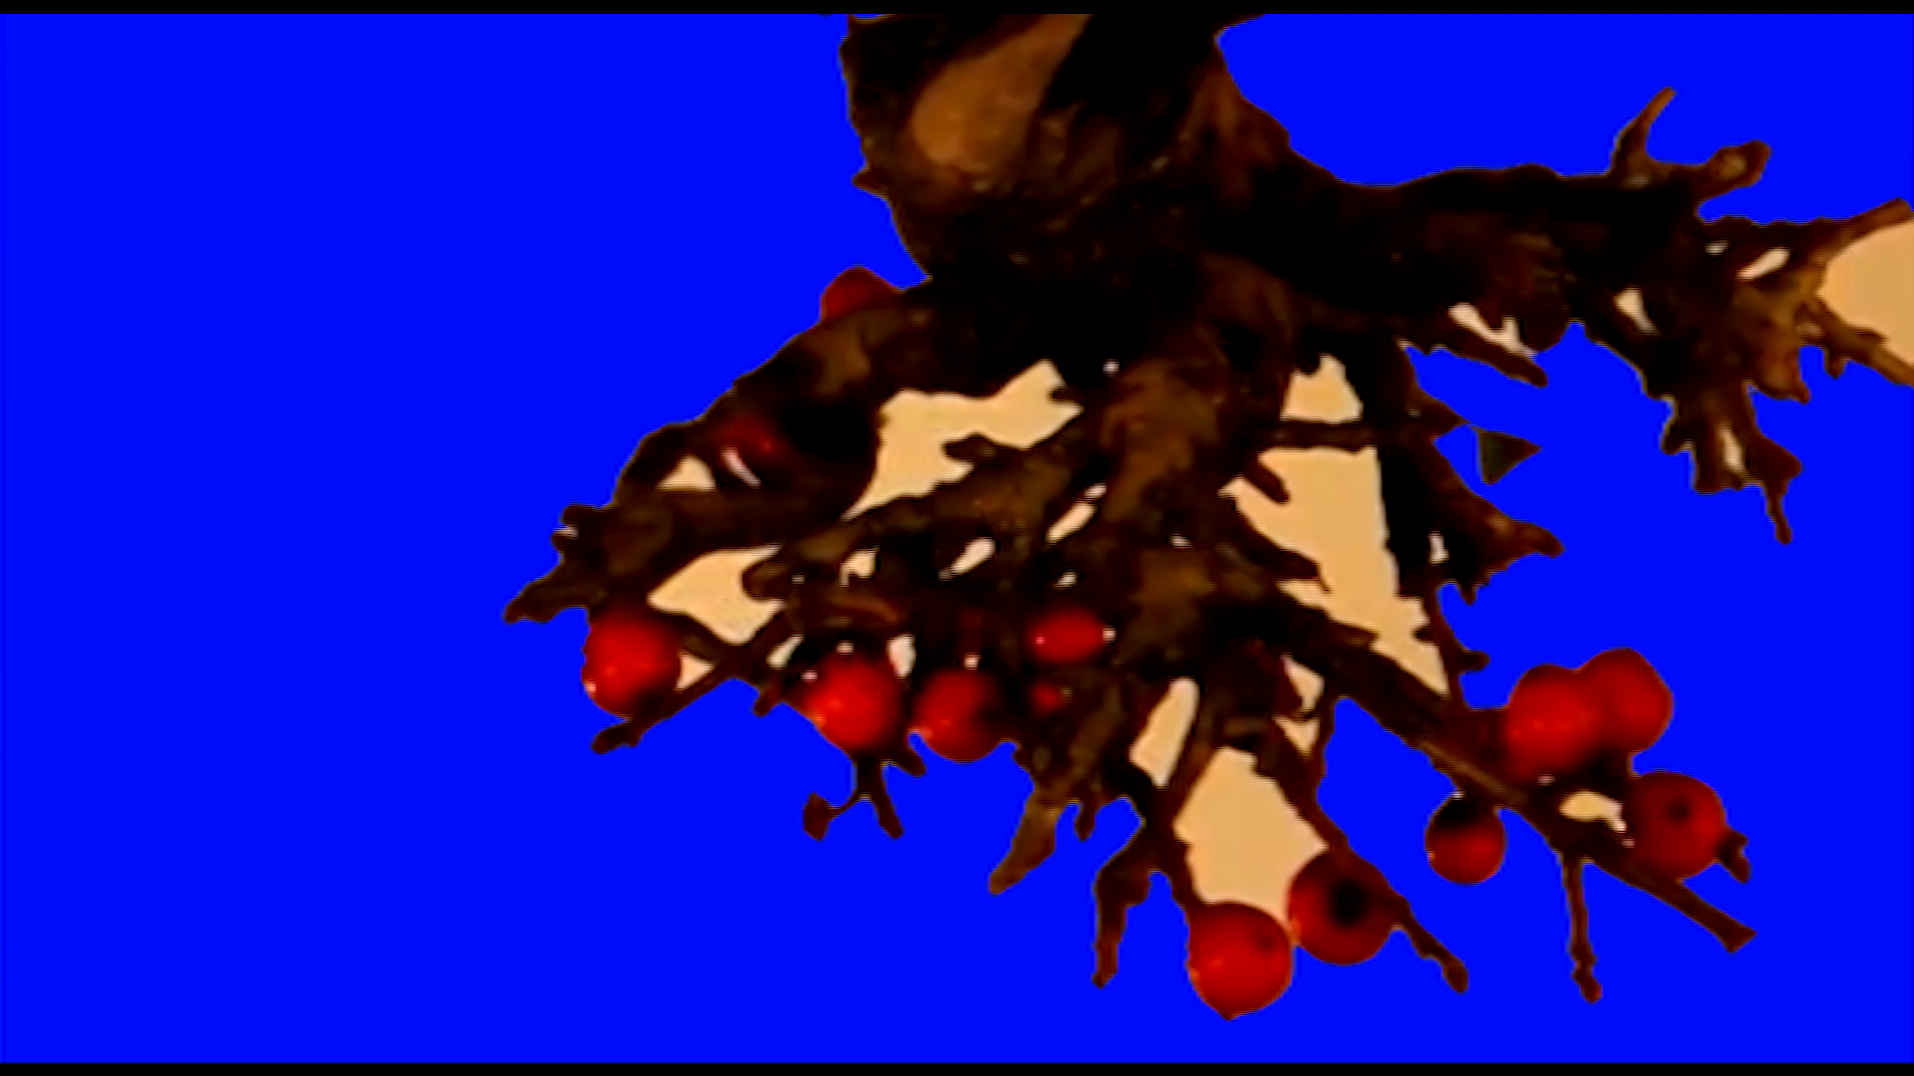
https://www.aestheticamagazine.com/resonant-ideas/
https://fastforward.photography/resist-be-modern-again-performance-publication-and-talks/
https://generic.wordpress.soton.ac.uk/arts-at-unisouth/2019/07/01/review-resist-be-modern-again/
https://fourcommunications.com/resist-be-modern-again/
https://www.a-n.co.uk/media/52560789/
Video workIntertextuel Sapphic Vaporwave

