Slide 1
Illustration and Adaptation

Slide 2
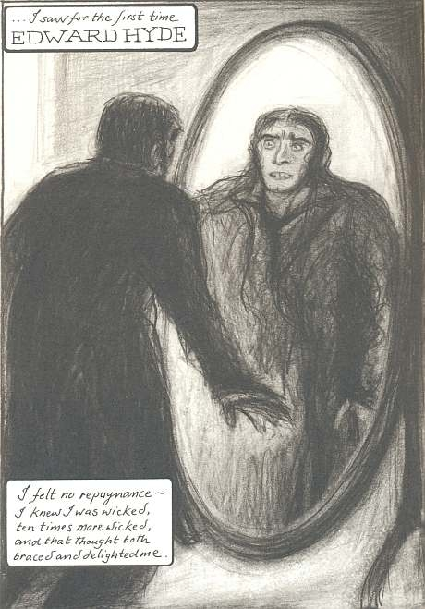
Dr Jekyll and Mr Hyde
Lorenzo Mattotti
Andrez Klimowski/Danusia Schejbal

Slide 3
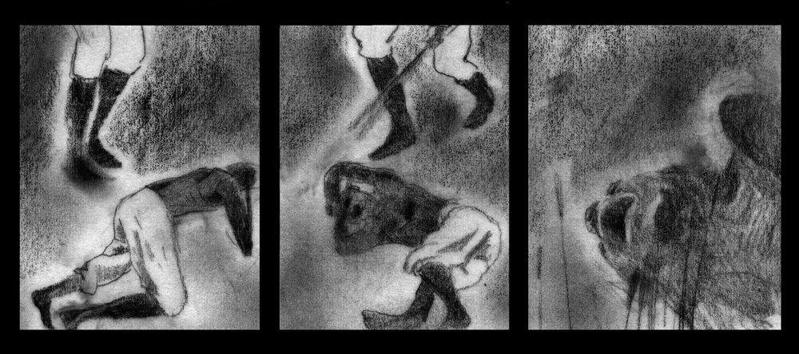
Heart of Darkness
Catherine Anyango

Slide 4
Shirley Jackson

Slide 7
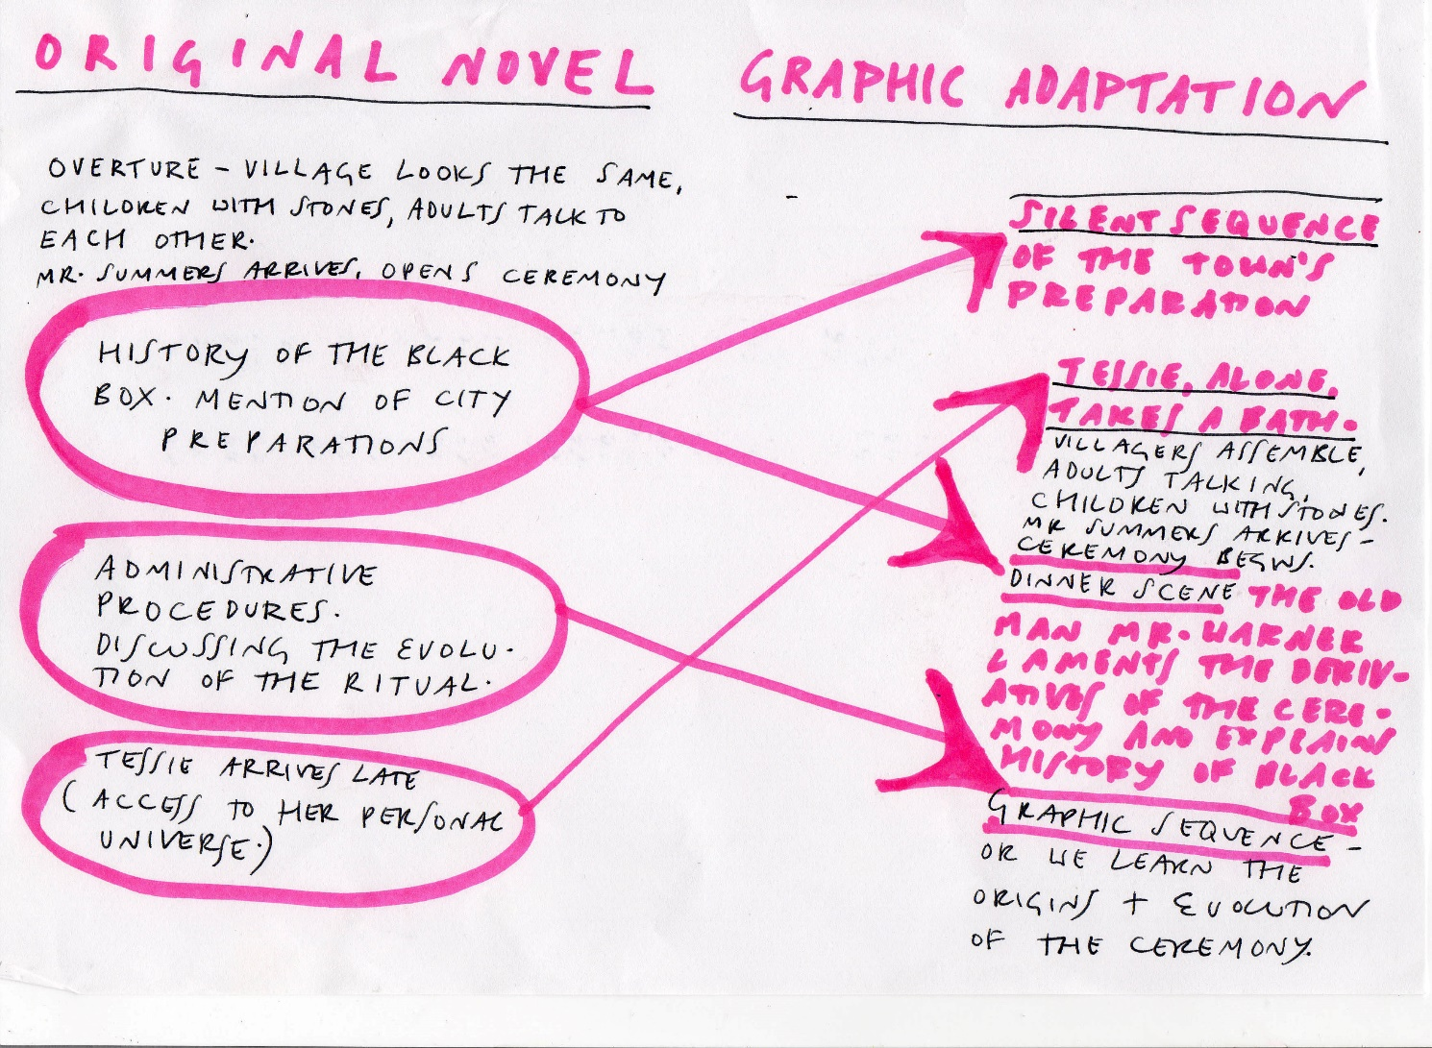
Hyman’s schemata

Slide 11
Setting the scene for the lottery

Slide 12
The winning ticket

Slide 13
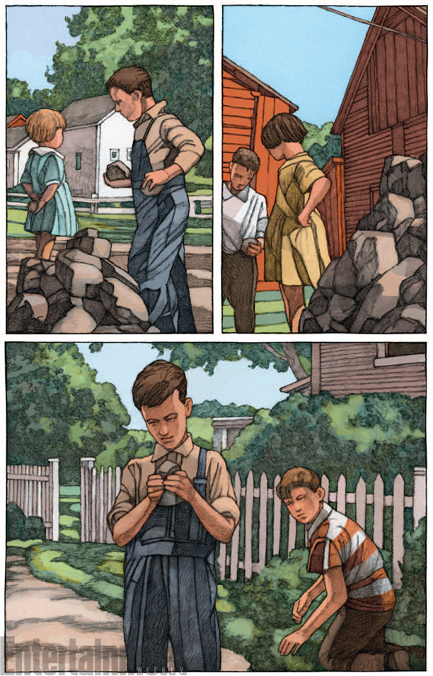
Gathering the stones

Slide 16
Tradition and ritual

Slide 21
The winning ticket

Slide 22
