Slide 1
Quinn
Multimedia art project comprised of large and medium format photographs, moving image, written narrative, installation and ephemera
Lottie Davies
Inequality and Storytelling

Slide 2
Page 2
Page 3
Page 4
Acknowledgments
Page 12
Page 13
Page 21
1

Slide 3
Created 2014-2020
Exhibited 2019, 2020
2

Slide 4
Quinn is a multi-media art project, realised over a six-year period from 2014-2020. It follows on from the artist’s previous work on exploring the artistic and photographic representation of memory and of historical and personal past moments, and the philosophical understanding of conflict and our collective past. Following work such as that by Joel Sternfeld (On This Site, 1996), Broomberg and Chanarin The Day That Nobody Died, 2008), Chloe Dewe Matthews (Shot At Dawn, 2014), and Larson Shindelman (Geolocation, 2009-16) and works of literature (Paul Auster, New York Trilogy, 1987), Quinn represents a major progression in Davies’ work, incorporating for the first time written narrative, installation and collected ephemera as well as large-format photographs and moving image works.
The work addresses the questions of how individual humans and human society as a whole respond to trauma, loss and grief. Each generation experiences changes imposed by conflict, environmental events and global socio-economic upheavals, leaving a stream of people either literally travelling alone or in groups or families to rebuild their place in the world, or individually attempting to overcome personal tragedy or misfortune. Quinn explores both psychological and physical responses to these, and asks whether landscape and time can be used as a tool for understanding, reconciliation and potential recovery. It is a meditation on the human search for meaning and the possibility of redemption.
Quinn has been created to take the viewer through a multi-dimensional experience; much like reading a novel, visiting the theatre, and going to the cinema at the same time.
The project has been exhibited in solo exhibitions at FORMAT International Photography Festival in Derby, UK (March 2019) and at the Herbert Art Gallery & Museum, Coventry, UK (February – May 2020), and at a screening and performance at Photo London, Somerset House May 2019.
3

Slide 5
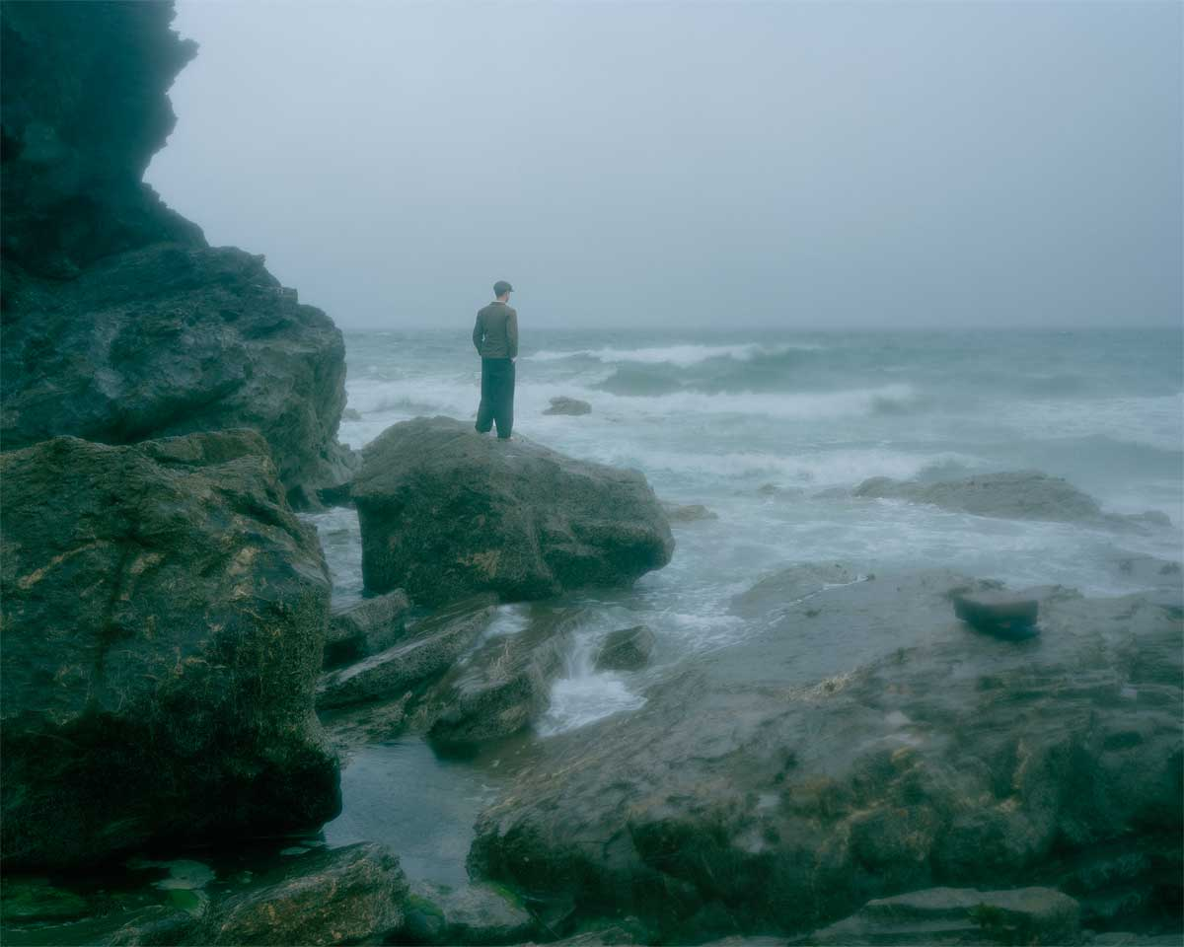
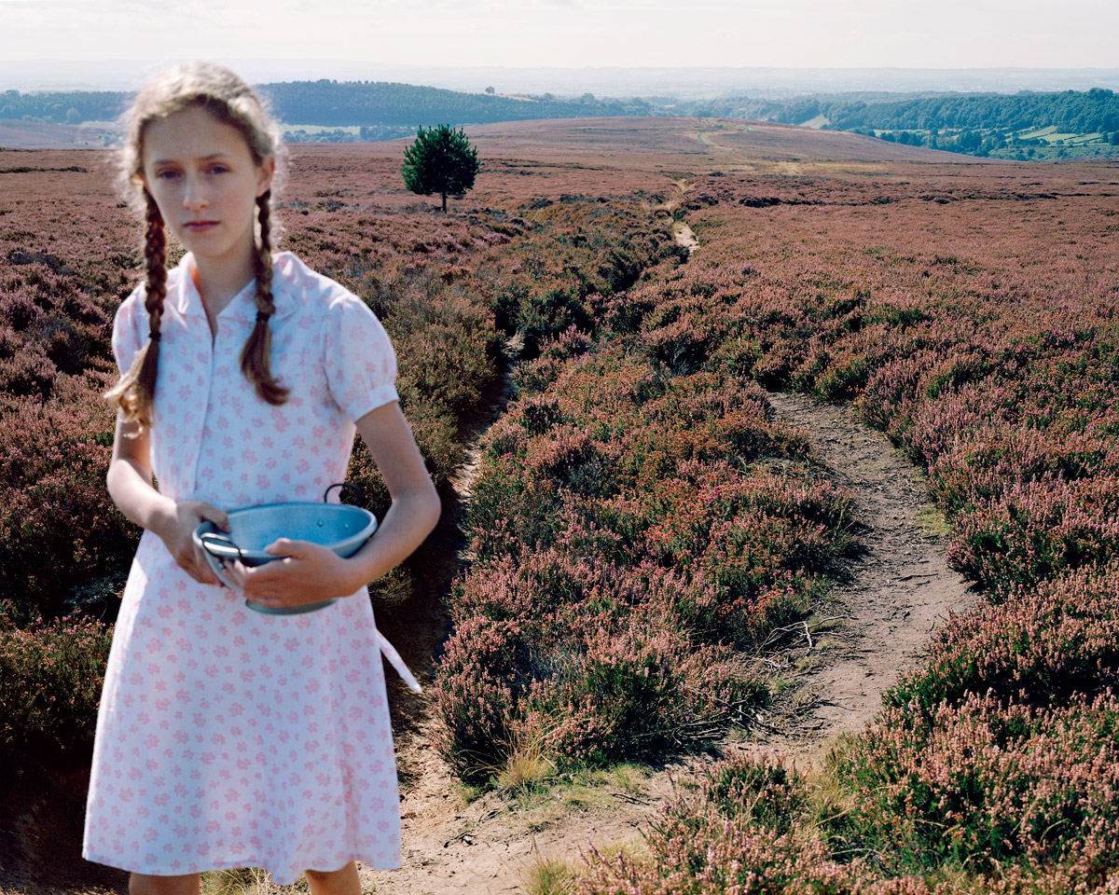
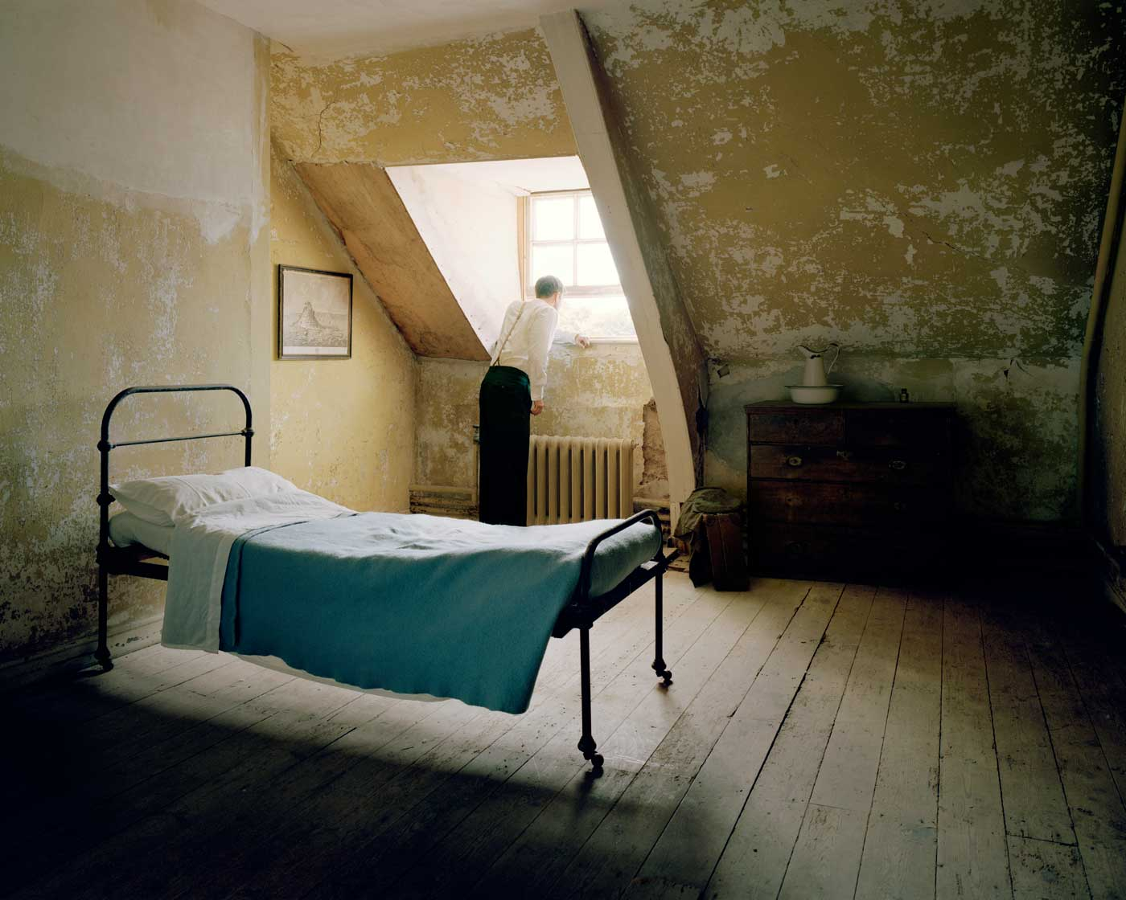
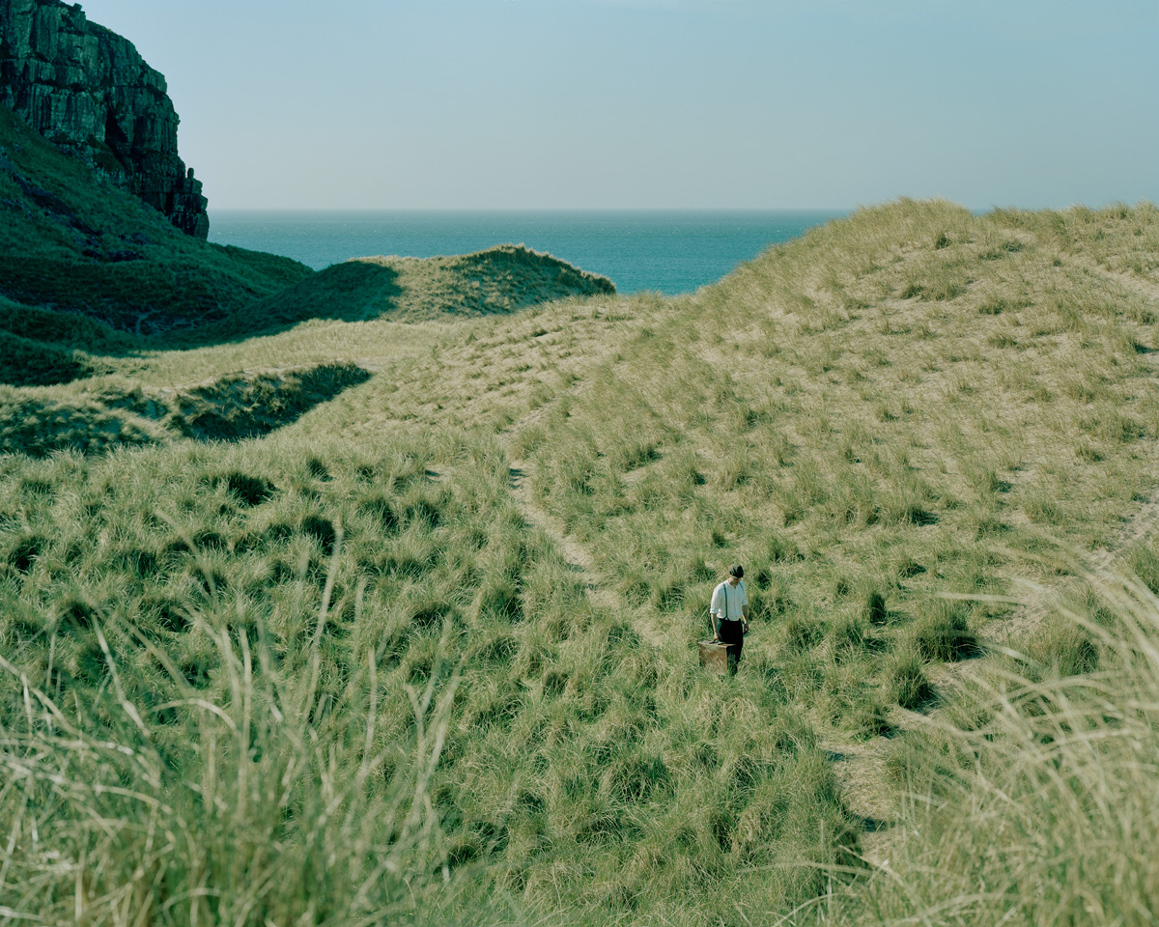
35 large format photographs of the character Quinn’s walking journey
4
www.whquinn.com
Selected large format photographs from a total of 35

Slide 6
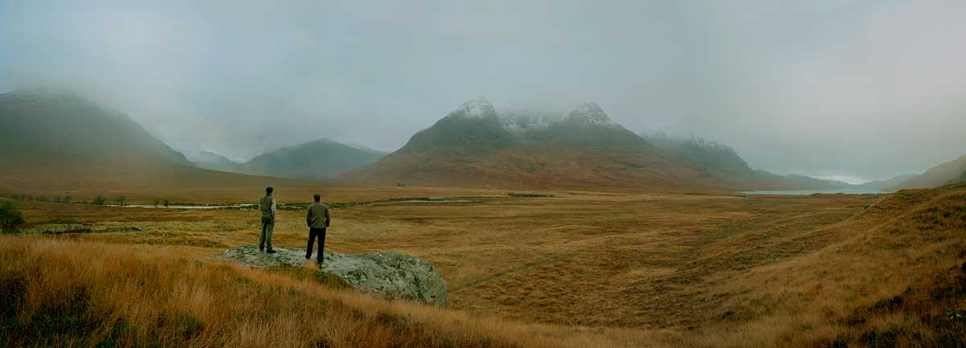
5
Large format composite photograph Untitled (Beinn Dearg Mor)

Slide 7
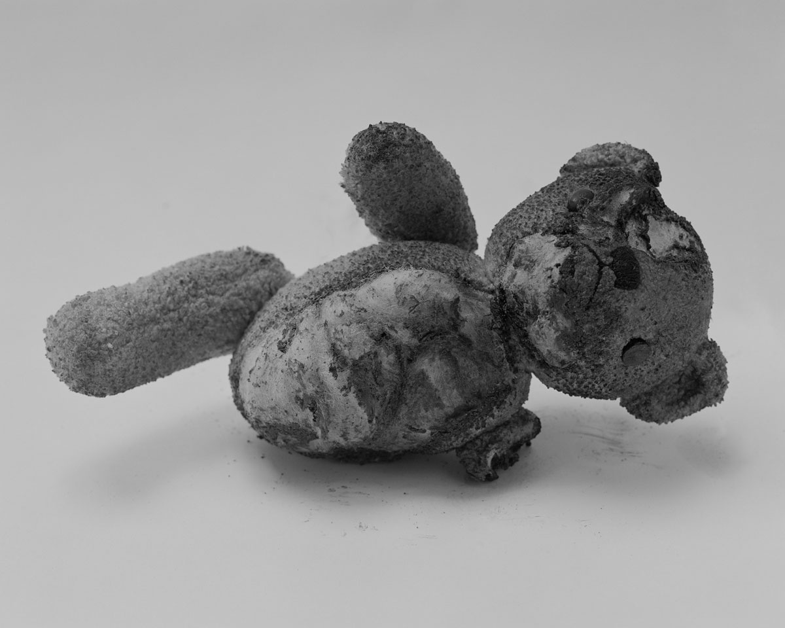
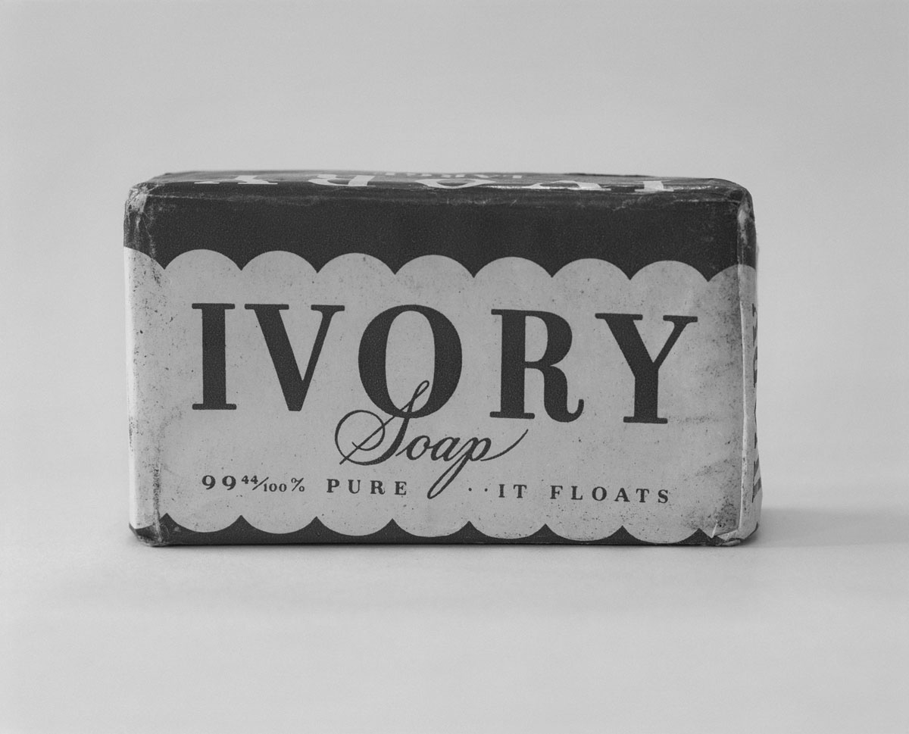
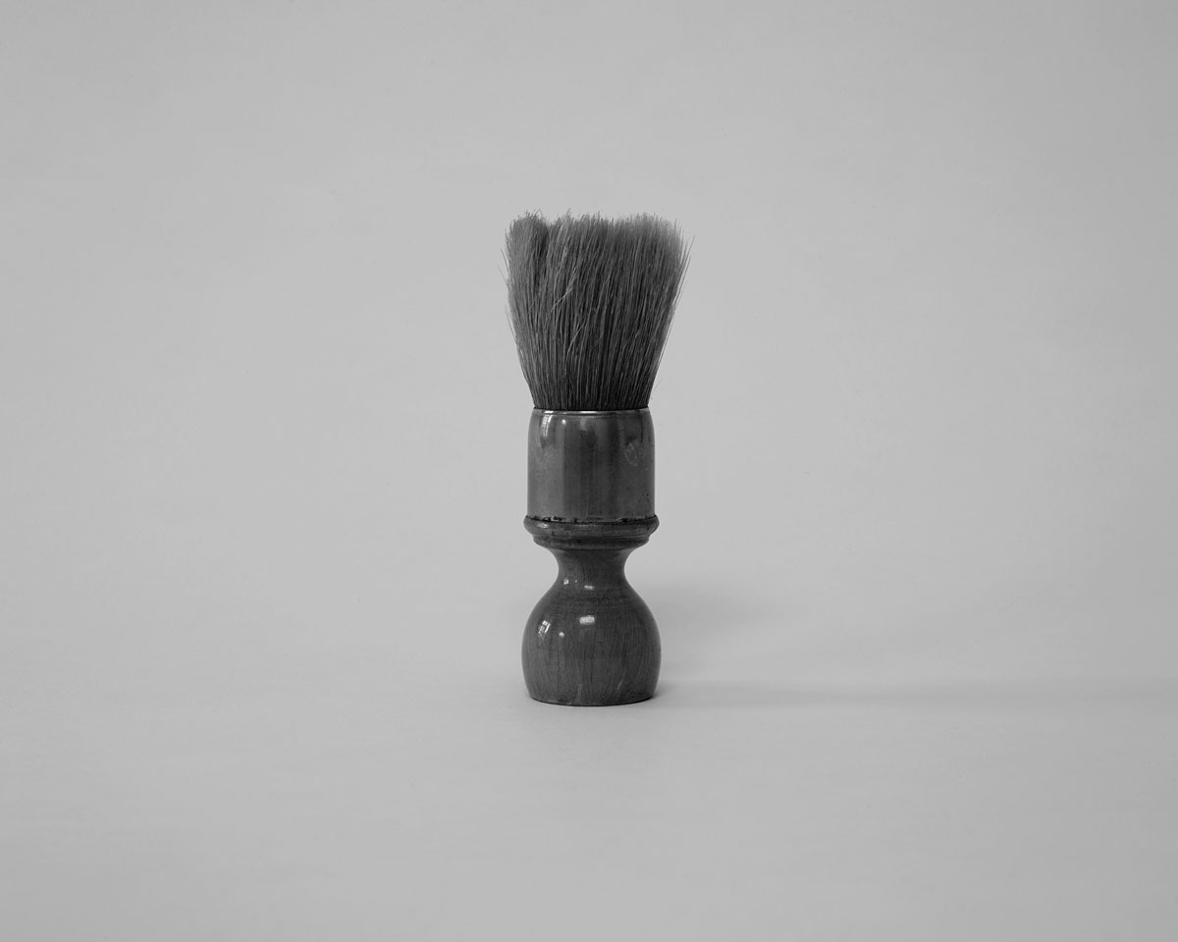
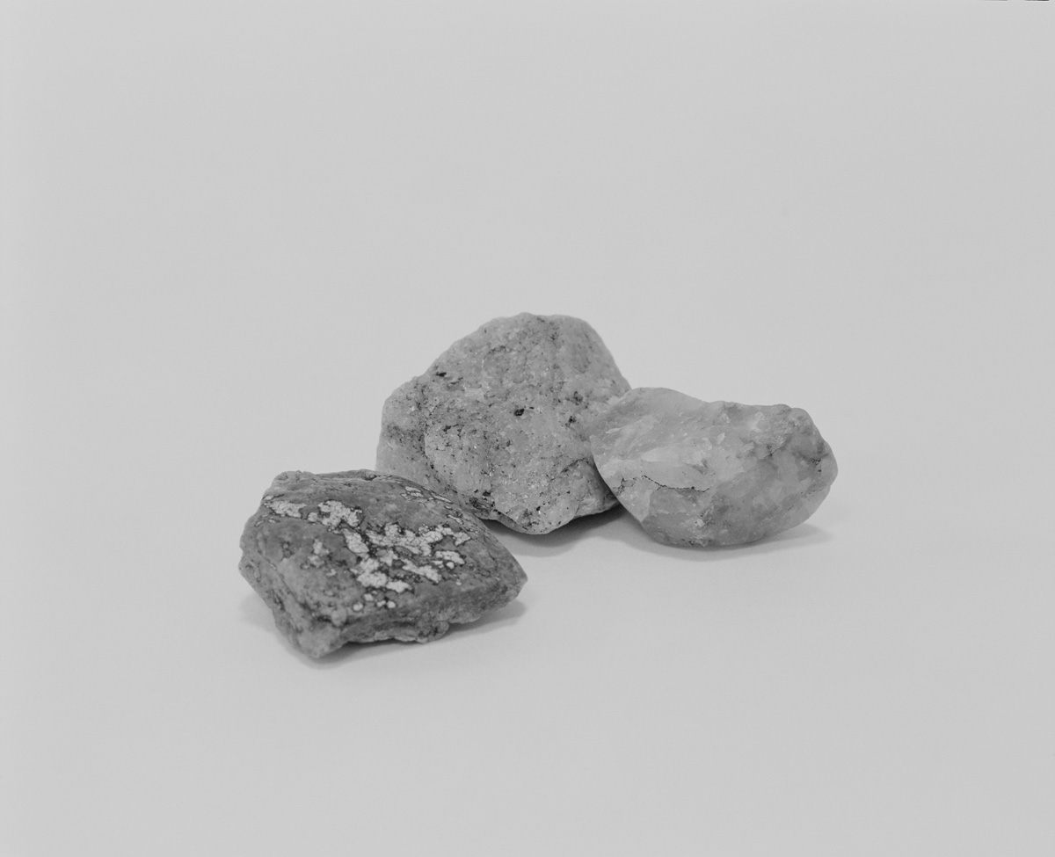
22 medium format photographs of ephemera associated with the character ‘Quinn’.
6
www.whquinn.com
Selected medium format photographs from a total of 22

Slide 8
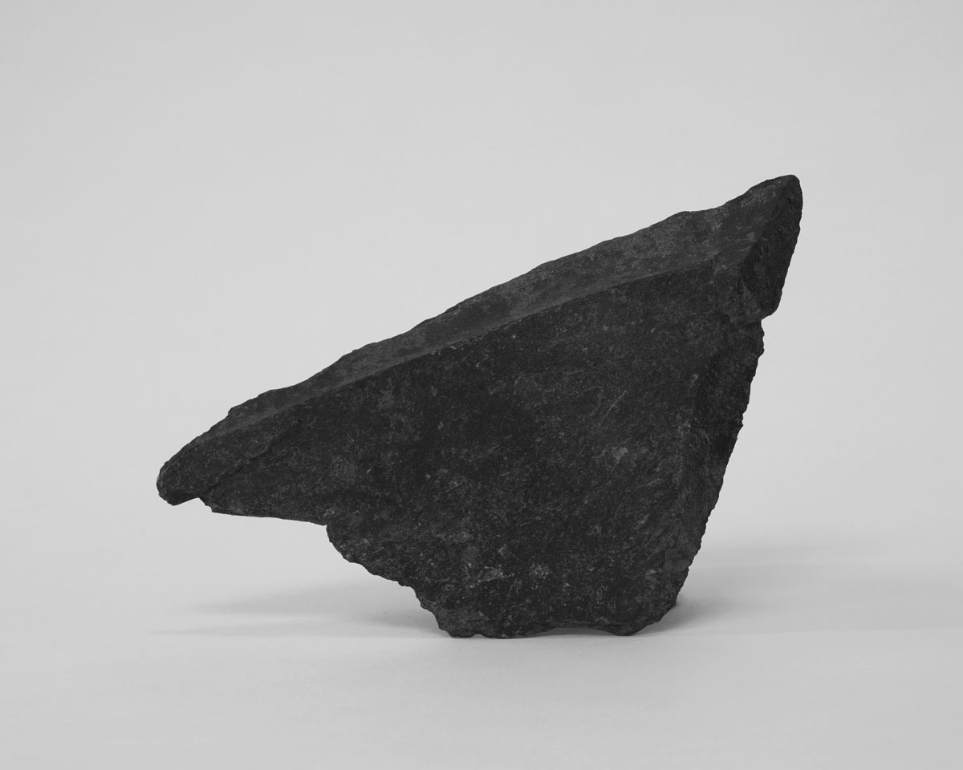
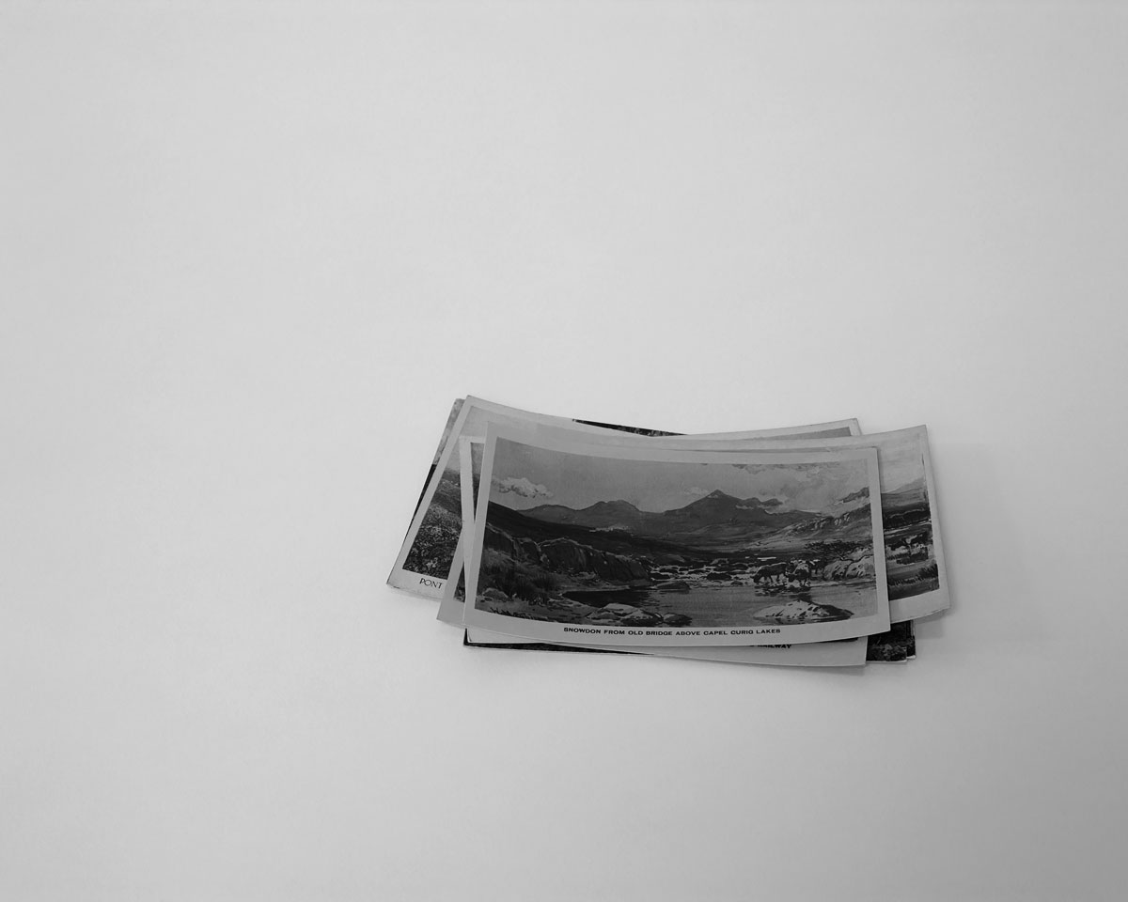
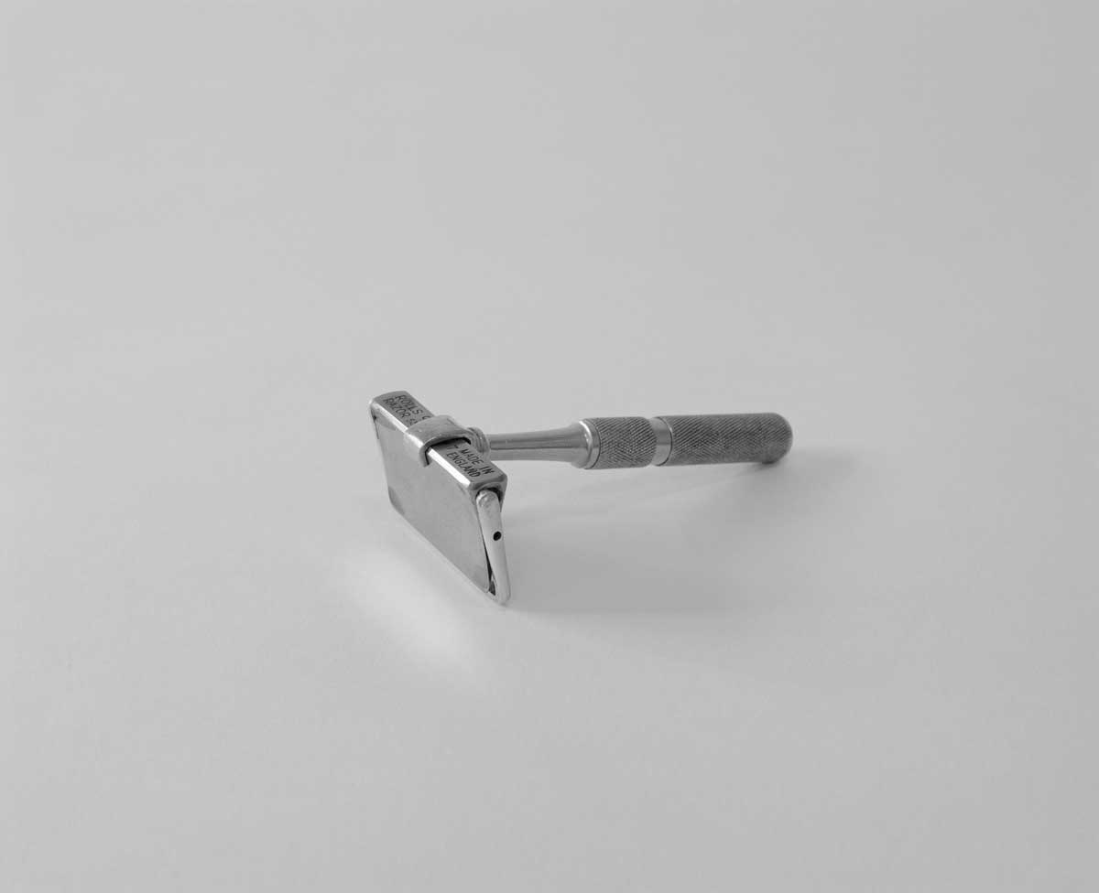
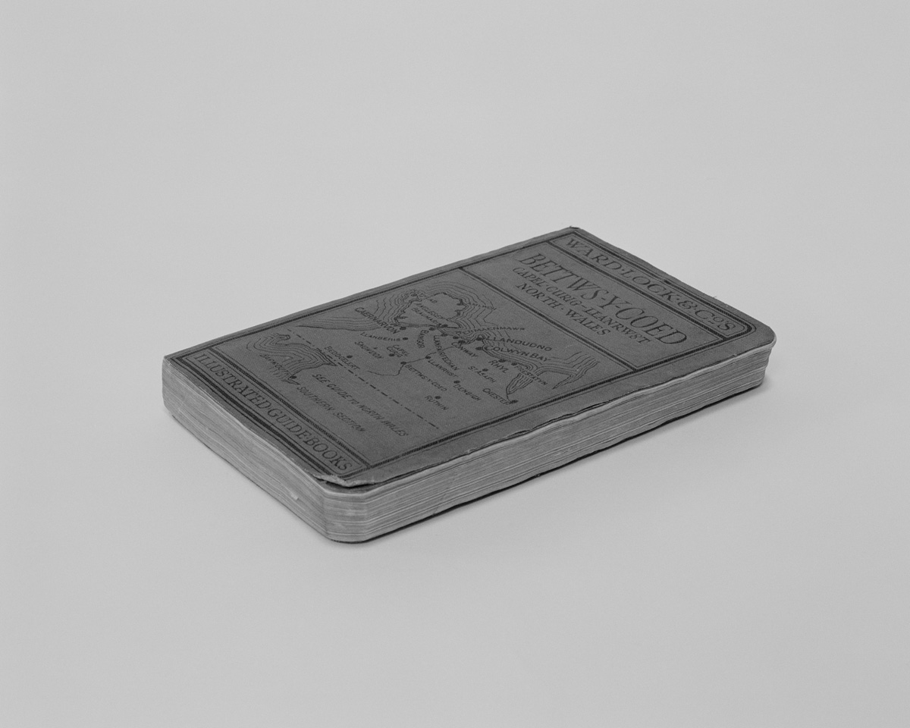
22 medium format photographs of ephemera associated with the character ‘Quinn’.
22 medium format photographs
7
www.whquinn.com

Slide 9
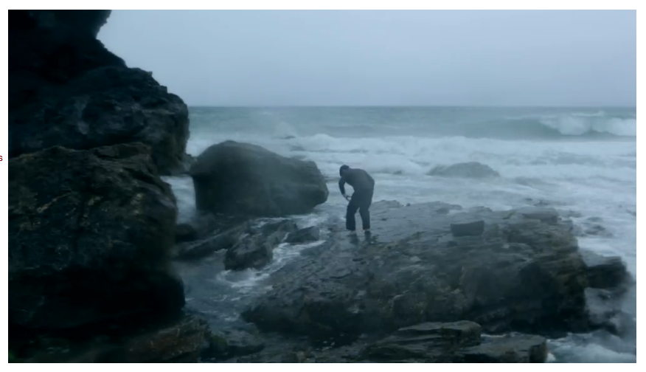
16 moving image art works
Question – here I can embed video pieces directly, embed a link to Vimeo in a piece of text, or embed a link to Vimeo using an image eg
8
https://vimeo.com/413128284
Video Untitled (Dollar Cove) 2:55

Slide 10
16 moving image art works
9
Please click on image to watch video piece
Video Untitled (Dollar Cove) 2:55

Slide 11
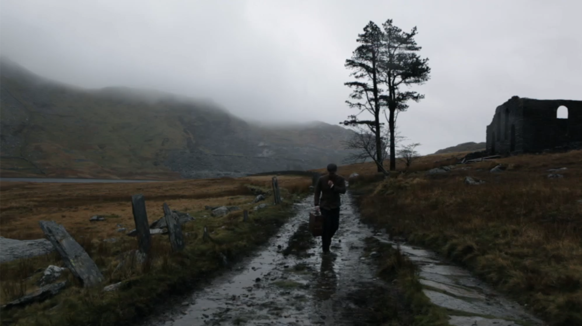
16 moving image art works
9
Please click on image to watch video piece
Video Untitled (Cwmorthin) 1:75

Slide 12
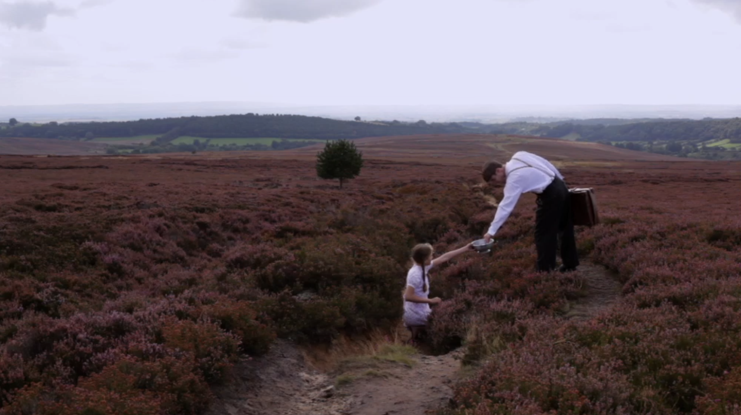
16 moving image art works
9
Please click on image to watch video piece
Video Untitled (Rose) 3:02

Slide 13
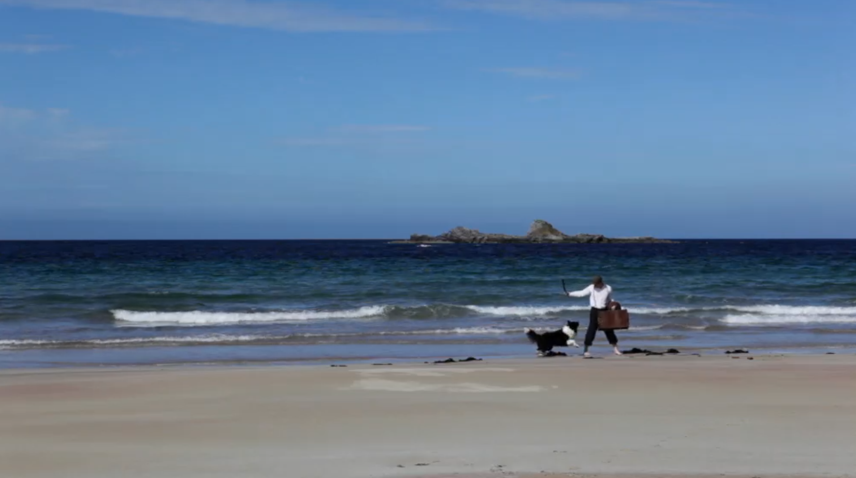
16 moving image art works
9
Please click on image to watch video piece
Video Untitled (Durness) 1:17

Slide 14
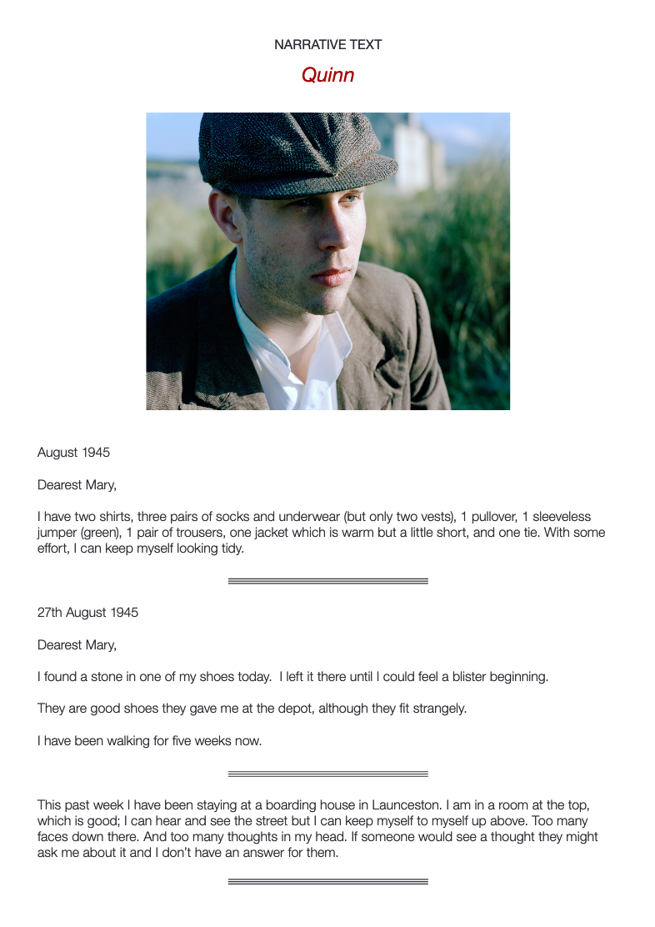
Creative writing in the form of a fictional diary belonging to the character ‘Quinn’
Available as a pdf to download here: FURR
11
www.whquinn.com

Slide 15
Exhibition, Quinn: A Journey – Herbert Art Gallery & Museum, 2020
Google Arts Exhibition: (live on 18th May 2020)
Exhibition, FORMAT International Photography Festival 2019
BBC News website – In Pictures 14/2/20
Project webpage: www.whquinn.com
Artist’s Interview at Herbert Art Gallery & Museum
The project has also been reviewed and presented in various regional and local media across the UK.
12

Slide 16
Google Arts online exhibition (launch 18th May 2020)
link and screengrab here once I can access when exhibition is live
13

Slide 17
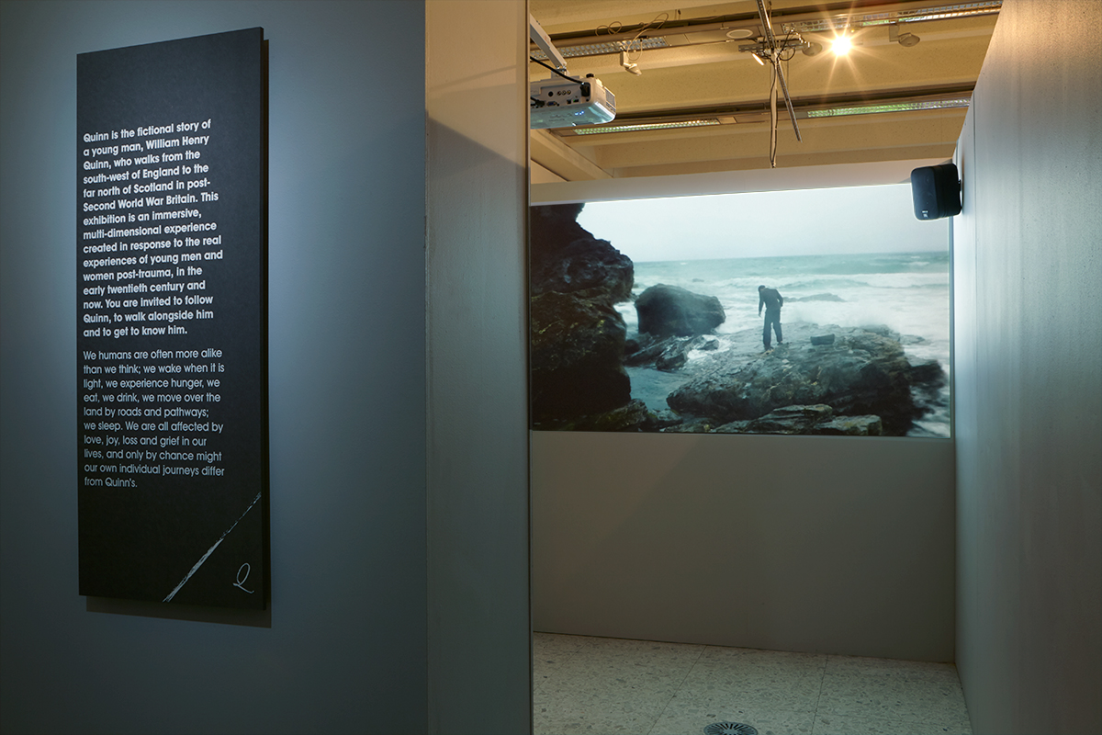
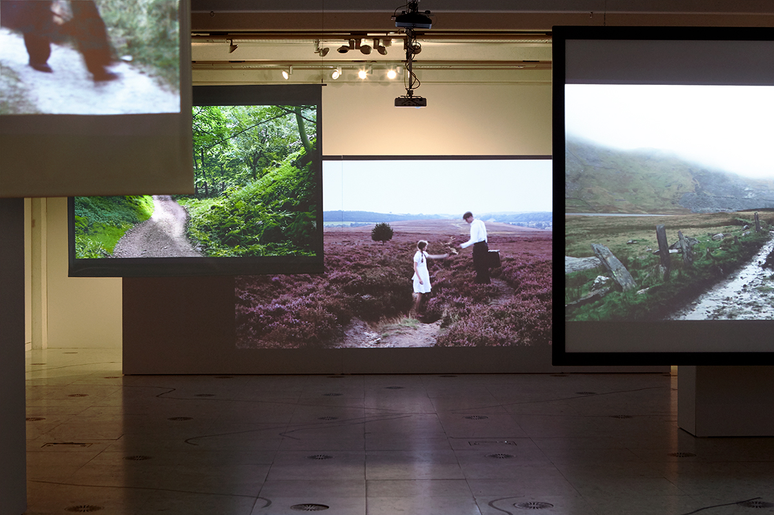
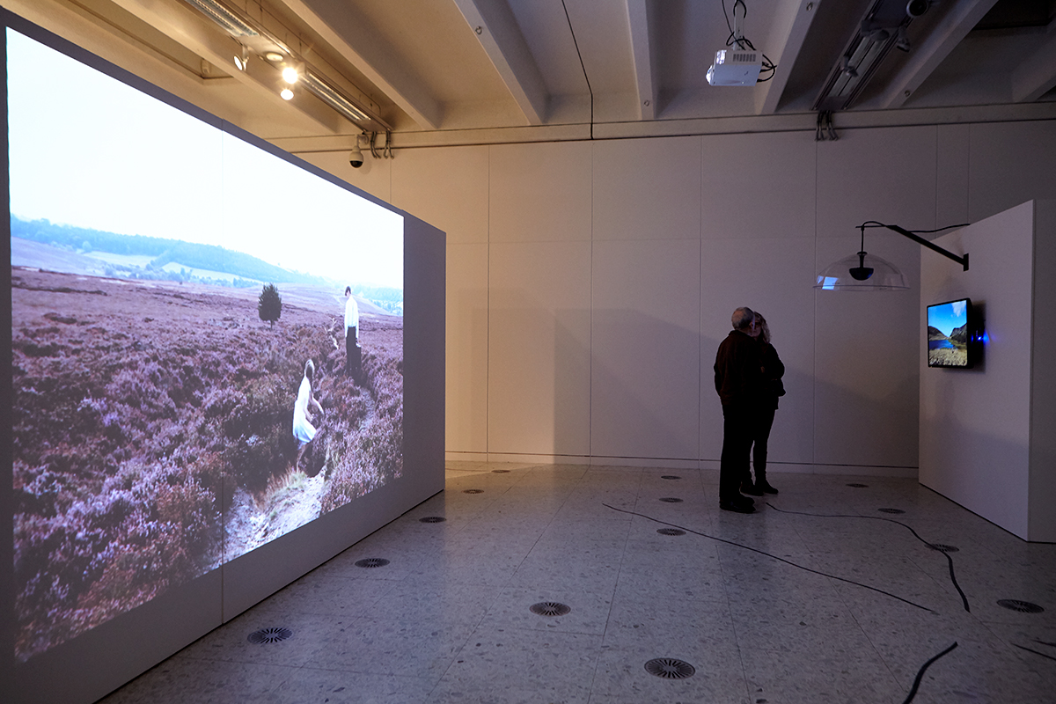
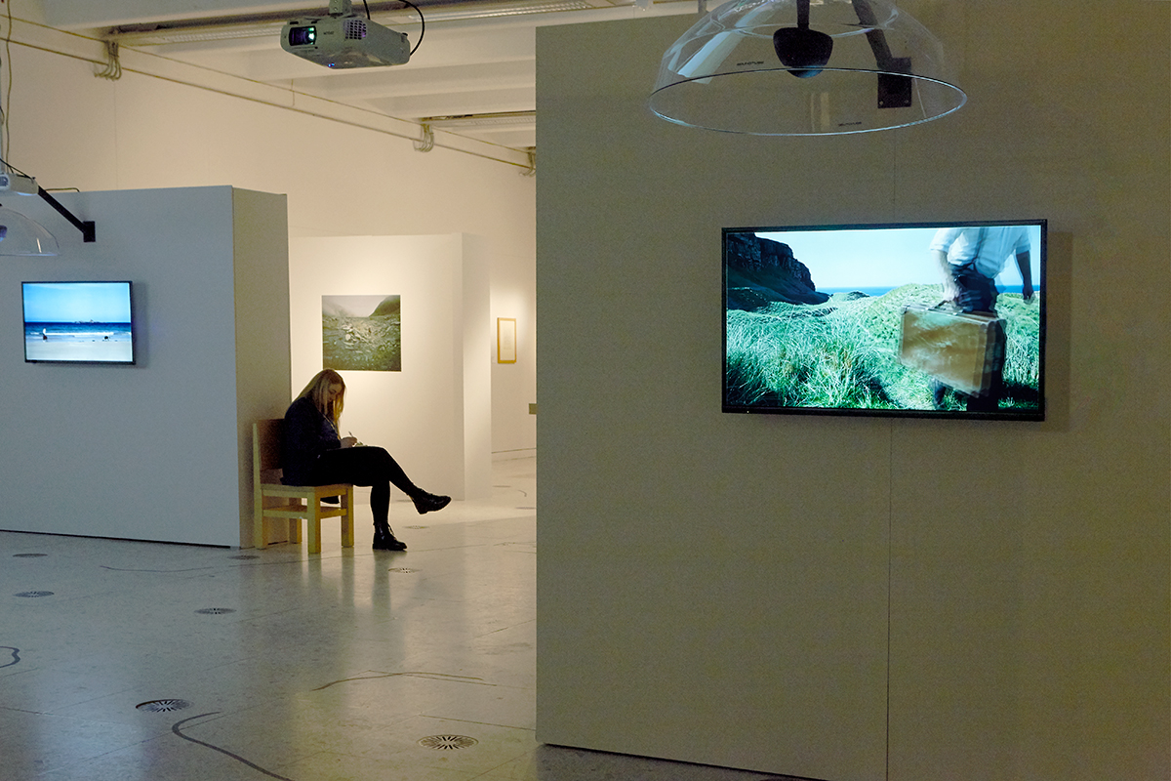
Exhibition at the Herbert Art Gallery & Museum, Coventry, UK
February – May 2020
14

Slide 18
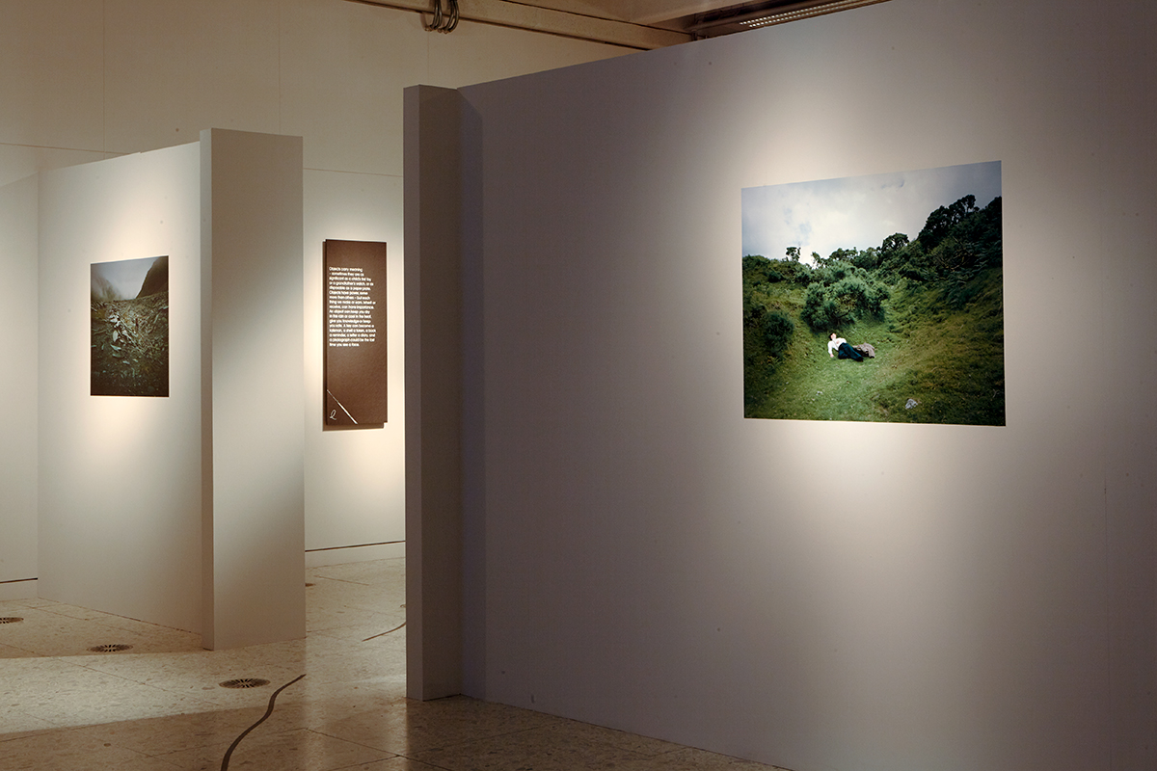
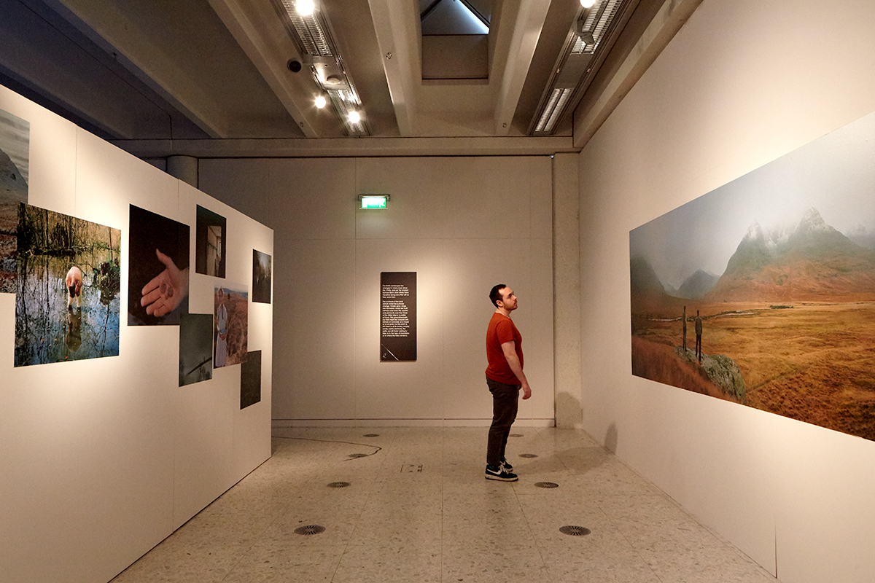
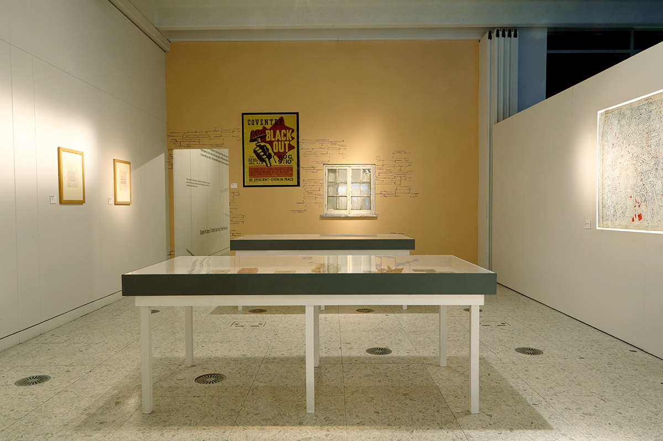
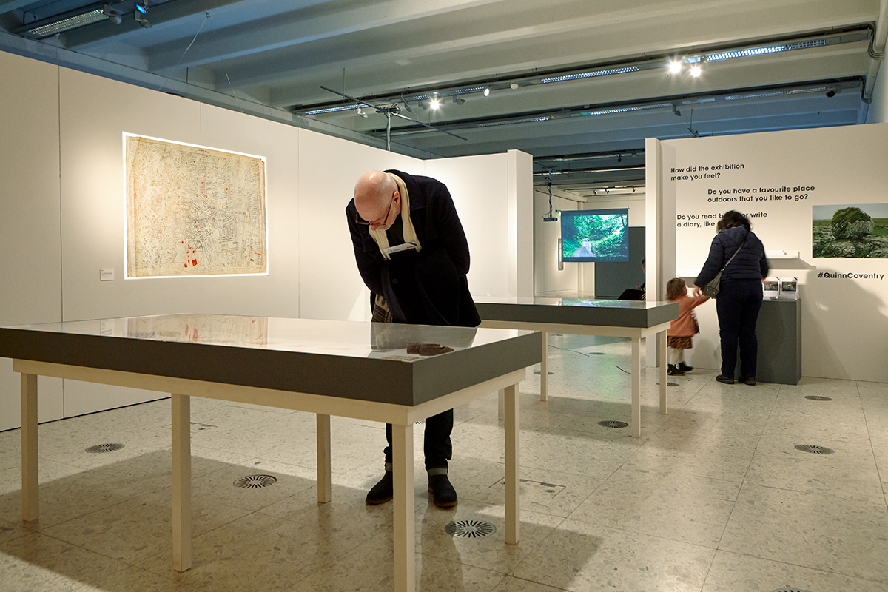
Exhibition at the Herbert Art Gallery & Museum, Coventry, UK
February – May 2020
15

Slide 19
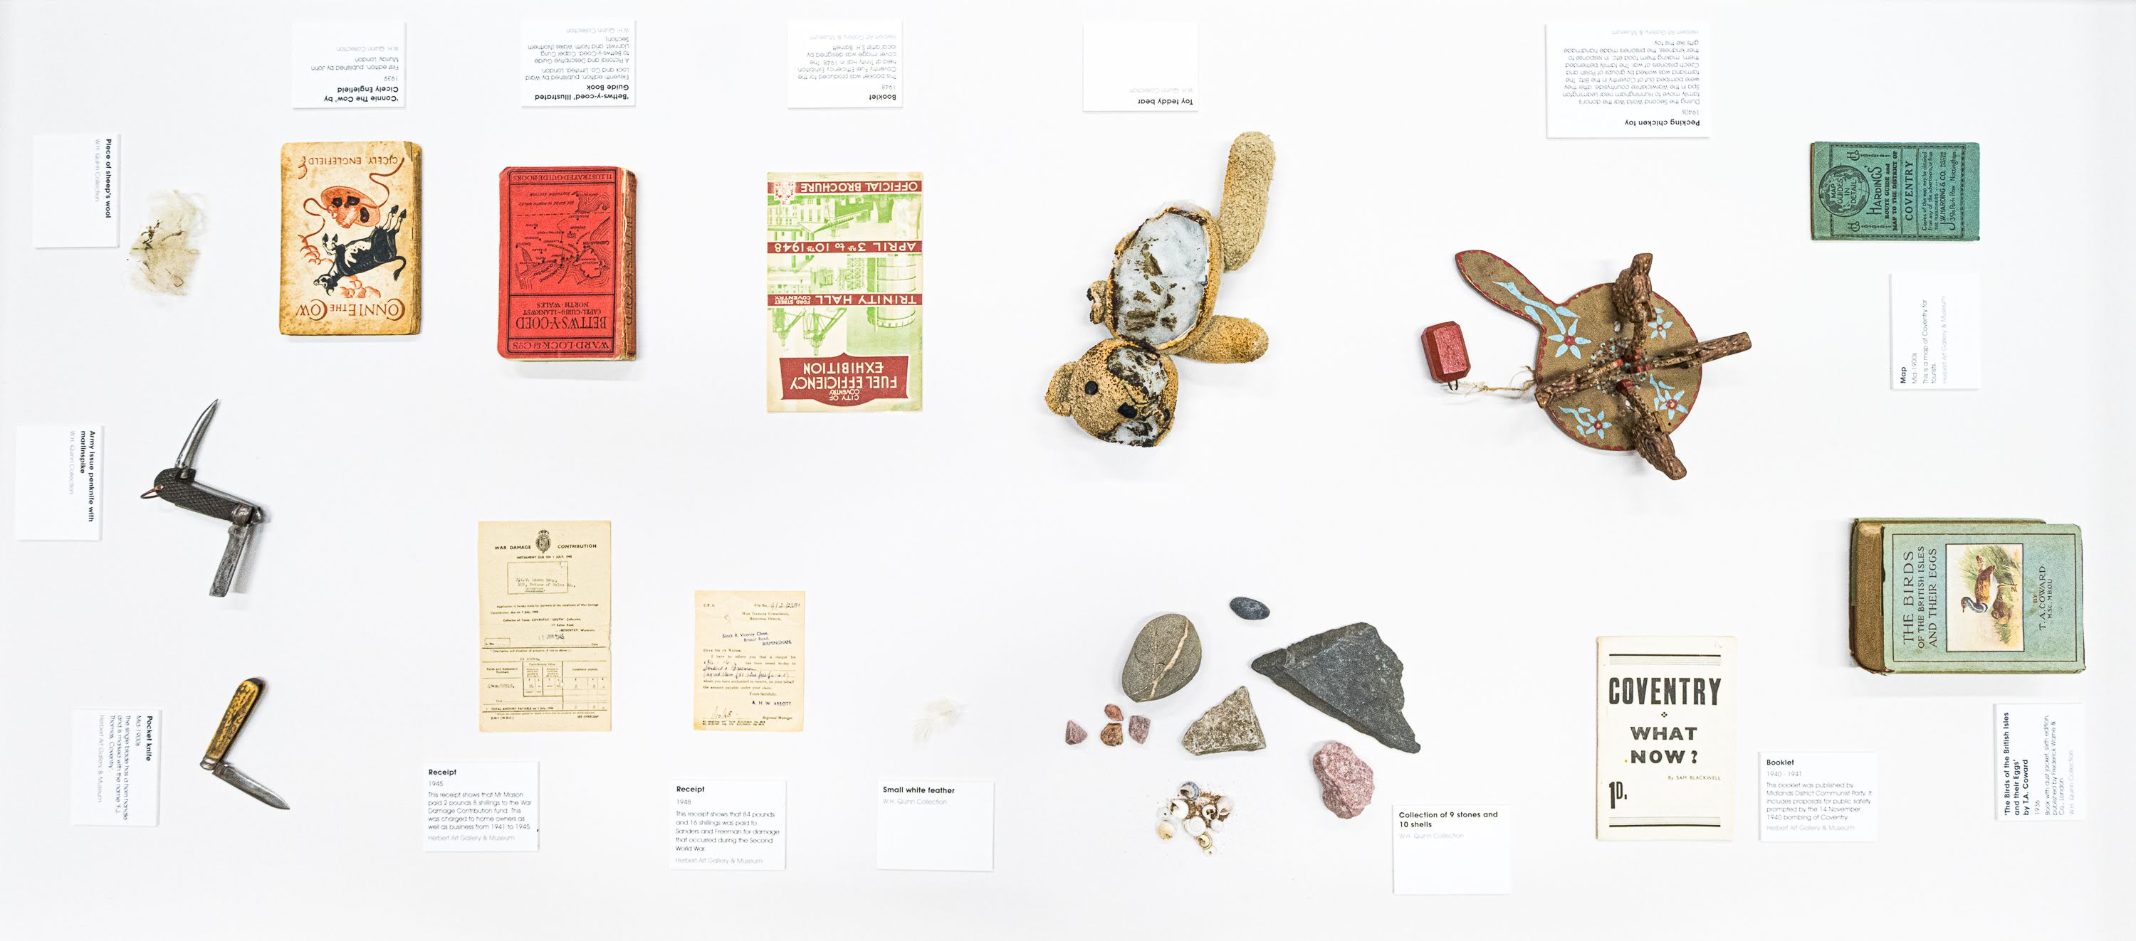
Exhibition at the Herbert Art Gallery & Museum, Coventry, UK
Display Case Overview
February – May 2020
16

Slide 20
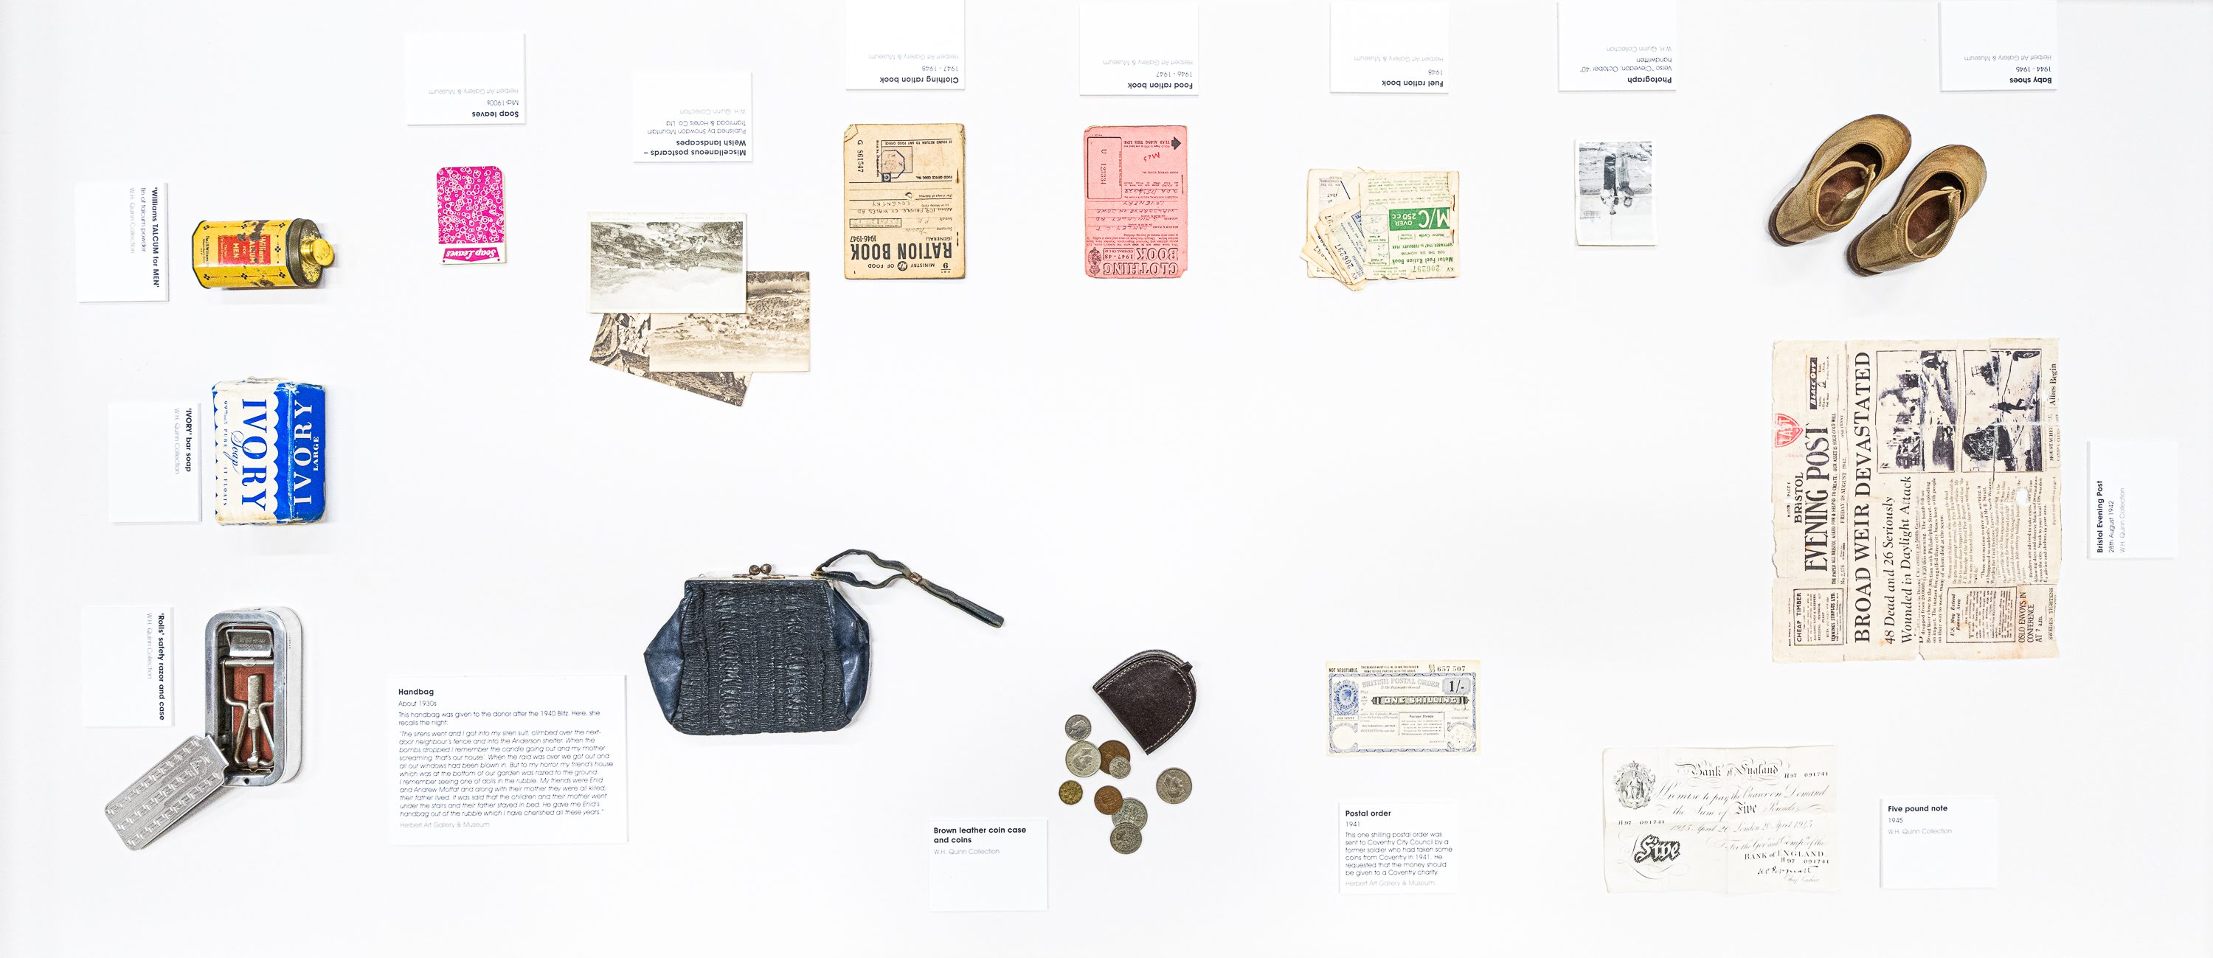
Exhibition at the Herbert Art Gallery & Museum, Coventry, UK
Display Case Overview
February – May 2020
17

Slide 21
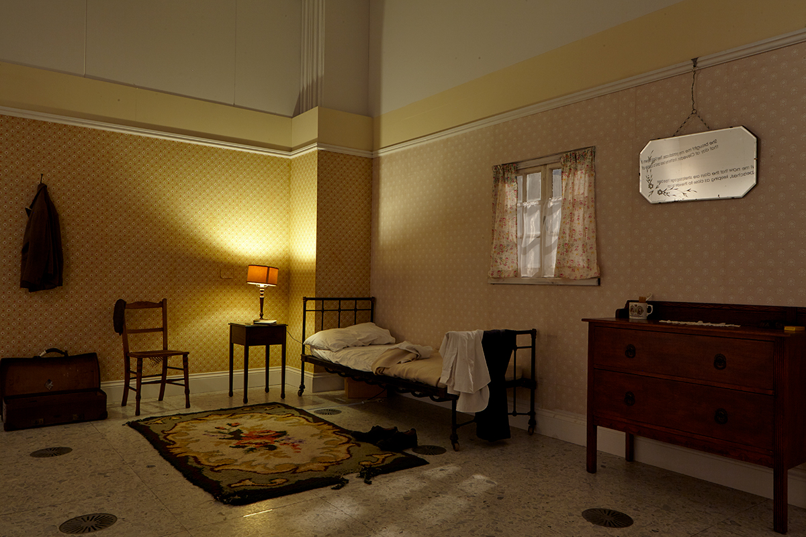
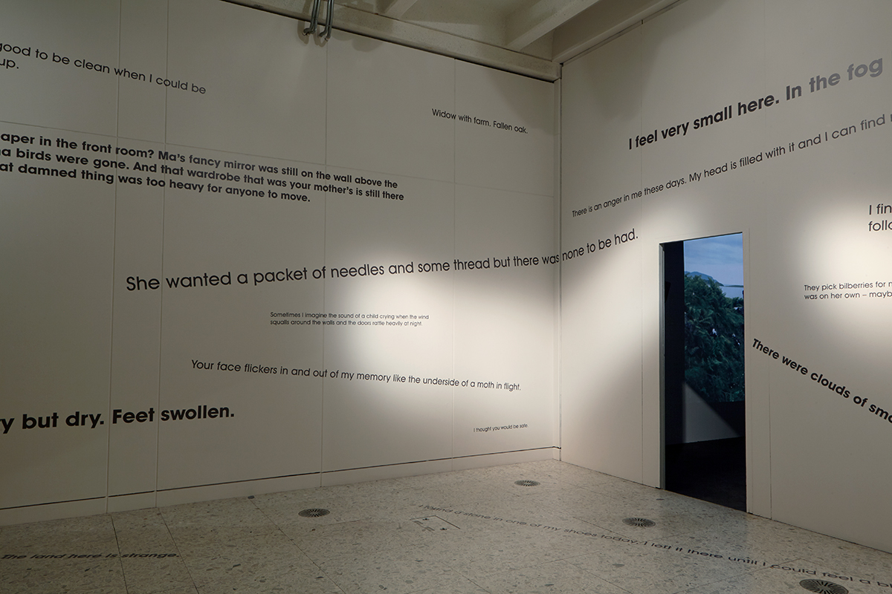
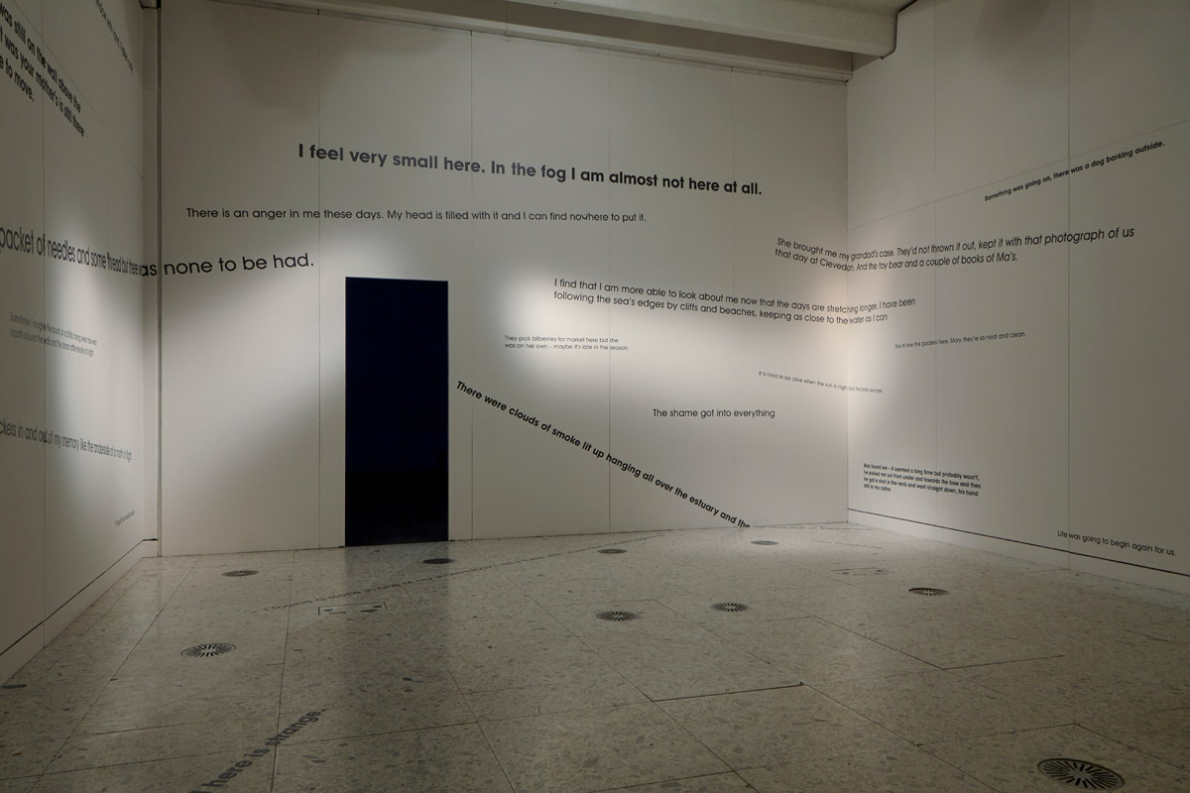
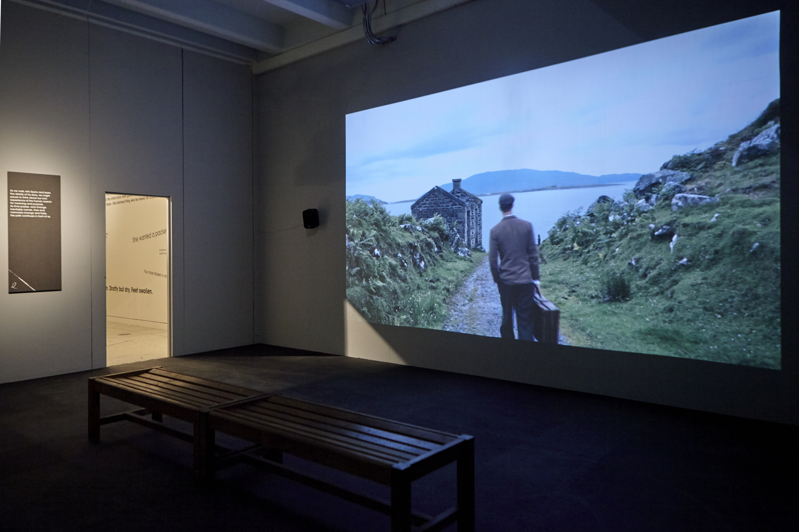
Exhibition at the Herbert Art Gallery & Museum, Coventry, UK
February – May 2020
18

Slide 22
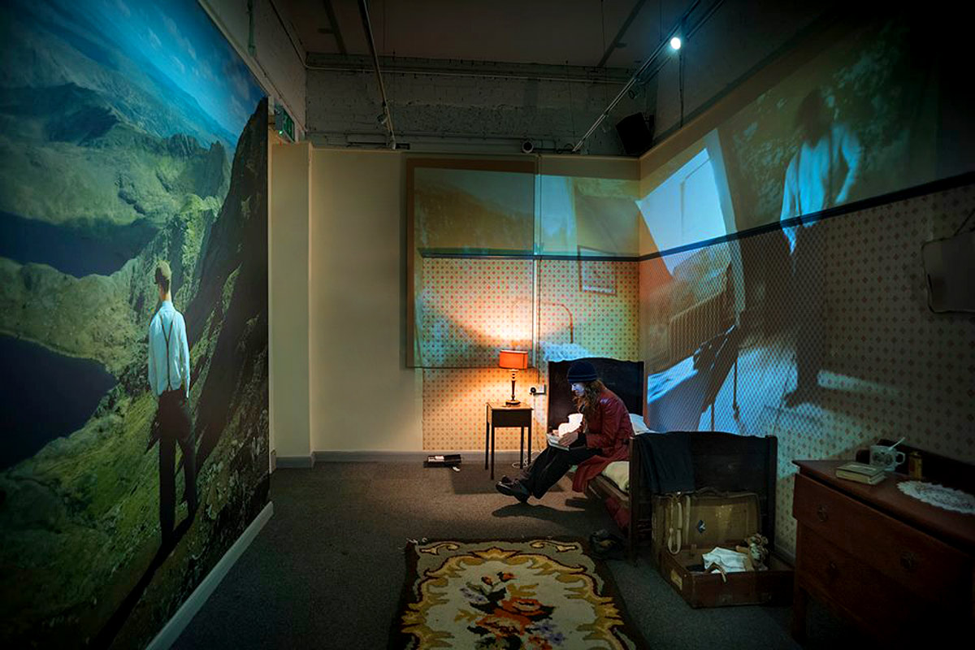
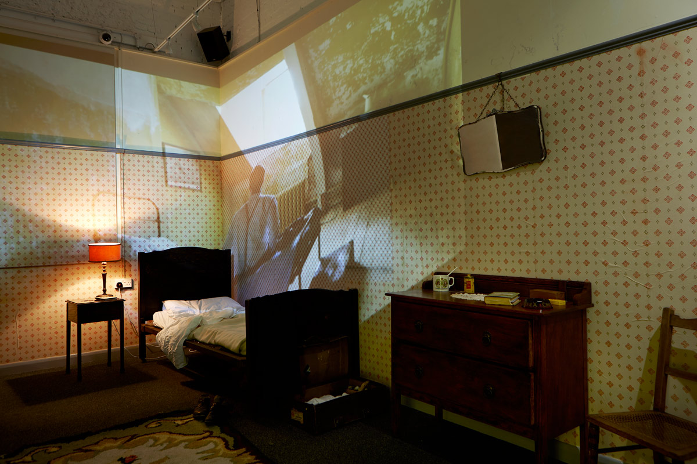
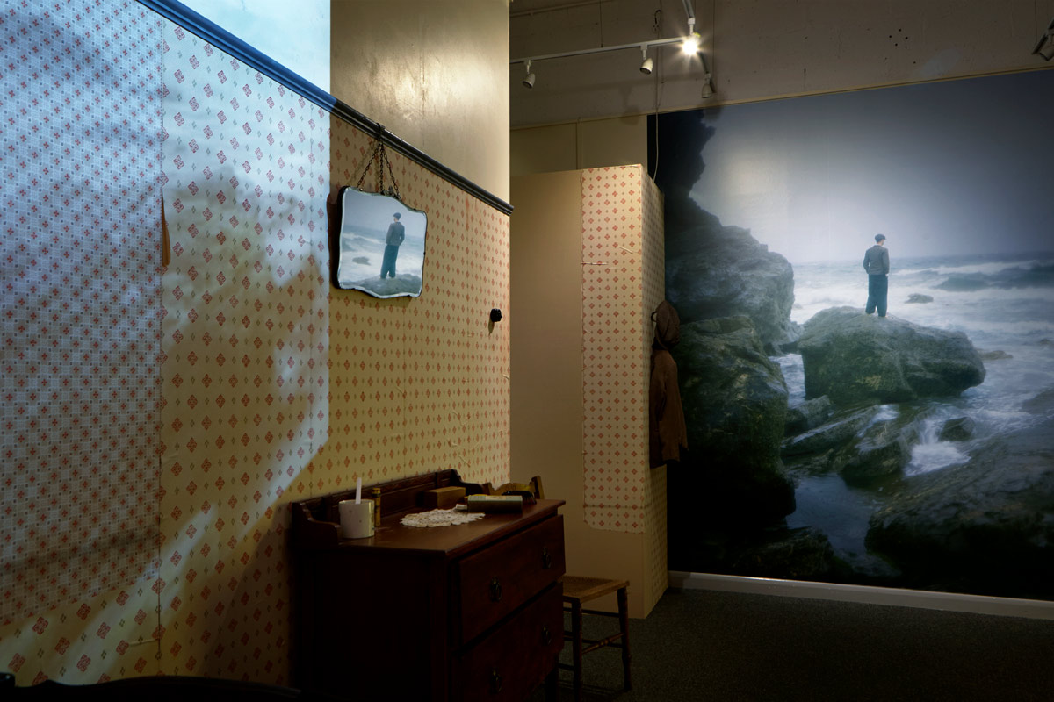
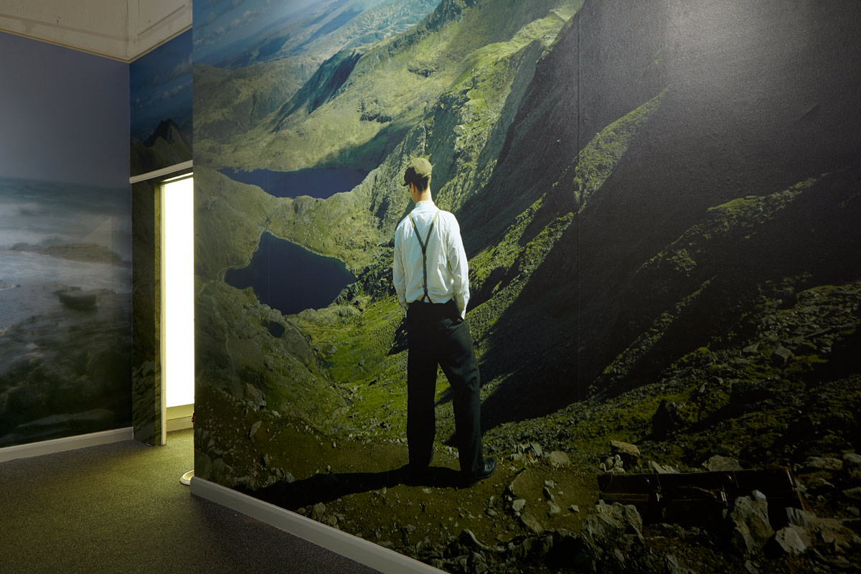
Exhibition at FORMAT International Photography Festival, Derby, UK
March – June 2019
19
FORMAT International Photography Festival

Slide 23
Exhibition at FORMAT International Photography Festival, Derby, UK
March – June 2019
20
https://v21artspace.com/format-19-crich

Slide 24
Samuel J Weir, Lois Bornat, Will Davies, Rowan Spray
21

