Slide 1
Engaging Students as Entrepreneurs in local communities
Student Engagement in Knowledge Exchange for Civic Good Conference
Adrian Bossey, Marcus Simmons, Chloe Lingard, John Lewis
8th July 2022

Slide 2
Overview:
Cornwall Business School in context
Launchpad
UG student case study
PG student case study
Discussion

Slide 3
Cornwall Business School – in context
Vision:
To be known as a Civic Business School at the heart of the community – working in partnership with entrepreneurs and SMEs on their road to success
Thematic areas of research focus:
Entrepreneurship and Small and Medium-Sized Enterprises (SMEs)
Events & Tourism
University-Based Incubation

Slide 4
UG Courses
BSc(Hons) Business & Entrepreneurship
3 year course
BA(Hons) Creative Events Management
3 year course
BSc(Hons) Business & Digital Marketing
3 year course
BA(Hons) Sustainable Festival Management
2 year course
BSc(Hons) Business Management
3 year course
BA(Hons) Sustainable Tourism Management
2 year course
BSc(Hons) Business & Marketing
2 or 3 year course
KEY
Penryn
Campus
Penryn & Eden Campuses
On-Line

Slide 5
Doing it for Real
All UG students get the chance to:
Engage with micro placement opportunities
Set up their own business and/or deliver their own events & campaigns
Work to live briefs set by industry
“The business challenges we have had were good real-life experiences” – B&E Graduate (NSS Feedback)

Slide 6
Experience Design UG curricular Civic Engagement
4 Events and Projects
6 Micro-placements
Wellbeing in Experience Management
Demonstrating Sustainability
Creative & Ethical Leadership

Slide 7
Business UG curricular Civic Engagement
Creative & Ethical Leadership
Collaborative Project: Growth Challenge
Social Action Project
Design Thinking

Slide 8
PG Courses
MSc Entrepreneurship (Launchpad)
MA Creative Events Management (On-line)
MSc Entrepreneurship
MSc Sustainable Business (On-line)
KEY
Penryn
Campus
On-Line

Slide 9
Launchpad & MSc Entrepreneurship - Designed to educate the next generation of entrepreneurs
“Disciplined” Entrepreneurship – informed and driven by research
Human (customer) centred approach to problems, creativity and innovation
A global mindset - understanding of the global nature of business.
21st Century Focus - Broad understanding of global business and tech landscape
We want to create “bullet-proof”, resilient entrepreneurs

Slide 10
Why?
Entrepreneurship is hard (so is social enterprise)
Start-up mortality rates are extremely high
Product failure rates are high
Entrepreneurship is organised chaos – you’re trying to do unprecedented things, to solve problems / pains in the world.

Slide 11
Our Teaching Approach
All modules and assessments are designed for learners on their entrepreneurial journey e.g. design thinking, opportunity mgt, finance, work based project
Interactive workshops, tutorials, informal feedback, formal feedback, industry experts, EIRs
We expect learners to read around the subject and become expert in THEIR domain (~200 hours) – independent learners

Slide 12
Launchpad Venture Studio
Monthly stipend following successful stage gate reviews
Access to market test funds (MTF) for rapid evaluation of ideas
Bi-weekly business coaching reviews
Access to Entrepreneurs in Residence (EIRs)
Access to funding opportunities once incorporated

Slide 13
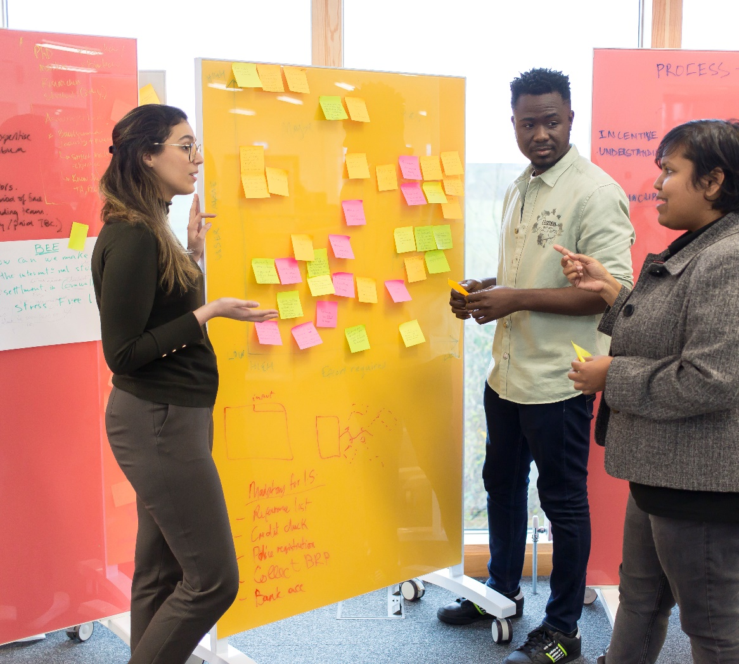
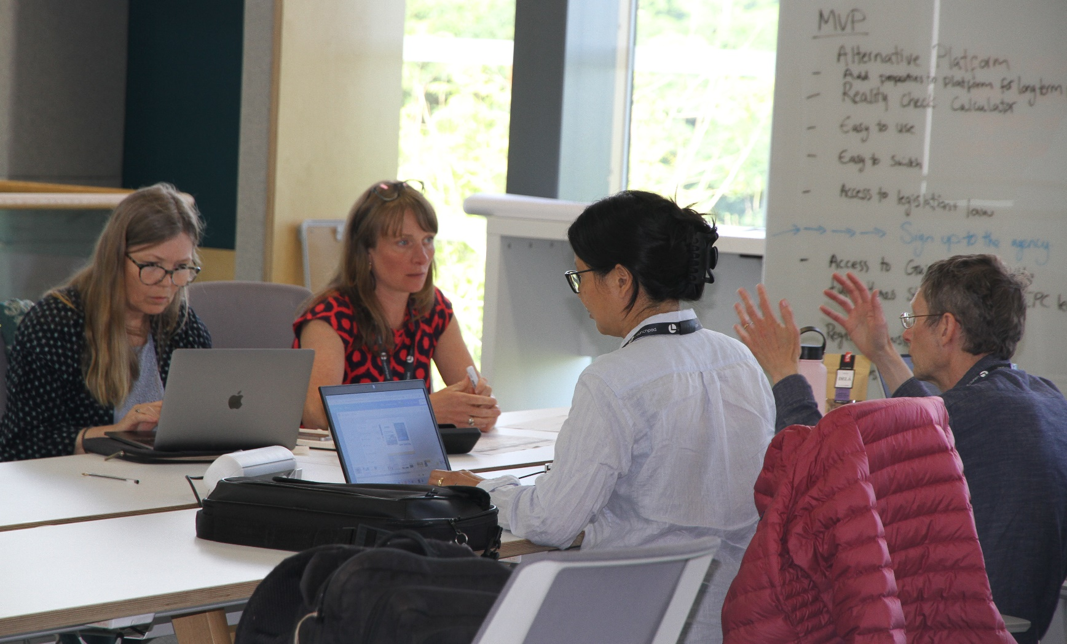
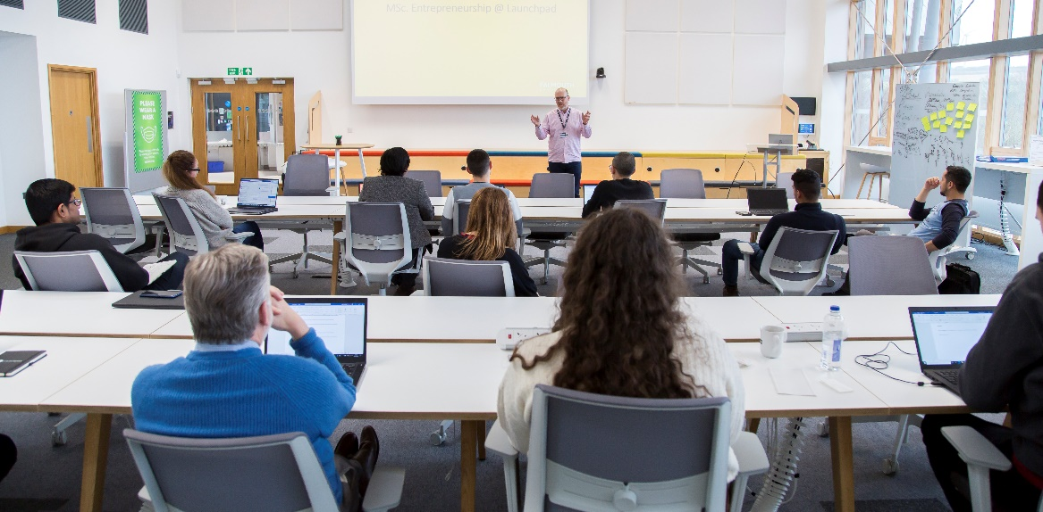
Fantastic facility to catalyse the creative process of business building

Slide 14
UG Student Case Study
Chloe Lingard
BSc(Hons) Business & Management (2Yr)
MSc Entrepreneurship
Founder, The Sustain Ability Project

Slide 15
Chloe Lingard & TSAP Travel
Chloe Lingard
BSc(Hons) Business & Management (2Yr)
MSc Entrepreneurship
Founder, The Sustain Ability Project

Slide 16
How it evolved...
2019
Completed assignments researching sustainability
Aligned assignment research with my business idea
Utilised the university library to support and research the market
Utilised knowledge developed when employing staff
Worked with external speakers and guest lecturers to support the company
2021
2021
Notes:
Our solution isn't to ask volunteers to teach English or do marine or wildlife conservation but for them to come to developing countries like Madagascar to share their talents and knowledge with the local community.
Primarily we are targeting undergraduates and graduates from institutions like Falmouth University, who are keen to share their knowledge and skills with communities that want to learn skills like marketing, photography, tech skills and more, as a way to improve their life for years to come.
& we believe that this can be carried out around the world

Slide 17
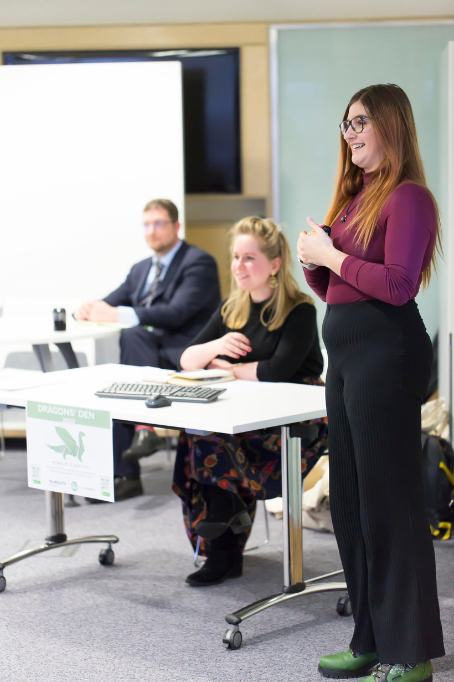
Achievements...
Awarded £2000 in the Dragons Den Competition
Notes:
Our solution isn't to ask volunteers to teach English or do marine or wildlife conservation but for them to come to developing countries like Madagascar to share their talents and knowledge with the local community.
Primarily we are targeting undergraduates and graduates from institutions like Falmouth University, who are keen to share their knowledge and skills with communities that want to learn skills like marketing, photography, tech skills and more, as a way to improve their life for years to come.
& we believe that this can be carried out around the world

Slide 18
Moving Forward...
We match graduate talents with impoverished community needs.
Madagascar
X
England
+
Graduates
=
Community Supported
+
Global Change

Slide 19
Q&A
@tsaptravel
@tsaptravel

Slide 20
PG Student Case Study
John Lewis
MSc Entrepreneurship & Launchpad
CIC Director and Co-Founder

Slide 21
Social Impact Management South West
John Lewis

Slide 22
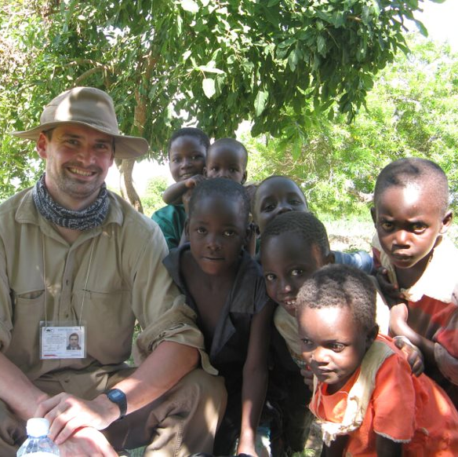
How I came to be at Launchpad?
17 Years working and volunteering in the Social and Community Sector
8 years of support work in Cornwall
2017 Business Degree
Business Development
CIC Director and Co-Founder

Slide 23
Social Impact
How do we know if a VCSE project has been success?
How can we make decisions about the good that people do?
How can we decide who to support?
What doe we know about VCSE’s?

Slide 24
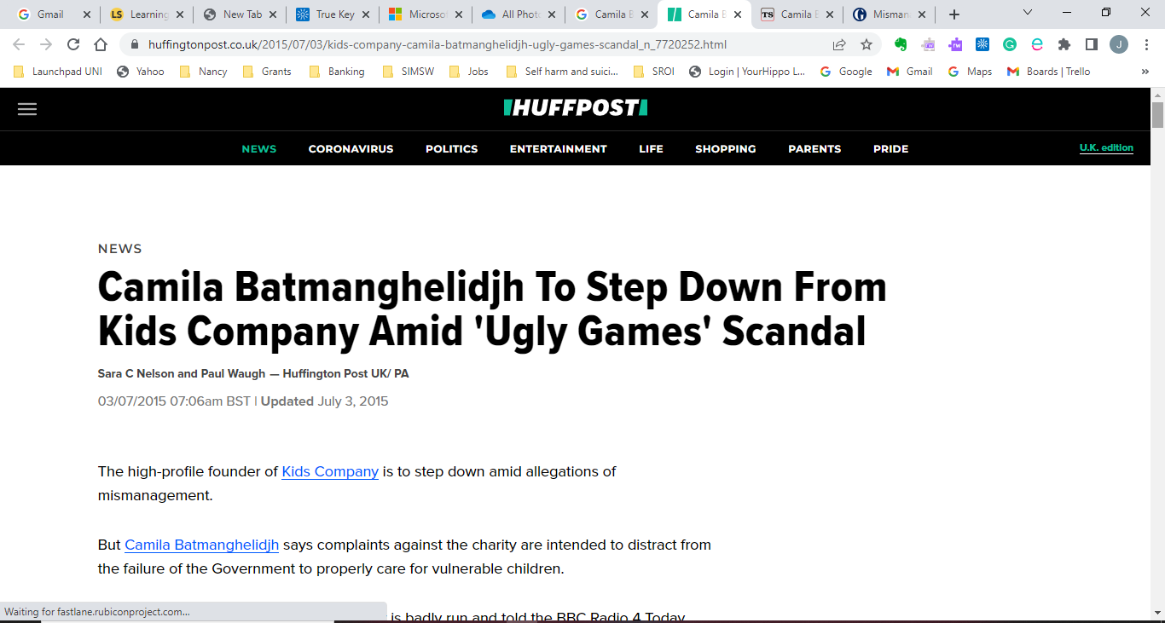
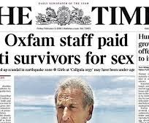
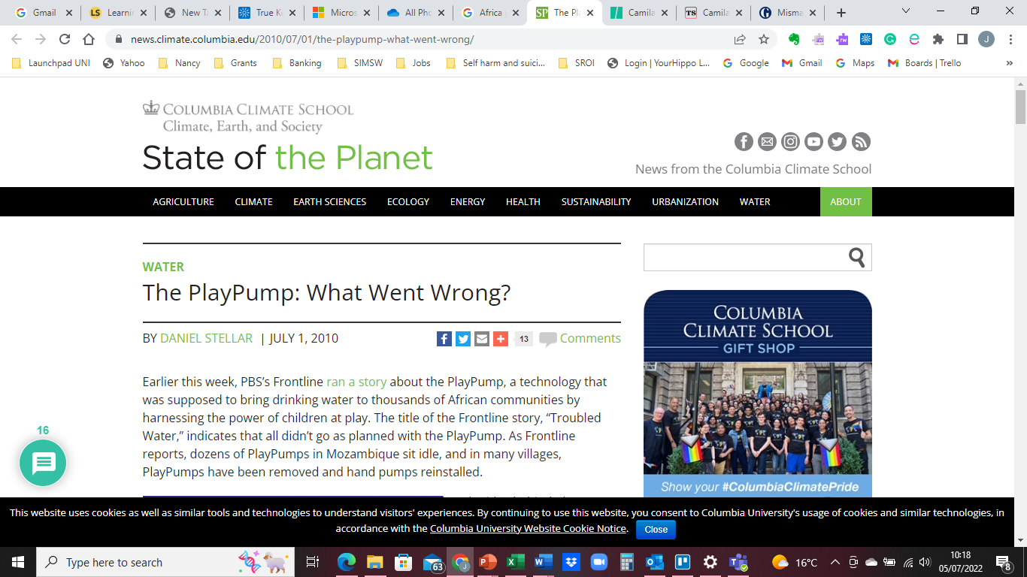
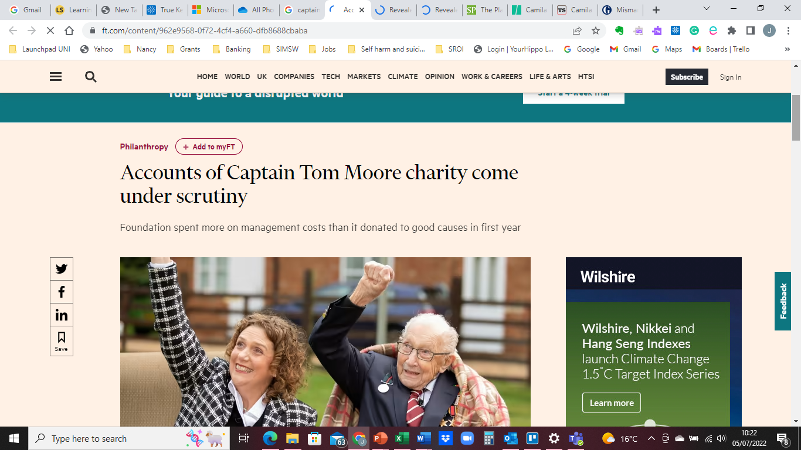
Newspaper clippings
Notes:
Over my career I have been involved with a range of projects and been lucky to observe the amazing work of individuals and projects. AT the same time I have witness the waste that occurs and where the purpose of an organisations has become detected from from its original vision.
I’ve also seen and heard examples of good intent gone wrong.

Slide 25
Social Return on Investment
Social Value UK
Ratio
Qualitative vs Quantitative
What has change?

Slide 26
How can we use impact information better?
Notes:
Impact in design thinking? Creating projects based on an understanding of what the impact will be.
Ethical planning – Thinking about how we can do more with less.
What will be the wider impact?
How can organisation share more information on Impact.

Slide 27
Thank You
It would be great to discuss this further

