Slide 1
Human-centred design research during the pandemic:
Using an online survey to inform personas of women at risk of hip fracture
Simon Andrews
PhD Researcher - 3D3 NPIF Studentship
Fashion & Textiles Institute
Falmouth University
simon.andrews@falmouth.ac.uk

Slide 2
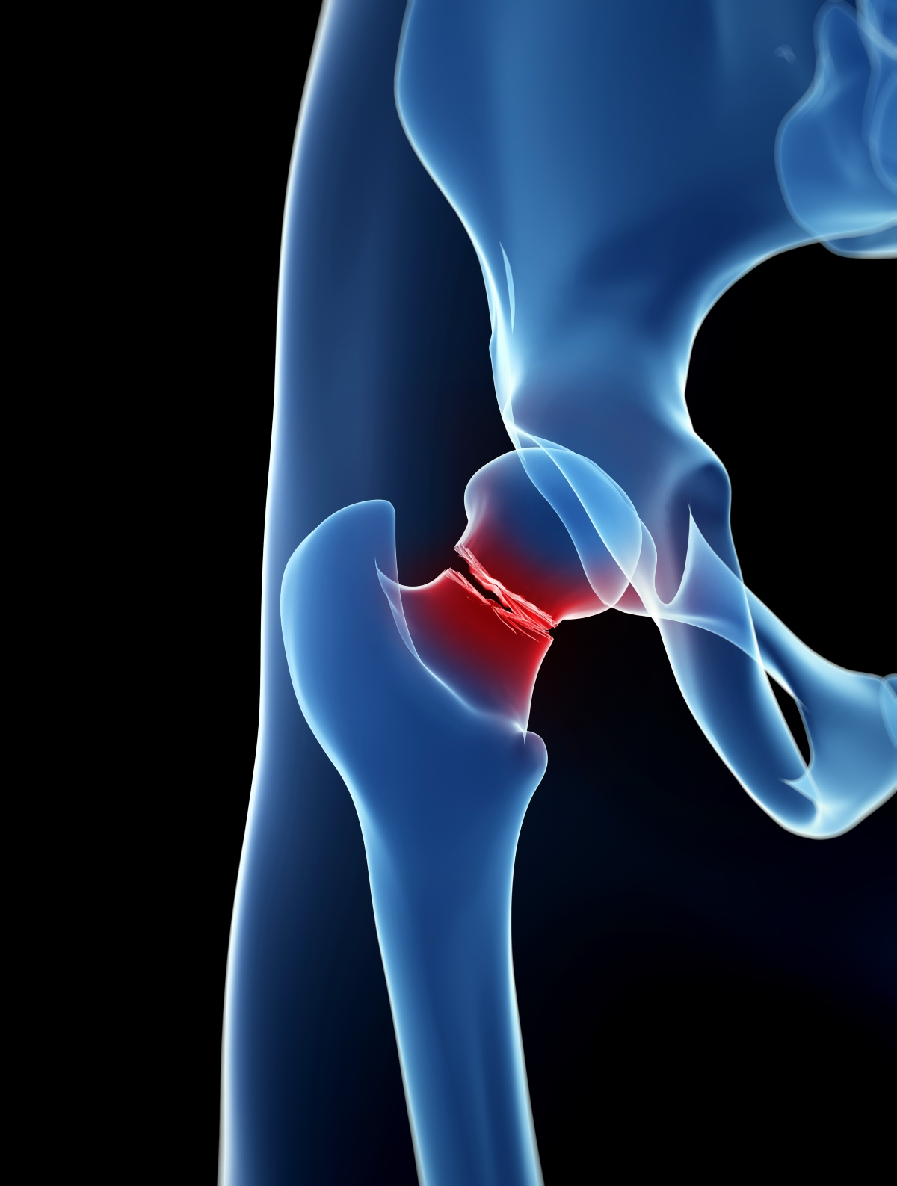
Impact of hip fractures
About 20% of people who experience a hip fracture die within one year of the injury occurring (Leibson et al. 2002).
Annual cost of medical and social care for all the hip fracture cases in the UK amounts to about £2 billion (National Clinical Guideline Centre 2011).
Women are statistically four times more likely to suffer a hip fracture than men (Parker et al. 2006).
Notes:
Hip fractures are a major cause of long-term disability and can lead to a rapid decrease in healthy life years, especially for older people. They are the most common reason for older people to need emergency surgery and the most common cause of death following an accident. The annual cost of medical and social care for all the hip fracture cases in the UK is about £2 billion. Women are four times more likely to suffer a hip fracture than men due to higher instances of osteoporosis and longer life expectancy.

Slide 3
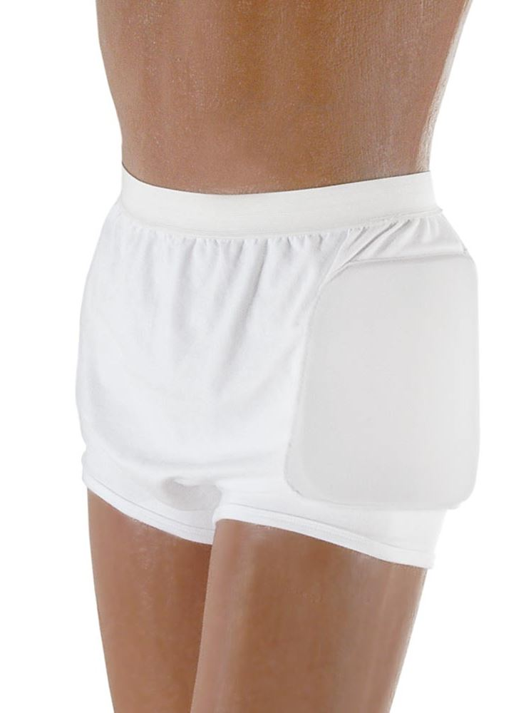
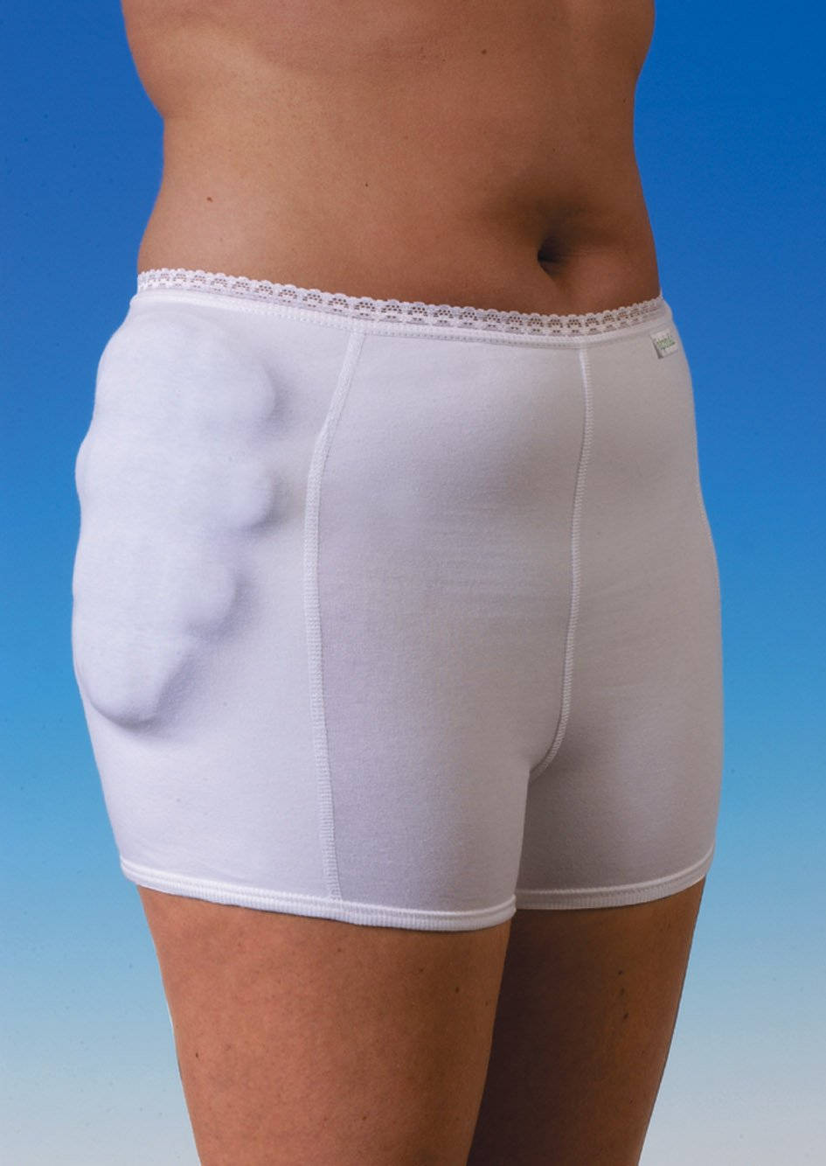
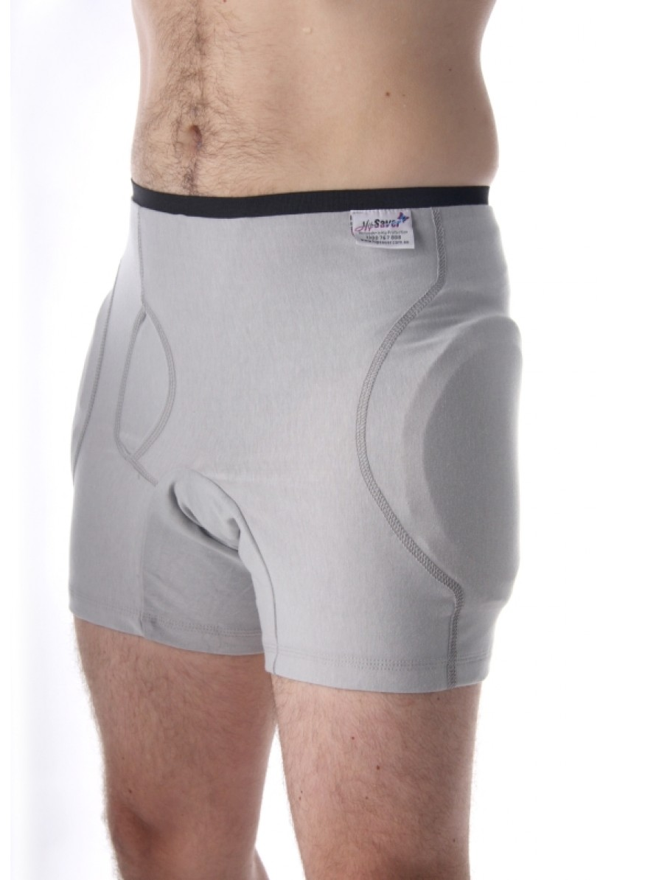
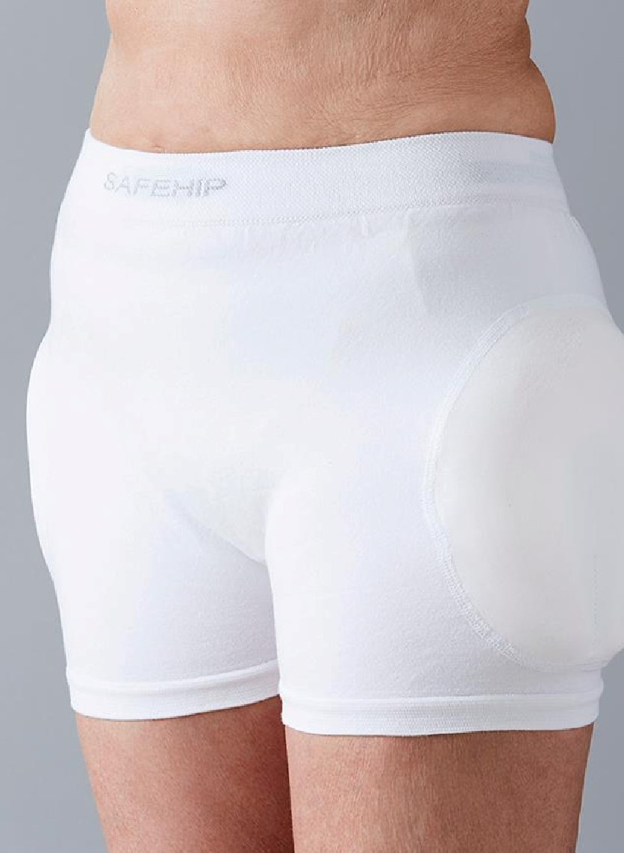
Long-term adoption is low due to:
Discomfort
Dislike of appearance
Difficulty of use (getting on and off due to physical frailty)
Notes:
Hip protectors can reduce the risk of fracture, but long-term adoption of these products is low because they’re uncomfortable, they don’t look good, and they’re difficult to use. Although women are at higher risk, they are underrepresented in the design of current underwear hip protectors which are often aesthetically and functionally better suited to men. My research is informing the development of improved designs of hip protection, that address these issues.

Slide 4
“Personas are imaginary characters – based on real people - that represent user archetypes.” RCA (2011)
Notes:
Social distancing rules cut short the focus groups I’d planned, so I developed an online survey to understand attitudes towards current hip protectors. The survey responses have, in turn, helped to inform a series of Personas. Personas are imaginary characters that represent different user archetypes based on real people who have engaged with the research practice. They help to focus design development by becoming a lens through which design concepts can be evaluated.
Although the pandemic disrupted people-facing research, the use of survey data provided a greater breadth of voices to inform the personas than focus groups alone.

Slide 5
Notes:
My survey targeted members of the Royal Osteoporosis Society and gathered 146 responses from women. They were asked to respond to two different types of hip protector, to understand attitudes towards these garments when worn under (hidden) or over (visible) clothing. This qualitative insight, and answers relating to context of use and style, revealed patterns related to age and helped to inform characteristics that could shape the personas.

Slide 6
Four Phases of Adult Development (summarised from Cohen 2006)
Ages 30
40
50
60
70
80
90
100+
Midlife Re-evaluation - Quest
Mid 30s to mid 60s
Quest rather than crises
Confront sense of mortality
Liberation - Innovation
Mid 50s to mid 70s
If not now, when?
Speak one’s mind
Summing Up – Recapitulation, resolution, contribution
Mid 60s through 80s
Keepers of culture
Urge to share wisdom
Encore – Continuation, reflection, celebration
Late 70s to end of life
Vitality of spirit
Have a positive impact
Notes:
It was important to create personas that represented users at different life stages. Older age is a risk factor for hip fractures but conditions such as osteoporosis can create risk for younger people too. Cohen’s Four Stages of Adult Development is a positive, and anti-ageist, way to frame mid to later life stages, as – from midlife re-valuation to encore - it views ageing as a holistic part of adult life.

Slide 7
Four Phases of Adult Development (summarised from Cohen 2006)
Ages 30
40
50
60
70
80
90
100+
Midlife Re-evaluation
Liberation
Summing Up
Encore
Notes:
Framing the personas this way challenges ageist attitudes, mediated through the development of new designs for hip protection, inclusive of younger and older people, that reflect positive messages about ageing.
Persona details such as personality, interests and social environment, were shaped by comments made in the survey and narratives identified through earlier focus groups and interviews. I took quotations directly from the survey, or paraphrased, to shape the personas’ attitudes towards hip protectors. Five personas were created that reflect Cohen’s framework.

Slide 8
Notes:
Older respondents tended to prefer hip protectors that were discreet and hidden from view. For example, Greta, a 77 year old retired teacher, notes how important it is that you can’t tell a hip protector is being worn.

Slide 9
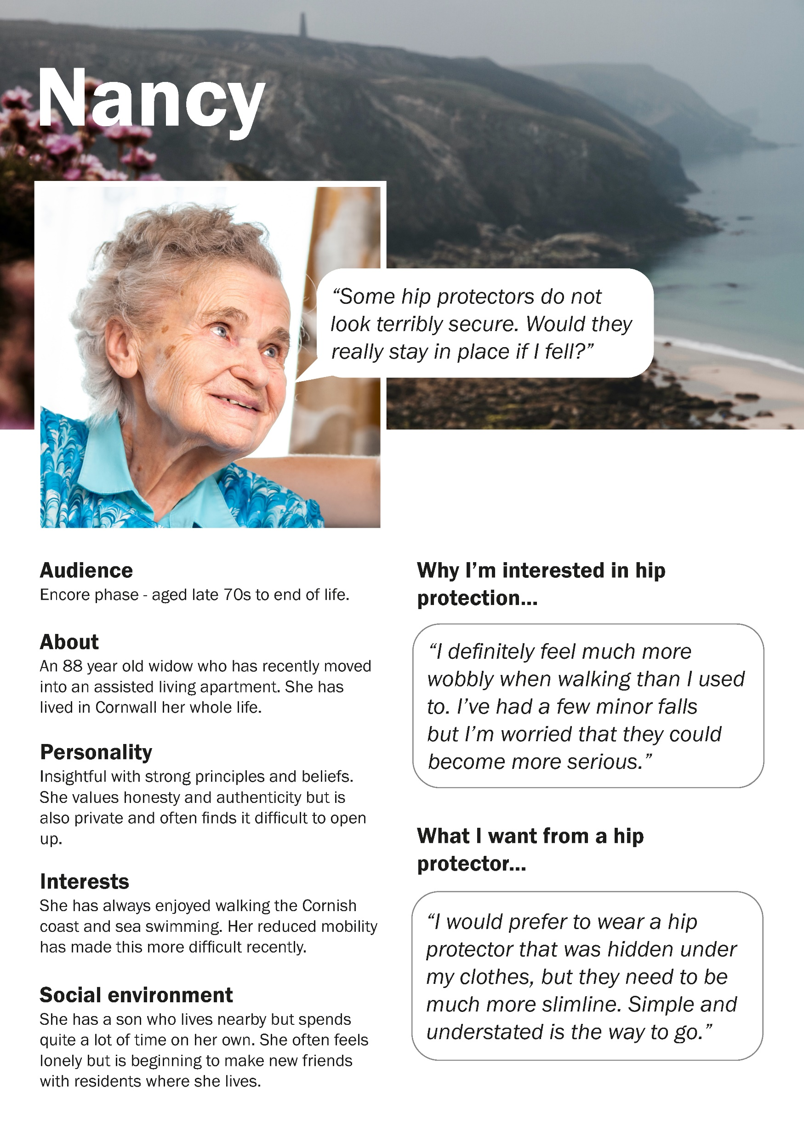
Notes:
Similarly, Nancy, in the ‘encore’ life stage, would prefer to wear a hip protector hidden under clothing, but they need to be much more slimline.

Slide 10
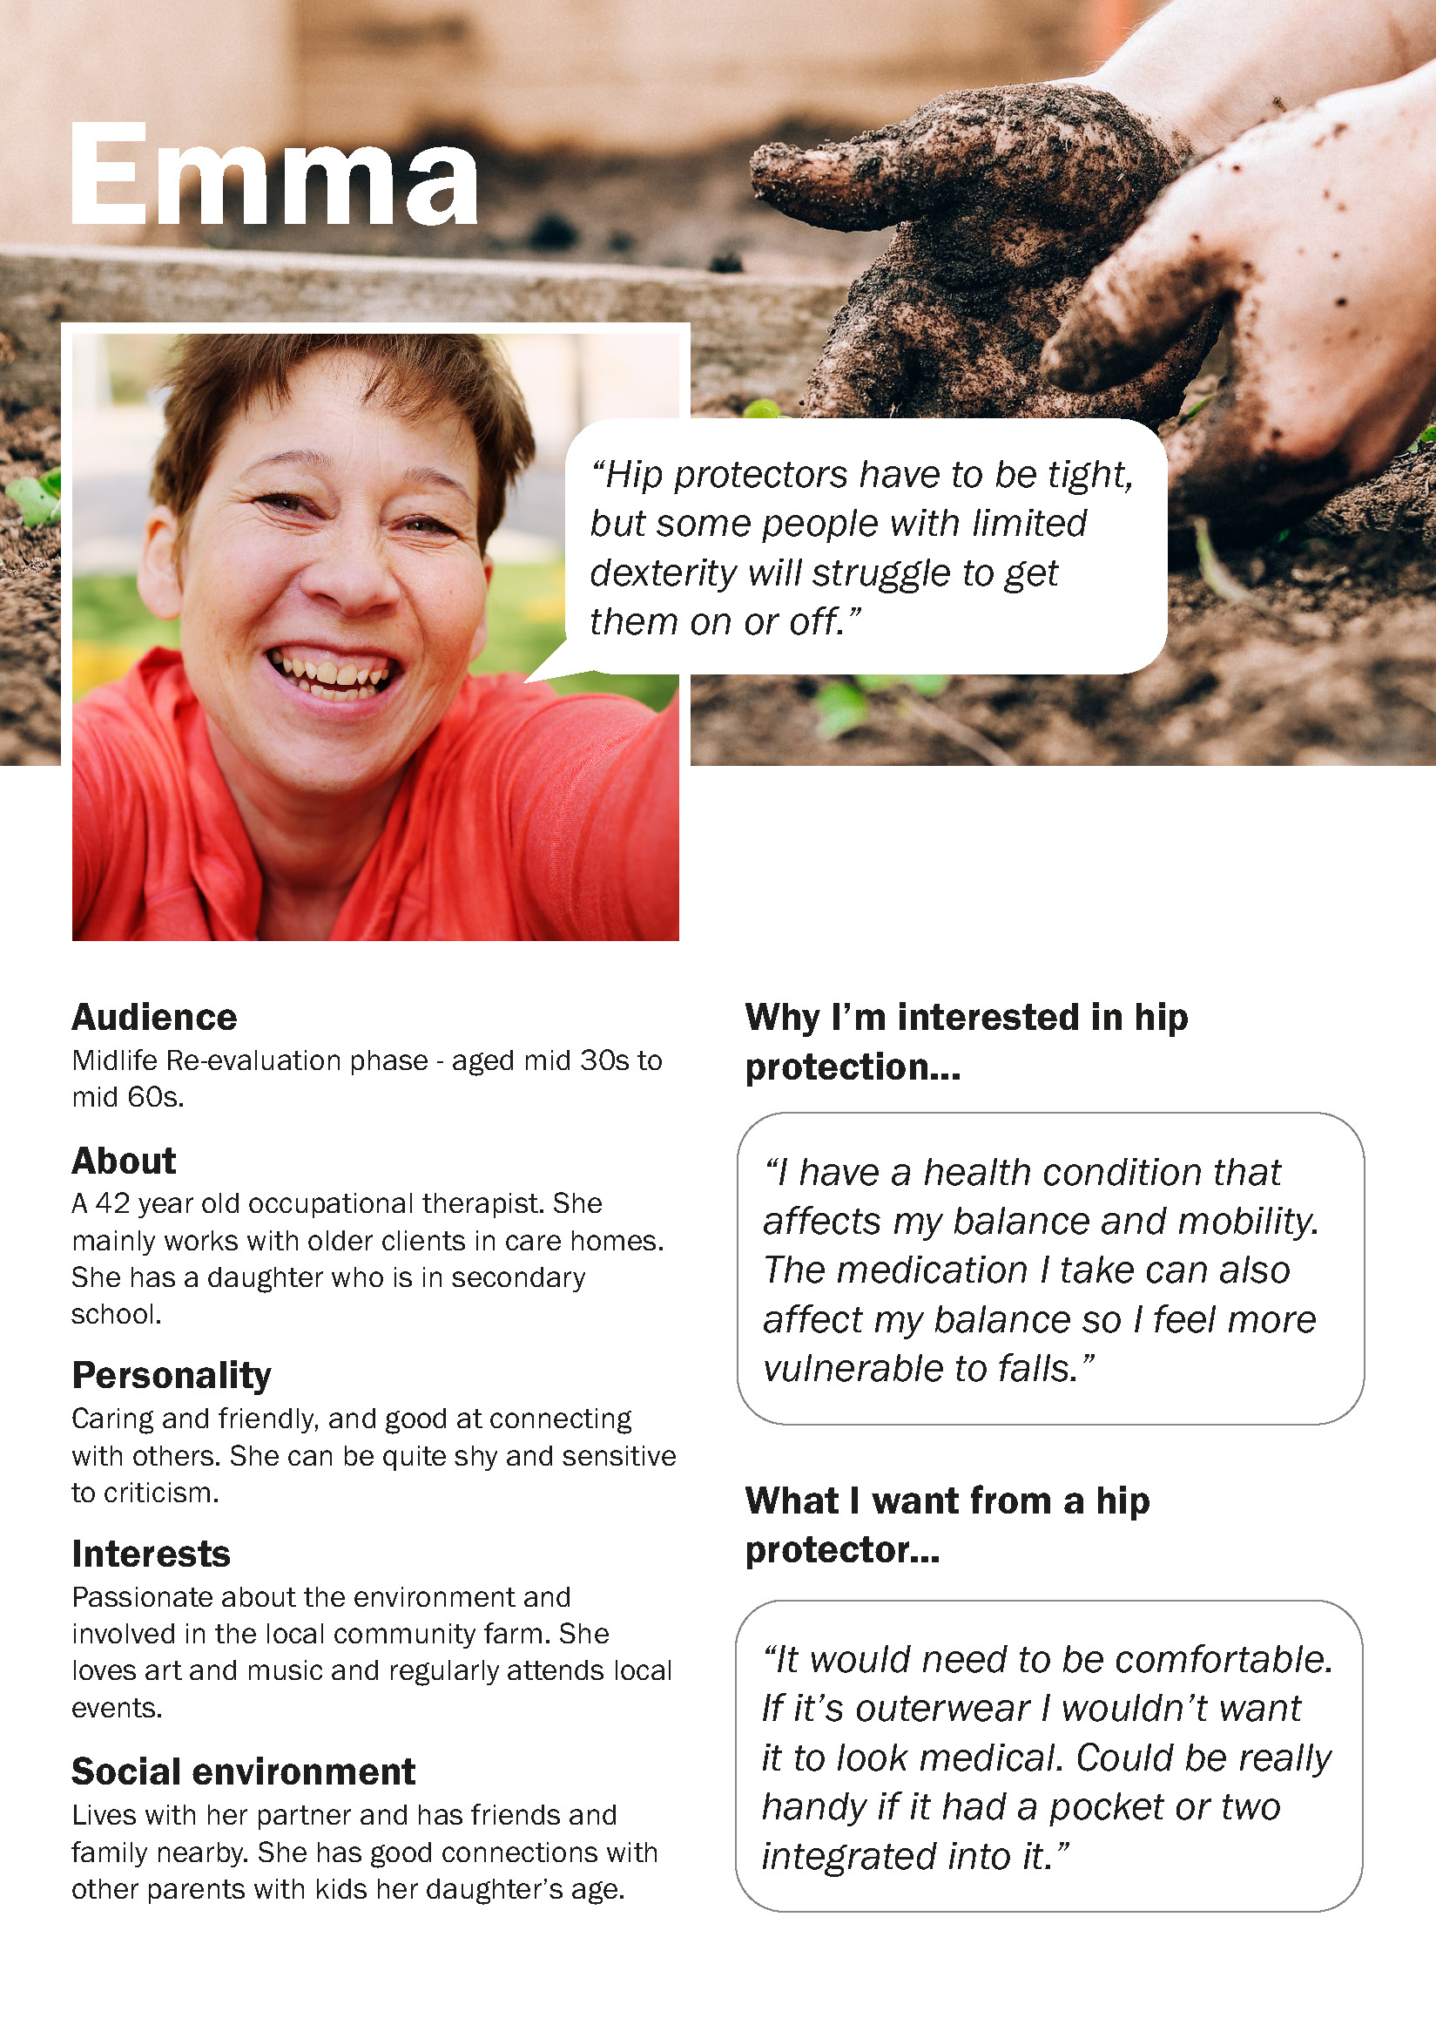
Notes:
Younger respondents tended to reflect more on function and performance and were more receptive to hip protectors that are visible when worn. For example, Emma can see that people might struggle to get a hip protector on or off, but also suggests, for one worn over clothing, integrated pockets would be good.

Slide 11
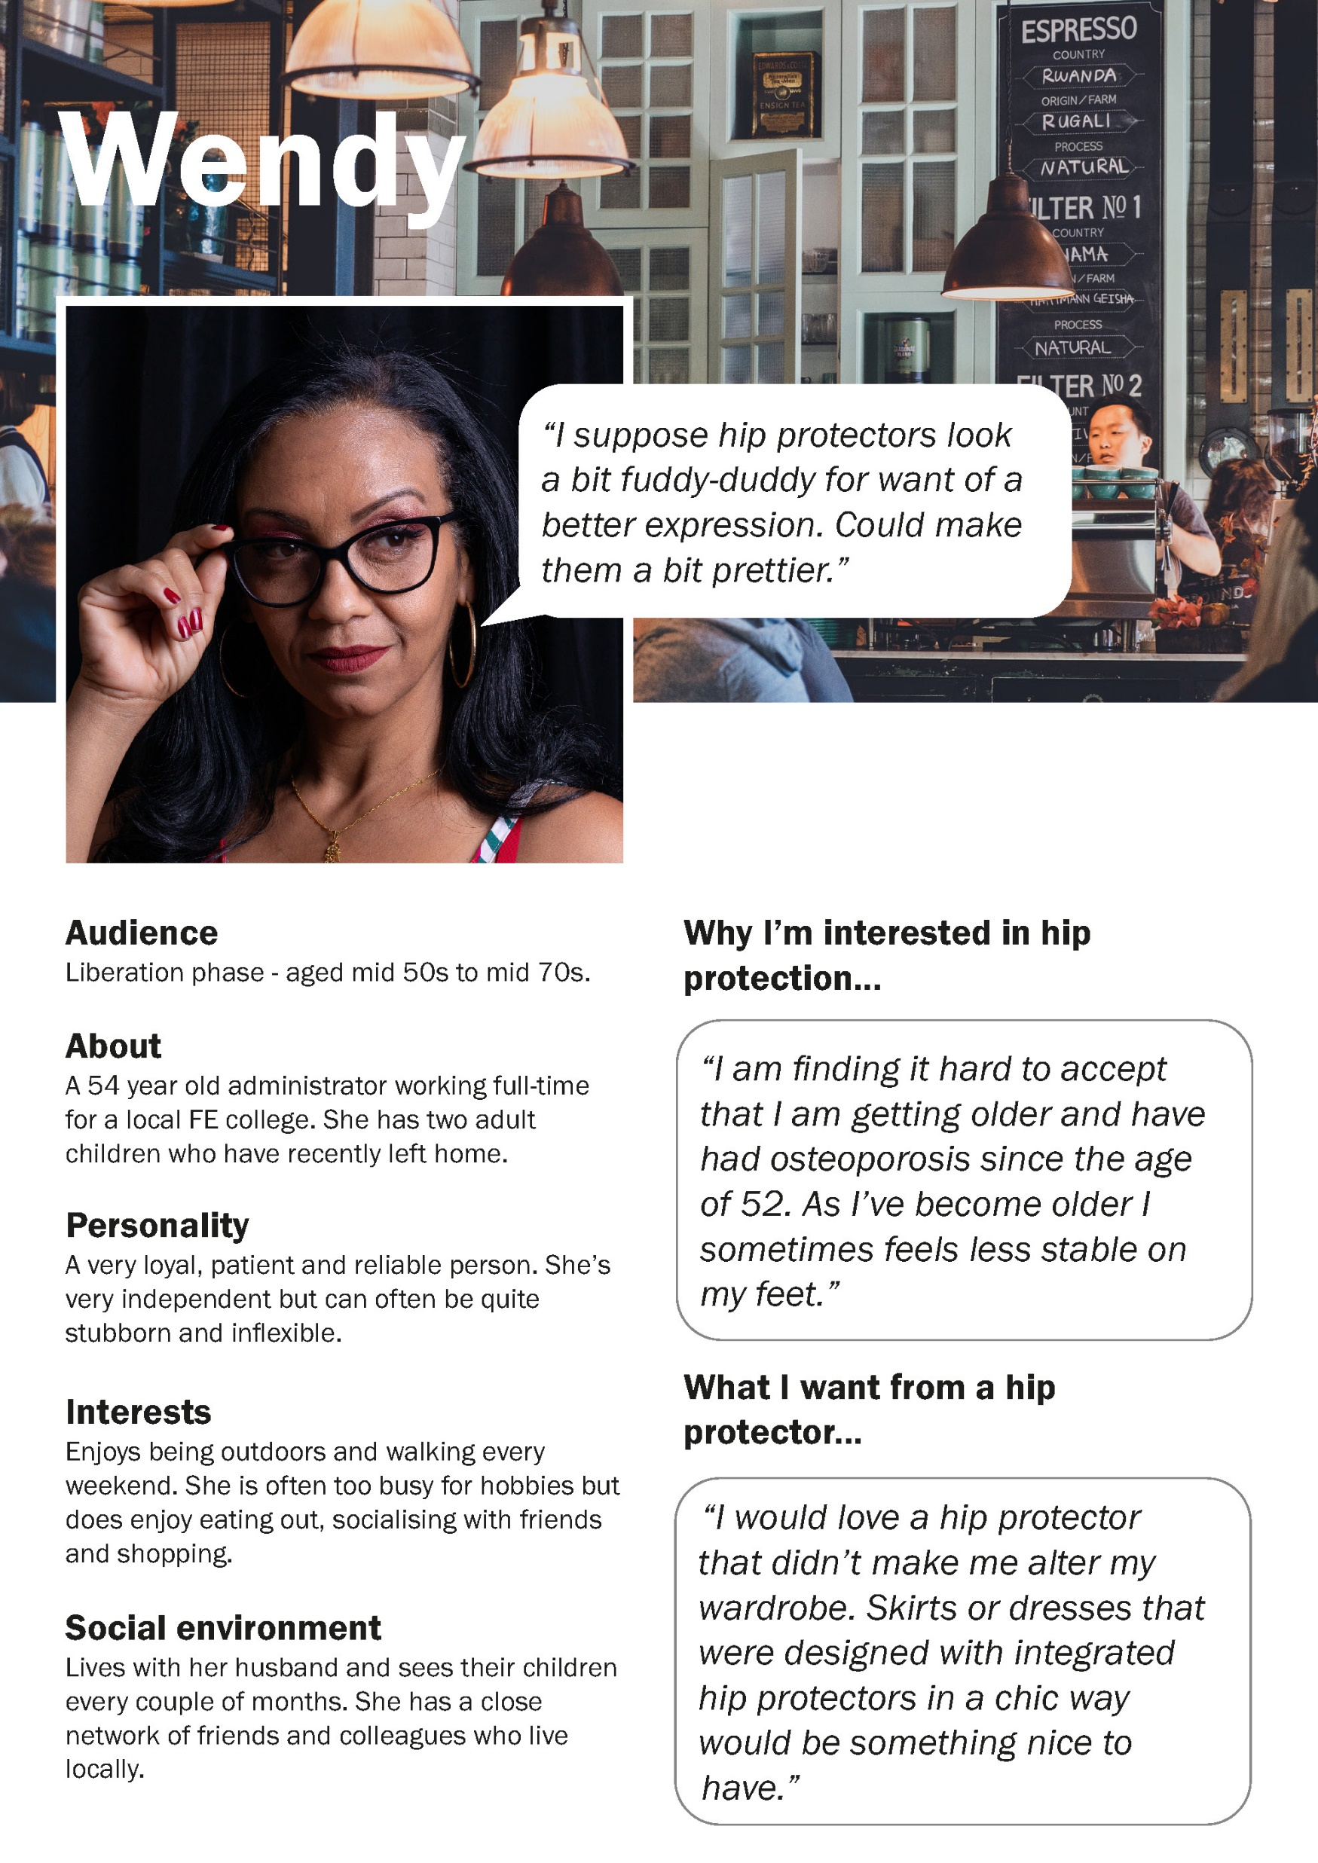
Notes:
Wendy notes that it would be nice to have clothing with integrated hip protection designed in a chic way.

Slide 12
Notes:
Many of the respondents, even into later life, said they enjoyed higher risk sports like skiing or cycling. This is an opportunity for my personas to challenge ageist ideas about lifestyle and being “too old” to do certain activities. For example, Delores, is 66 years old and is a keen skier. She likens padded cycling shorts to a potential hip protector solution.

Slide 13
Reflection
Include survey questions to help build the persona characteristics more directly
+
Survey other fall-risk groups using in-person/paper based methods
+
Widen survey target sample to include more male participants
Notes:
There are some limitations to my approach: the survey questions weren’t originally designed with the aim of creating personas. Survey questions could be included to help build the profiles more directly.
Access to online surveys is not wholly inclusive, and whilst the target audience of ROS members provides insights from people living with osteoporosis, it is not representative of wider populations at risk of falls. Surveying other groups and providing paper-based means of responding would help in this respect.
Men are also at risk of hip fracture but a very low response rate (9 responses) in the survey made it difficult to generate male personas. Again, widening the target survey sample would help to develop this.

Slide 14
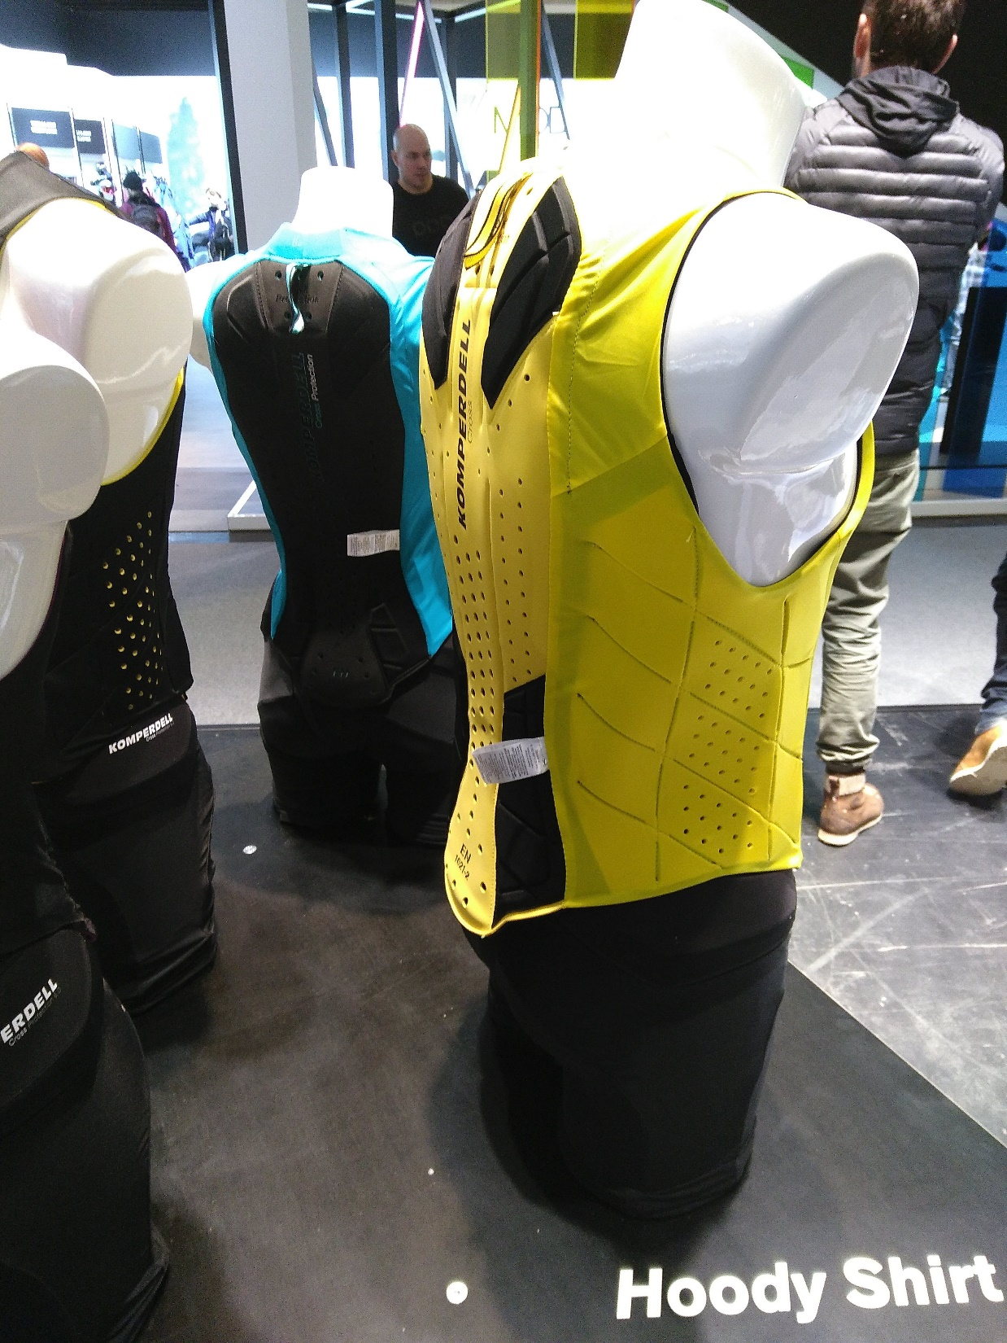
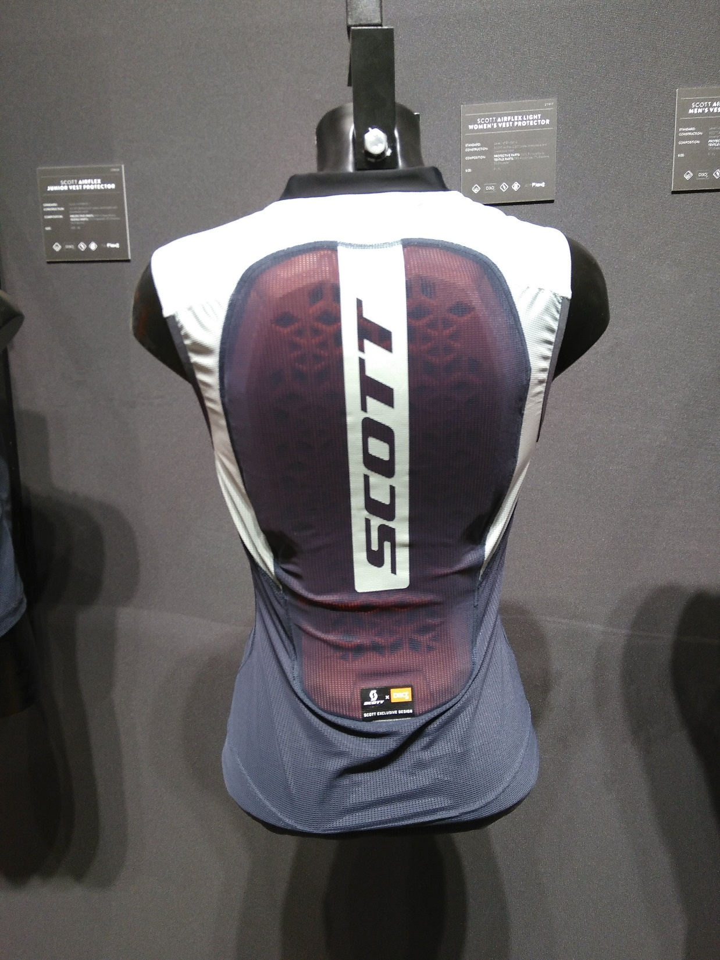
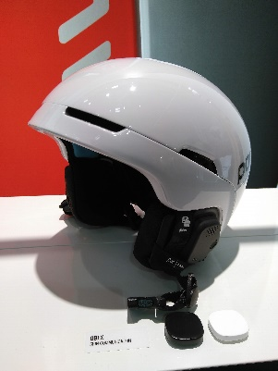
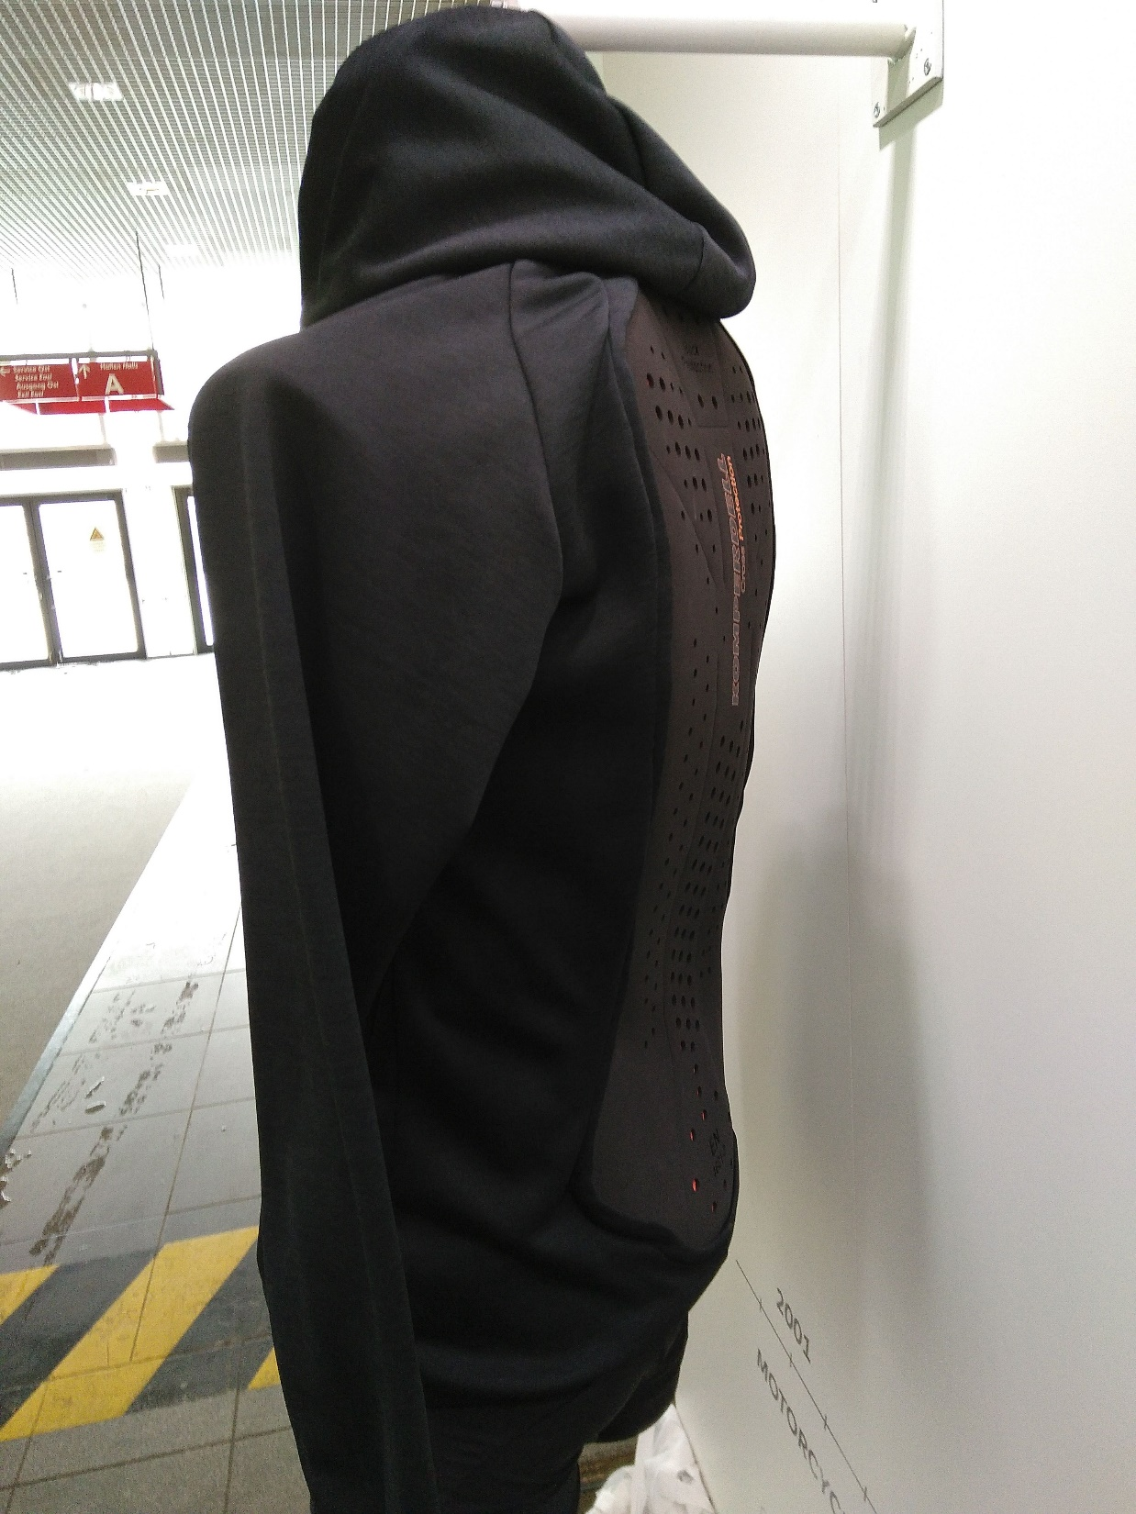
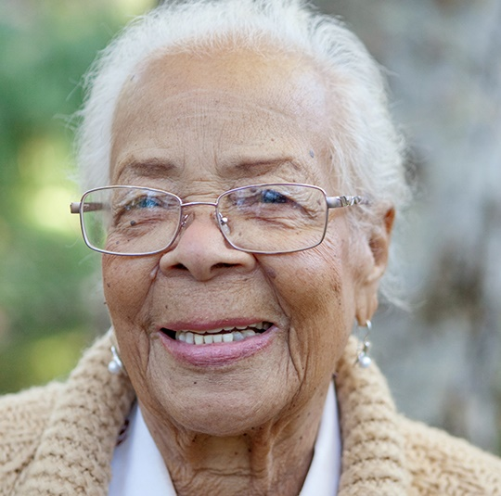
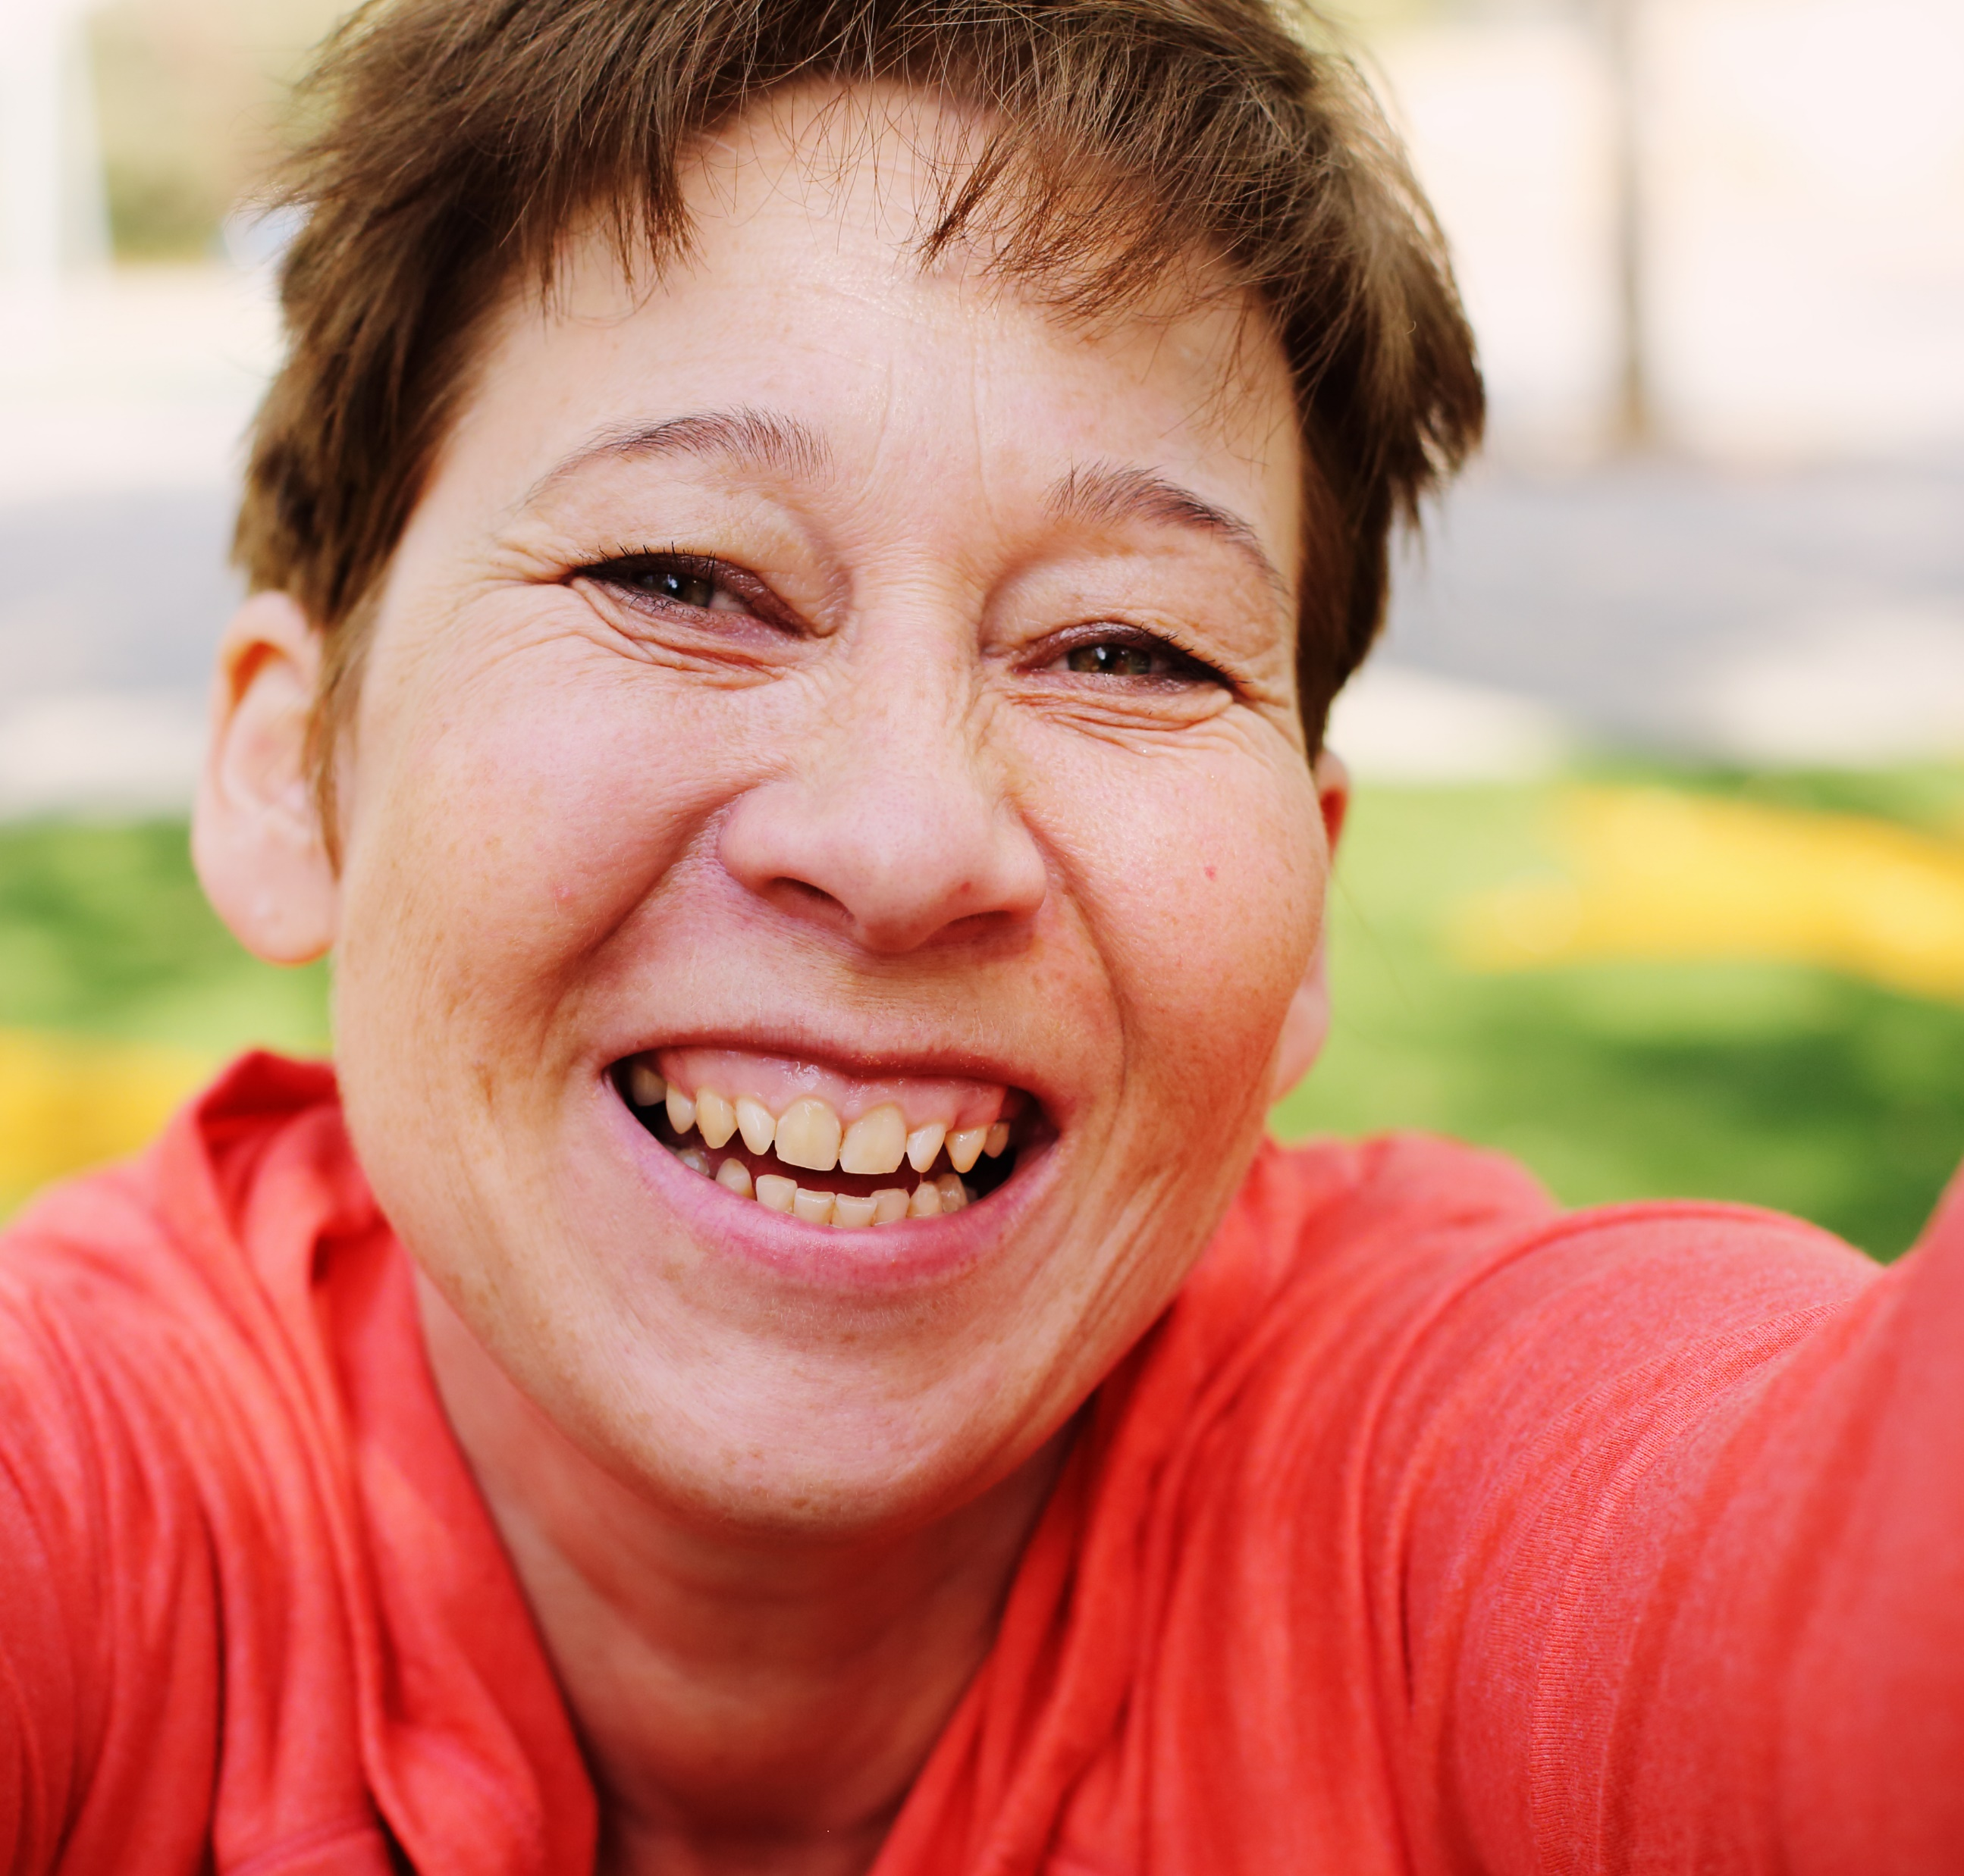
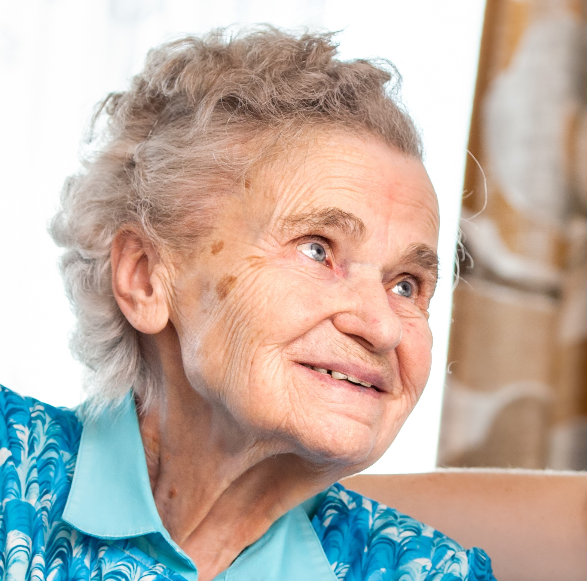
Liberation
Summing Up
Encore
Midlife Re-evaluation
?
Wendy
Greta
Emma
Nancy
Delores
Ages
10
20
30
40
50
60
70
80
90
100+
Notes:
However, the survey has helped to develop a rich collection of personas that represent women at different life stages, and reflect the trends identified through the analysis of the survey data. This overcame constraints relating to social distancing but was also a more holistic approach than relying only on focus group or interview data.
When mapping the personas against existing products or new hip protection concepts, we can ask, for example, how might Greta or Nancy’s needs differ from Emma’s? We may also explore how the visual language of other types of protective clothing, marketed towards younger users, could be appropriately diffused upwards towards older users at risk of falls. In doing so, we can ask how do we shift the perception of hip protectors from garments of dependency to garments of empowerment?

Slide 15
Thank you
Simon Andrews
PhD Researcher - 3D3 NPIF Studentship
Fashion & Textiles Institute
Falmouth University
simon.andrews@falmouth.ac.uk

