Slide 1
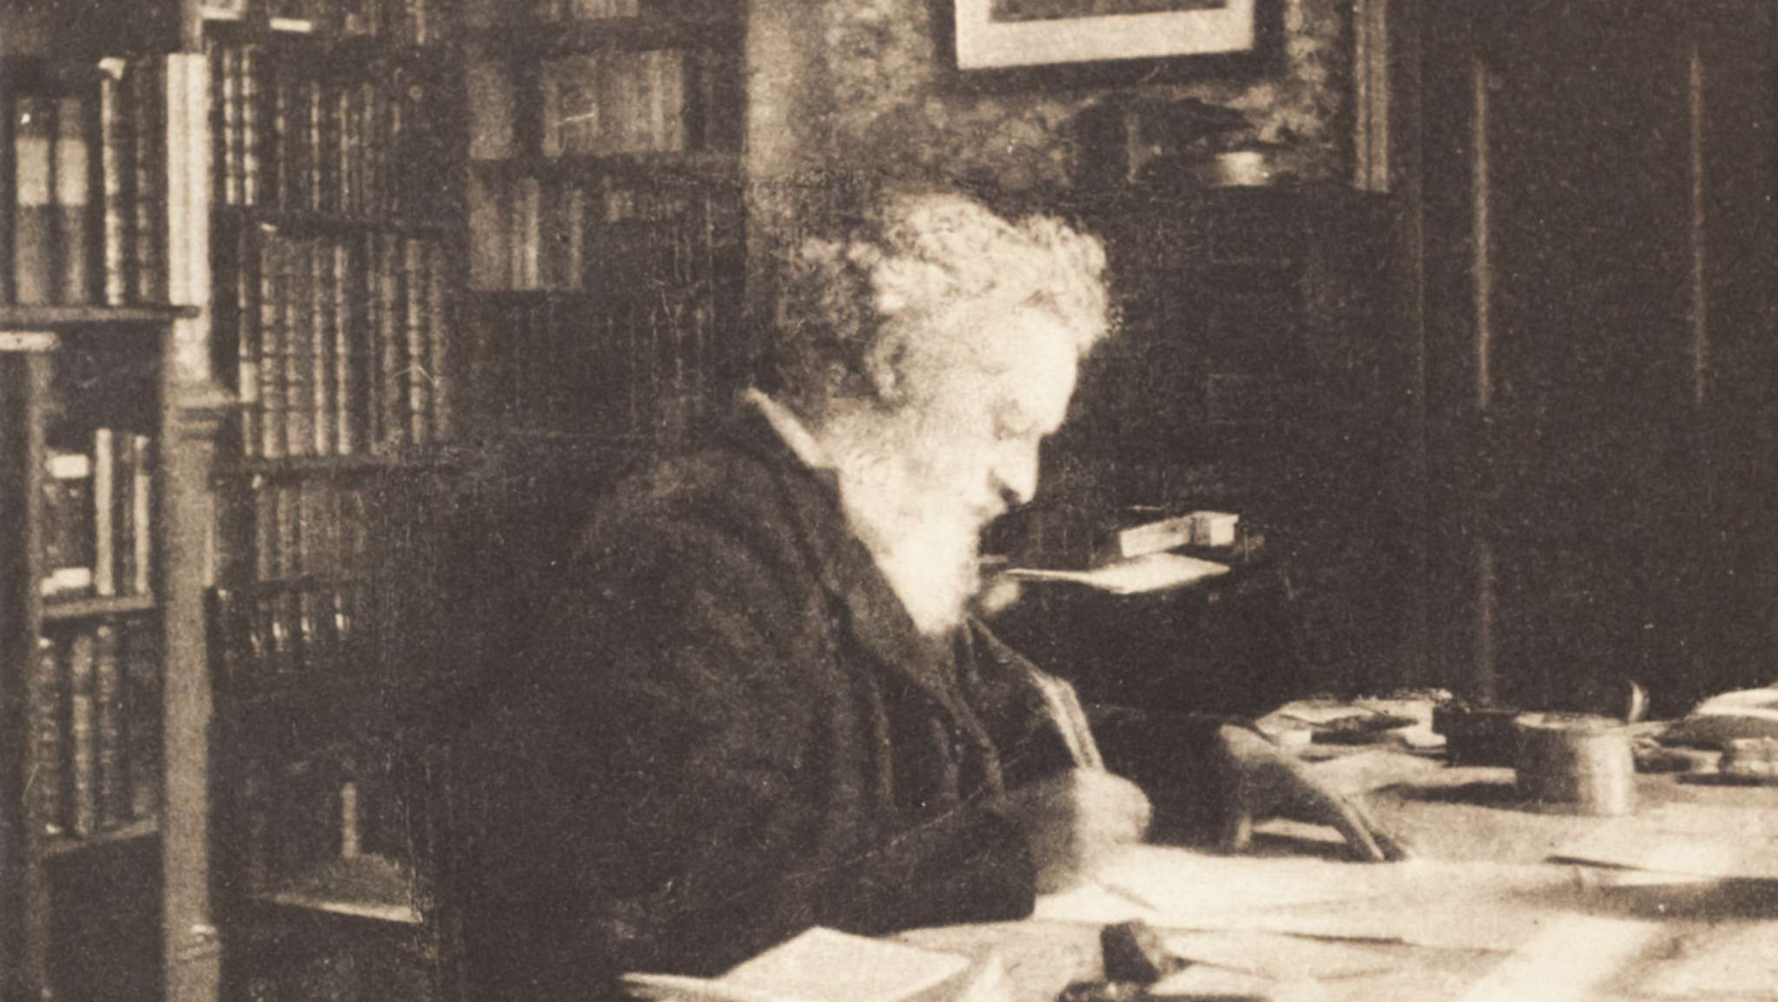
Artists and Libraries: Research for Creative Practice
Rosie Enys, Victoria Rees and Catherine Worrall
Academic Liaison Librarians, Falmouth University
William Morris in his library at Kelmscott House, Hammersmith, 1890s (b/w photo), British Photographer, (19th century) / William Morris Gallery, Walthamstow, UK / Photo © Stefano Baldini / Bridgeman Images

Slide 2
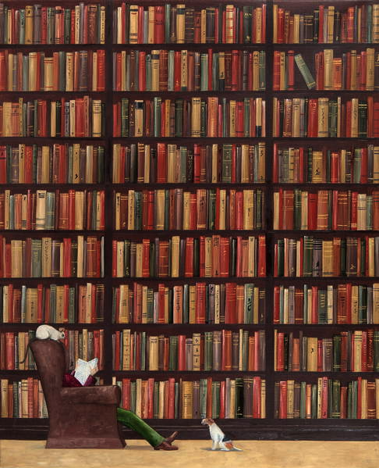
Context: a research disconnect
Creation and delivery of a session 'Research for Creative Practice'
For students at Falmouth University
Disconnect between 'research' and practice-based assignments
Discomfort in library spaces, both physical and digital
Do Not Disturb, 2010 (oil on linen), Campbell, Rebecca / Private Collection / © Rebecca Campbell. All Rights Reserved 2023 / Bridgeman Images

Slide 3
Why the disconnect?
Part of a programme of 'Bitesized' sessions
Open to all
Delivered online
Library associated with written assignments
Library not a space connected with practice
Unrealised value of research to creative practice
Students not recognising they already research!

Slide 4
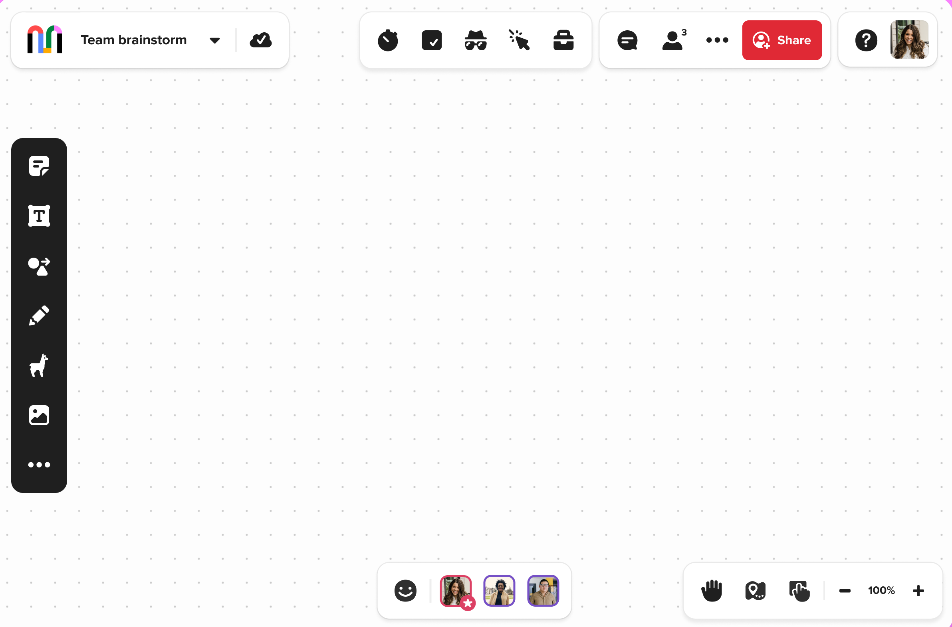
What tool?
Online teaching tool embraced during the pandemic
Intuitive digital whiteboard
Visually engaging digital space
Promotes interactivity

Slide 5
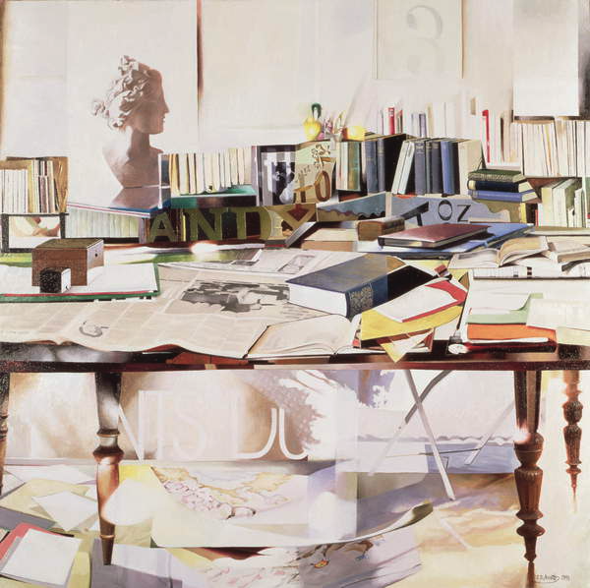
The Library as an inclusive space
A place to enhance and inspire creativity
Creativity and improvisation as transferable skills for research
Exploring and sharing collaboratively
Offered to both online and on-campus students
Reference, 1991 (oil on canvas), Annett, Jeremy / Private Collection / © Jeremy Annett. All Rights Reserved 2023 / Bridgeman Images

Slide 6
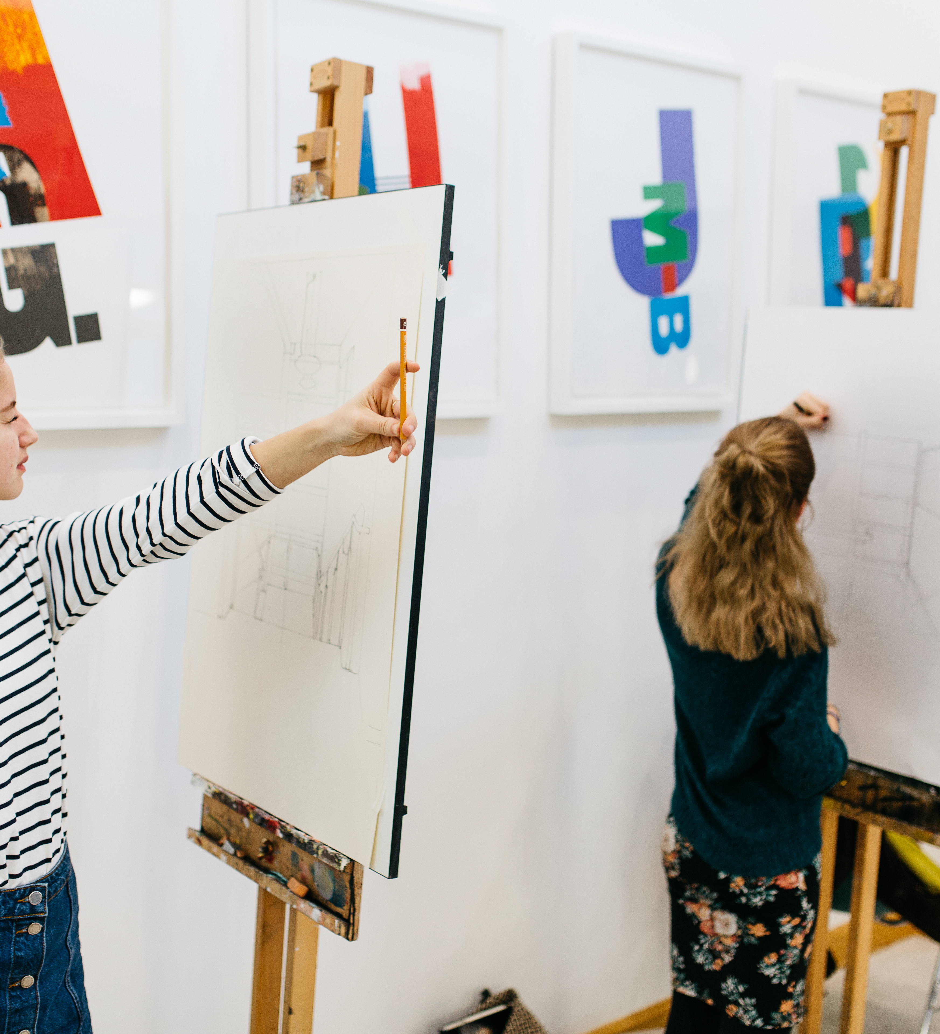
What do we mean by research for creative practice?
Research as IL/DL not Practice Research
Is it just to support the creation of a final piece of work?
Is it more than this?
How do students view it?

Slide 7
Session schedule
Piloted 4th March 2022 (Study Block 2)
2x in April, 1x November, 1x December 2022
1x January 2023
Continue sessions autumn 2023
Length – 50-60 mins

Slide 8
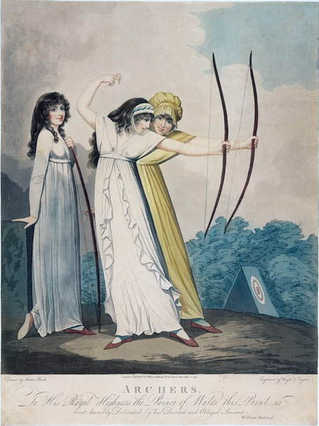
Session aims
To help students understand what research can bring to practice
To share ideas and strategies to support research for creative practice
To encourage confidence and enthusiasm for research
To illustrate tutors’ perspectives on research and practice
To offer a method of recording their research
Archers, engraved by J.H. Wright (fl.1795-1838) and Conrad Ziegler, 1799 (aquatint), Buck, Adam (1759-1833) (after) / Yale Center for British Art, Paul Mellon Collection, USA / Bridgeman Images

Slide 9
Mural session...
a video walk-through

Slide 11
Feedback
Voiced during the sessions - in conversation or using the Chat function
Feedback form shared at the end and sent via email

Slide 12
Feedback example
What aspect of the session was most useful to you?
"The entire session was excellent – worth getting up at 4am in California in the States for. I was worried about staying awake and no issue with that. It was engaging and so useful!"

Slide 13
Feedback example
What aspect of the session was most useful to you?
"I'm returning to education after 10+ years and have been a bit lost regarding research, the session really cleared up some fuzzy areas regarding what can be considered 'research' (especially within a creative field). The use of Mural to present was inspired, and I will definitely be using this is my own work going forward! All information was shared in a clear and concise way, and the interactive elements were relevant. Librarians are the best, thank you!"

Slide 14
Summary of replies...
More opportunities to write down thoughts
Representation of other types of creative practice
Request for longer session and more coverage of things like primary / visual research
More real examples – case studies
Is there anything else you would have liked from the session?

Slide 15
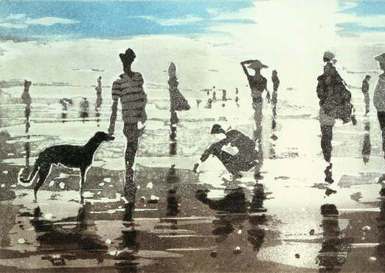
Reflections
Session evolving
Accessibility - neurodivergence
Personal reflections on the research process
Changing information landscape – generative AI
Appreciated and valued session
Kenneggy, Cornwall, 1988 (colour aquatint), Willis, Lucy / Private Collection / © Lucy Willis. All Rights Reserved 2023 / Bridgeman Images

Slide 16
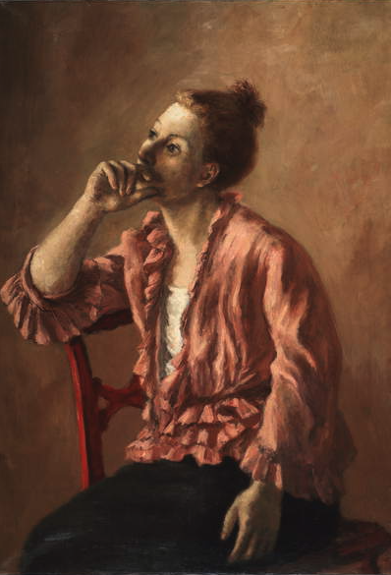
The future...?
Develop asynchronous content ​
Liaise with academics
Explore relationship between research (IL/DL) and Practice Research ​
Develop a secondary session ​(alternate modes of delivery)
Include employability attributes for the creative industries
Consider development for STEM subjects (Exeter courses)​
Sentimental Ideas (oil on canvas), Brook, Alexander (1898-1980) / Huntington Library, Art Museum, and Botanical Gardens, San Marino, CA, USA / © Huntington Art Collections / © Huntington Library, Art Museum, and Botanical Gardens / Bridgeman Images

Slide 17
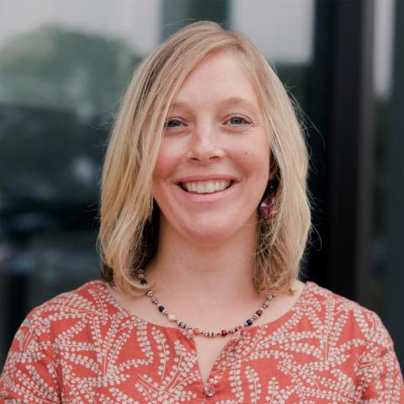
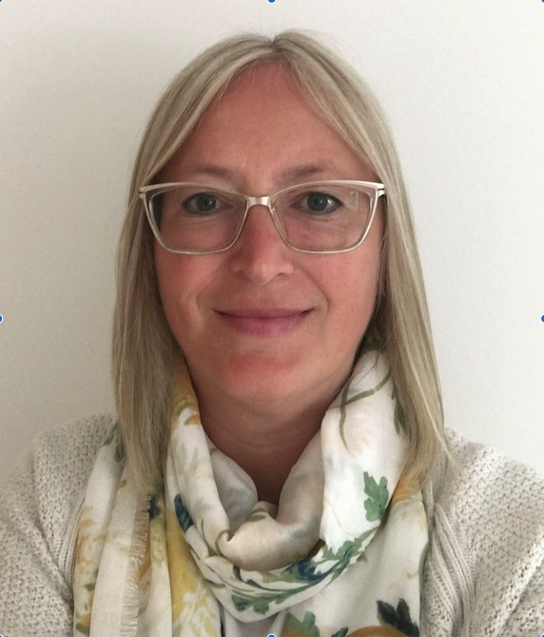
Contact us...
Rosie Enys
rosie.enys@fxplus.ac.uk
Victoria Rees ReesV5@cardiff.ac.uk
Catherine Worrall
catherine.worrall@fxplus.ac.uk
The Yellow Books, 1887 (oil on canvas), Gogh, Vincent van (1853-90) / Private Collection / Bridgeman Images

