Slide 1

Embedding study skills to improve student feedback and retention
Esther Cummins and Beth Sennett

Slide 2

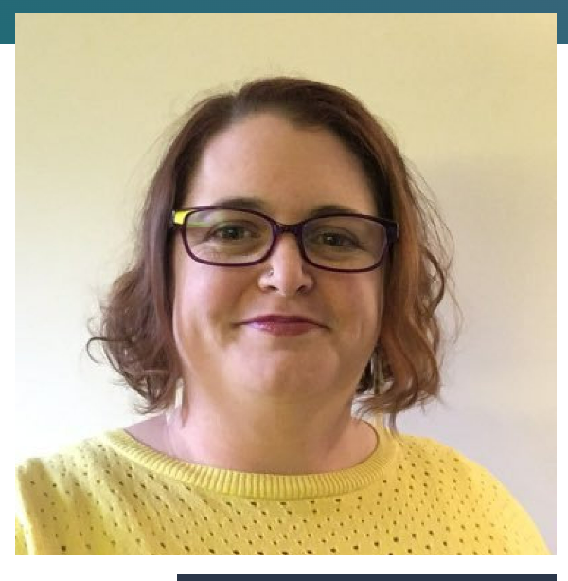
Who are we?
Esther Cummins
Course Leader MA Education (online)
Esther.cummins@falmouth.ac.uk
Beth Sennett
Learning Designer
Beth.sennett@falmouth.ac.uk

Slide 3

How complicated is it anyway?
Write a 1,000-word report on the preferred ice cream flavour of the UK population.
What skills would you need to do this?
Notes:
Lets think about that for a second – Imagine you have to write...

Slide 4



The Skills Chain
Note taking
Computer literacy
Research
Synthesizing
Paraphrasing
Reading
Understand a report
Comprehension

Slide 5

Inclusive Practice
Academic Success!
Fabian et al., 2022; Mortimore & Crozier, 2006)

Slide 6



Without these skills...
Feedback
Attainment
Retention
Fabian et al., 2022; Mortimore & Crozier, 2006)

Slide 7
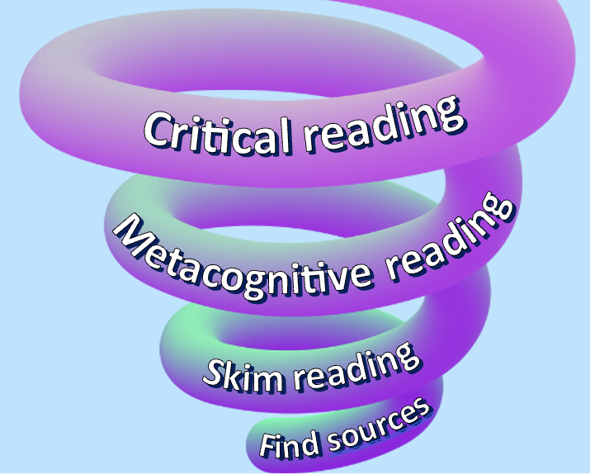
Spiral Curriculum
(Bruner, 2009)
Notes:
(Bruner, 2009)

Slide 8

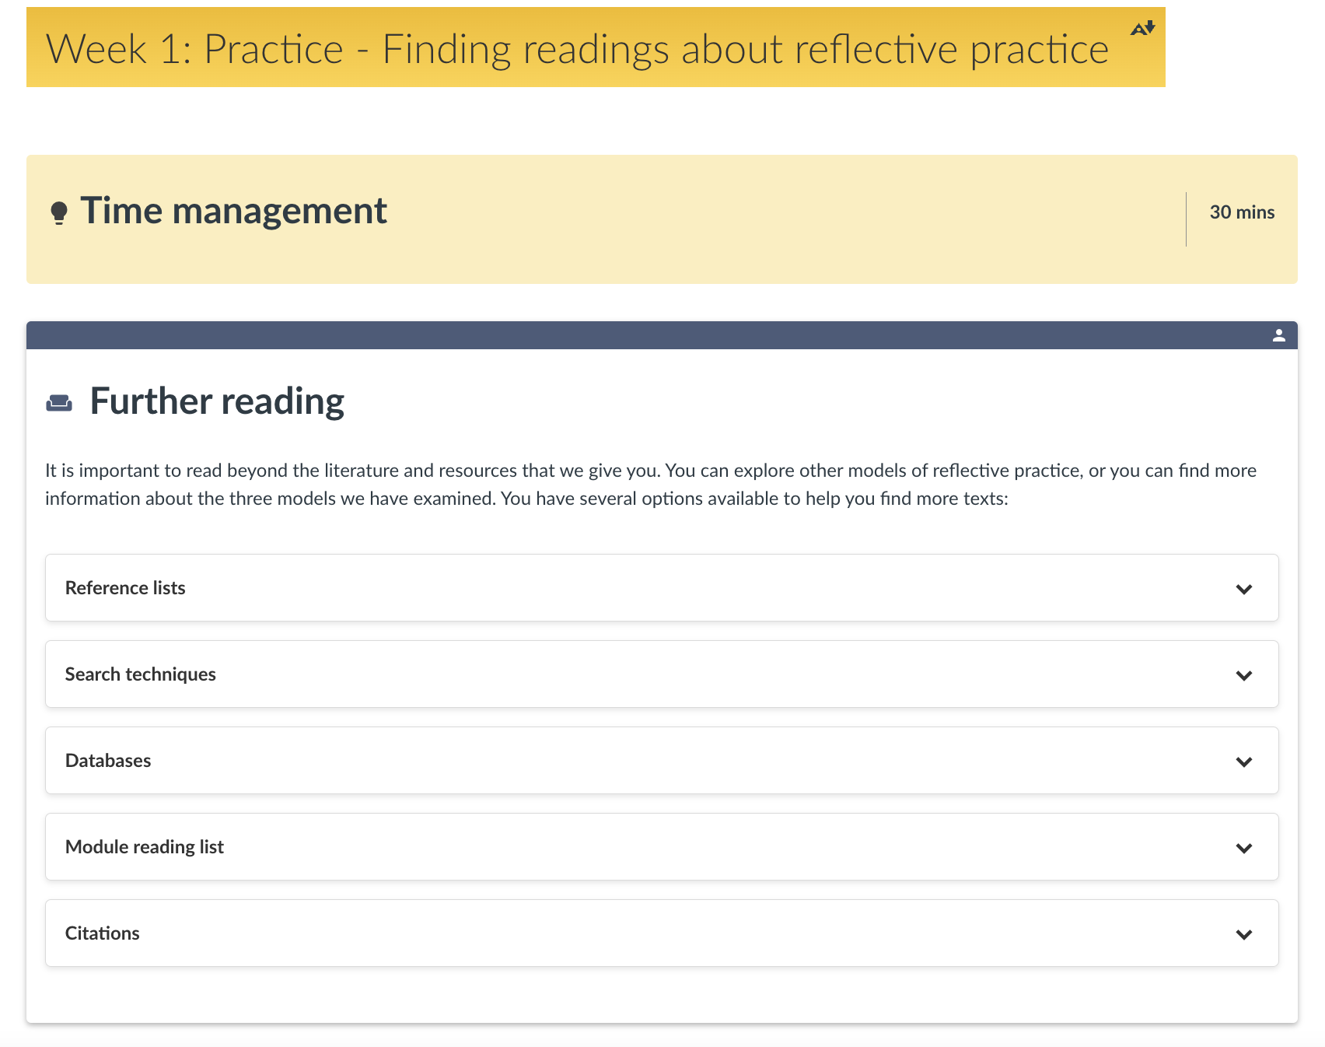
Examples from MA Education Online
It is important to read beyond the literature and resources that we give you. You can explore other models of reflective practice, or you can find more information about the three models we have examined. You have several options available to help you find more texts.
Notes:
This is a page from our MA Ed online
Research skills - Supporting students to find additional sources on REFLECTIVE PRACTICE
Drop down bars – we give students advice on how to do this

Slide 9
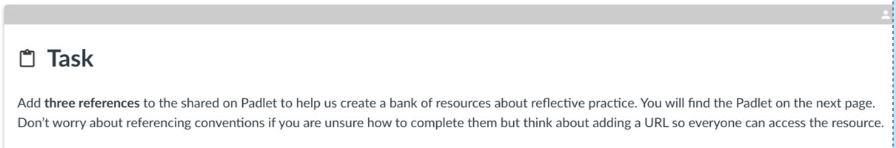
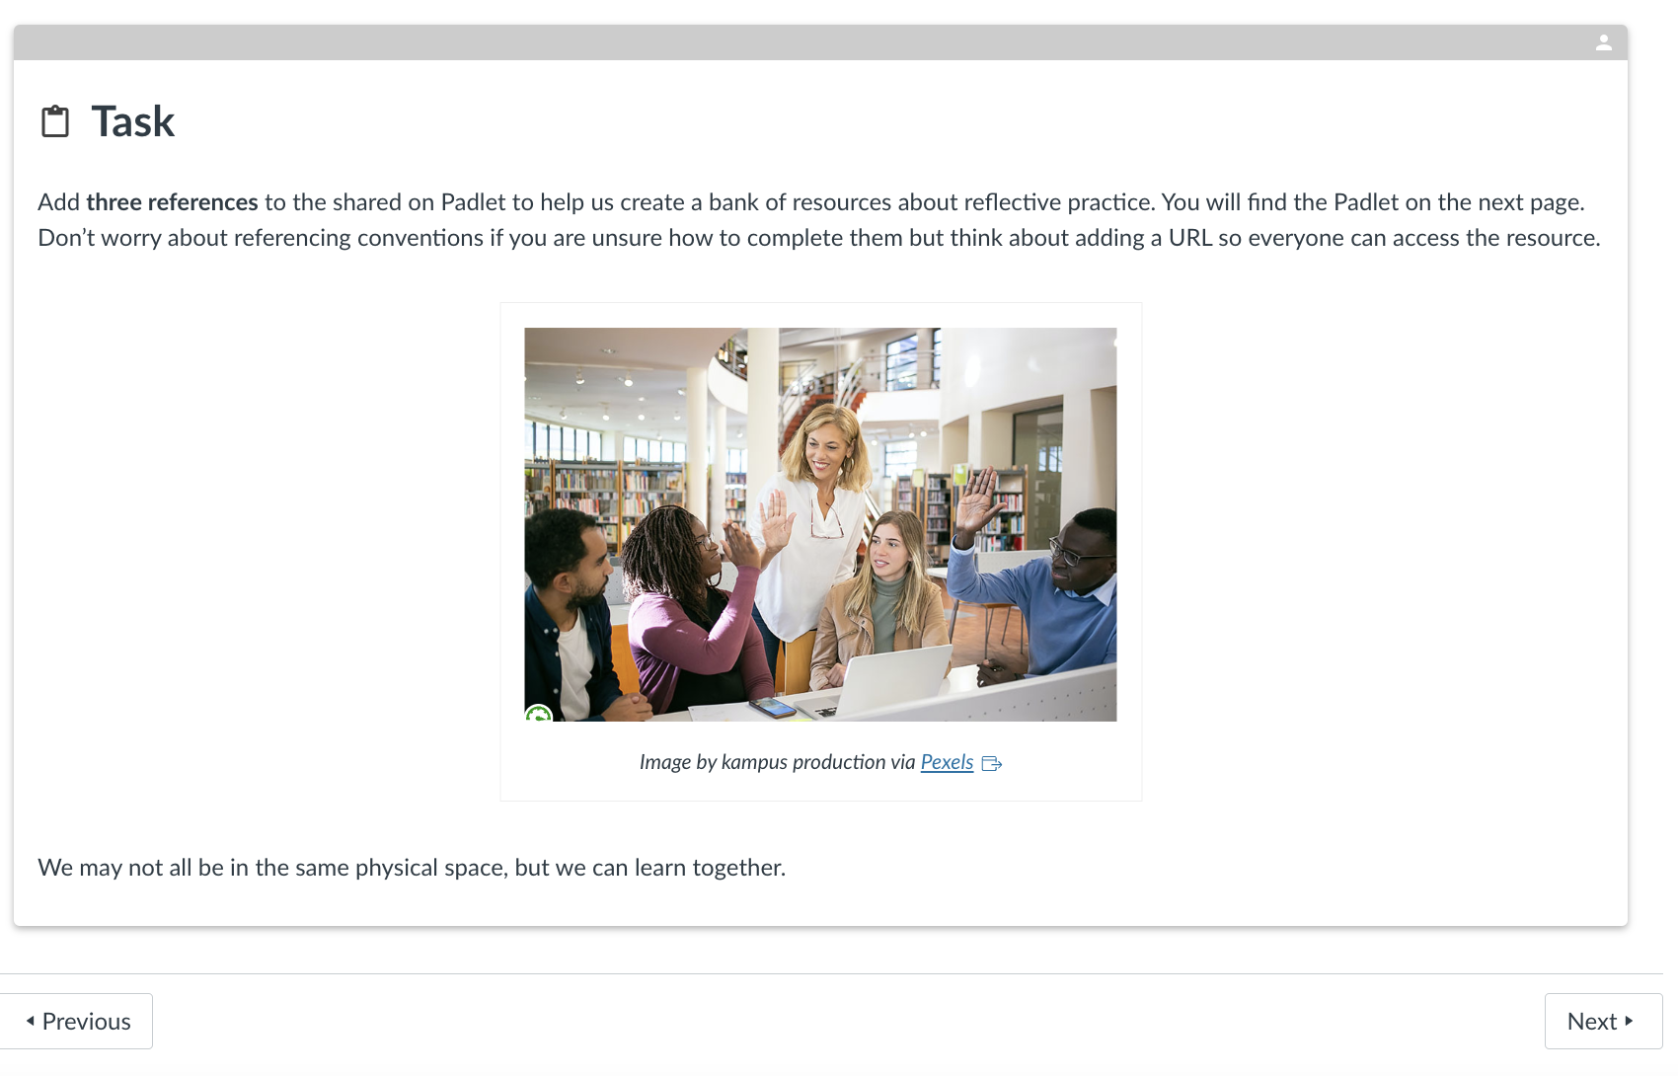
Examples from MA Education Online
Add three references to the shared Padlet to help us create a bank of resources. You will find the Padlet on the next page. Don't worry about referencing conventions if you are unsure how to complete them but think about adding a URL so everyone can access the resource.
Notes:
Sharing resources with each other

Slide 10
Mapping study skills to subject specific skills
Subject Specific Skills - Education Specialism
Week 1 | Who am I as a learner?
Week 2 | How do I learn?
Week 3 | How do I teach?
Week 4 | What is inclusive teaching and learning?
Week 5 | What does wellbeing look like in educational settings?
Week 6 | What does an inclusive curriculum look like?
Week 7 | Study week
Week 8 | What makes a good leader?
Week 9 | How do I lead projects?
Week 10 | What do I value?
Week 11 | What have I learnt?
Week 12 | Reflecting and evaluating
Academic Skills
Week 1 | Finding academic literature
Week 2 | Reading critically
Week 3 | Referencing using APA
Week 4 | Writing critical paragraphs
Week 5 | Writing critical paragraphs
Week 6 | Linking paragraphs and sections
Week 7 | Planning assignments
Week 8 | Defining concepts
Week 9 | Writing concisely
Week 10 | Writing against criteria
Week 11 | Writing a thesis statement
Week 12 | Editing and proofreading
Notes:
When we were designing the MA – the required study skills were mapped to the subject specific skills each week.
e.g.
Week 1 – Who am I as a learner? - Finding academic literature on approaches to learning
Week 2 – Reading critically
Week 4 – What is inclusive teaching (criticality) - Writing critical paragraphs.
The skill of writing is then revisited each week as students develop their critical paragraphs

Slide 11
Assessing your
study skills
 | Very confident | Confident | Neutral | Not confident | Really not confident
Note-taking
Finding literature
Reading literature
Citing literature
Paraphrasing
Referencing
Planning assignments
Time management
Critical thinking
Reflective thinking
Applying theory
Writing paragraphs
Working independently
Working digitally
Notes:
"...considering how student self-assessment of their study skills is central to the success of this approach"
self-assessment of your study skills.

Slide 12

Final thought...
"The act of study should not be measured by the number of pages read in one night or the quantity of books read in a semester. To study is not to consume ideas, but to create and re-create them."
(Freire, 1985)

Slide 13
References
Bruner, J. S. (2009).The process of education. Harvard university press.
Fabian, K., Smith, S., Taylor‐Smith, E., & Meharg, D. (2022). Identifying factors influencing study skills engagement and participation for online learners in higher education during COVID‐19.British Journal of Educational Technology,53(6), 1915-1936.
Freire, P. (1985) The Politics of Education: Culture, Power and Liberation. Trans by D. Macedo. London: Bergin & Garvey.
Mortimore, T., & Crozier, W. R. (2006). Dyslexia and difficulties with study skills in higher education.Studies in higher education,31(2), 235-251.

