Slide 1
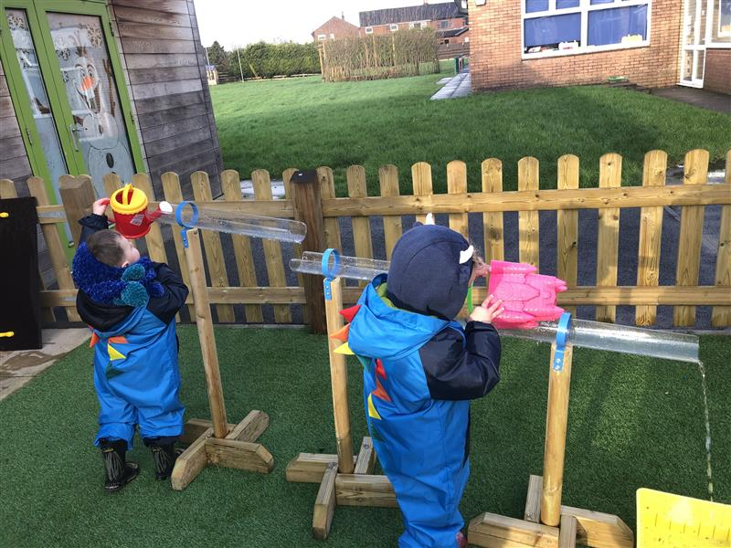
Can Early Years Principles Support Inclusion in HE?

Slide 2

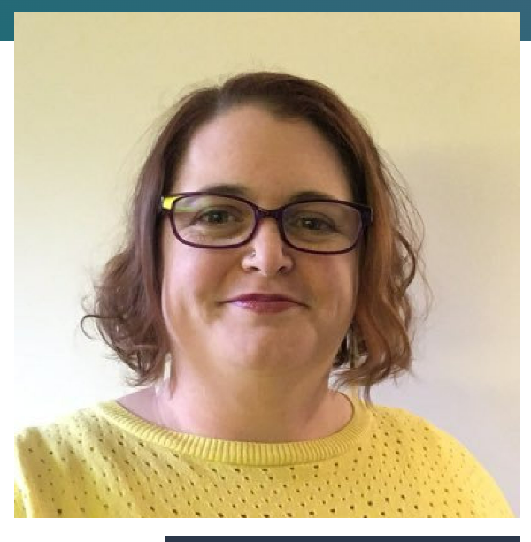
Who are we?
Previous Infant and EYFS Teachers
Esther Cummins
Course Leader MA Education (online) (
Esther.cummins@falmouth.ac.uk
Beth Sennett
Learning Designer & Specialist Study Skills Tutor
Beth.sennett@falmouth.ac.uk

Slide 3
Outline of Workshop
What are Early Years teaching principles?
Play
Active Learning
Critical & Creative Learning
Love

Slide 4
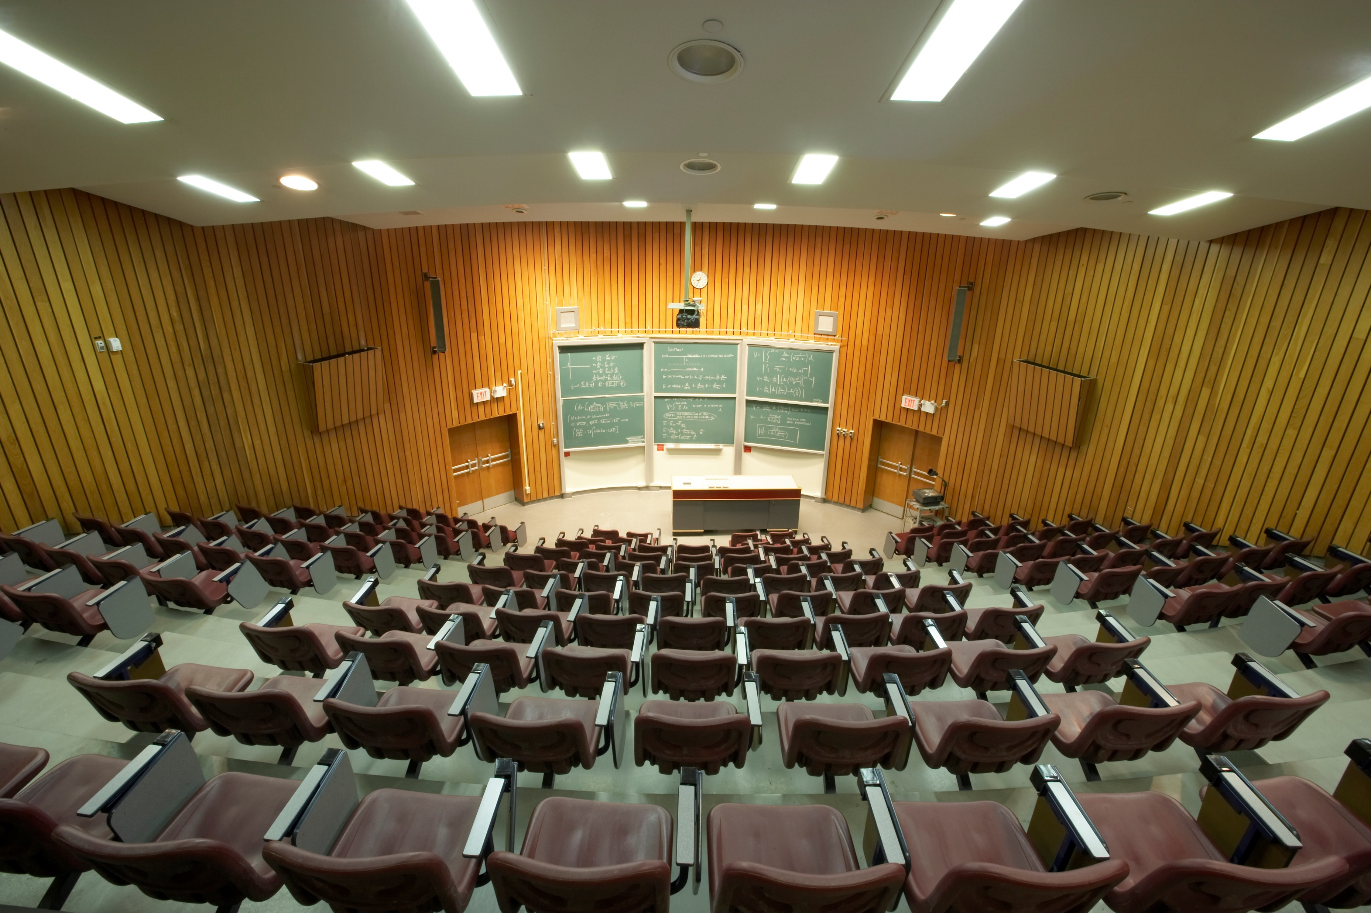

What are HE Teaching Principles?
Figure 1: Lecture Theatre
Notes:
https://falmouthuniversity.padlet.org/bethsennett5/can-early-years-principles-support-inclusion-in-he-nldt3mbgh67rfvxc

Slide 5
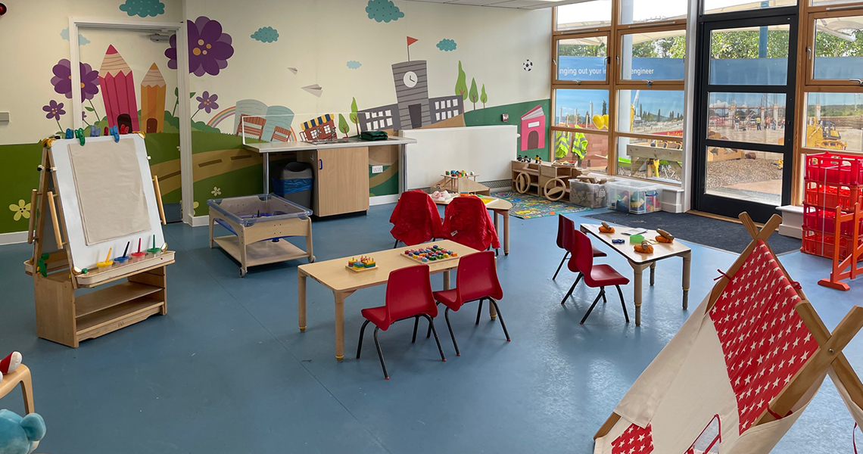
What are Early Years Teaching Principles?
Figure 2: Early Years Play and Development Centre in Ilford, London
Notes:
Https://www.redbridge.gov.uk/news/nov-2022/early-years-play-and-development-eypad-centre-opens-in-ilford/
https://falmouthuniversity.padlet.org/bethsennett5/can-early-years-principles-support-inclusion-in-he-nldt3mbgh67rfvxc

Slide 6
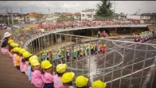
What are Early Years Teaching Principles?
Notes:
1.15 – 3.47
https://www.youtube.com/watch?v=J5jwEyDaR-0&t=17s

Slide 7
What are Early Years Teaching Principles?
Figure 2: Early Years Play and Development Centre in Ilford, London
Notes:
https://www.redbridge.gov.uk/news/nov-2022/early-years-play-and-development-eypad-centre-opens-in-ilford/

Slide 8
Pedagogy
EY Pedagogy
'science of teaching’ – A series of techniques.
consider the learning environment that enables play and exploration
Grimmer (2021)
Notes:
How is this different to HE?
Grimmer (2021)
In many areas of education, especially HE, pedagogy is viewed as something the teacher does, a series of techniques and approaches.
In EYs pedagogy includes the learning environments. If the teacher sets up the environment well, then they are free to walk around and facilitate or guide learning through questioning.
You CANNOT Lecture a 4 year old – As EY Teachers you need to be able to set up activities where chn discover things for themselves!

Slide 9
Play

Slide 10


Play in Early Years Education
playing and exploring:
children investigate and experience things, and ‘have a go’
Department for Education, 2021: 16
Notes:
The Statutory Framework for EYFS, highlights the importance of Play.

Slide 11
Why is play important?
Play
joy
Cognitive flexibility
Problem Solving
Social competence
Resilience
Adaptability
creativity
(Van Vleet & Feeney, 2015; Koeners and Francis, 2020)

Slide 12
Why is play important in HE?
Physical and mental resilience
Social intelligence
Cognitive flexibility and intellect.
(Koeners & Francis, 2020)

Slide 13
Why is play important?
“At their best, play and work, when integrated, make sense of our world and ourselves.”
“At their best, play and work, when integrated, make sense of our world and ourselves.”
(Brown & Vaughan, 2009)

Slide 14
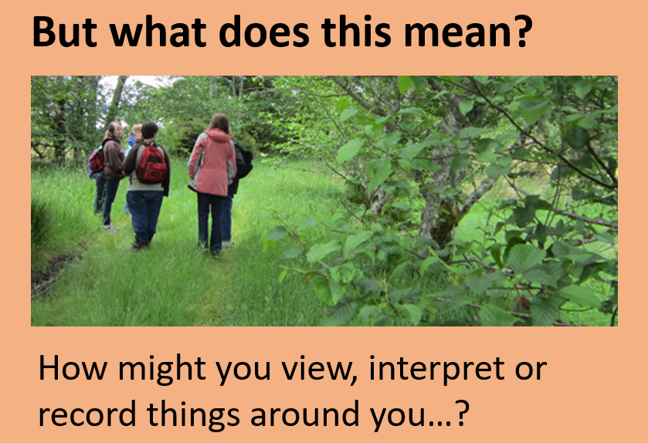
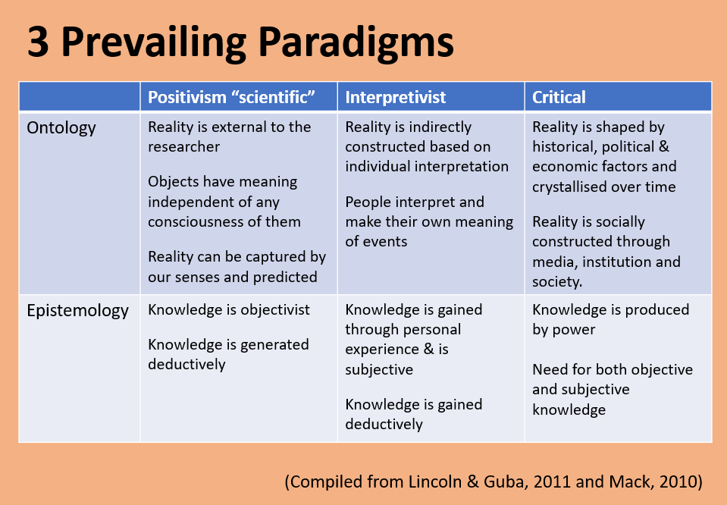
…but isn’t play ‘childish’?

Slide 15
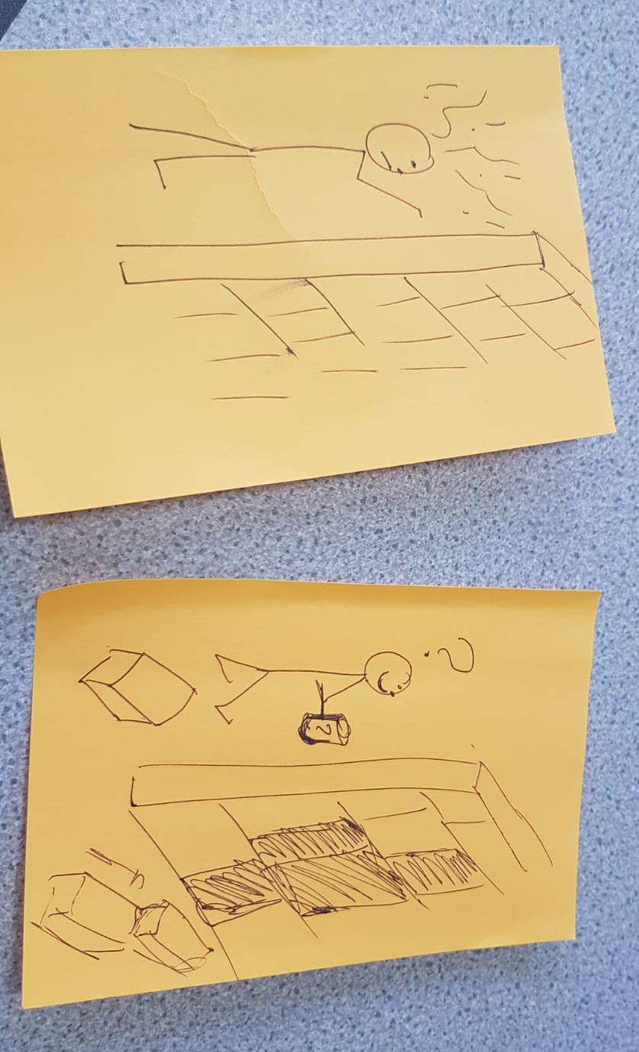
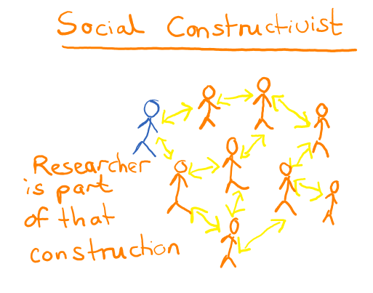
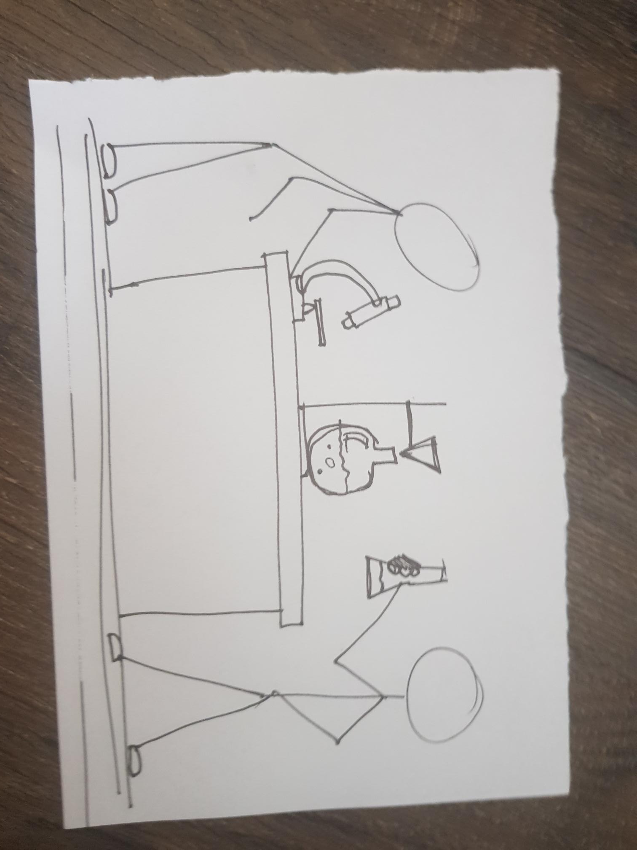
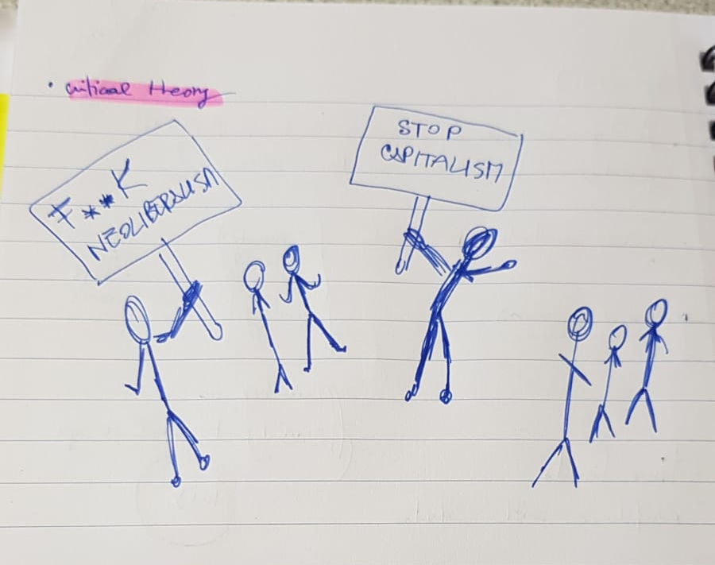
How do we play in HE?
Critical
Positivism
Social Constructivism
Notes:
Images show drawings of various ontologies and epistomologies
Point – You can have fun and play at any level!!!

Slide 16
How does play support inclusivity?
Supports the principles of Universal Design for Learning (UDL) – provides multiple ways of Engagement, Representation and Action & Expression (CAST, 2023)
If something is fun it increases dopamine, which aids concentration, mood and executive functioning (Hosenbocus & Chahal, 2012; Shaw et al., 2014)
Develops social skills and helps us understand the world around us (Koeners & Francis, 2020)
Storytelling is an important part of many cultures (Bisht, 2017)
Notes:
Bisht, P. (2017). Decolonizing futures: Exploring storytelling as a tool for inclusion in foresight.

Slide 17


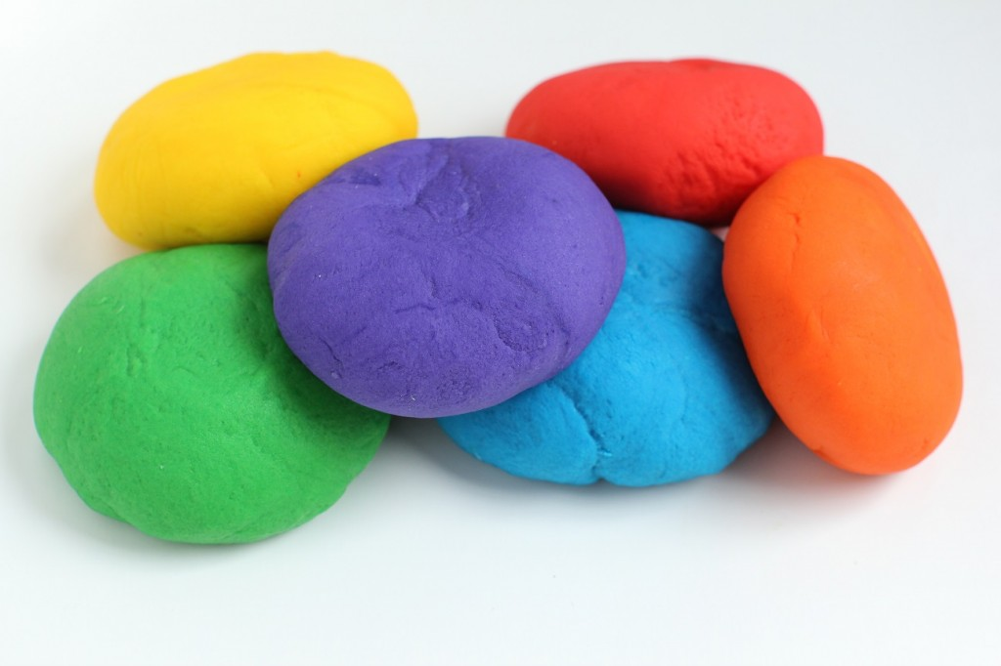
What other ways could we incorporate play into HE?
This Photo by Unknown Author is licensed under CC BY-NC-ND
Notes:
https://falmouthuniversity.padlet.org/bethsennett5/can-early-years-principles-support-inclusion-in-he-nldt3mbgh67rfvxc

Slide 18
Active Learning

Slide 19
Active Learning in Early Years Education
Active learning - children concentrate and keep on trying if they encounter
difficulties, and enjoy achievements
Department for Education, 2021: 16
Notes:
Based on Constructivist learning theory which emphasizes that individuals learn through building their own knowledge, connecting new ideas and experiences to existing knowledge and experiences to form new or enhanced understanding (Bransford et al., 1999).

Slide 20
What is active learning?
Active rather than passive
For example:
engaging in discussion rather than sitting and listening
Physically manipulating objects
(Messeyanni et al.,2018: xvii)
Notes:
We could see this in the kindergarten video at the beginning.

Slide 21
Why is active learning important?
Develops autonomy
Co-construction
Students are in control of their own learning
Students are involved in creating knowledge and ideas, rather than being told them.
Develops higher order thinking
Students have to critically engage with and apply knowledge
(Messeyanni et al.,2018; Mizokami, 2018)

Slide 22
bell hooks (2010)
“At their best, play and work, when integrated, make sense of our world and ourselves.”
“…in many ways the lecture is the teaching moment that most promotes passivity and discourages participation from learners.”
bell hooks (2010:64)

Slide 23
Making learning active in HE
Active Learning
Paired discussion during lectures
Polling tools for reflection
Offer choice
Case studies
Mind Map concepts
Sequencing processes
Different levels of challenge
(Brame, 2016)
Notes:
Brame, C. (2016). Active learning. Vanderbilt University Center for Teaching.
REMEMBER - Teachers don’t have to always be the ‘experts’, telling students everything – often teaching students to be researchers can make learning more active - discuss work with academics as a learning designer and encouraging them to let students do the research and to teach you.
EYSF teachers are good at this because (as anyone who is apparent will know) kids are great at coming up with questions we often don’t think about as adults e.g. why is the sky blue

Slide 24

Active learning: Differentiation & Scaffolding
Learner can do with guidance (ZPD)
"In planning and guiding what children learn, practitioners must reflect on the different rates at which children are developing and adjust their practice appropriately." (DfE, 2021)
Learner can do unaided
What do students need to know in order to understand what I’m about to teach them?
Learner cannot do
(Vygotsky, 1978)
Notes:
For students to become active learners with autonomy that we differentiate and scaffold the learning. No student is working at the same pace as everyone else.
Vygotsky, L. S. (1978). Mind in society: The development of higher psychological processes. Cambridge, MA: Harvard University Press.

Slide 25
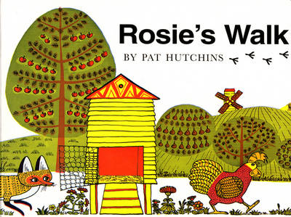
Active reading (or the ‘joy’ of reading)
"What texts teach is a process of discovery for readers, not a programme of instruction for teachers."
Meek, 1988: 19-20
Notes:
In early years education, reading is taught for pleasure. Children will ‘read’ and tell stories through more than just decoding the words. In EYFS, stories come to life through images, discussion, questions, re-telling stories, re-inventing stories.
In HE – students often think reading is simply decoding.

Slide 26

Active reading
"The act of study should not be measured by the number of pages read in one night or the quantity of books read in a semester. To study is not to consume ideas, but to create and re-create them."
(Freire, 1985)

Slide 27


What other ways could we incorporate active learning into HE?
Notes:
e.g.
https://falmouthuniversity.padlet.org/bethsennett5/can-early-years-principles-support-inclusion-in-he-nldt3mbgh67rfvxc

Slide 28
Creative and Critical thinking

Slide 29
Creative & Critical Thinking in Early Years Education
creating and thinking critically - children have and develop their own ideas, make links between ideas, and develop strategies for doing things
Department for Education, 2021: 16

Slide 30

“children have and develop their own ideas”
Students as teachers
(Freire, 1970)
Notes:
Why is this important?
This means as teachers we ALSO need to be prepared to have our students TEACH US! To have them question our ideas.

Slide 31
“children have and develop their own ideas”
Students as teachers
“At their best, play and work, when integrated, make sense of our world and ourselves.”
“I cannot think for others or without others, nor can others think for me … it is only as [students] rethink their assumptions in action that they can change. Producing and acting upon their own ideas - not consuming those of others…”
(Freire, 1970:89)
Notes:
Why is this important?

Slide 32
Pedagogy
EY Pedagogy
'science of teaching’ – A series of techniques.
consider the learning environment that enables play and exploration
Grimmer (2021)

Slide 33
CT cannot be done through lecturing alone
“At their best, play and work, when integrated, make sense of our world and ourselves.”
“Whereas banking education anesthetizes and inhibits creative power, problem-posing education involves a constant unveiling of reality.”
(Freire, 1970: 62)
Notes:
Why is this important?

Slide 34
How do we enable critical and creative thinking in HE?
Enable authentic dialogue
Ask questions
Utilise opportunities for play
Encourage students to question themselves, others and you.
Consider what you want your students to explore, and then enable them to do this through asking questions
Provide opportunities for students to explore and experiment

Slide 35
How does critical and creative thinking support inclusivity?
Critical and creative thinking can be a strength for many previously marginalised neurodivergent students.
It can help all marginalised students to recognise and question the oppressive systems and structures they find themselves in (Freire, 1970, Ledwith, 2016)

Slide 36

What other ways could we incorporate more critical & creative thinking into HE?
Notes:
https://falmouthuniversity.padlet.org/bethsennett5/can-early-years-principles-support-inclusion-in-he-nldt3mbgh67rfvxc

Slide 37
Love

Slide 38

Love in Early Years Teaching
Early Years pedagogy needs to consider the need for the caring and loving aspect of the teacher's role (Grimmer, 2021)
Notes:
It is mentioned multiple times in the statutory guidance
Although Grimmer points out that the word 'love' was removed from the EYFS guidance in 2012
In HE, we often shy away from this.

Slide 39
Love in HE
“Love in the classroom creates a foundation for learning that embraces and empowers everyone.”
(hooks, 2010:159)

Slide 40

Love in HE
“If we refuse to make a place for emotional feelings in the classroom it does not change the reality that the presence of emotional energy over-determines the conditions where learning can occur.”
(hooks, 2010: 160)

Slide 41
bell hooks (1994:7)
"Excitement in higher education was viewed as potentially disruptive of the atmosphere of seriousness assumed to be essential to the learning process. To enter classroom settings in colleges and universities with the will to share the desire to encourage excitement, was to transgress. … Critical reflection on my experience as a student in unexciting classrooms enabled me not only to imagine that the classroom could be exciting but that this excitement could co-exist with and even stimulate serious intellectual and/or academic engagement."

Slide 42
References
Bisht, P. (2017). Decolonizing futures: Exploring storytelling as a tool for inclusion in foresight.
Brame, C. (2016). Active learning. Vanderbilt University Center for Teaching.
Brown, S. & Vaughan, C. (2009) Play: How it Shapes the Brain, Opens the Imagination, and Invigorates the Soul. Avery: New York.
CAST (2023) The UDL Guidelines. Available at: https://udlguidelines.cast.org/
Department for Education (2021) Statutory Framework for the Early Years Foundation Stage: Setting the standards for learning development and care for children from birth to five,
Freire, P. (1970) Pedagogy of the Oppressed. Trans by M. Ramos. Reprint, London: Penguin Books, 1996
Freire, P. (1985) The Politics of Education: Culture, Power and Liberation. Trans by D. Macedo. London: Bergin & Garvey.

Slide 43
References
Grimmer , T. (2021) Developing a Loving Pedagogy in the Early Years: How love fits with professional practice, Routledge
hooks, b, (1994). Teaching To Transgress. Oxon: Routledge.
hooks, b, (2010) Critical Thinking Practical Wisdom. New York: Routledge
Meek (1988) How Text Teach What Readers Learn, Gloustershire: The Thimble Press
Mizokami, K. (2018)Deep Active Learning from the Perspective of Active Learning Theory, Springer.
Hosenbocus S, Chahal R. (2012) A review of executive function deficits and pharmacological management in children and adolescents. J Can Acad Child Adolesc Psychiatry. (3):223-9. PMID: 22876270; PMCID: PMC3413474.

Slide 44
References
Koeners, M. P., & Francis, J. (2020). The physiology of play: Potential relevance for higher education. International Journal of Play, 9(1), 143-159.
Ledwith, M. (2016). Community Development in Action. Bristol: Policy Press.
Messeyanni et al (2018) Active Learning Strategies in Higher Education. Emerald Publishing: Bingley
Shaw P, Stringaris A, Nigg J, Leibenluft E. (2014) Emotion dysregulation in attention deficit hyperactivity disorder. Am J Psychiatry. 171(3), 276-93.
Vygotsky, L. S. (1978). Mind in society: The development of higher psychological processes. Cambridge, MA: Harvard University Press.

Slide 45
Images
Figure 1: Lecture Theatre. MS Stock Image
Figure 2: Early Years Play and Development Centre in Ilford, London. Available at: https://www.redbridge.gov.uk/news/nov-2022/early-years-play-and-development-eypad-centre-opens-in-ilford/

