Slide 1

Marcus Simmons
From internships to freelancing and beyond...

Slide 2
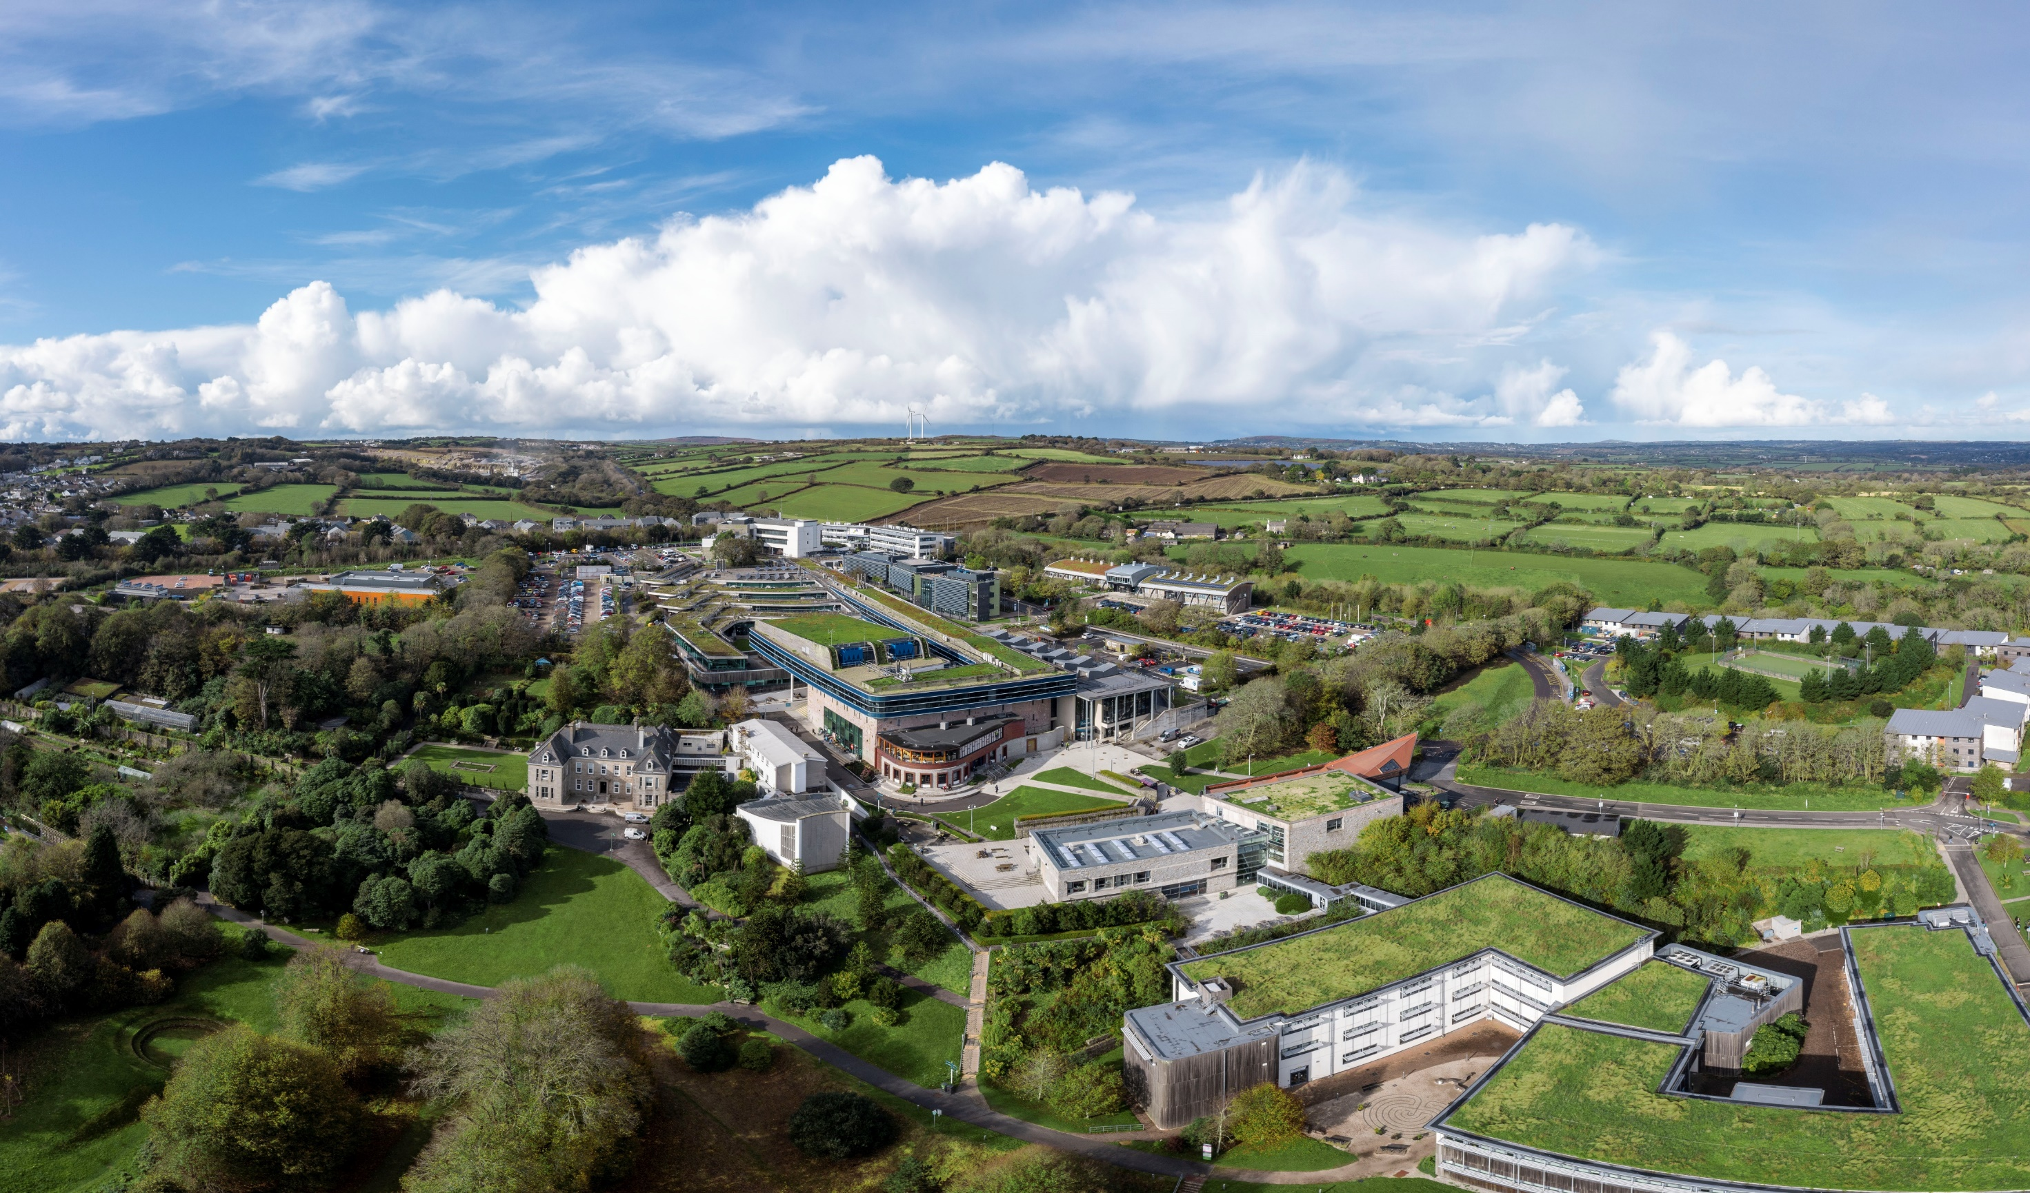
Falmouth University
Notes:
Falmouth pretty amazing place
- Creates more start-ups than most despite small 6k
- 6 years to 2020 >1,000 startups, most freelance
- Why is this? Because we are great EEs??
Image credit: Falmouth University

Slide 3
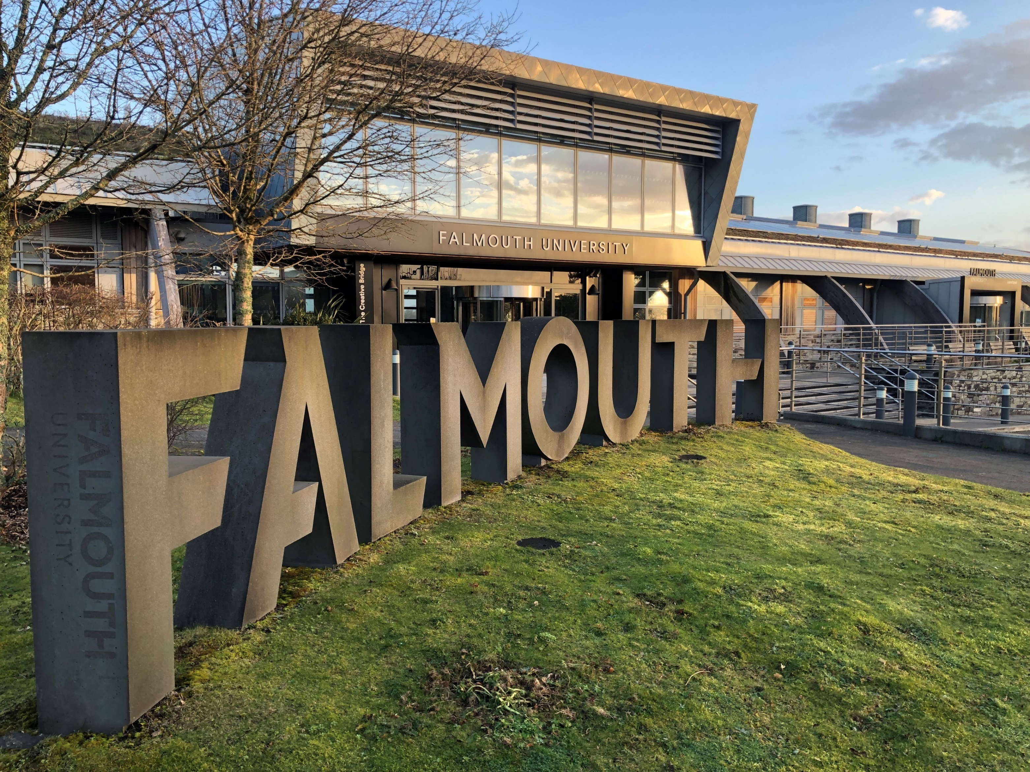
Falmouth Launchpad
Notes:
No. 1 Arts University
- Natural home for creative industries where freelancing is the norm.
- So for many students, freelancing is the expected outcome when they graduate
Image credit: Marcus Simmons

Slide 4
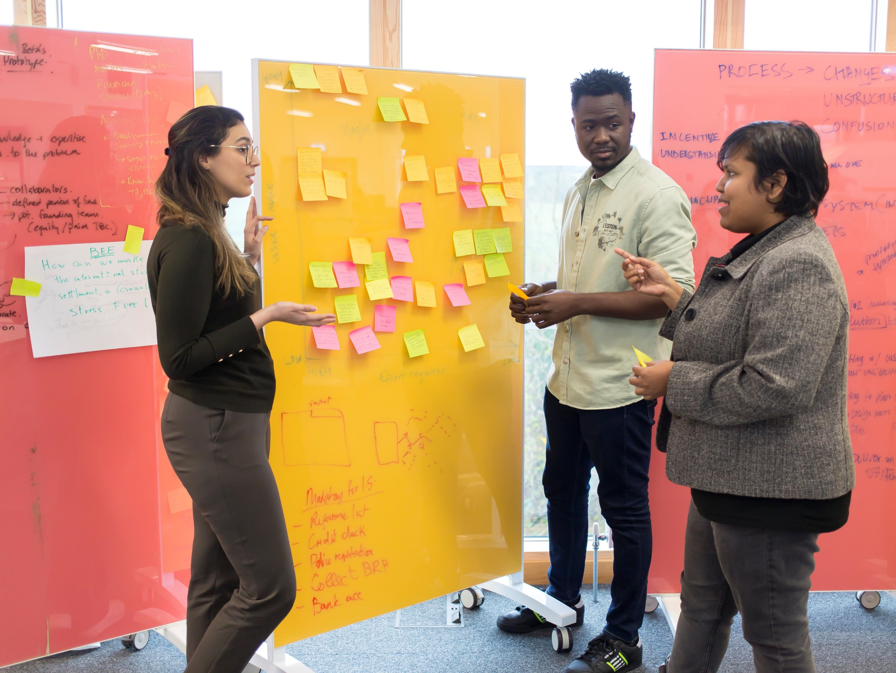
MSc Entrepreneurship & Launchpad
Notes:
Launchpad – business incubator –
- EU funded create new businesses & jobs
- 18 months: 63 New biz, 163 New jobs
- So, lots of businesses and lots of freelancers, but not in a joined up way
Image credit: Falmouth University

Slide 5
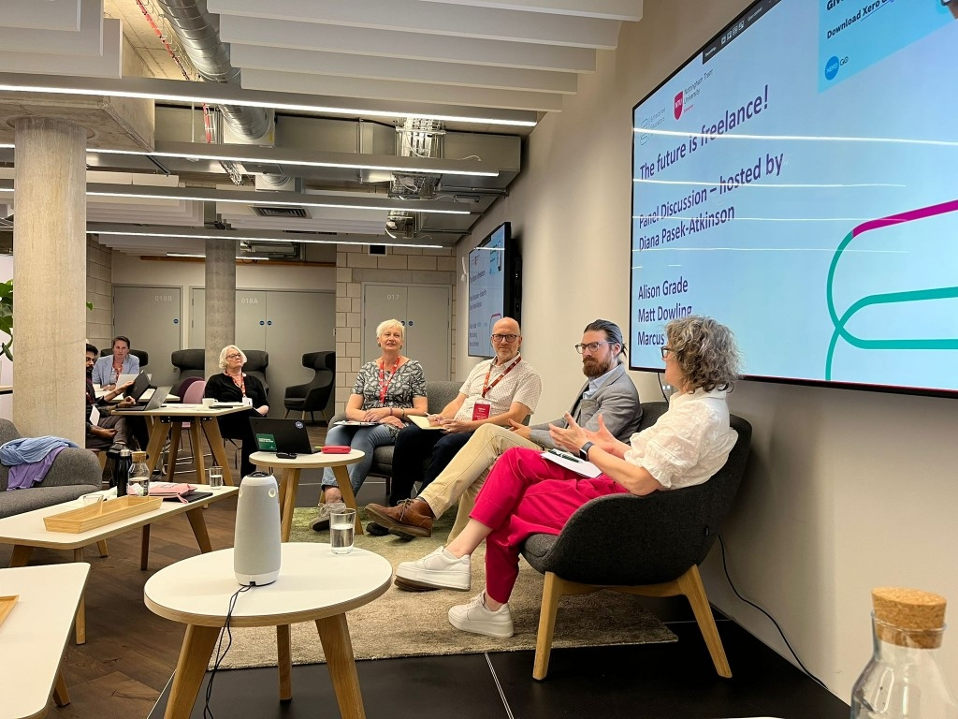
The Future is Freelance Event
Notes:
The Future is Freelance! EEUK in May 2023
>80% young dream of self-employment
most graduates think universities don’t preparing them properly for this
How can we prepare better – Do It For Real!
Photo credit: EEUK

Slide 6

The Freelance Fantasy
Notes:
TikTok & YouTube fantasy image of freelancing
Reality = many freelancers “fail” in first year,
- 'lack of business know-how'
- 'lack of industry contacts'
– boring stuff need to know, hard to engage
Image credit: shutterstock.com

Slide 7
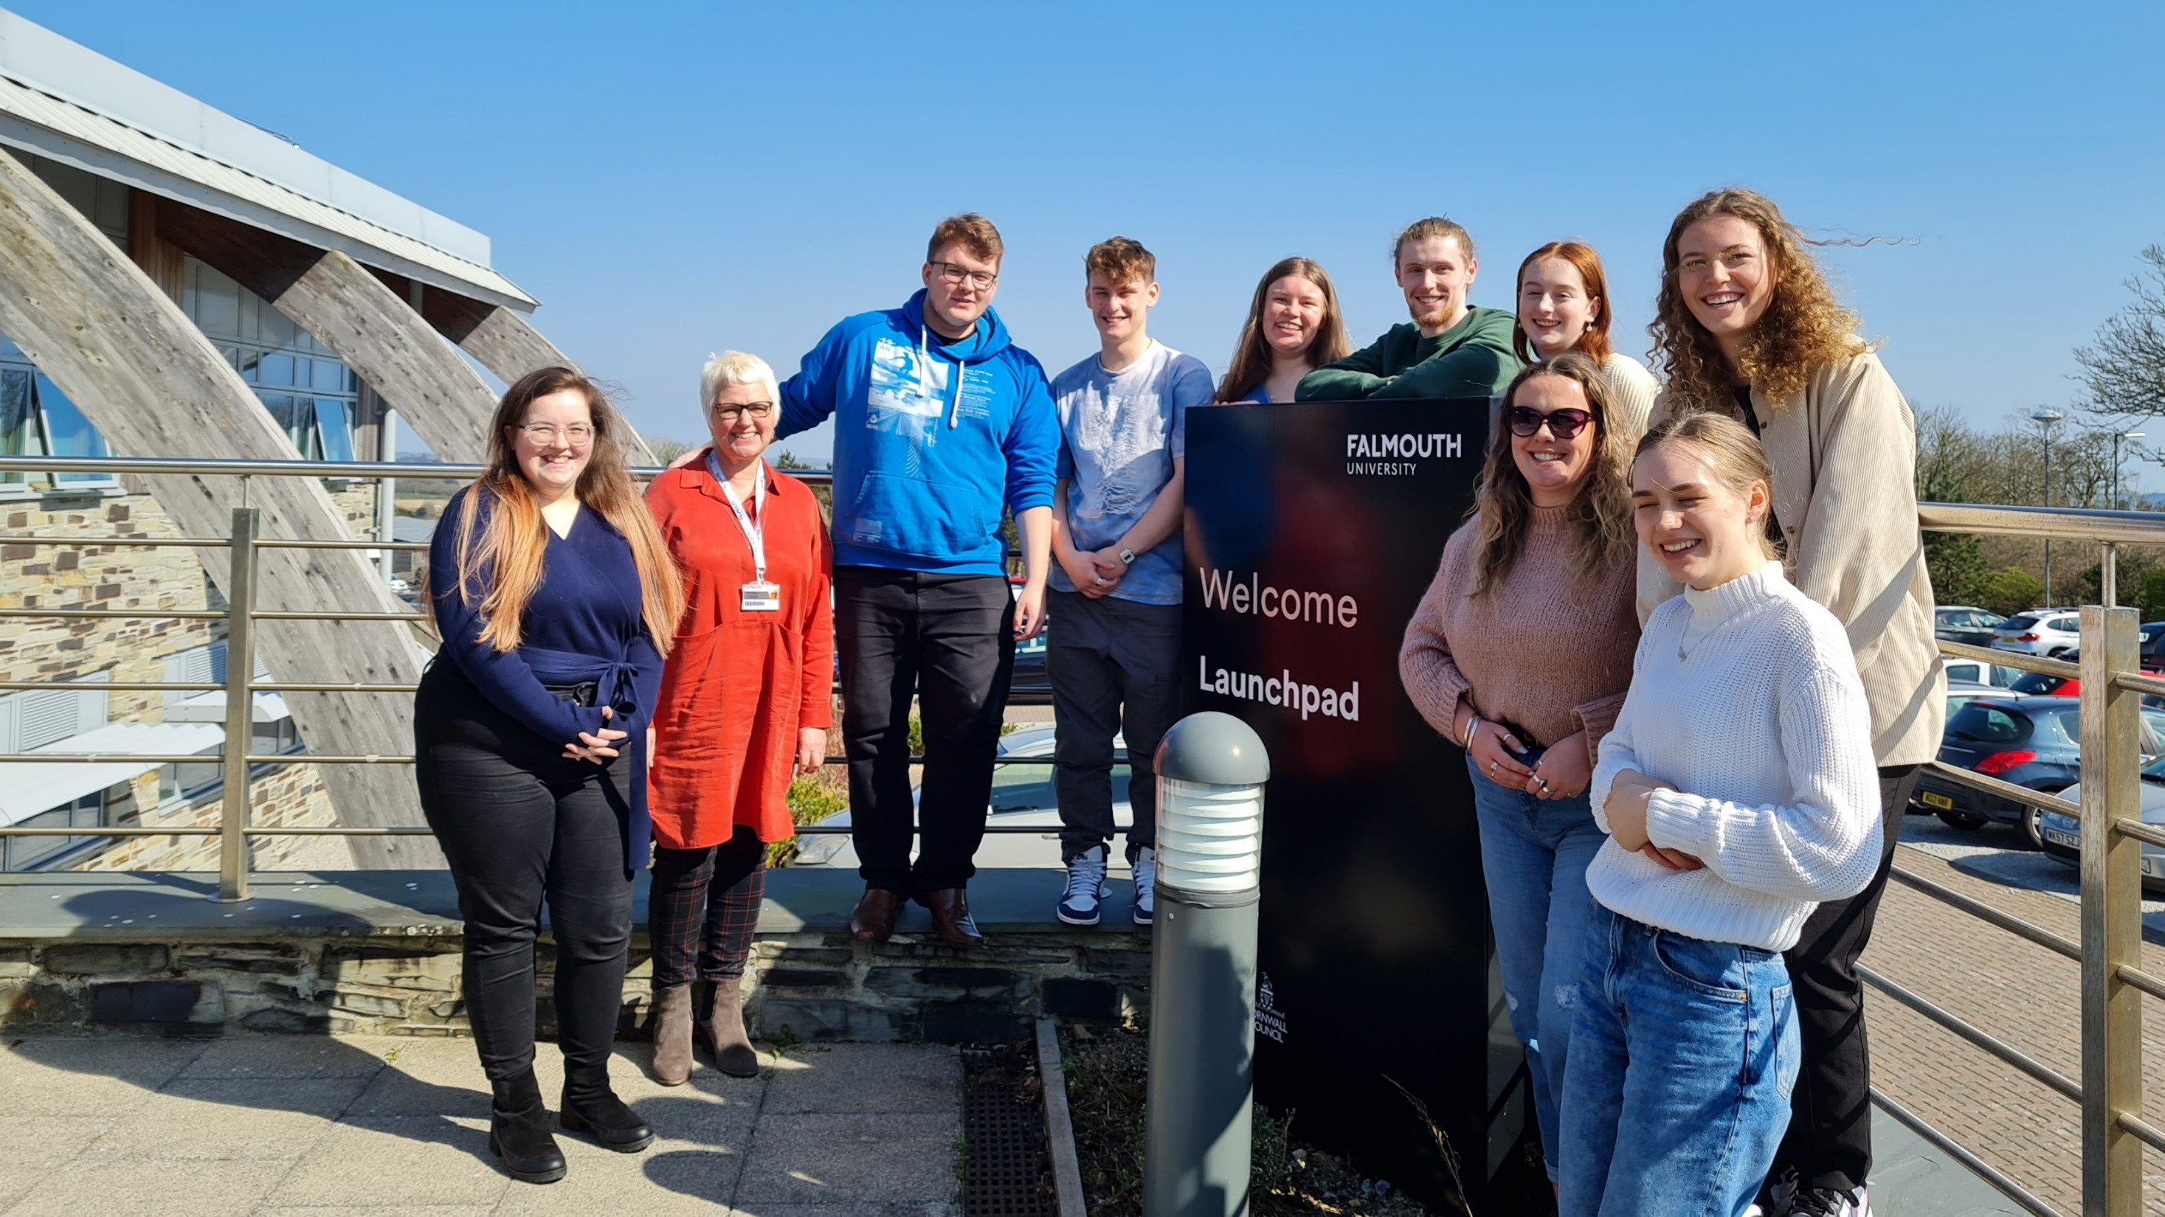
Internships
Notes:
Started engagement
Started a match-making service between UGs looking for internships and Launchpad startups - Aligning interest & skills with project needs.
Pilot showed great potential to accelerate startups & boost student skills and confidence
Image credit: Marcus Simmons

Slide 8
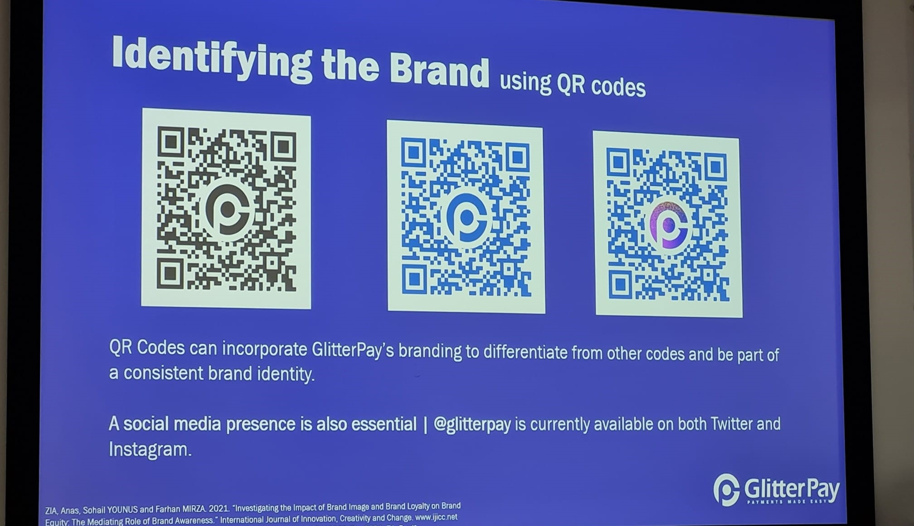
Internship Presentation
Notes:
Example of great work from interns
Businesses so pleased they hired freelance
Great results, but - small number of students
resource intensive
The question was then How to scale up?
Image credit: Marcus Simmons

Slide 9
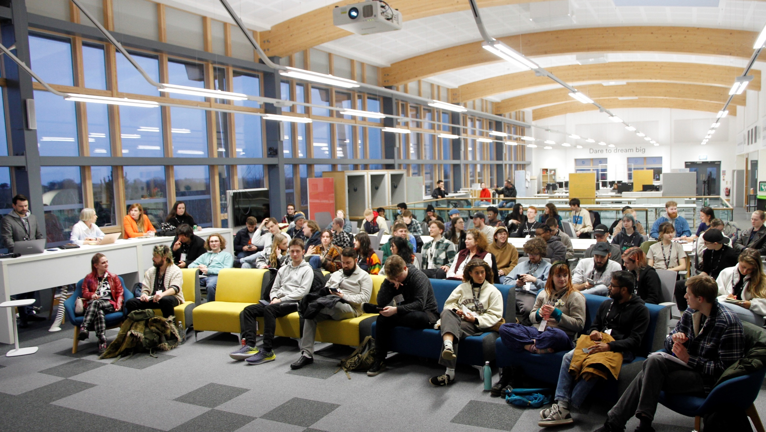
Freelance Extravaganza
Notes:
Freelance Extravaganza open to all students
Freelance projects by current & former LPs
1 = 50 2 = 74
“Freelancing” meeting “Entrepreneurship”
–far more engagement from students in “Freelancing” than “Entrepreneurship”
Image credit: Falmouth University

Slide 10
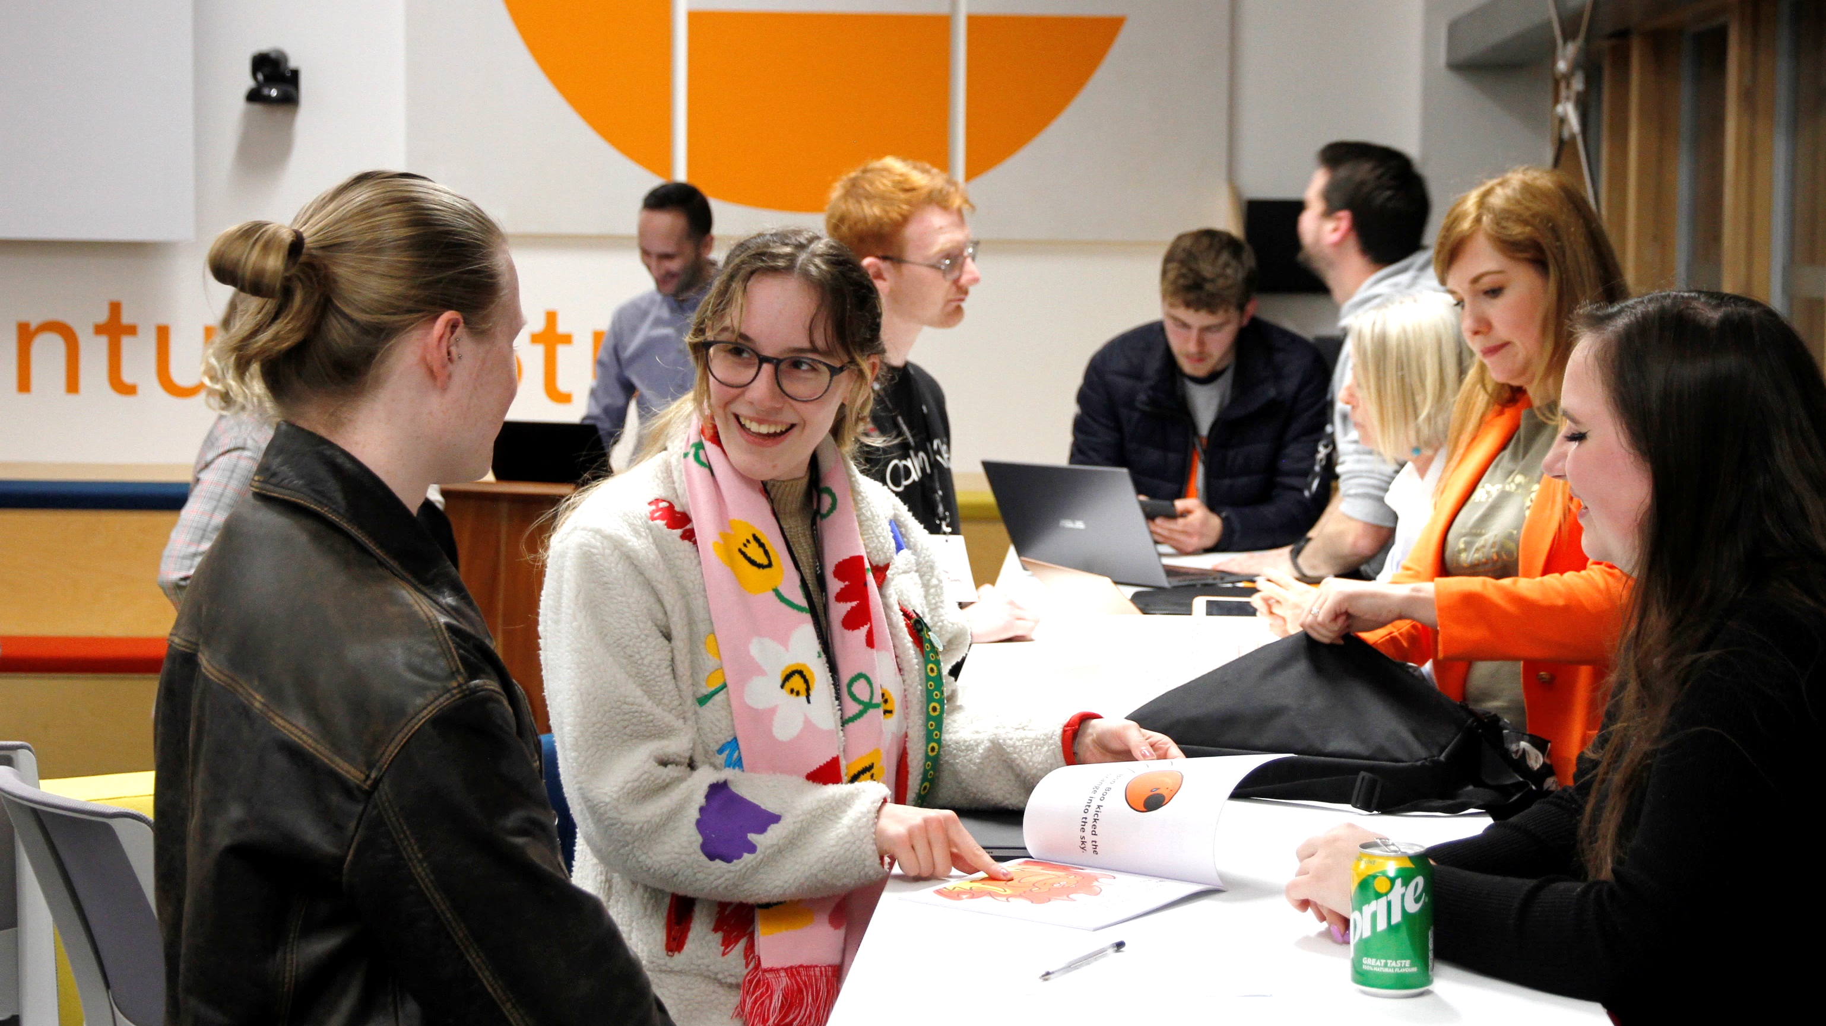
Students talking to startup founders
Notes:
After pitching, students talk to biz about the projects they were most interested in
Led to Approx 30 freelance projects
How did we get so many to attend?
Image credit: Marcus Simmons, Falmouth University

Slide 11
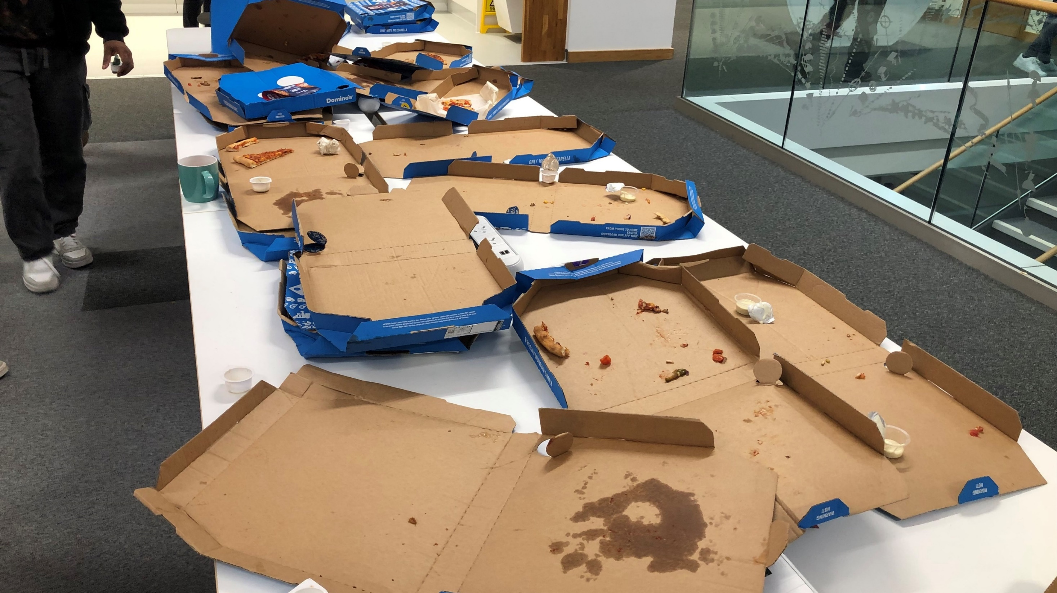
Freelance Pizza
Notes:
Pizza! + Communicating variety of channels.
Don’t mention Entrepreneurship
Need variety ways for students to engage in ways that works for them – more examples
Image credit: Marcus Simmons, Falmouth University

Slide 12
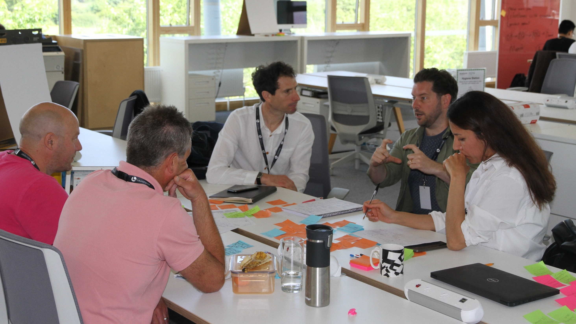
Techstars startup weekend
Notes:
2 x Techstars weekends
Great way to reach people inside & outside the University, highly recommended
Created freelance opportunities, new businesses and some extra PG students
Image credit: Marcus Simmons, Falmouth University

Slide 13
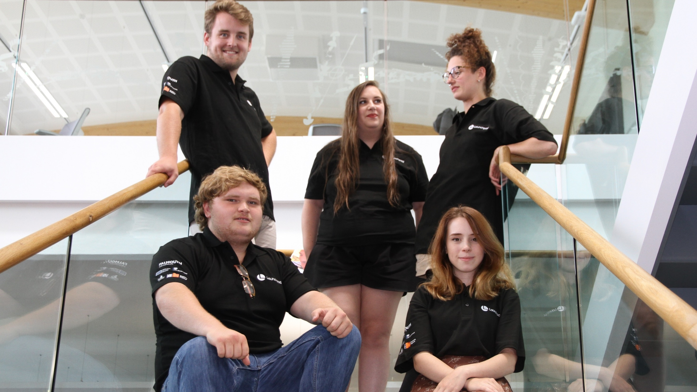
Business summer school
Notes:
6 week Summer School
–support to get business ideas off the ground
SIX students created FOUR Ltd companies
BUT FIRST, three Freelancers, who then formed two Ltd businesses
Image credit: Marcus Simmons, Falmouth University

Slide 14
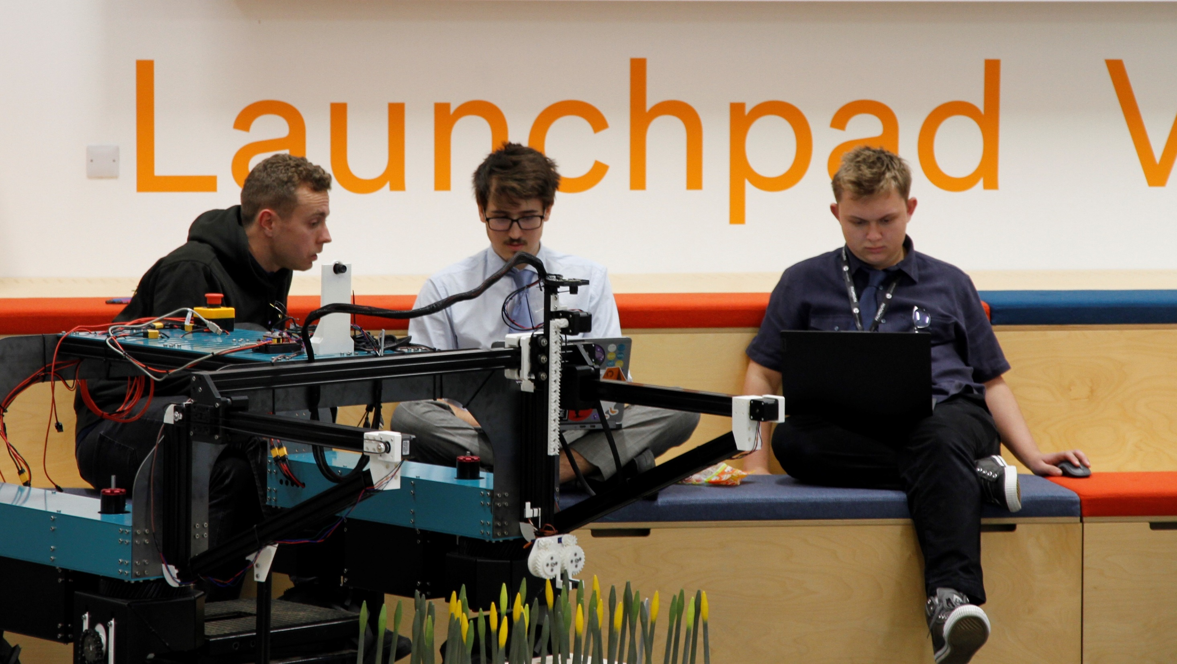
Agri-tech Hackathon
Notes:
Agri-tec Hackathon
3 freelancers to ONE incorporated Ltd Company
Created environment where students with different backgrounds & motivations make the right decisions for them
Image credit: Marcus Simmons, Falmouth University

Slide 15
Student Freelance Engagement
Activity | Date | Attendance | Unique Attendance
Micro-Internship 1 | March 2022 | 12 | 12
Micro-Internship 2 | Oct 2023 | 5 | 5
Freelance extravaganza 1 | Nov 2022 | 50 | 50
Freelance extravaganza 2 | Feb 2023 | 74 | 55
Freelance drop-ins | March – May 2023 | 29 | 6
TOTAL |  | 170 | 128
Notes:
Two freelance events created by far the greatest interest
Over 12 months we engaged with
128 individual students, 170 student engagements in total

Slide 16
Student Freelance Outcomes
Outcomes | Students | Percentage
Internships / Freelance Projects | 36 | 28%
Interested in incorporating | 29 | 23%
Engaged in support activity | 14 | 11%
Incorporated Freelancers | 11 | 9%
Started Ltd Companies | 6 | 5%
Ltd Companies | [3] | 2%
Notes:
Of the 128 individual students…
36 Paid internships or Freelance projects created
11 incorporated freelance businesses set up
6 into 3 Ltd companies

Slide 17
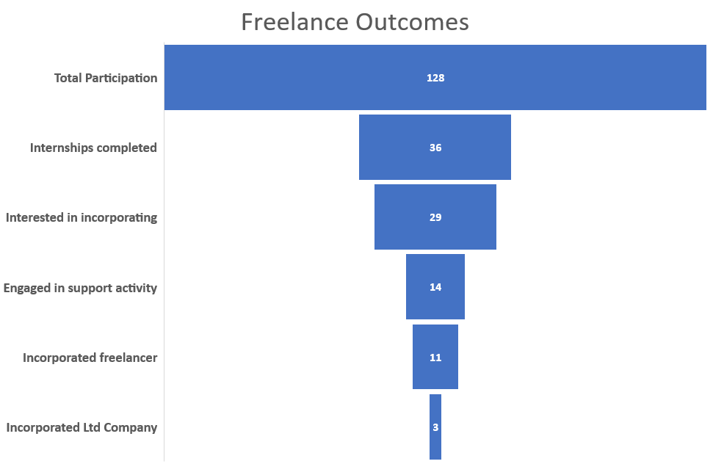
Outcomes as a Sales Funnel
Notes:
You could see these figures as a sales funnel
Cast the net wide and expect drop-off due to things like…
Timing for an individual student
Skills / project fit
- Academic calendar

Slide 18


Freelance vs Entrepreneurship identity
Notes:
Entrepreneurship has an identity problem
Typical Google - Freelance & Entrepreneur
Female v Male,
Solo v Team,
Informal v Serious
Ambitious freelancers often become entrepreneurs but don’t respond to the tag
Image credits: shutterstock.com

Slide 19

The Boring Stuff
Notes:
Freelancers DO need to know business basics…
Legal trading status, Accounts & invoicing, Sales, contracts & IP
- “The boring stuff”
Hard to teach in advance, better when they need the knowledge – then they really engage
Image credit: Shutterstock

Slide 20
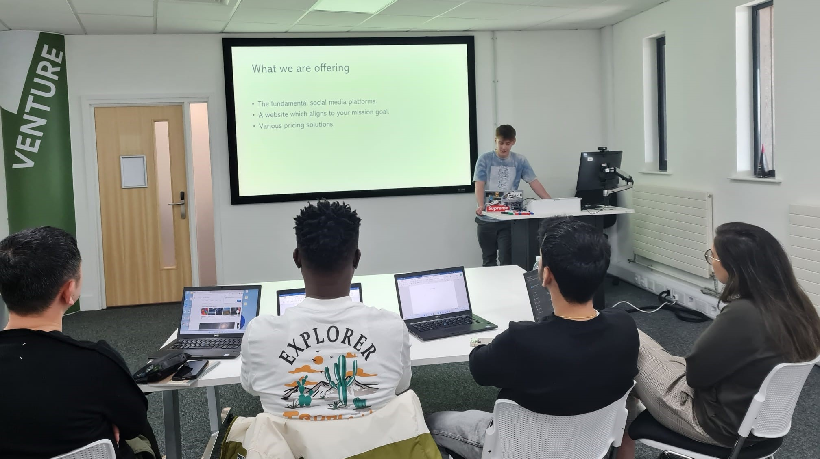
Intern Project Presentation
Notes:
Reality of freelance is adding value to clients
Very important for students to experience this
Internship student presenting to startup clients
A fantastic & inspiring learning experience
Image credit: Marcus Simmons, Falmouth University

Slide 21
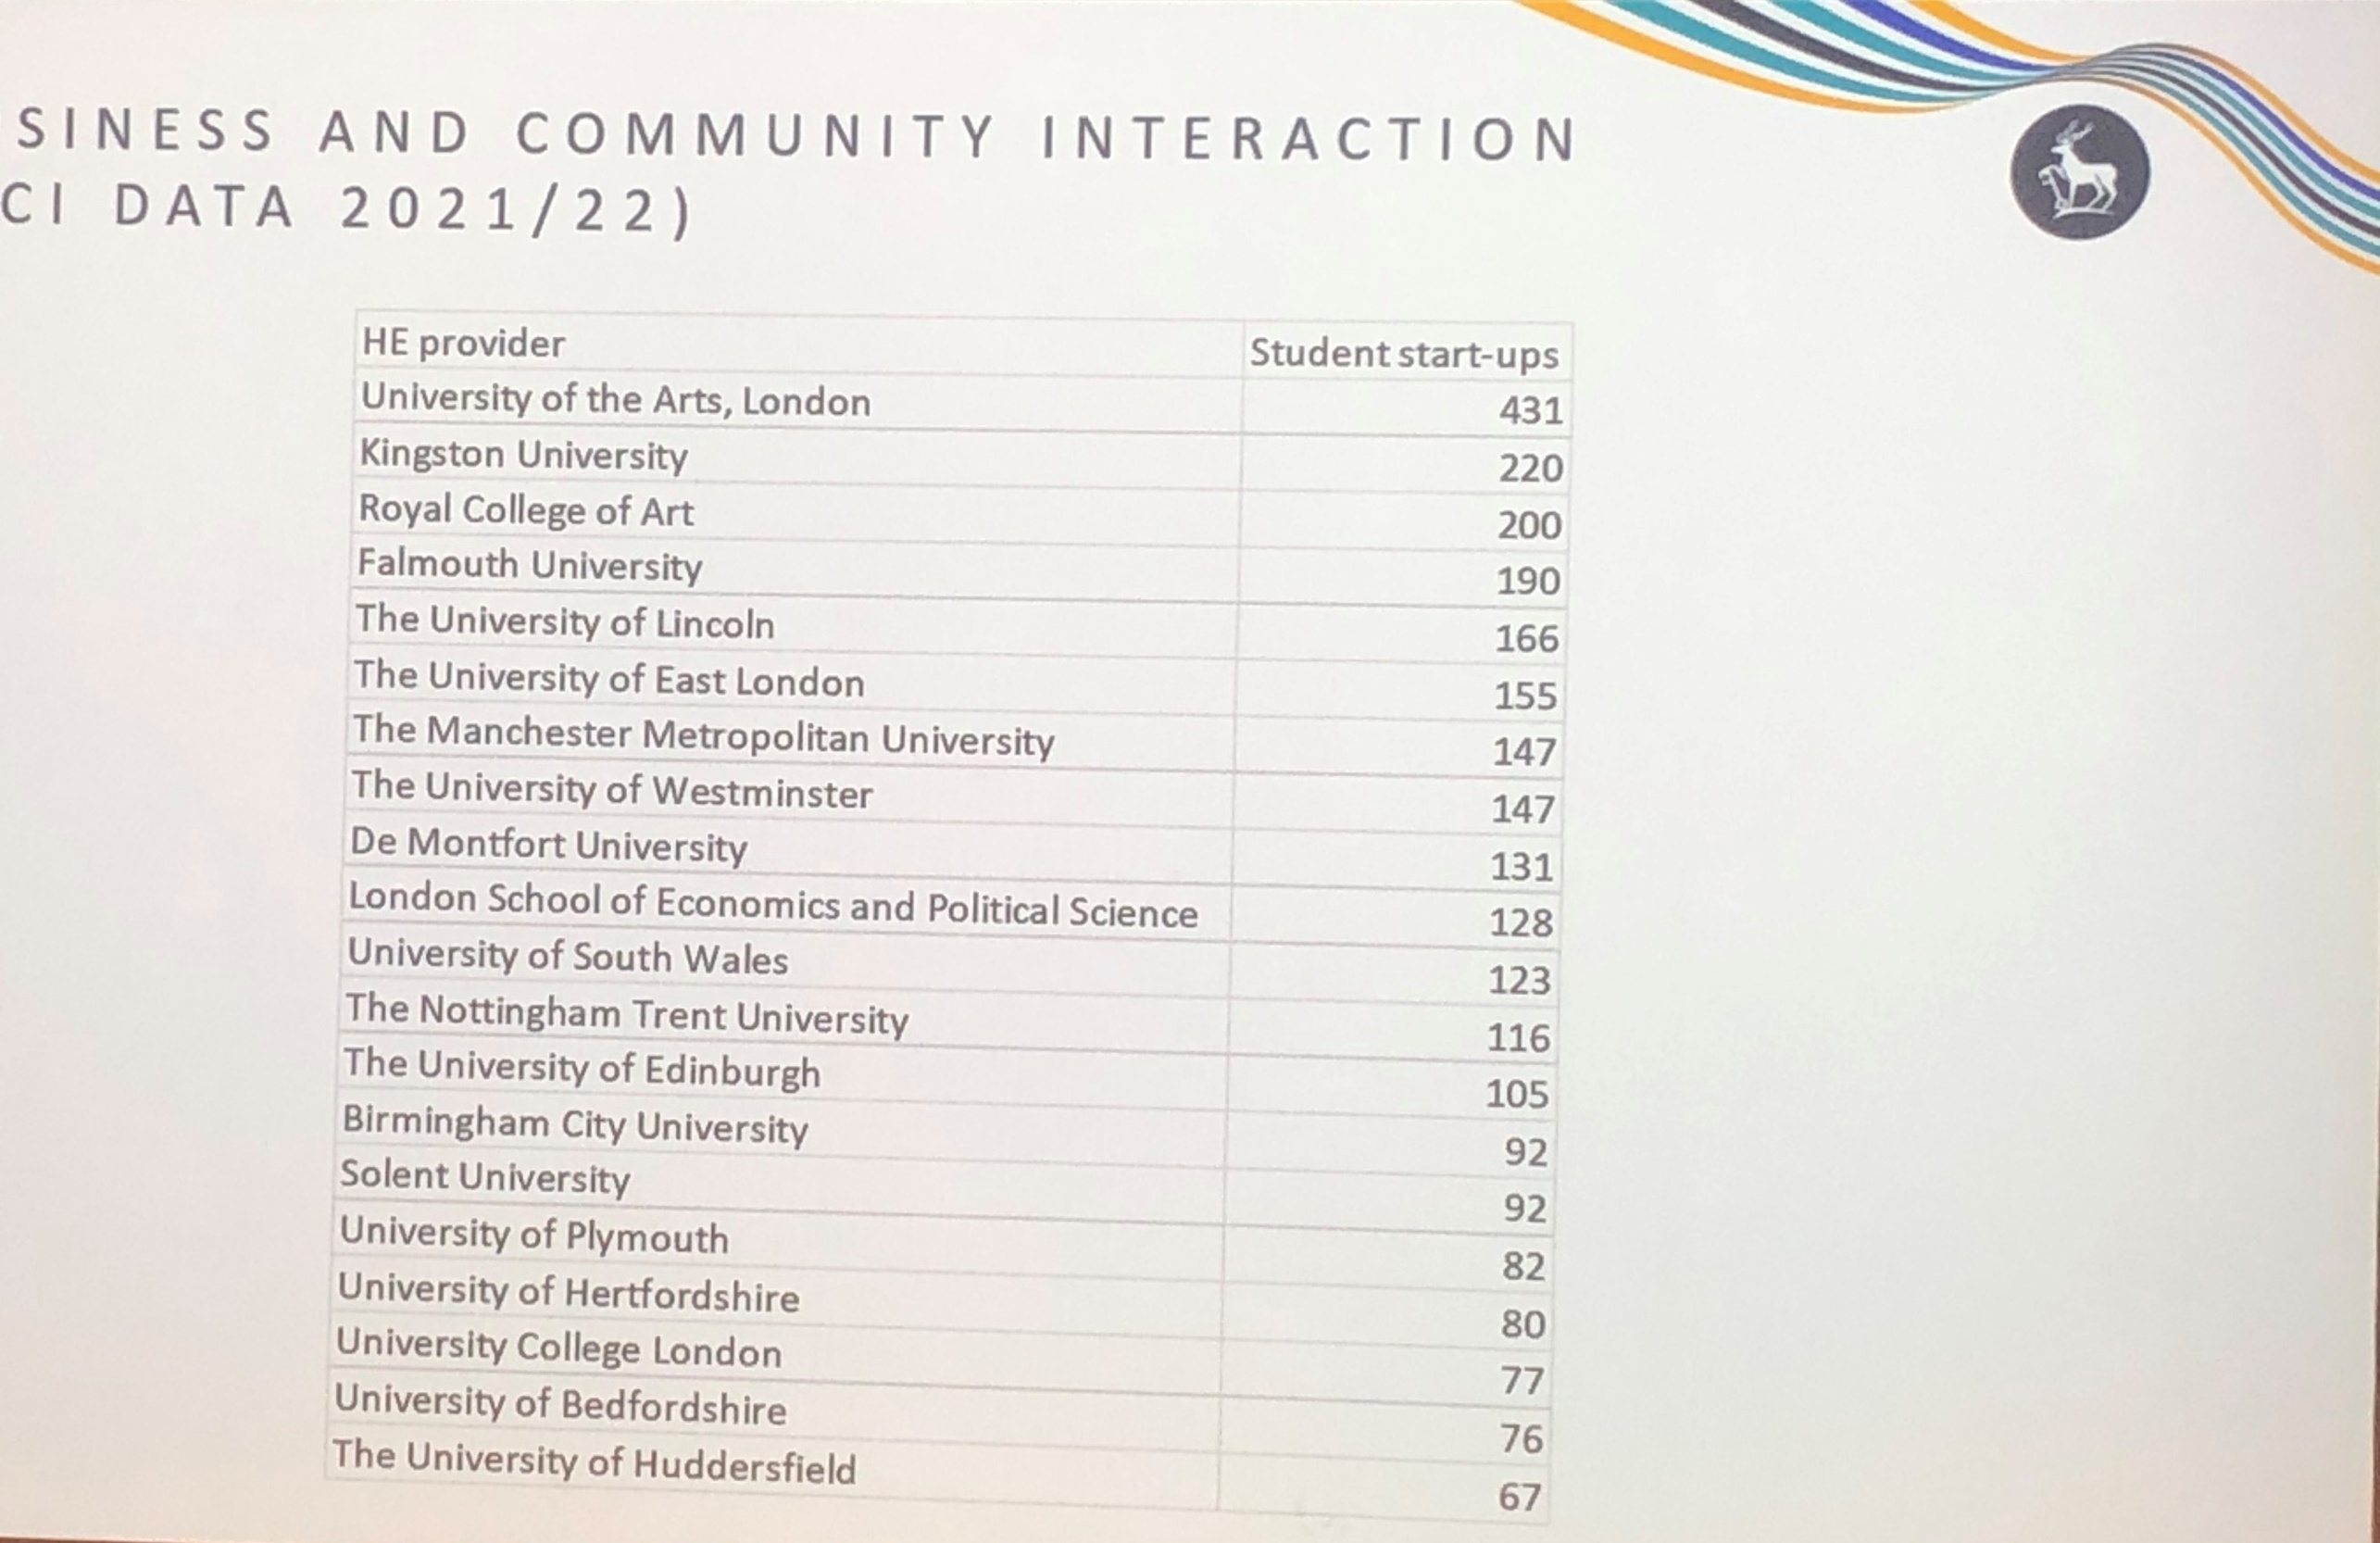
Student startup stats by University 2021/2022
Falmouth
Care of:
Professor Osama Khan
Keynote EEUK 2023
Notes:
Measurement Thanks Osama Khan & Keynote
Impressive Falmouth figures dwarf our activity.
Highlights problem with measuring outcomes
e.g. Some not suited to freelance / entrepreneurship so good outcome for them is to find that out
ALSO – the skillsets may be brilliantly applied within employment, so invisible to current measure

Slide 22

Thank you
Marcus Simmons
From internships to freelancing and beyond...

