Slide 1
Welcome
Taking action doesn't have to be hard: From deciding to doing.
Dr Natalie Semley
Natalie.Semley@falmouth.ac.uk
Lecturer in Sustainable Tourism Management

Slide 2
Reflection for Action…
…Intention to Change

Slide 3
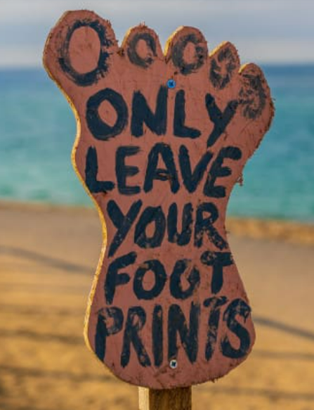
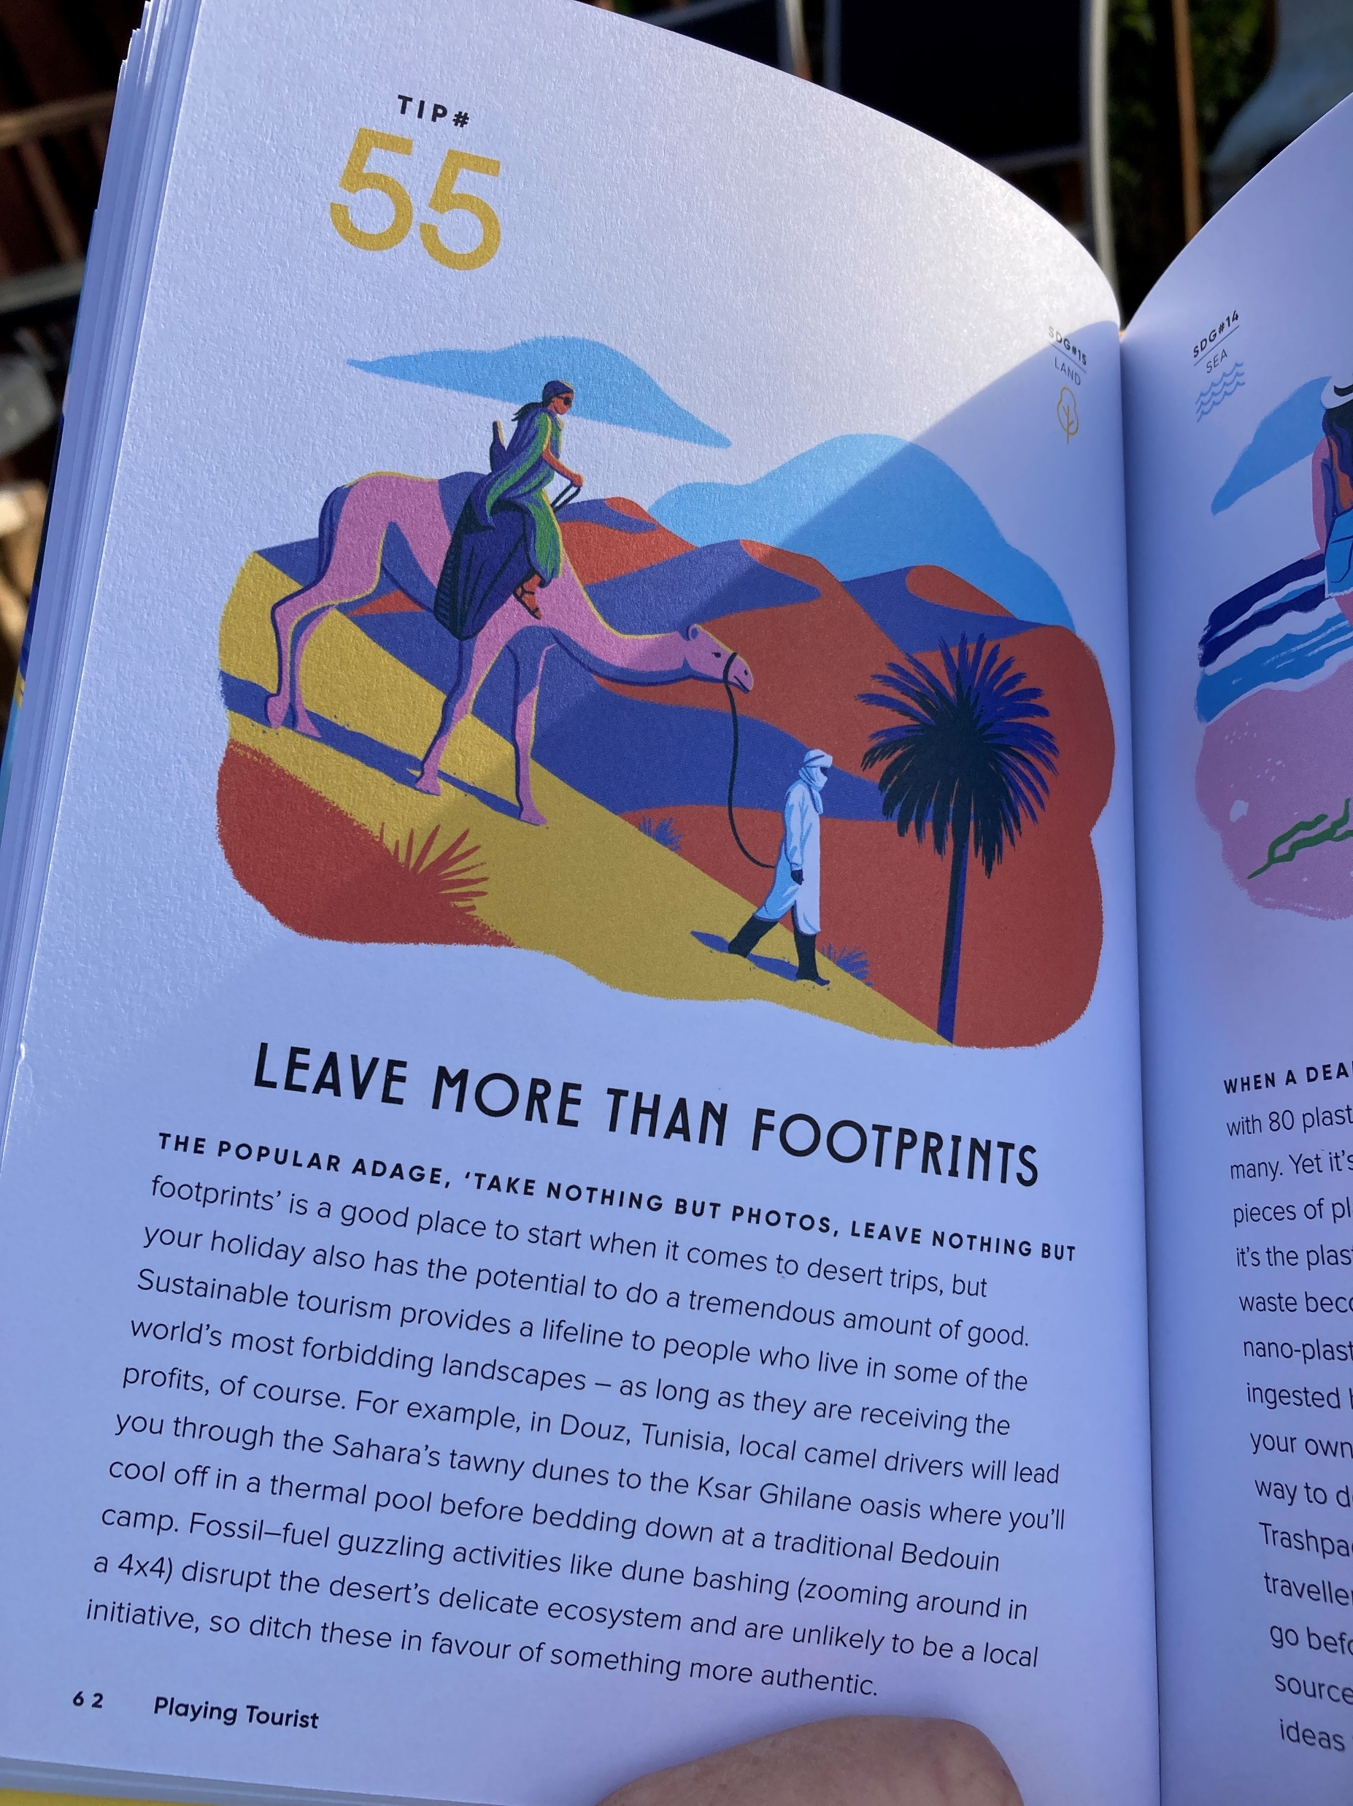
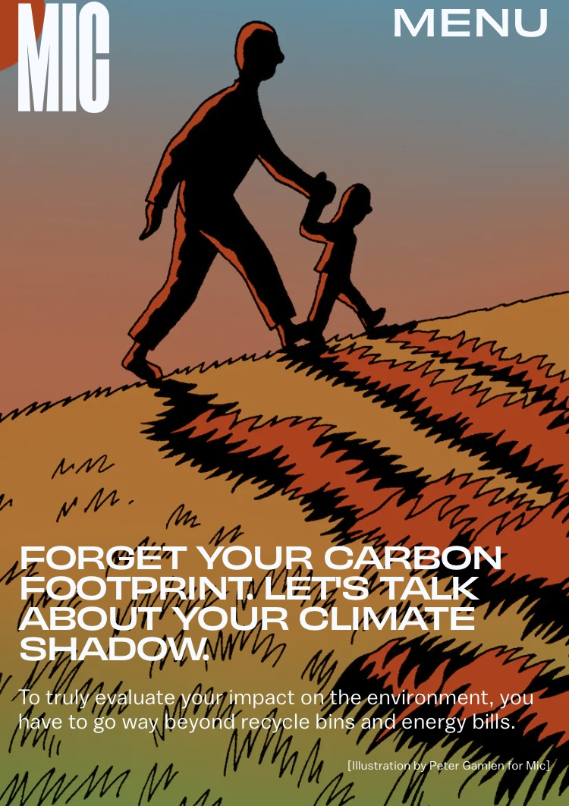
Listen. Think. Talk. Share. Discuss. Plan. Take Action.

Slide 4
Making Decisions
DECISIONS WE MAKE TODAY WILL SHAPE WHAT RESOURCES – AND PRACTICES – WE USE TOMORROW

Slide 5
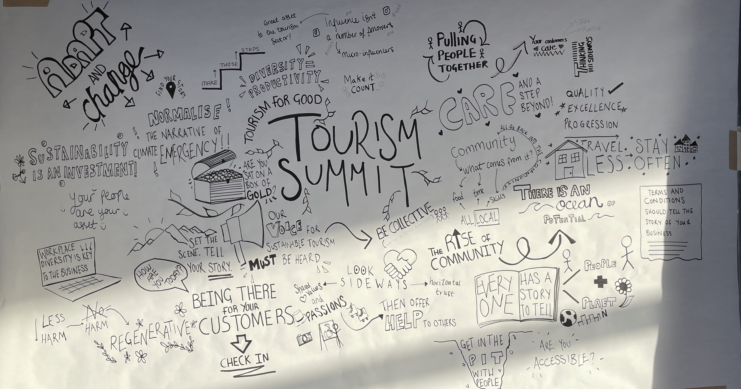
The Output

Slide 6
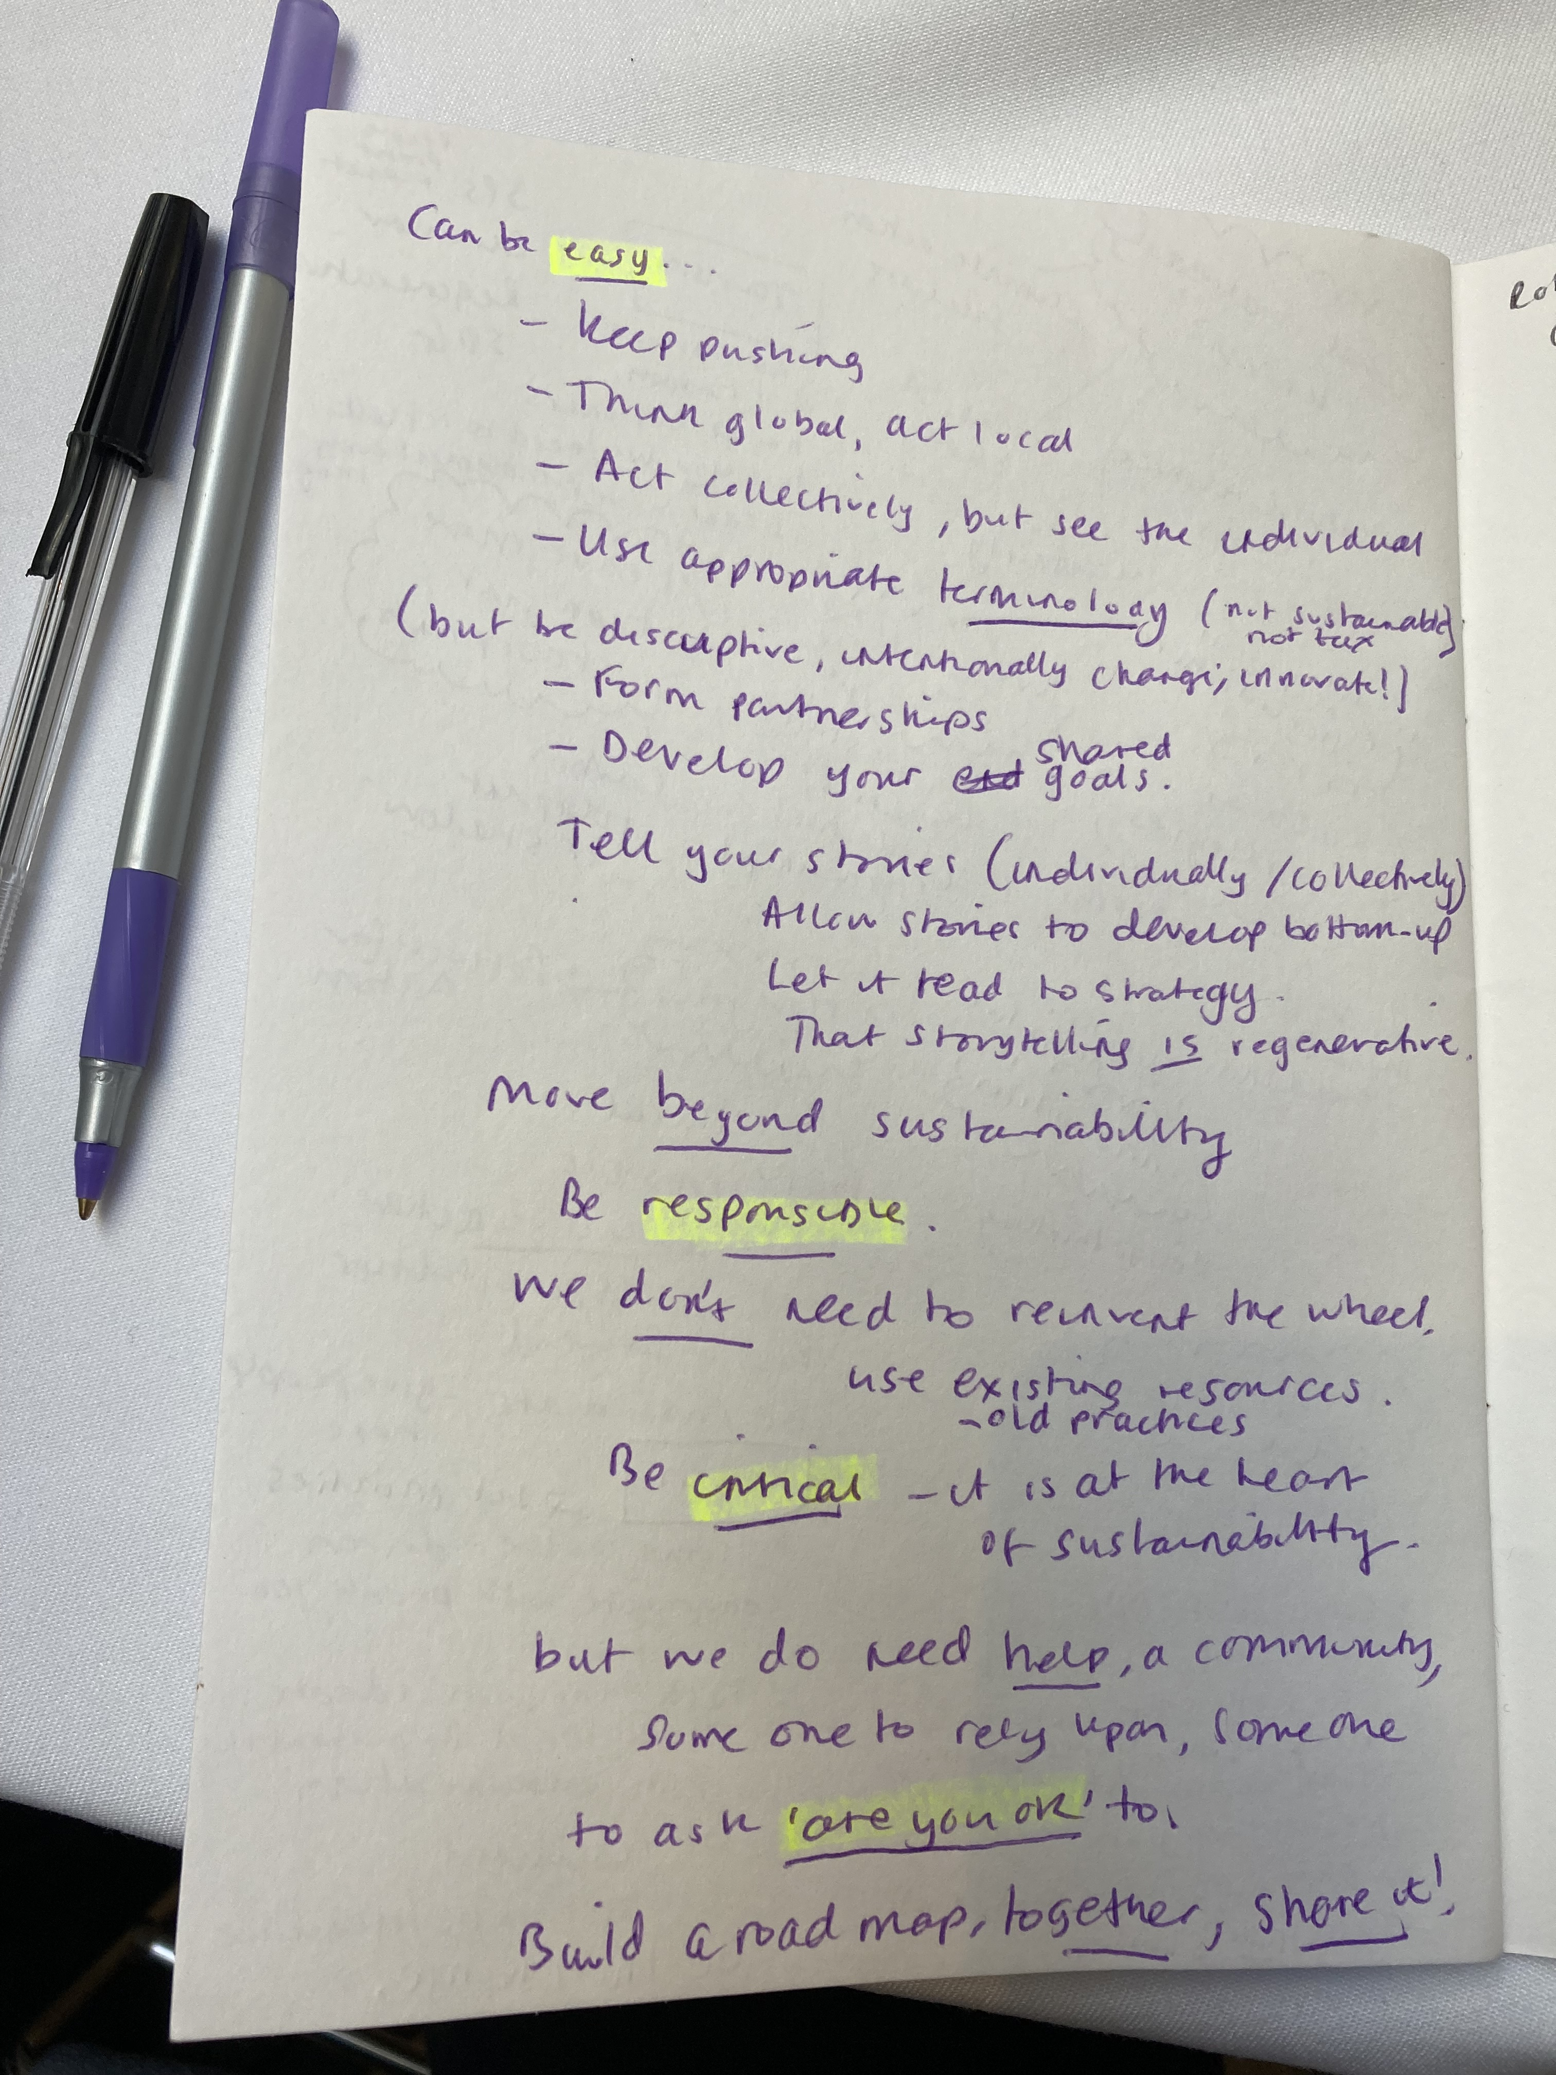
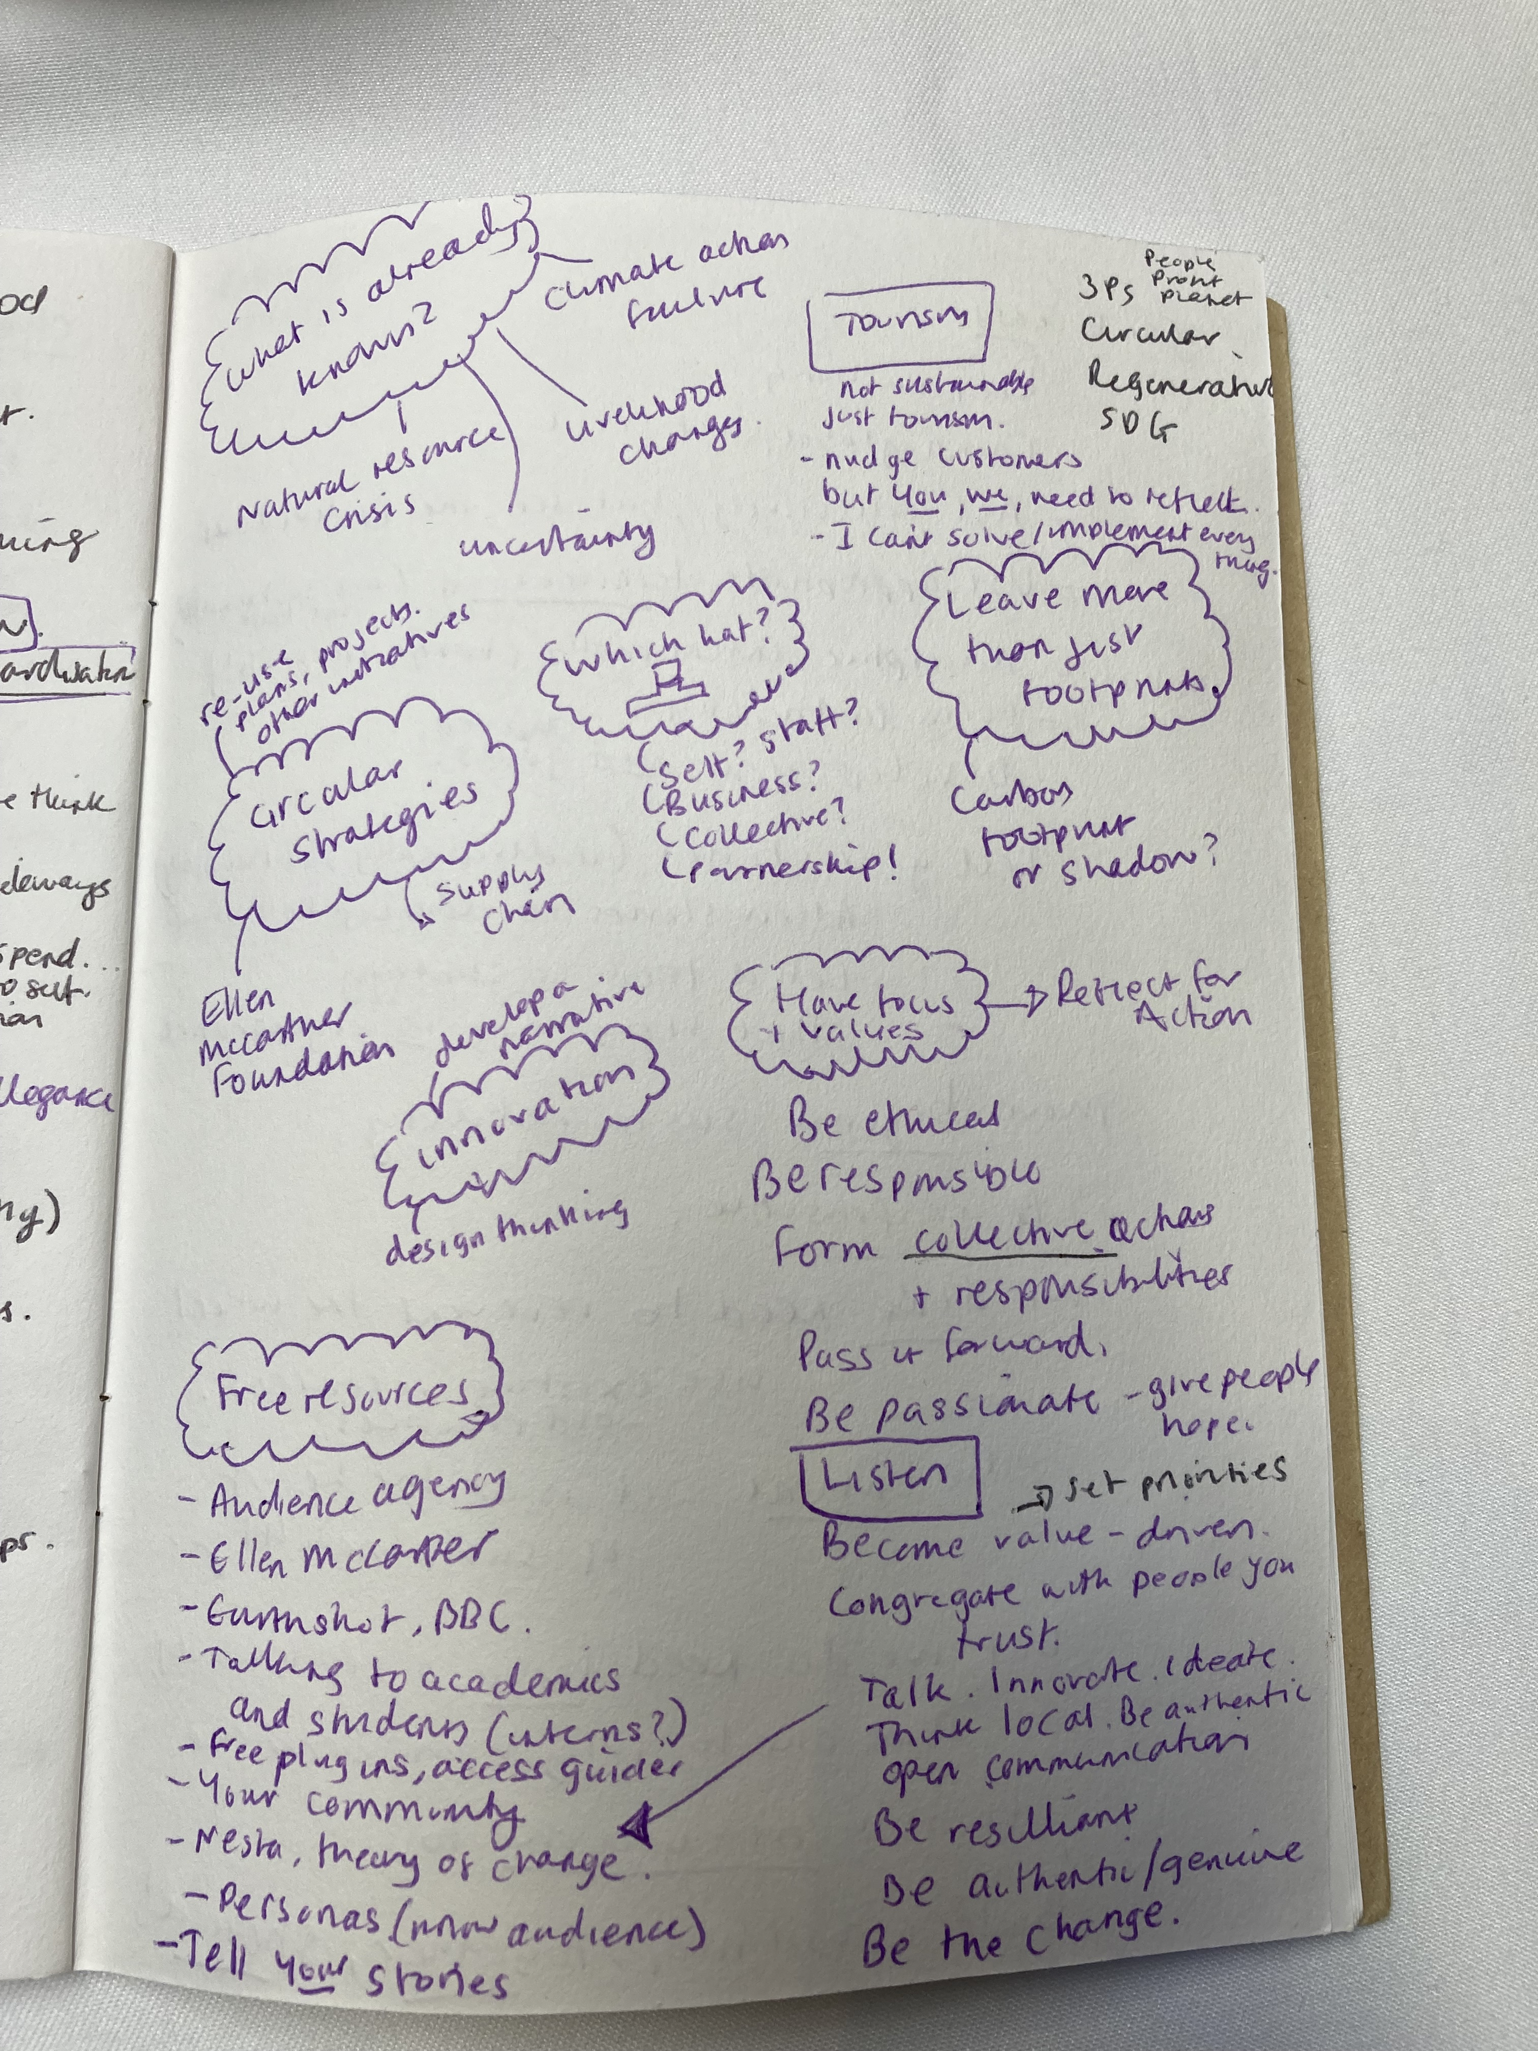
Review your notes…
…draw meaning from them!

Slide 7
Be Proactive.
IF. You become an empowered decision-maker.
AND. You can gauge your impact.
THEN. You can locate yourself in industry and start to take responsibility for your actions and shape your practice.

Slide 8
Take Control.
IF. We examine our values and beliefs.
AND. Take responsibility for our action.
THEN. We can free ourselves from impulsive and routine experiences, and we can act more with deliberate and intentional actions.

Slide 9
Use existing resources!
Resources (circulardesignguide.com)

Slide 10
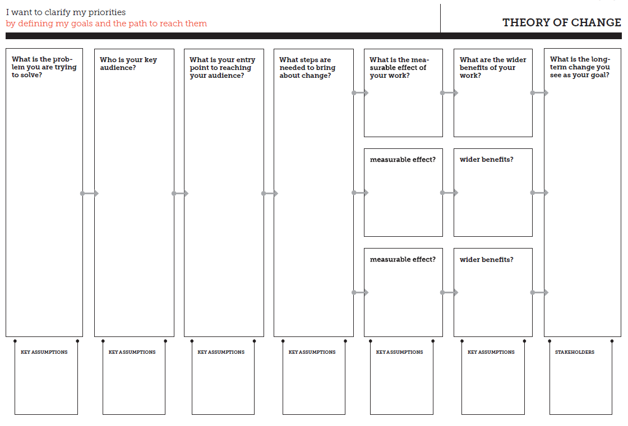
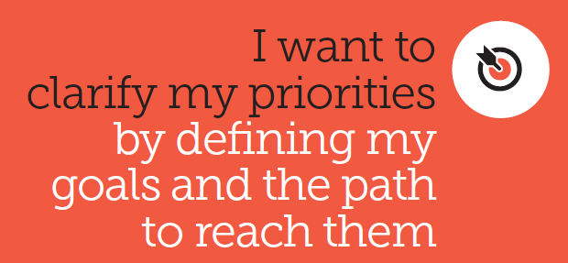
NESTA Template
Notes:
What is the Main Problem you want to solve?
What is the Long-term vision?
Who is Most Affected by the issue?

