Slide 1
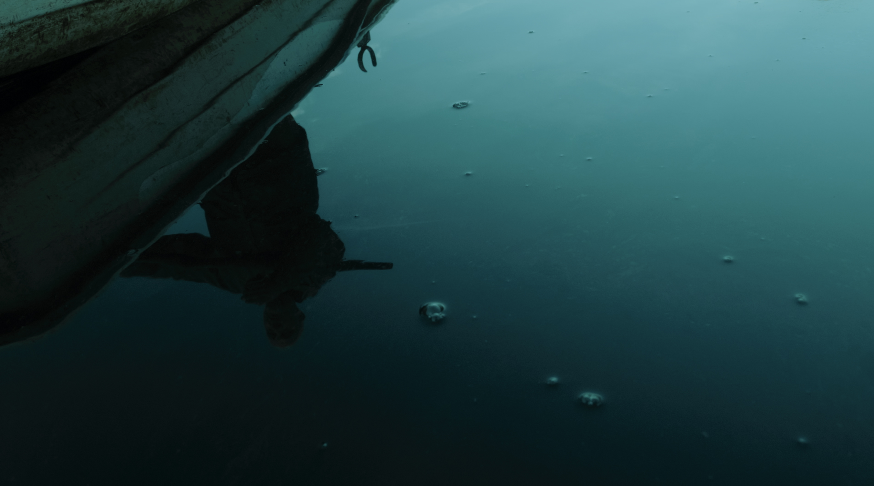


From the River
A documentary short filmed in Cornwall in 2021/22. The film has screened - followed by Q&As and panel discussions - at international film festivals, community events and academic conferences throughout 2022/23.
Paul Mulraney
Research Theme - Practice: Research and Impact

Slide 2
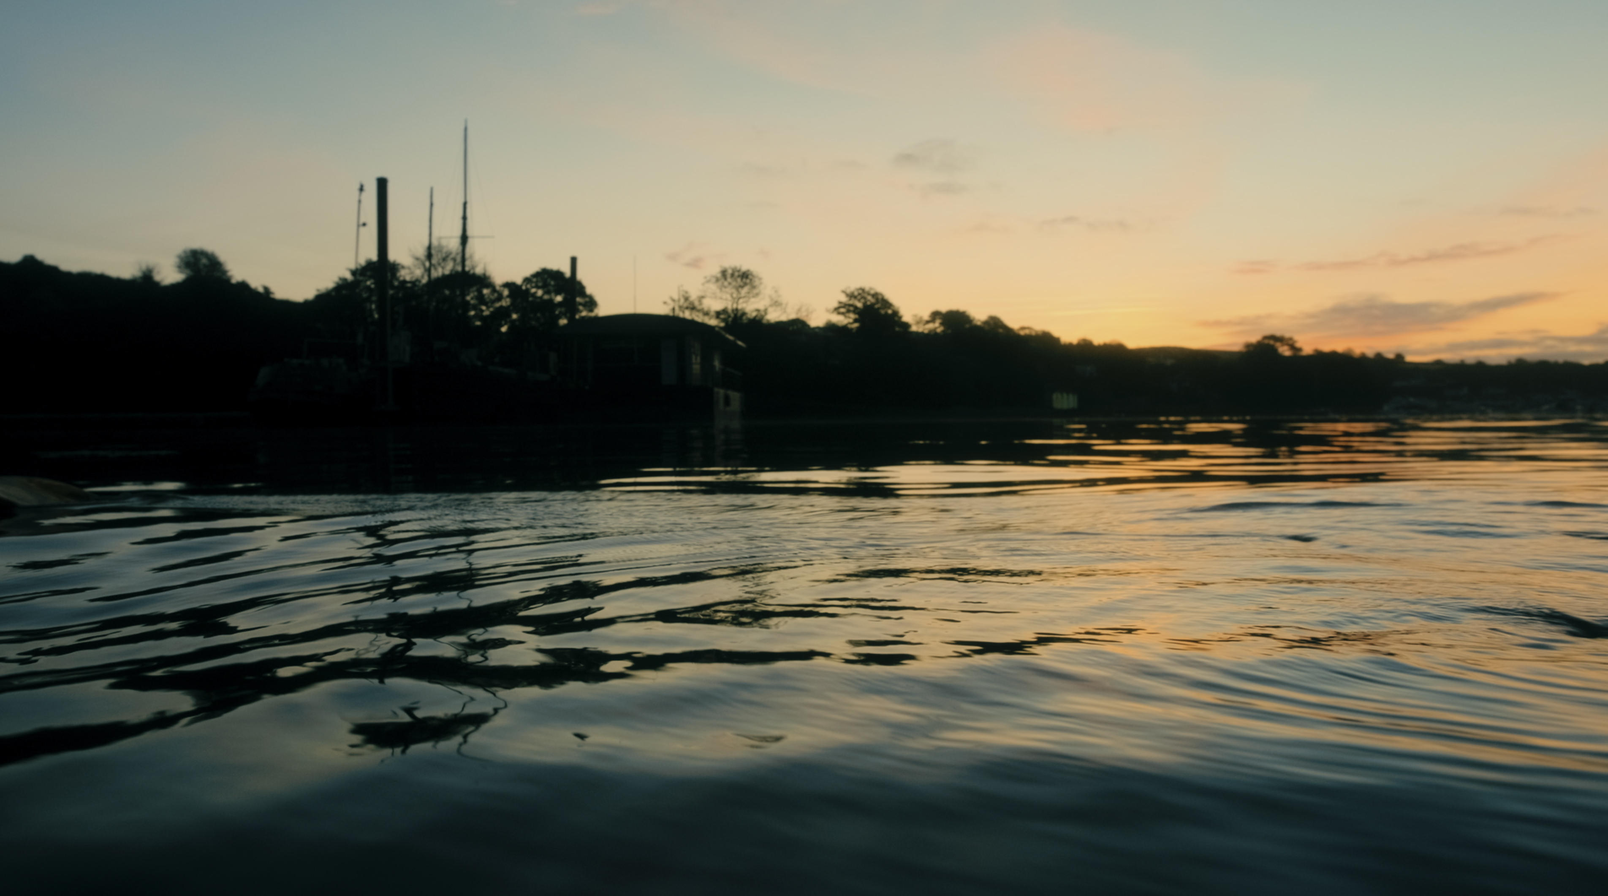
Contents
Page 3
Page 5
Page 7
Project Details
Supporting
Statement
Research
Output
Page 9
Page 12
Dissemination
Contextual
Evidence

Slide 3
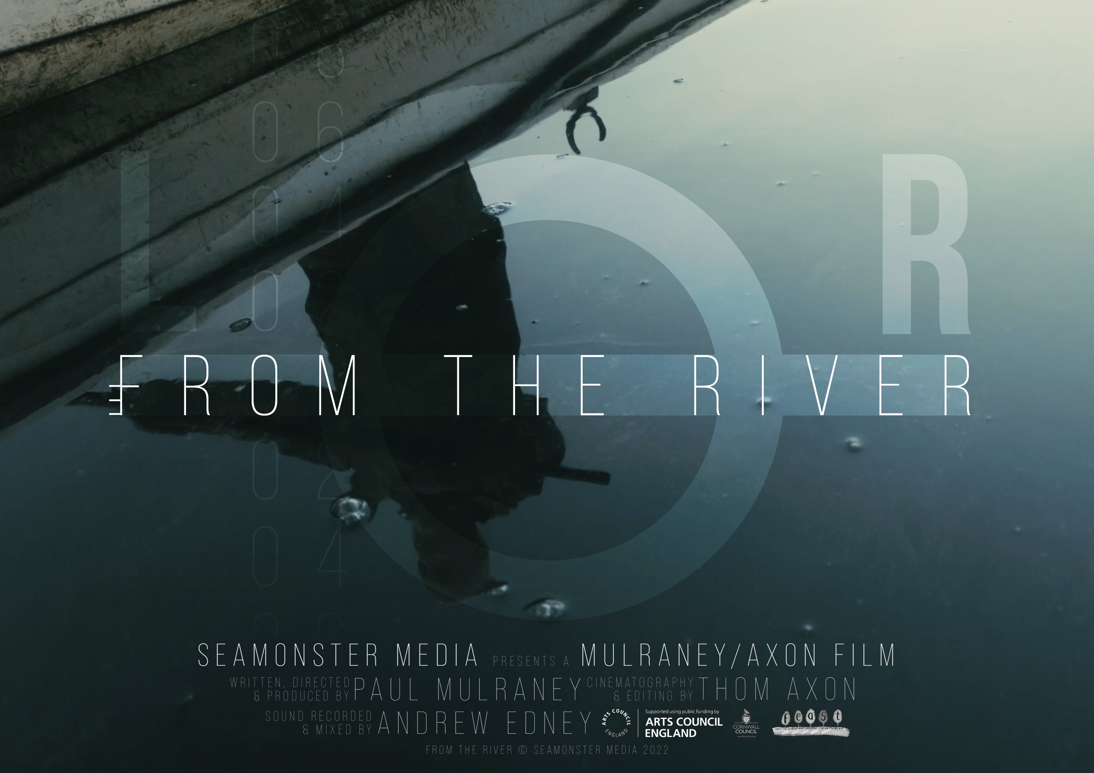
Project details
From the River (2022)
Dir: Paul Mulraney | 18mins |
Documentary | UK
Produced in 2021, edited in 2022, premiered at Cornwall Film Festival November 2022 followed by screenings at 4 international film festivals, 3 academic conferences and a number of community events.
Funding: Arts Council, Feast, Cornwall Council, Crowdfunder
Partners: Seamonster Media, School of Film & Television
Staff Collaborators: Andrew Edney (sound), Jane Pugh (script editor)
R&I Program Alignment: Practice: Research and Impact

Slide 4
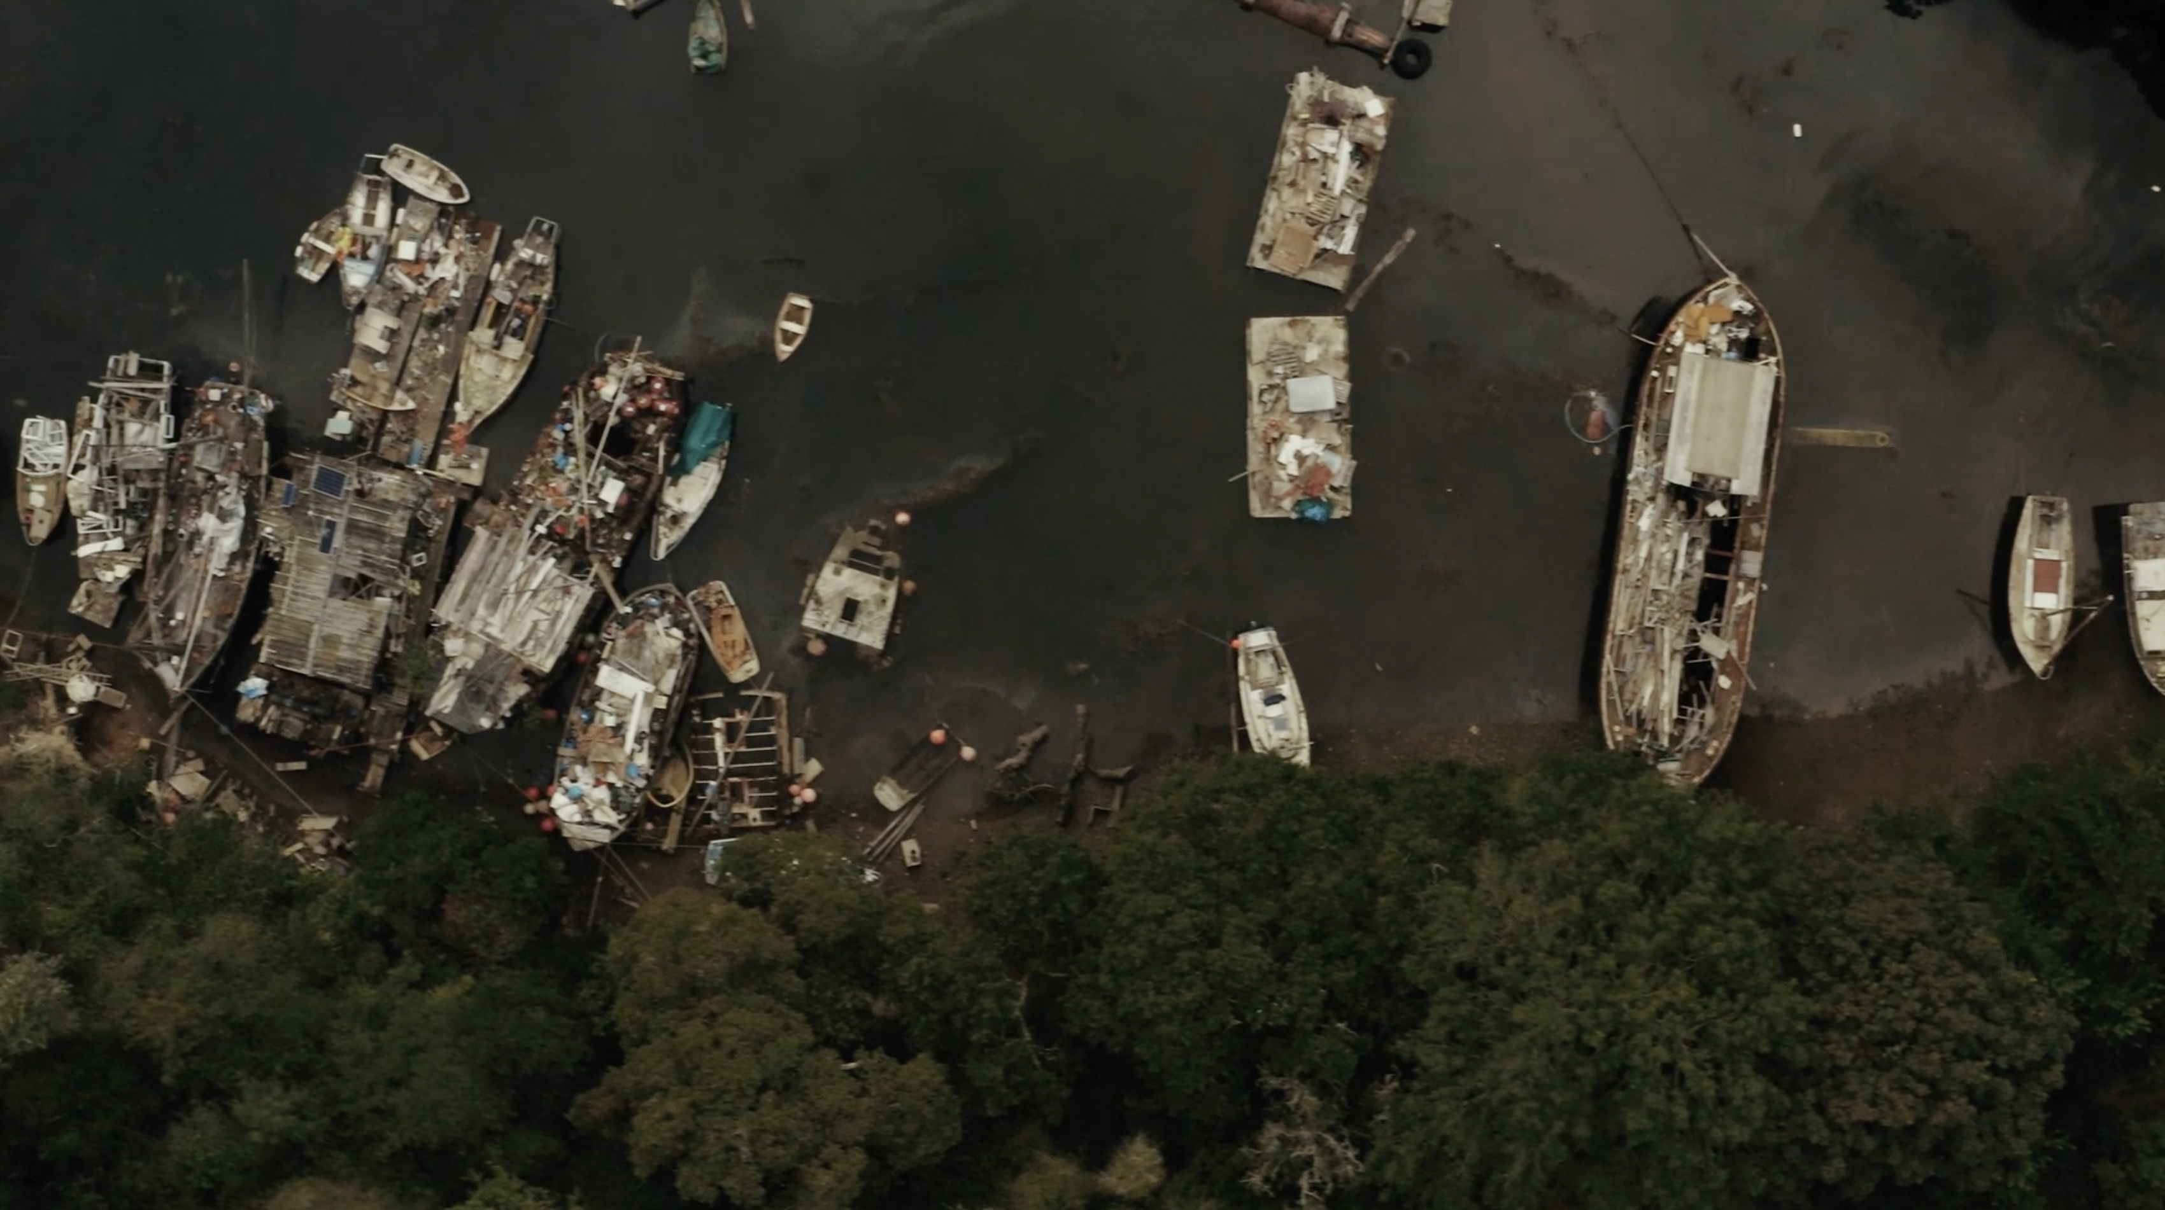
From the River, ‘Where Dreams Go To Die’ (Seamonster Media, 2022)

Slide 5
300-word supporting statement
Working within a community of local filmmakers, Falmouth University technicians and scholars, with the collaboration of the Sailor’s Creek Community Interest Company and the creek’s residents, From The River tells the story of a unique place, of the people who have lived and died there, of modern-day ghost ships, and the death of dreams.
Sailor’s Creek is a place so unlikely that its conception would test the imagination of the most creative production designer - a readymade film set that is the perfect location for a low-budget, vernacular approach to filmmaking.
Having been drawn in by the creek’s aesthetic appeal, it was a tragic accident and a chance encounter that led the director to piece together a fifteen-year long character arc, with a highly unfortunate resolution. This change in focus - from the visual to the personal, from aesthetics to ethics – drives a research enquiry into the problems inherent within re-presenting real places as cinematic mise-en-scène.
The focus on the personal story grew throughout the film’s production, it was interrogated in a number of local community and international screenings, panel Q&As and audience discussions, before yielding a screening and paper at the 2023 Visible Evidence conference in Udine, Italy.
The underlying interest in the vernacular – in local voice, in found material, in low or zero budget production - ties in with the director’s interest in telling stories about peripheral places and the people who live there, in capturing voices that speak from outside of the law of the land, that elude mainstream filmmaking and commercial funding. This theme is further explored in Paul’s latest film From the Culch, and in-production Redfish, establishing a body of documentary work within this research field. This research ultimately feeds into Falmouth School of Film and Television’s low budget production methodology, informing the filmmaking practice of the documentary wing of the Sound/Image Cinema Lab.

Slide 6
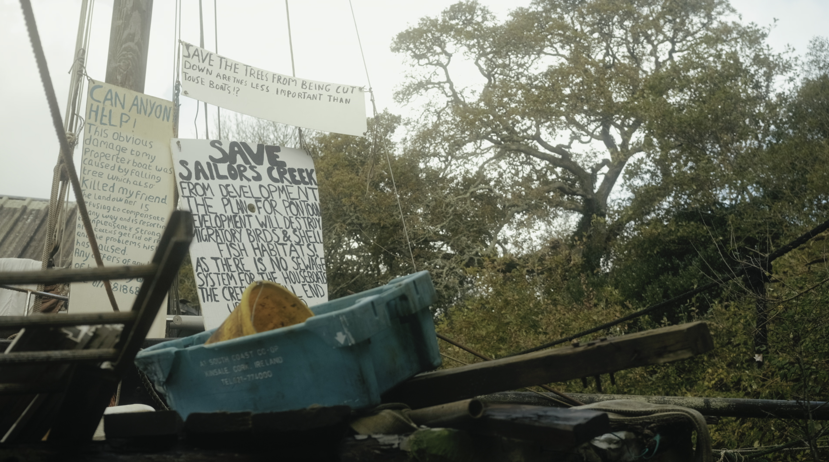
From the River, ‘Lee’s Signage’ (Seamonster Media, 2022)

Slide 7
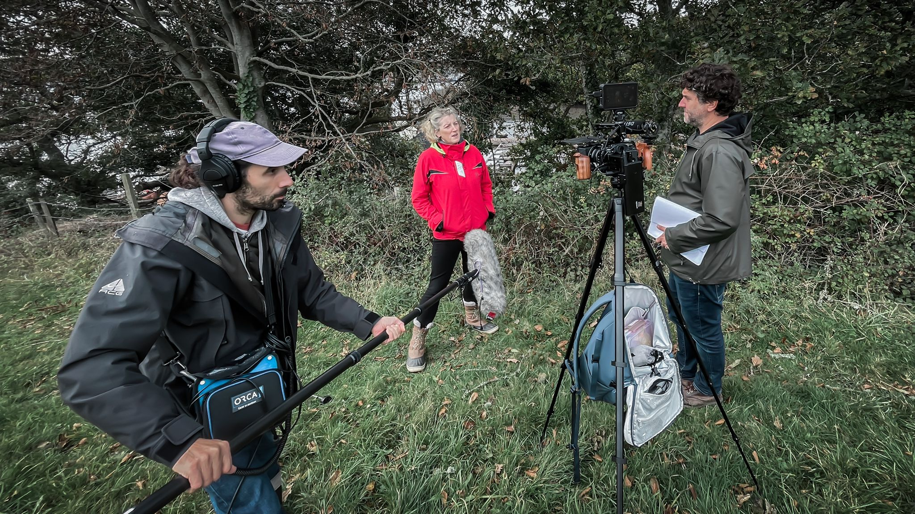
Research Output
From the River can be viewed at:
https://vimeo.com/732154383
Official Website:
https://www.fromtheriver.co.uk
Social Media:
https://www.facebook.com/fromtheriverfilm
From the River BTS, courtesy Seamonster Media.
Sound designer Andrew Edney, contributor Mel Williams and director Paul Mulraney shooting a scene, September 2021.

Slide 8
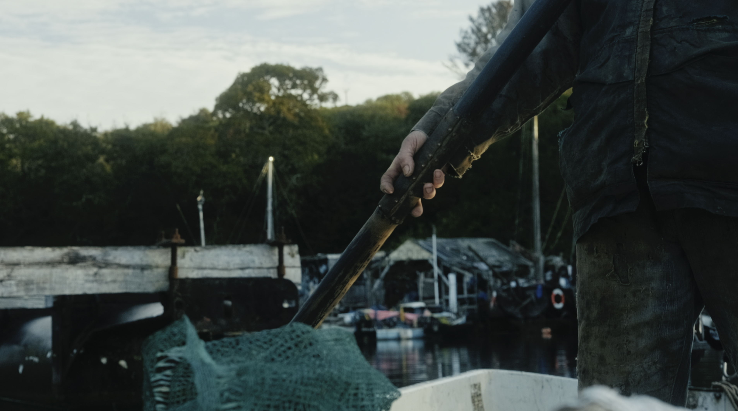
From the River, ’Everything is a Poem’ (Seamonster Media, 2022)

Slide 9
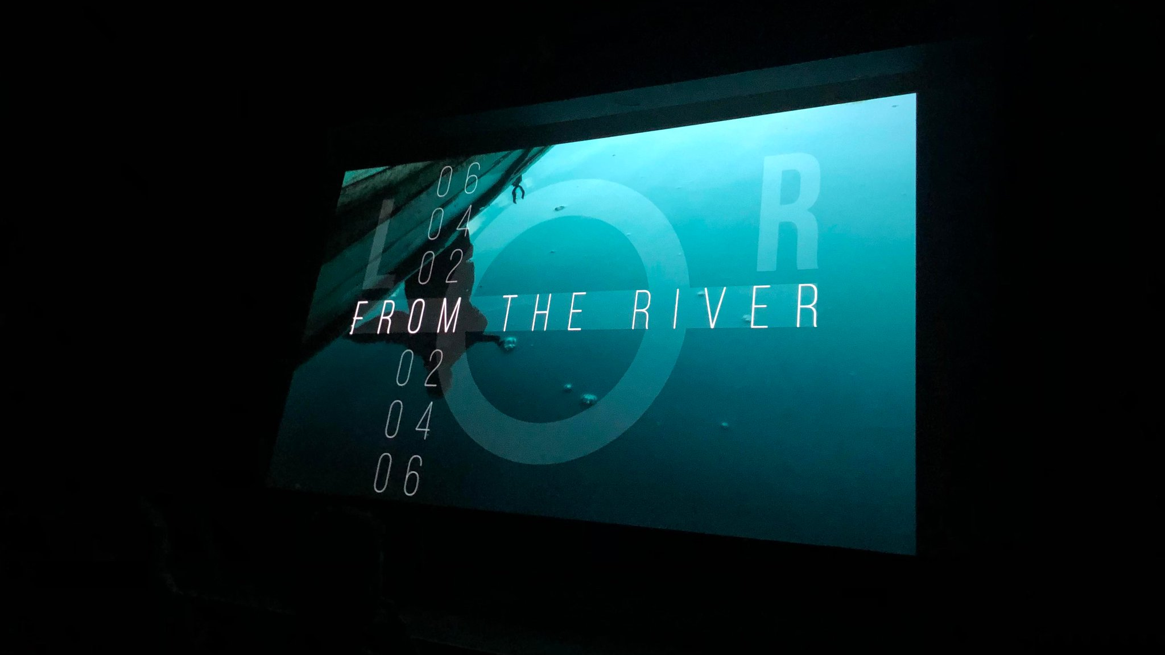









Dissemination

Slide 10
Dissemination (cont.)
From the River has screened to over 1000 people in cinemas, lecture theatres and community spaces around the world:
Screening and Q&A: Leisure Studies Association Conference, Falmouth University (July 2022)
Screening and Q&A: Cornwall Film Festival (November 2022) – Premiered in Waterways, double-bill special screening
Screening and Q&A: Flushing Sailing Club (December 2022)
Screening and Q&A: Royal Cornwall Yacht Club (December 2022)
Screening: Fastnet Film Festival, Cork, Ireland (May 2023)
Screening: Haunted Landscapes Conference, Falmouth University (July 2023)
Screening: No Coast Film Festival, Kansas, US (August 2023)
Screening, Q&A and Paper: Visible Evidence Conference, Udine, Italy (September 2023)
Screening: Lowestoft Film Festival, UK (October 2023)
Screening and Q&A: Porthtowan Ocean Film Festival (November 2023)
Screening and Q&A: This is England Film Festival, Roeun, France (November 2023)
Screening: Still Voices Film Festival, Co. Longford, Ireland (November 2023)
Digital distribution: Waterbear (January 2024)
| UK Dissemination | Community Dissemination | International Dissemination |

Slide 11
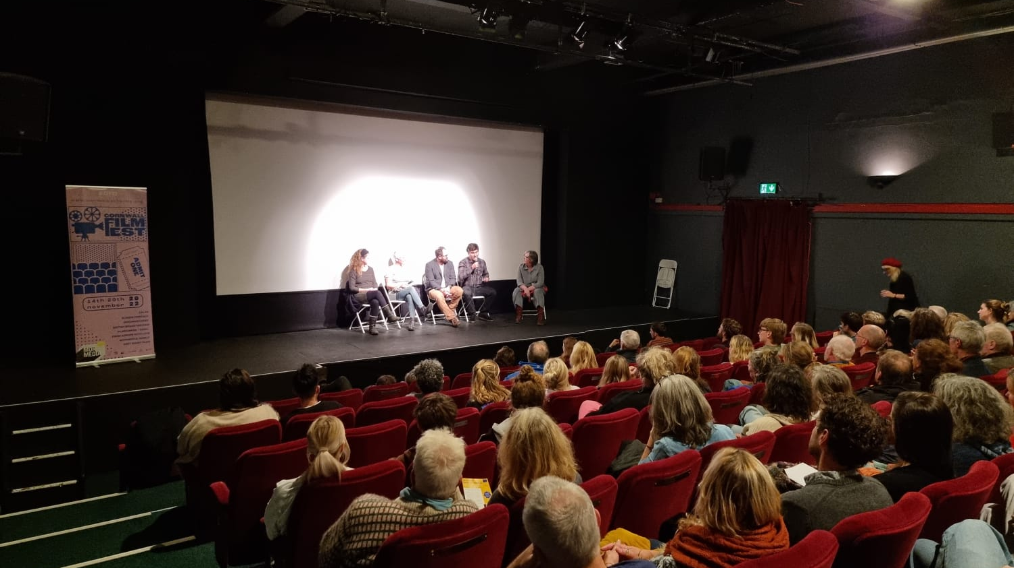
The director speaks at the film’s premiere at The Poly, Cornwall Film Festival, 2022
Notes:
I was amazed to find real lives lived in such similar ways to those in Zeitlin’s vernacular fantasy, right on my doorstep.

Slide 12
Contextual Evidence
“The panel thought your film has an important environmental and social story to tell which is very pertinent to Cornwall.”
Funding Panel, Feast Cornwall
“Working on From The River has been a pivotal moment in my creative journey both personally and professionally. It allowed me to combine my two careers of working in boats and working with cameras. It made me look closely at the process of making documentary films and how to approach them visually and ethically, and I had the honour to talk to the students and share my knowledge of working as a marine coordinator within the film industry.”
Thom Axon (DoP. From the River / Marine Coordinator. Game of Thrones, House of the Dragon, The Heart of the Sea )
“Paul presented From the River, in dialogue with Iconoplast by Sara Bonaventura, and we discussed with them what “Life During and After the Anthropocene” is, the challenges of coexistence and community building, and the practices of filmmaking and art-based research. It was an intense, inspiring and very engaging exchange…the audience didn’t want us to leave!”
Maria Ida Bernabei (Ricercatrice, Università degli Studi di Torino/ Panel Host, Visible Evidence 2023)
“Your film stayed with me. The tone was fabulous. I may have neglected to say how much I liked your talk as well. It was a highlight of Visible Evidence. Your students are very lucky to have you”
Nick Hector (Editor. Prey, Sharkwater Extinction / Associate Professor, University of Windsor)
”So different, so sensitively balanced and gave a really human perspective to the issues we struggle with. Did one back Lee or see him as an obstacle to environmental improvement? Thinking about it on the way home I thought it was also a study in the power of personality and how standing for something you believe in can tip into bullying.”
Rose Barnecut, Feast Cornwall
“We screened the short film From The River … together with a Q&A. Paul provided interesting, insightful commentary about his process as a filmmaker, how he works with interviewees and how the project developed, we covered different processes in the documentary field about scripted and unscripted work and working with vulnerable contributors. It was a very popular event … we are happy to be able to link audiences with filmmakers of this quality.”
Louise Fox (Director, Cornwall Film Festival)

Slide 13
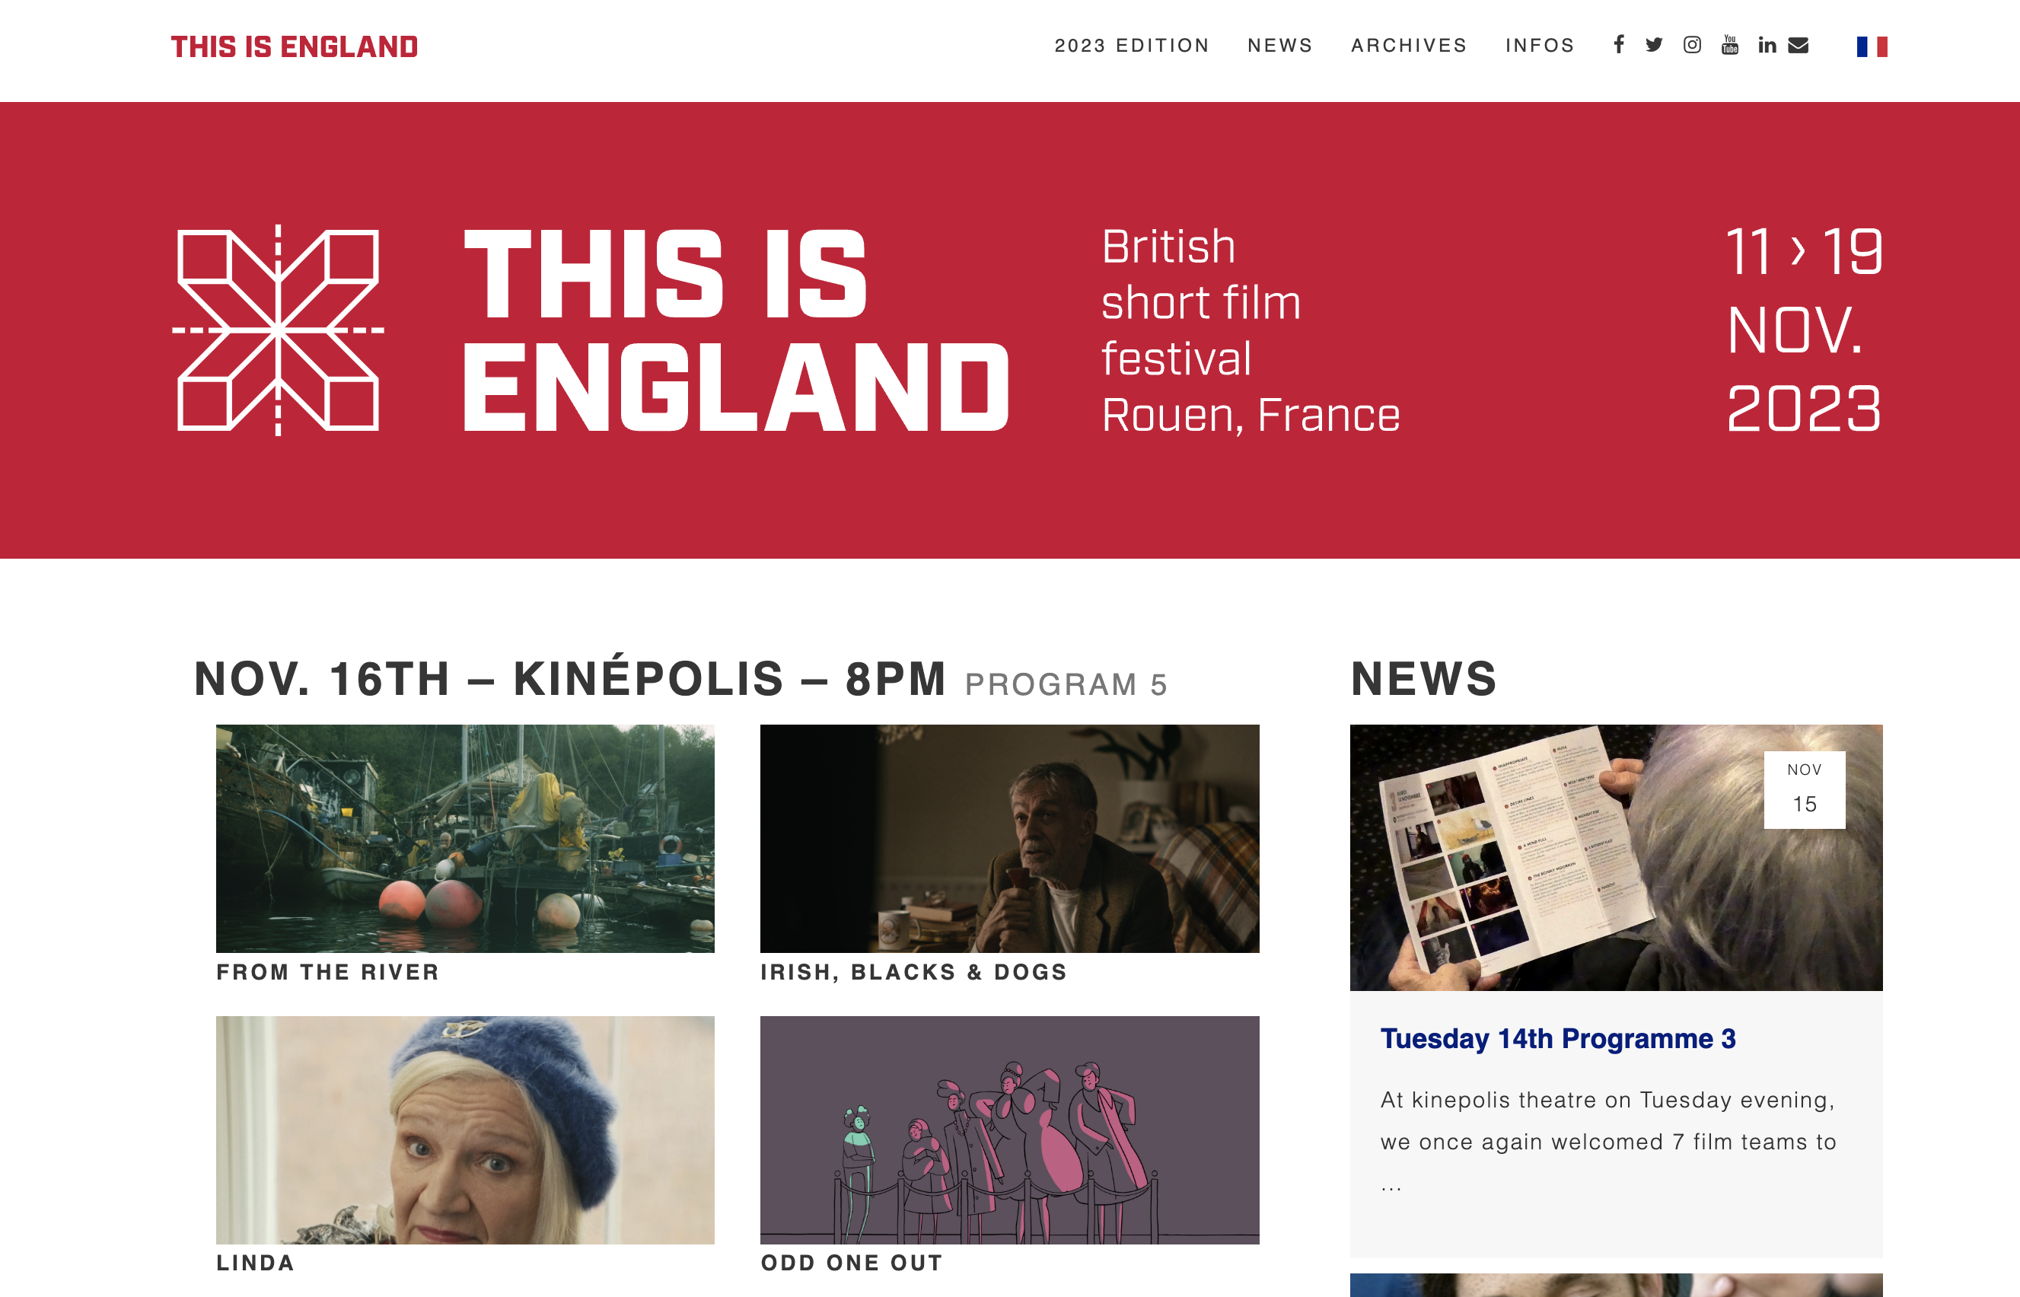

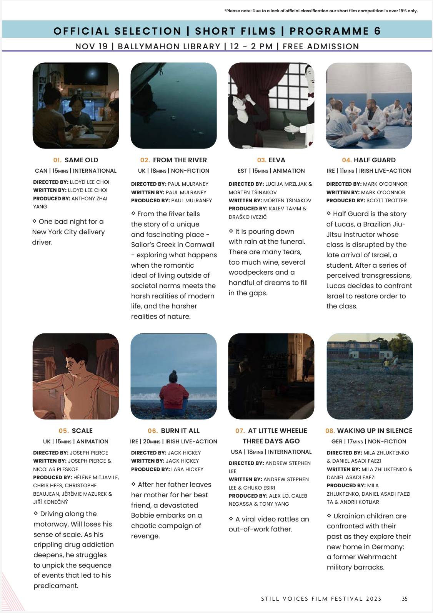
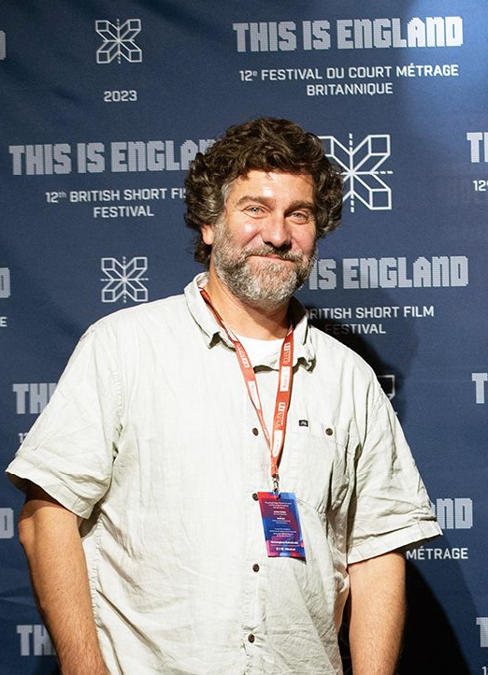
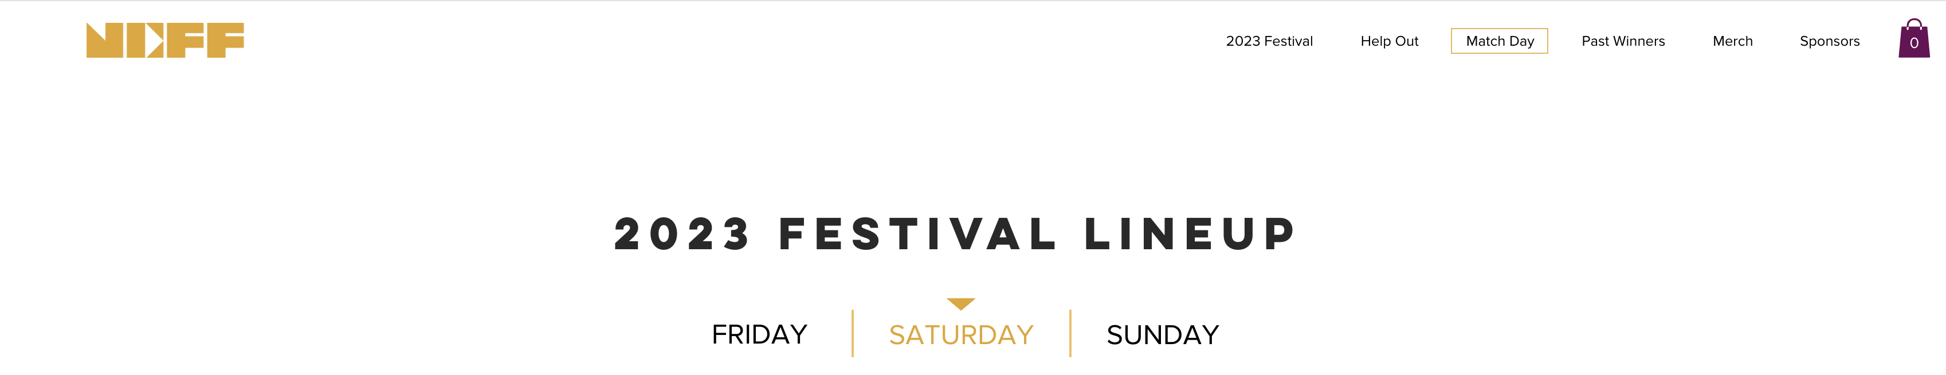

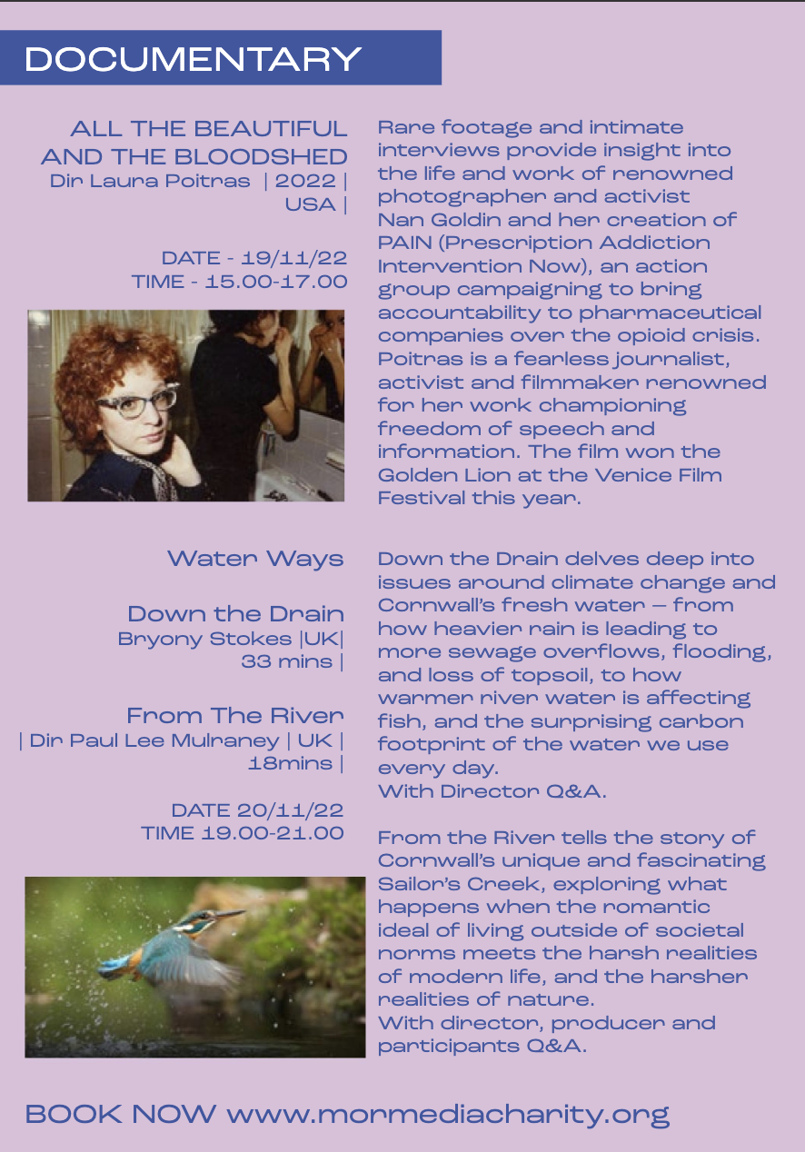
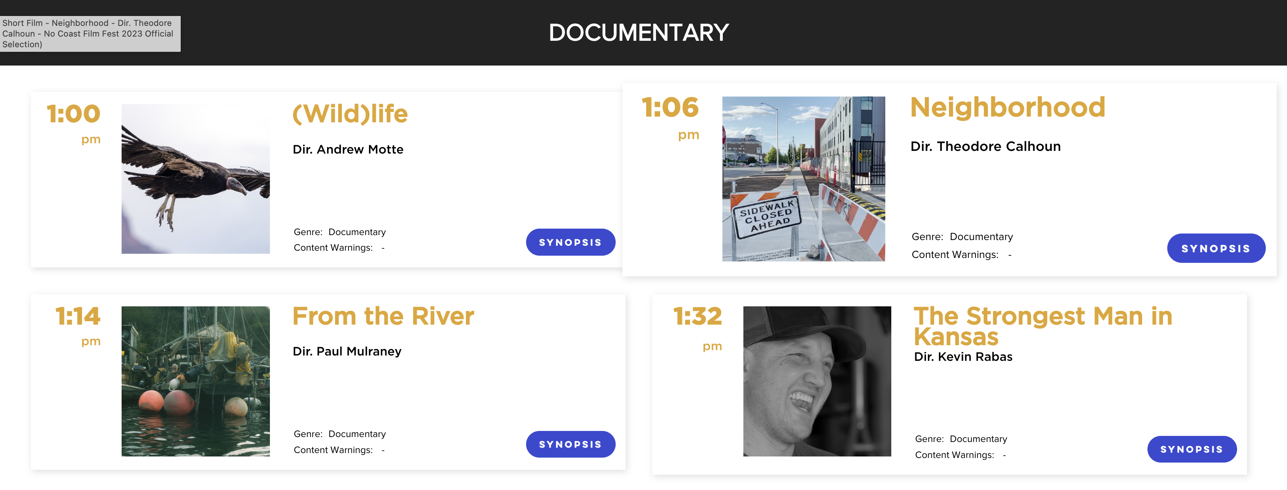
Contextual Evidence (cont.)

