Slide 1
From the Culch
A documentary short edited from the bin cuts of a lost BBC documentary that was shot in Cornwall in 1978. The film has
screened alongside Q&As and panel discussions at film festivals, community events and academic conferences throughout 2023.
Paul Mulraney
Research Theme - Practice: Research and Impact

Slide 2
Contents
Page 3
Page 5
Page 7
Project Details
Supporting
Statement
Research
Output
Page 9
Page 12
Dissemination
Contextual
Evidence

Slide 3
Project details
From the Culch (2023)
Dir: Paul Mulraney | 17mins |
Documentary | UK
Shot in 1978, edited in 2023, premieres at Cornwall Film Festival, November 2023.
Partners: Seamonster Media, School of Film & Television
Staff Collaborators: Dr Kingsley Marshall (composer), Andrew Edney (sound),
R&I Programme Alignment: Practice: Research and Impact

Slide 4
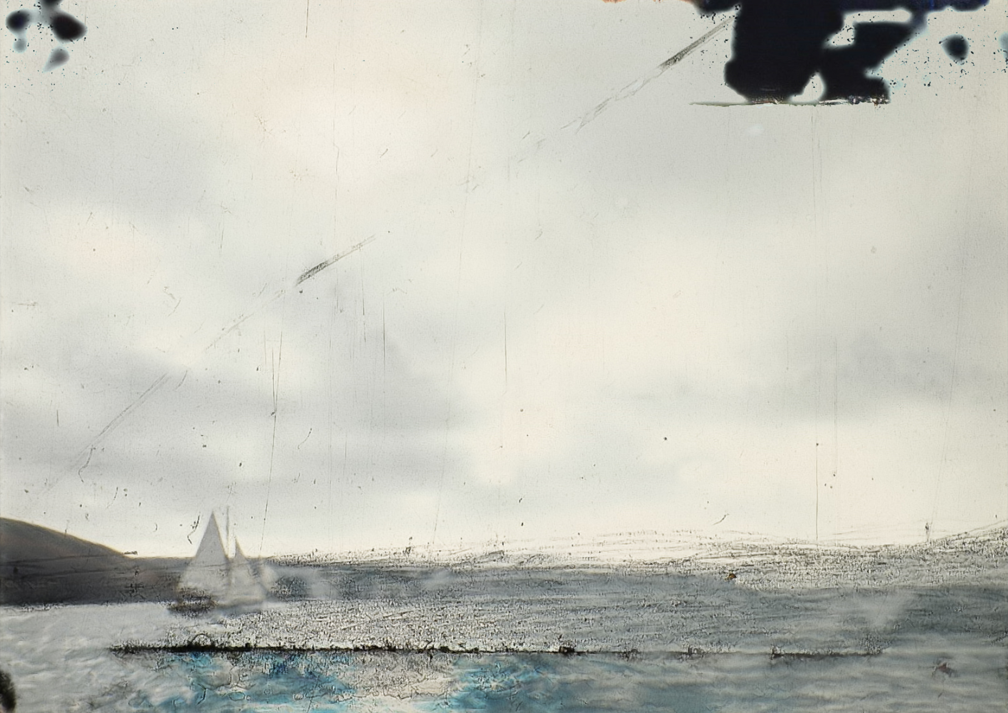
300-word supporting statement
From the Culch is assembled from the bin cuts of a lost 1978 BBC documentary about the Fal River oyster fishery. After the documentary was broadcast a can of randomly assembled 16mm film was given to Dennis Laity, crewman on the working boat George Glasson, as a memory of his brother who passed away just after shooting wrapped.
The can of film lay in Dennis’s airing cupboard for 45 years, unseen, before being passed to the director. A 4K digital scan revealed the beauty captured in the celluloid and Dennis, now 82 years old, gave voice to his memories of the men who dredged the Carrick Roads and the boats they sailed on.
Working within a community of Falmouth University technicians and scholars, bringing in the technical expertise of Alive Studios in Plymouth for the restoration, the film is created as a collaboration with the Laity family in the village of Flushing, as an act of remembering for the community, as an act of remembrance for his brother, and as a eulogy for a threatened way of life.
Following a technique deployed by filmmaker Adam Curtis, From the Culch asks whether authenticity, honesty and emotional truth can be found in the unwanted, unplanned and unguarded moments left behind by history.
Harvested from Bin Cuts, a forthcoming paper to be delivered at the FIAT/IFTA Rethinking Broadcast Archives symposium, proposes that these once discarded moments of aesthetically and narratively undesirable footage are in fact a more fitting container for emotion and memory than the carefully staged and framed footage more common to broadcast documentary.
This research charts a production process that was cathartic and deeply moving, it considers how film can be impacted by a desire to remain true to the memory of people, language and place, looking to achieve this by working in a vernacular tradition to find production value within the raw material of life.

Slide 5
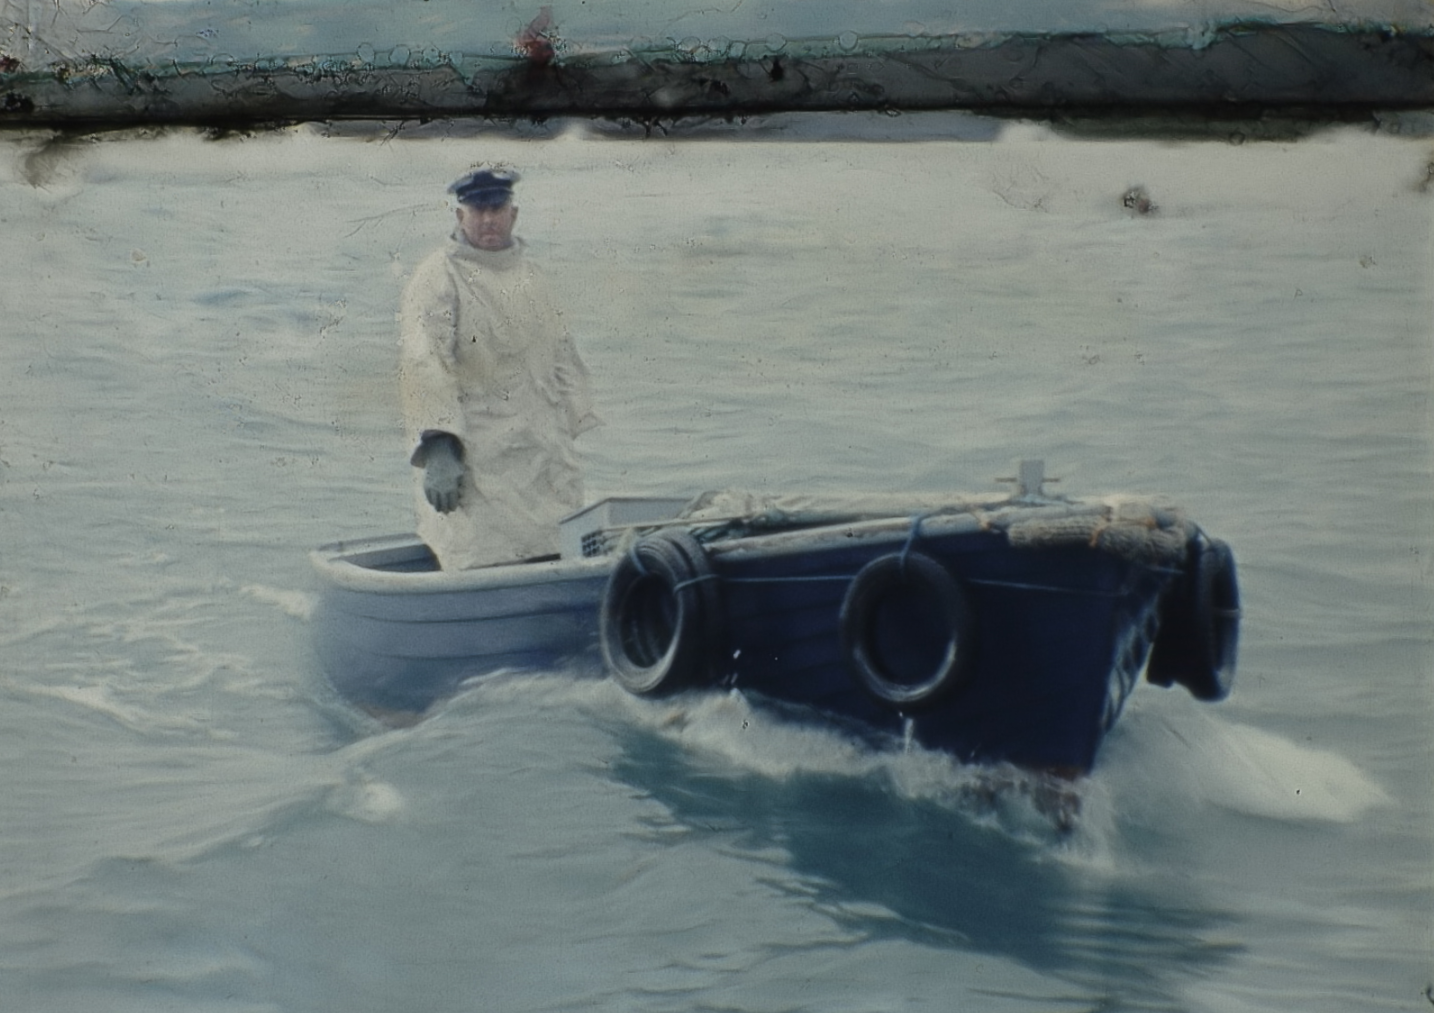
From the Culch, The Bailiff (Paul Mulraney, 2023)

Slide 6
Research Output
From the Culch can be viewed at:
https://vimeo.com/792259305
A recording of the paper Harvested From Bincuts, presented at the BFI Southbank’s FIAT/IFTA Media Studies Seminar 2023:
https://www.youtube.com/watch?v=cICelAiMBas&list=PLDsGt8W90ecDMmyCwsOnuafwjgZWLoKYu&index=1&ab_channel=FIATIFTA
The original can of 16mm film, From the Culch, courtesy Seamonster Media.

Slide 7
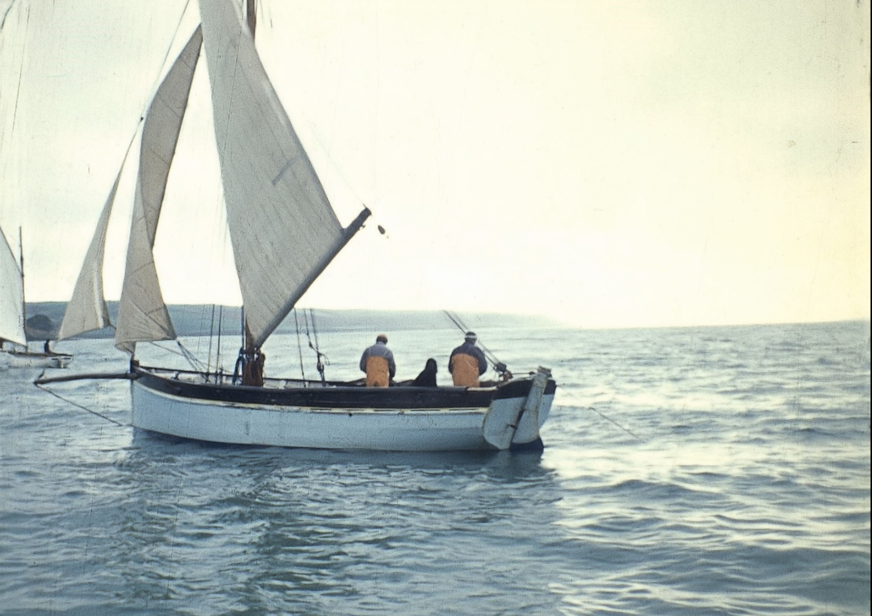
From the Culch, The George Glasson (Paul Mulraney, 2023)

Slide 8
Dissemination
Test screening and Q&A: Flushing Sailing Club (March 2023)
Screening: Falmouth Oyster Festival (October 2023) – Rolling screening throughout the weekend
Screening: Cornwall Film Festival (November 2023) – Public premiere in a Sunday evening themed screening
Screening and Q&A: Porthtowan Ocean Film Festival, St. Agnes Marine Conservation Society (November 2023)
Screening & Academic Paper: Media Studies Seminar, FIAT/IFTA Rethinking Broadcast Archives: Dig, Deconstruct, Display, BFI Southbank (December 2023)
| General Dissemination | Community Dissemination | International Dissemination |

Slide 9
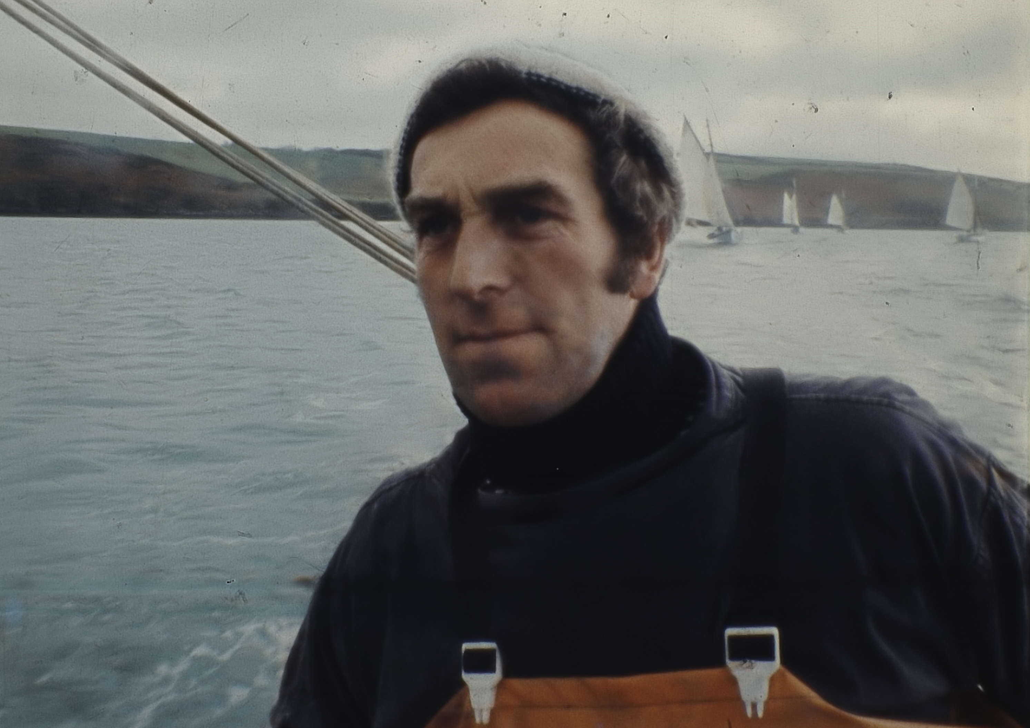
From the Culch, Paul Laity (Paul Mulraney, 2023)

Slide 10
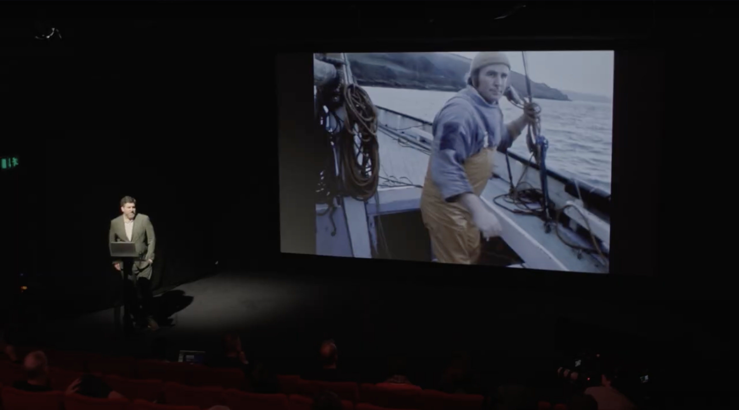
Contextual Evidence
“Very much enjoyed the peacefulness of the imagery and commentary. Started a reflection on the sense of honesty within both, in comparison with the manipulation now inherent in the "documentary" form. Watching, there's no doubt about the truthfulness within, so one relaxes into trusting these fragments."
Kirk Tougas (Cinematographer, The Corporation, Manufacturing Consent / Dir. The Politics of Perception)
Promo for the paper Harvested From Bincuts, at the BFI Southbank
Director’s paper and Q&A at the BFI Southbank:
https://www.youtube.com/watch?v=cICelAiMBas&list=PLDsGt8W90ecDMmyCwsOnuafwjgZWLoKYu&index=1&ab_channel=FIATIFTA

Slide 11
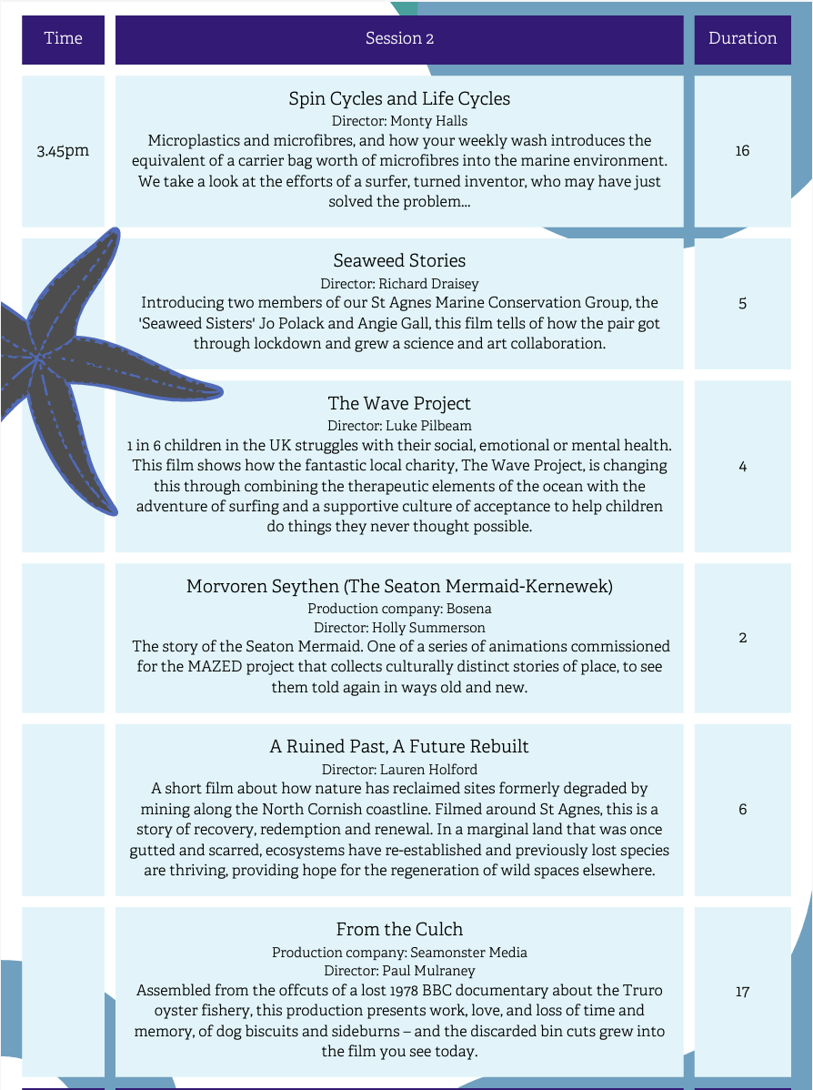
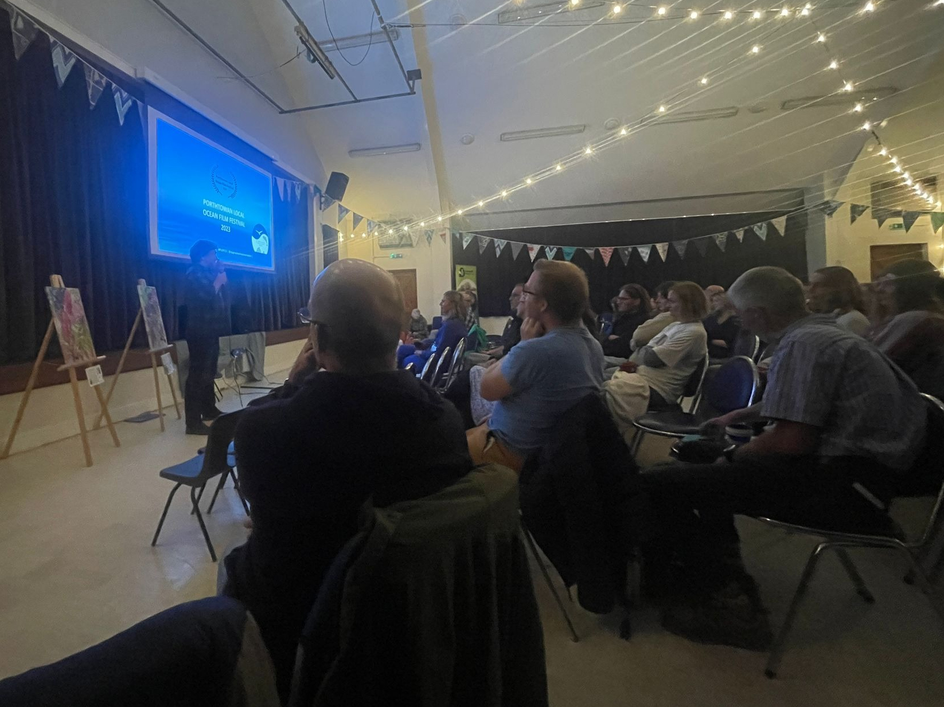
Contextual Evidence (cont)
Director’s Q&A at the Porthtowan Ocean Film Festival
“From the Culch was an important film for the festival as it brought such a different perspective to the audience. It was poignant and moving and, though based on historical footage, it was still so relevant as that fishery, the last of its kind, still operates today. One of the key features of the festival was hearing from the filmmakers themselves and this was highly valued by the audience in the feedback. Having Paul present to meet people in the intervals and take part in the Q&A sessions was integral to the success of a project that one hundred percent of respondents said they would like to see repeated."
Angela Gall (Festival Organiser, Director St Agnes Marine Conservation Society)
Promo for the film’s screening in the ‘Tides of Connection’ event in the 2023 Cornwall Film Festival
Promo in the Porthtowan Ocean Film Festival programme

Slide 12
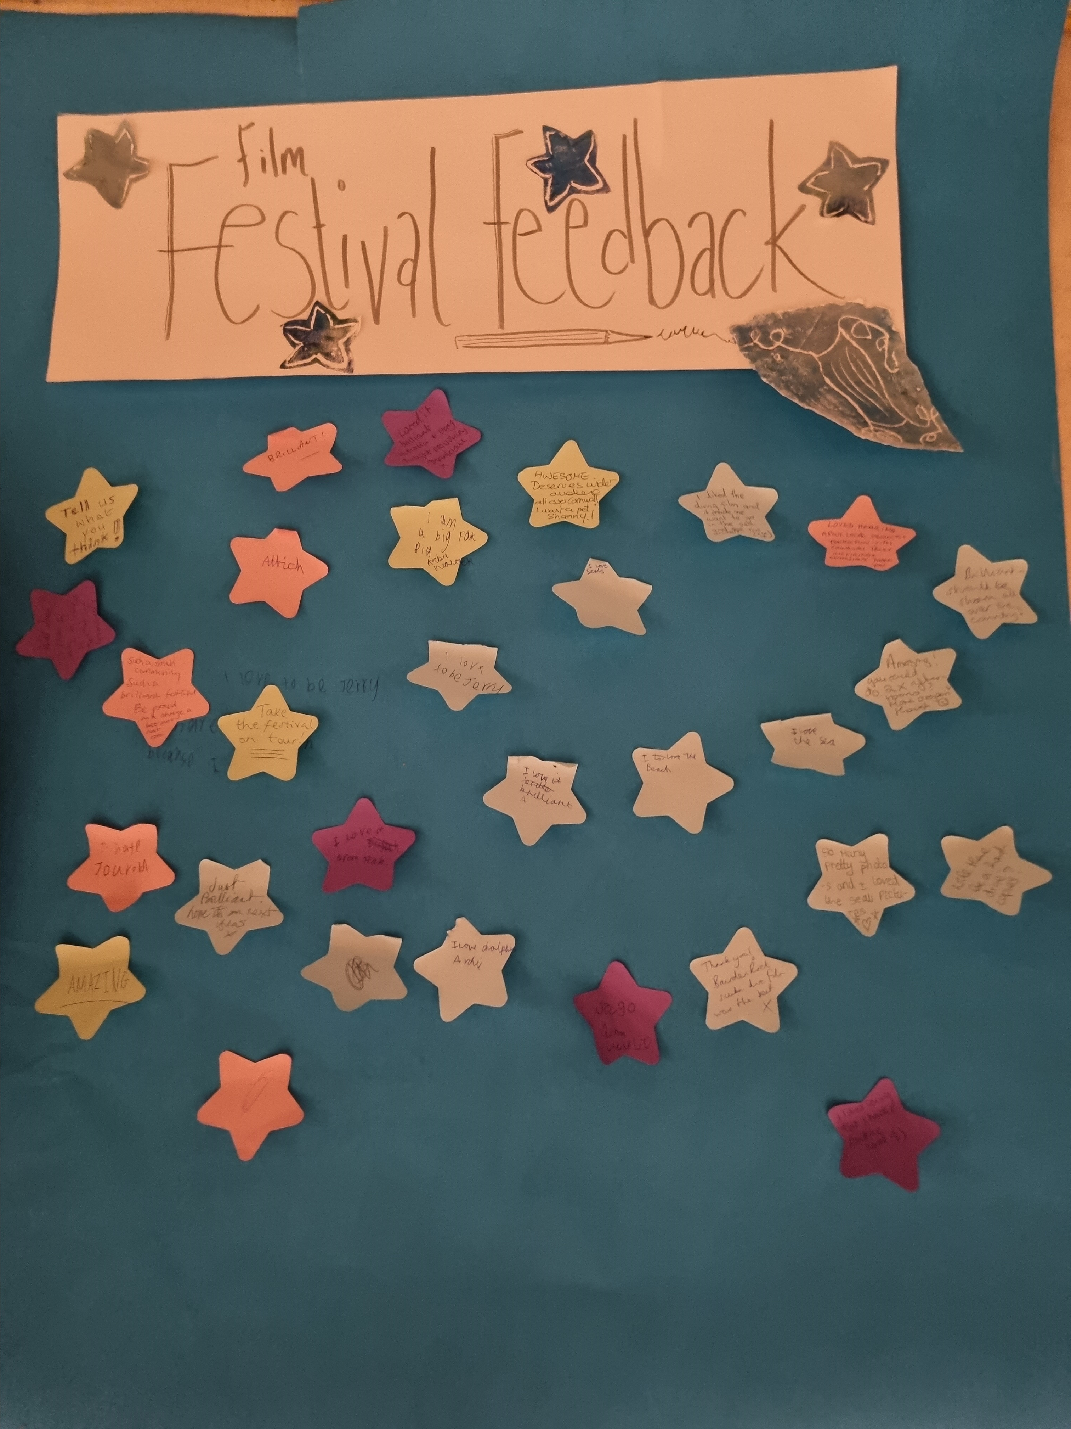
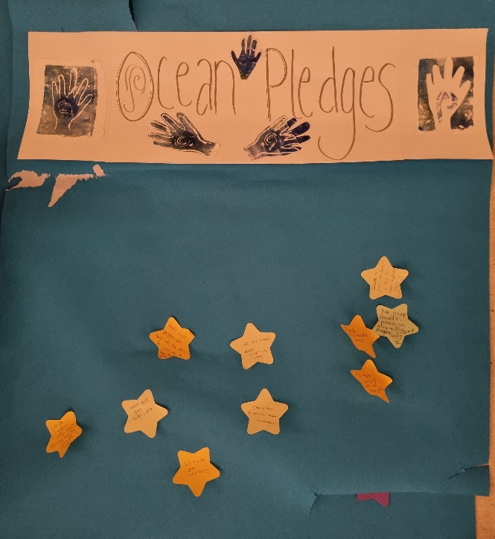
Contextual Evidence (feedback)
Will you make any changes in your life as a result of seeing the films?
I was pledging to get involved in Seaquest and seagrass surveys
I thought the seagrass project was super interesting so will research that a bit more.
Looking for an outflow filter.
Maybe volunteer in some capacity apart from beach cleans
Possibly, I have been searching for a new career/ possibly studying again, and find events like these very inspiring and mind opening, and hopefully they will guide me in new direction (purpose)
Get more involved with the local community
I hope to join some of the events run by the group.
Yes
Yes several things to change
Yes. We are going to get a filter for our washing machine
I already do beach and village cleans whenever possible, I recycle as much as possible and try to do things to protect the environment. I will now look at different ways of doing my weekly washing.
Collated audience feedback, Porthtowan Ocean Film Festival

