Slide 1
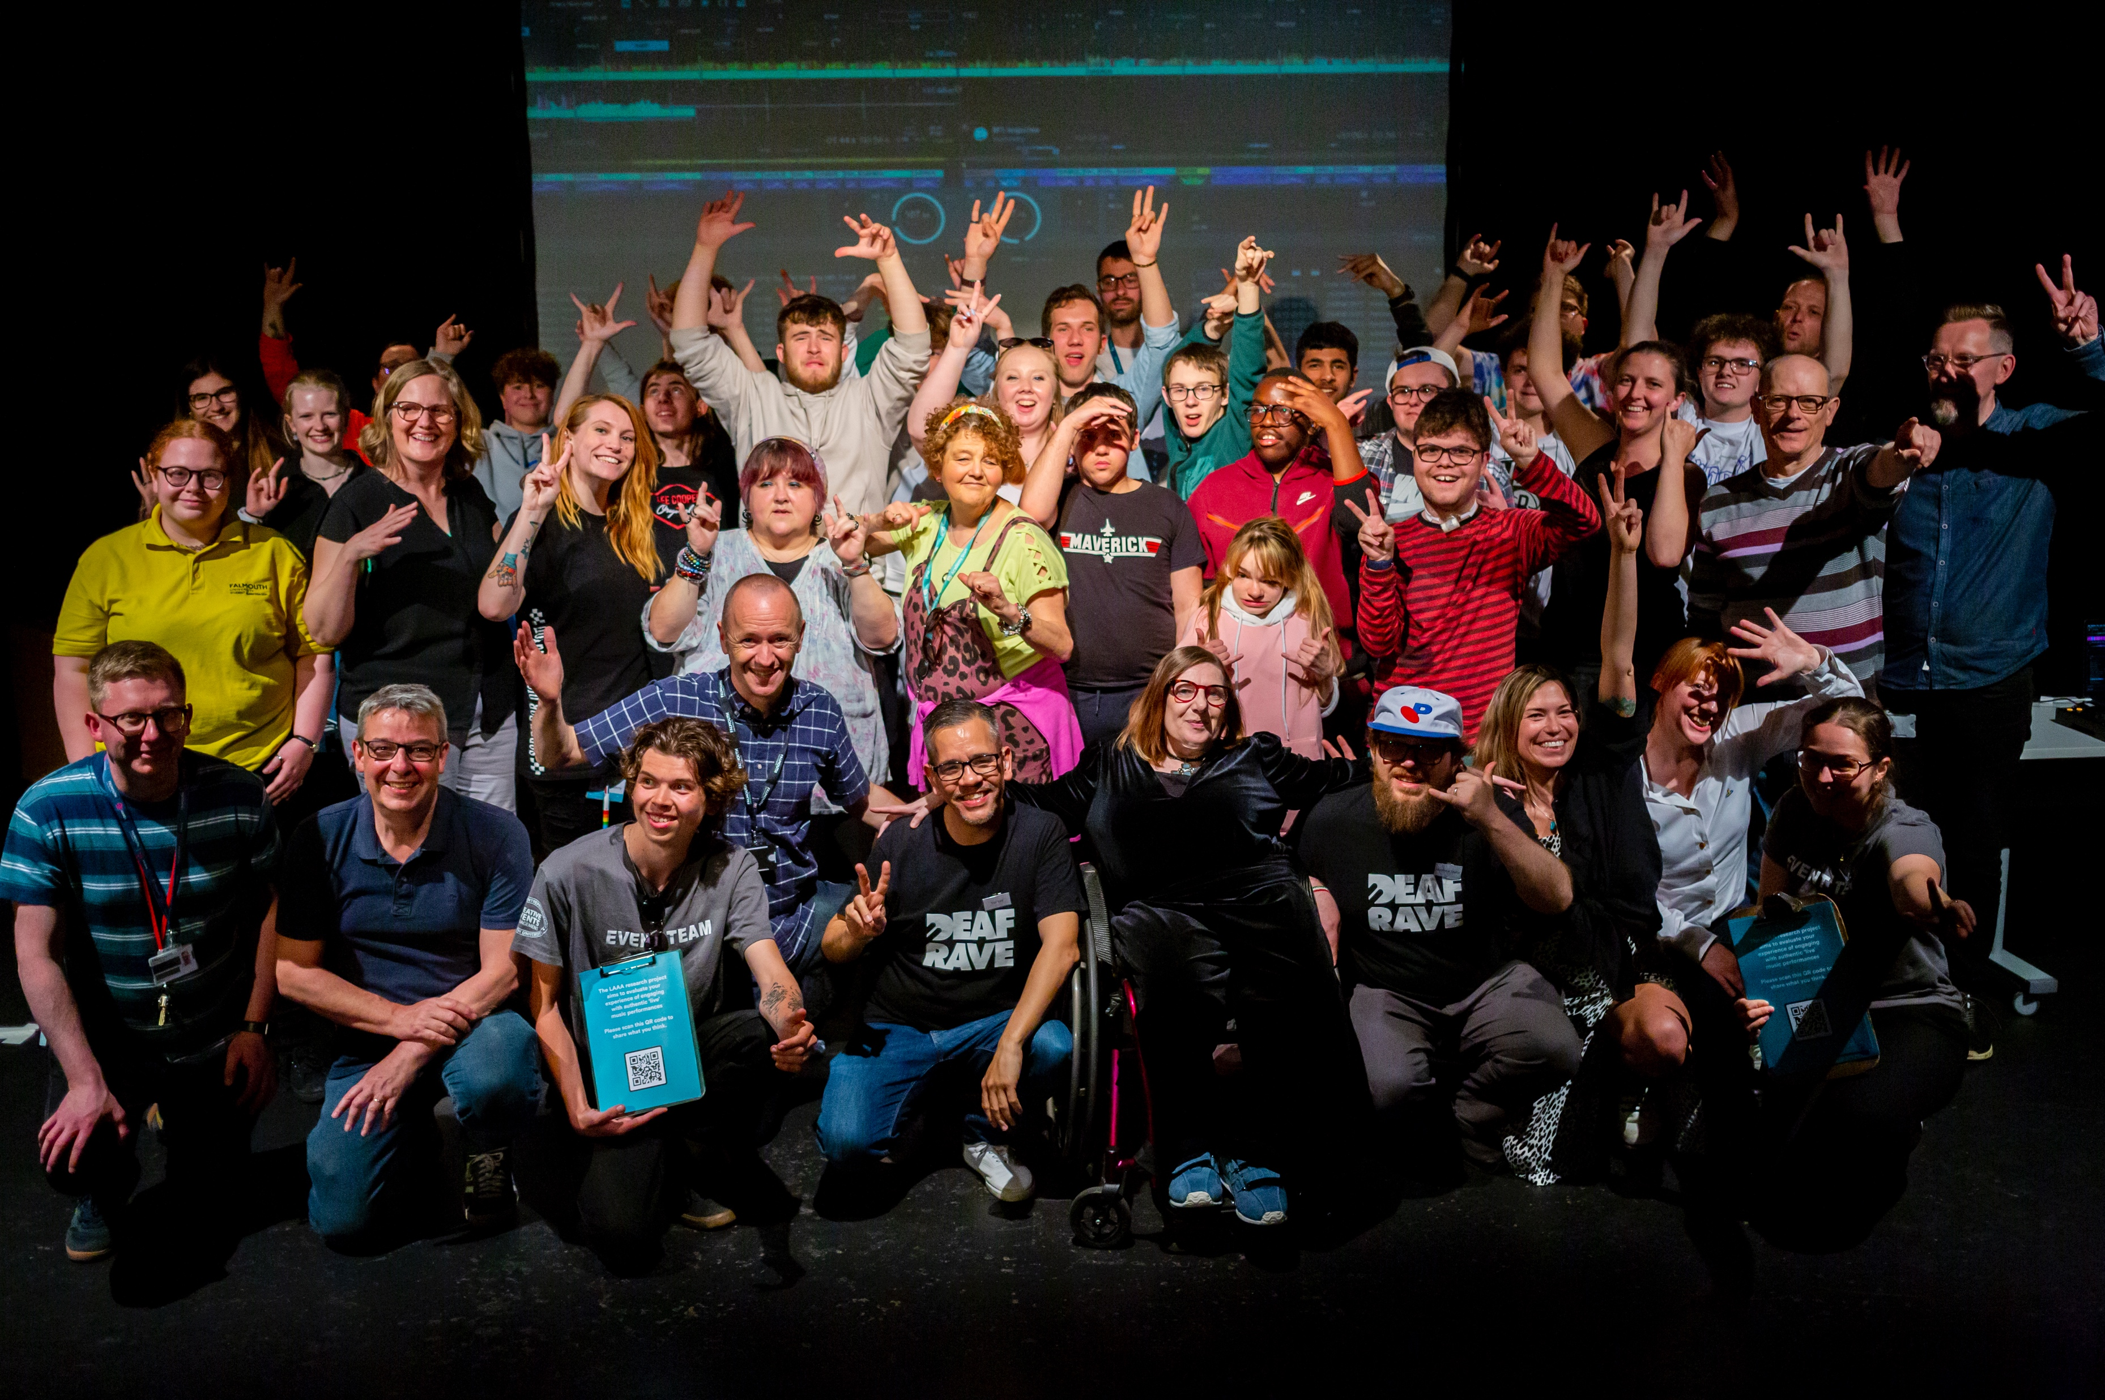
Accessibility and inclusion in Festivals
IMAGE: Deaf attendees at LAAA Project DJ Workshops CREDIT: M. Jessop
Adrian Bossey
Notes:
1

Slide 2
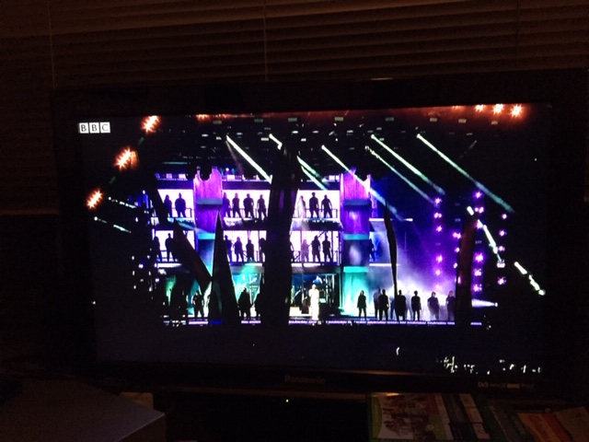
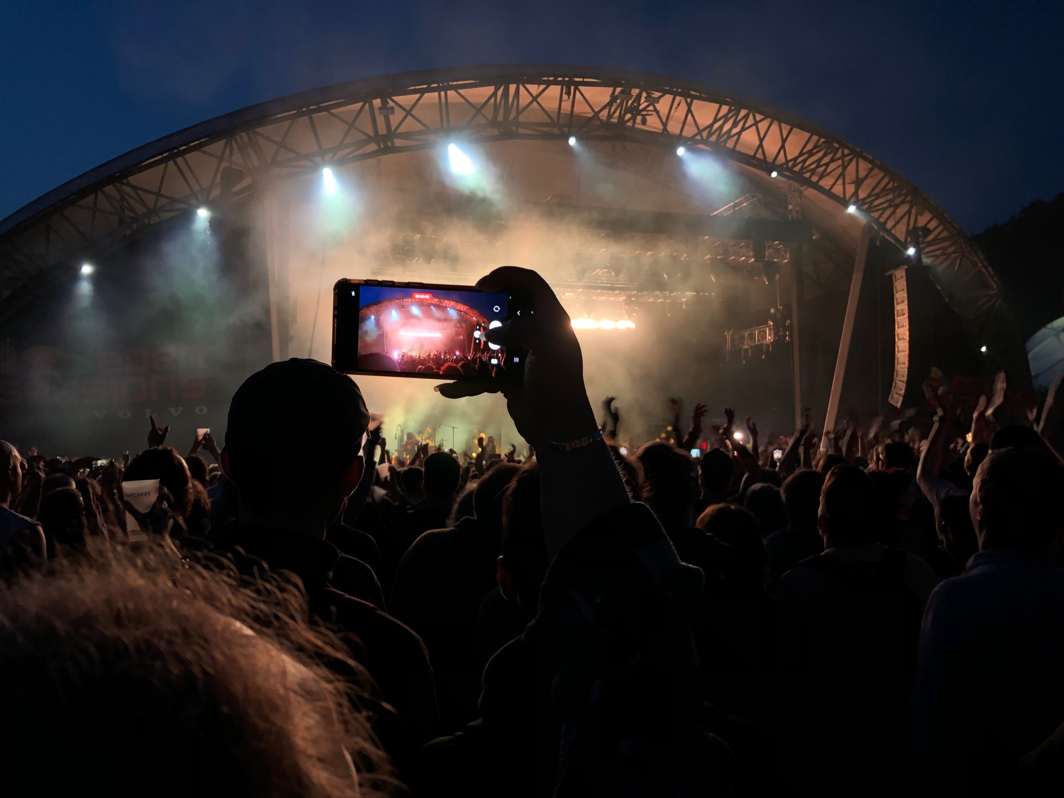
My research:
Considers ‘liveness’ in relation to music festivals
Image: Stormsy live at Glastonbury 2019, ‘live’ on BBC; on my TV Image: Attendees at Eden Sessions 2022 – credit Adrian Bossey
– credit Adrian Bossey
It has evolved to incorporate accessibility…
Notes:
2

Slide 3
Disability in the UK
“An individual can be classified as disabled if they have ‘a physical or mental impairment that has a ‘substantial’ and ‘long-term’ negative effect on (their) ability to do normal daily activities” (The Equality Act, 2010)
In 2020/21, 24 percent of the UK population (16 million people) had a “physical or mental health condition or illness that has lasted or is expected to last 12 months or more” (House of Commons Library 2023:1)
“More than a quarter of UK residents will be aged 65 years or over within the next 50 years” (Office for National Statistics, 2018)
Accessibility refers to “measures put in place to address participation by those with impairments” Finkel, Sharp & Sweeney (2019. 2)

Slide 4
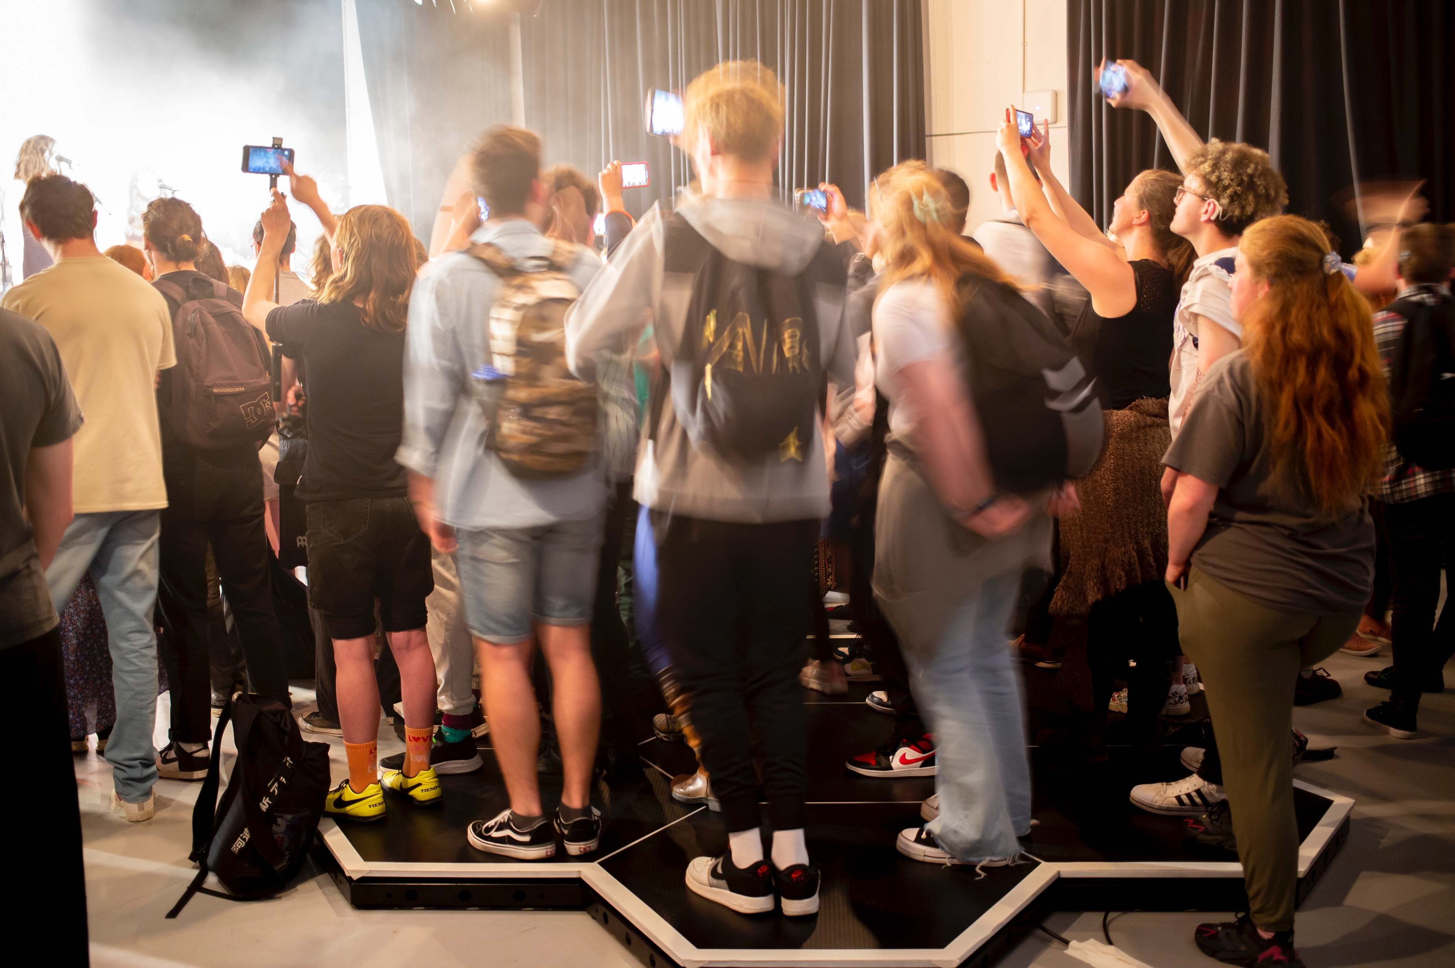
Live Audience Accessibility & Augmentation Project
Image: LAAA Deaf attendees using haptic floor CREDIT Matt Jessop
Notes:
4

Slide 5
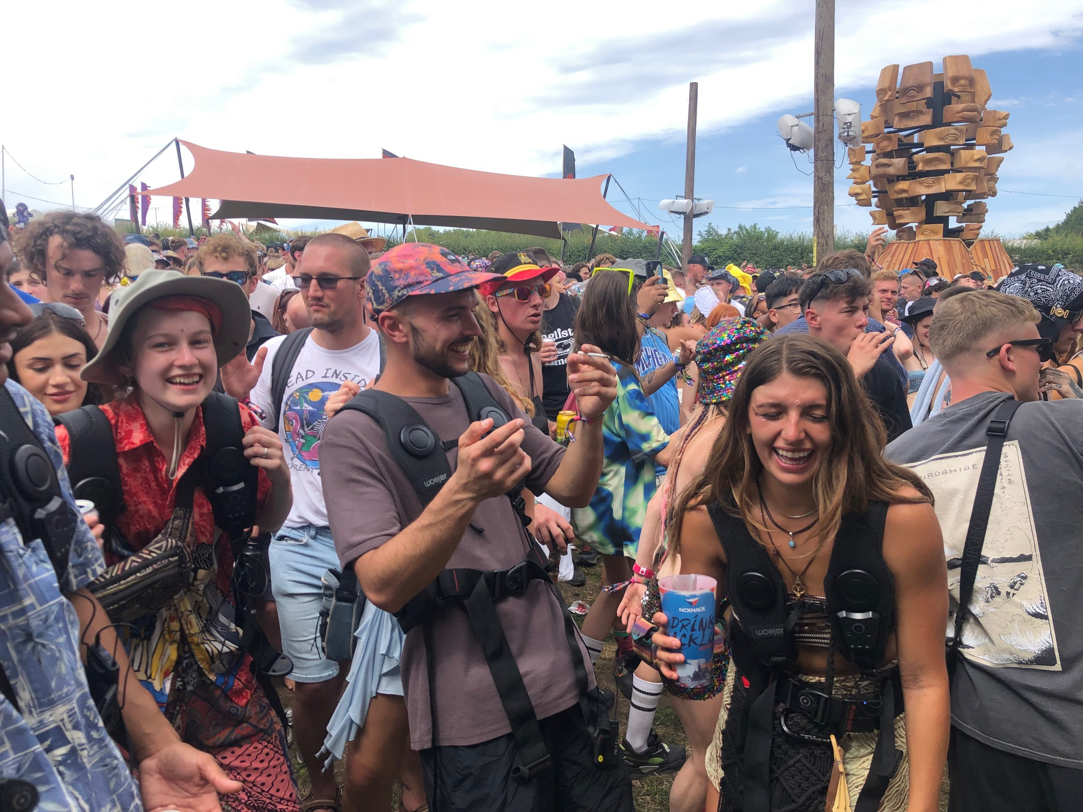
Live Audience Accessibility & Augmentation 2 Festivals
Image: Attendees at Boomtown Fair 2023 during Deaf Rave takeover – credit Adrian Bossey
Notes:
5

Slide 6
On-line Accessibility Training
Attitude is Everything: Disability Equality for the Live Events Industry
Next start date 4 March 2024
Please contact shortcourses@falmouth.ac.uk

