Slide 1
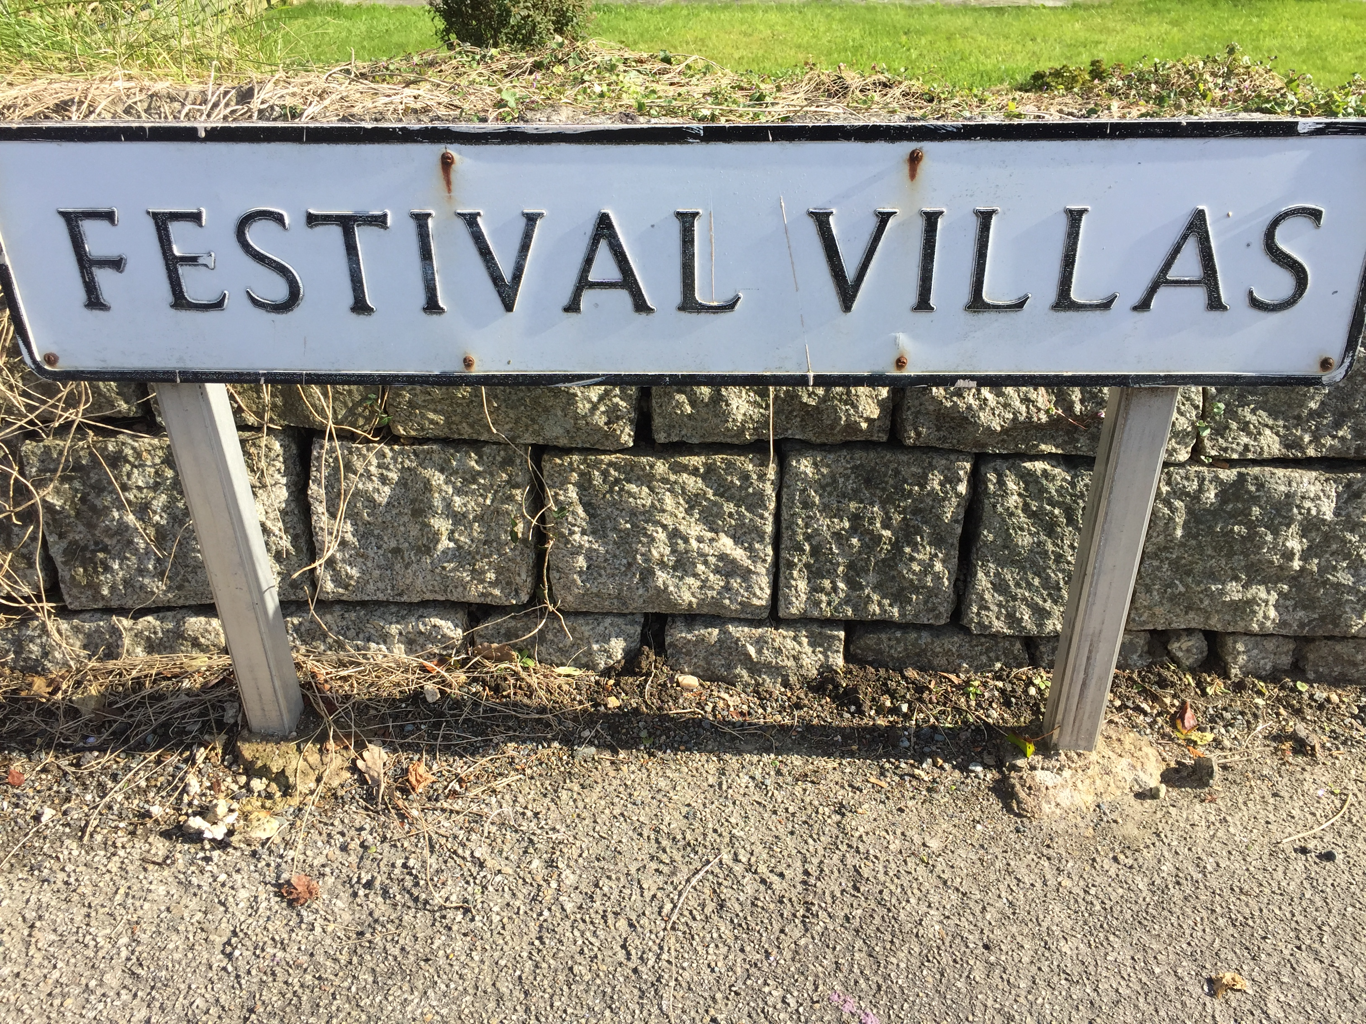
What we talk about when we talk about sustainability
IMAGE: ‘Festival villas’ street sign CREDIT: A. Bossey
Adrian Bossey
Notes:
1

Slide 2
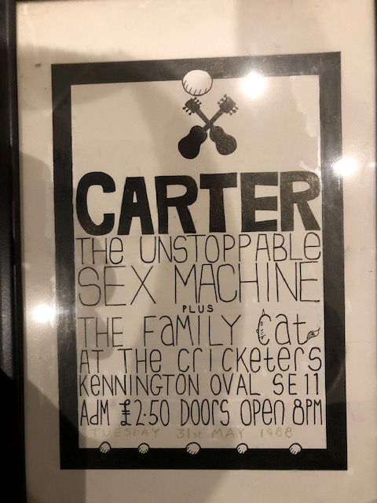
So, what do I know?
IMAGE: ‘Carter’ pub gig poster CREDIT: A. Bossey IMAGE: ‘Glastonbury’ 1992 poster CREDIT: A. Bossey
Captured on film ... Q. WHAT IS SUSTAINABILITY?

Slide 3
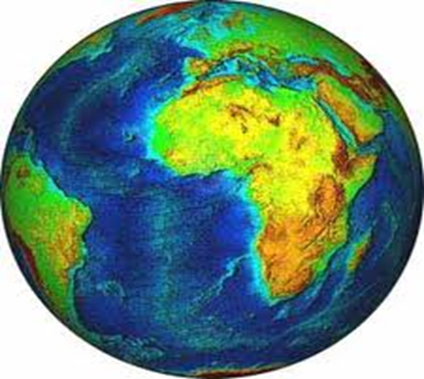
Sustainability Definition
"Development that meets the needs of the present without compromising the ability of future generations to meet their own needs” Brundtland Report – ‘Our Common Future (1987)
We need to consider financial, social and environmental issues
Focusing solely on environmental issues will not be sufficient

Slide 4
We’ve come a long way (baby)
IMAGE: ‘Glastonbury Festival site in 1981. IMAGE: ‘Glastonbury Festival’ site in 2016
1981 – 18,000 capacity 2016 – 203,000 capacity
£8 per ticket £228 + £5 booking fee
Very poor traffic management Fined £31,000 for pollution
Very poor accessibility! Gold AiE Charter of Best Practice
Supported CND £2m Greenpeace, Oxfam, Water Aid
ITV broadcast Warming Warning Declarations of climate emergency

Slide 5
On-line Sustainability Training
A Greener Festival: Assessing Sustainability for the Live Events Industry
Next start date 12 February 2024
Please contact shortcourses@falmouth.ac.uk

