Slide 1
Bringing industry and students together via CPD
AEME Teaching & Learning SIG Presentation
Adrian Bossey

Slide 2
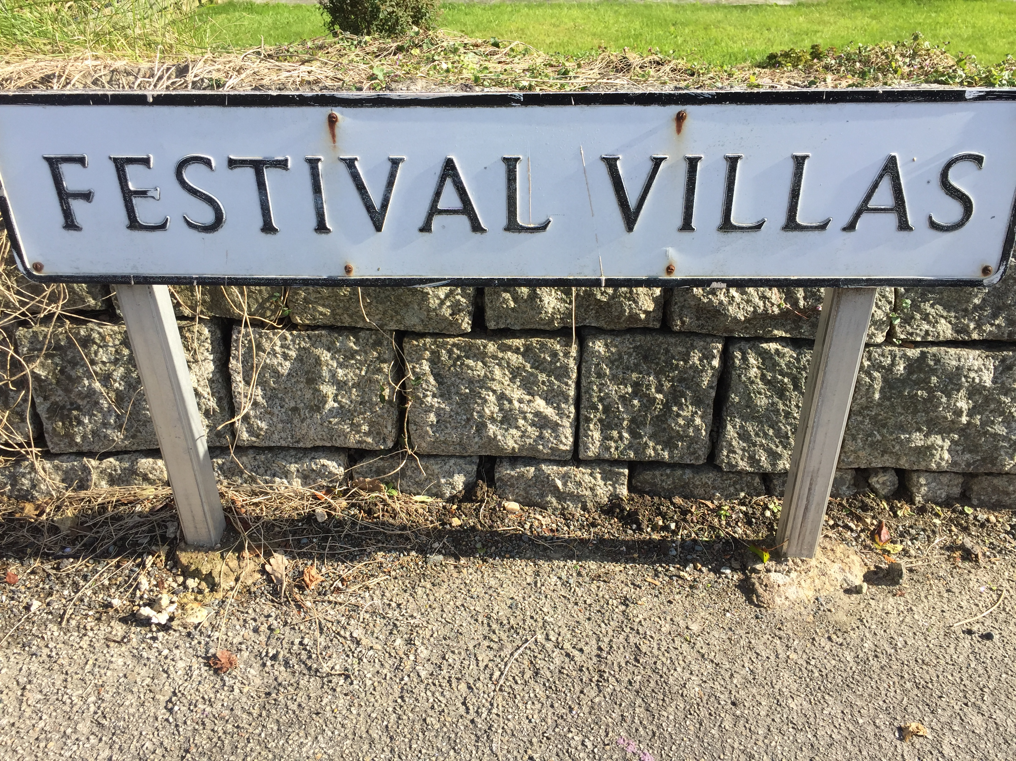
Overview
Identified need in the live music sector
Development of 2 online short courses
Student benefits of studying with industry practitioners
Practitioner understanding of HE and how great our students are
demonstrate the symbiotic relationship
What is sustainability?
Image: ‘road to employability’ CREDIT: A Bossey

Slide 3
Defining Sustainability
"Development that meets the needs of the present without compromising the ability of future generations to meet their own needs” Brundtland Report – ‘Our Common Future (1987)
Need to consider financial, social and environmental issues
Focusing on environmental issues will not be sufficient
Climate emergency creates urgent need for training

Slide 4
Measuring Disability in the UK
“An individual can be classified as disabled if they have ‘a physical or mental impairment that has a ‘substantial’ and ‘long-term’ negative effect on (their) ability to do normal daily activities” (The Equality Act, 2010)
In 2020/21, 24 percent of the UK population (16M people) had a “physical or mental health condition or illness that has lasted or is expected to last 12 months or more” (House of Commons Library 2023:1)
“More than a quarter of UK residents will be aged 65 years or over within 50 years” (Office for National Statistics, 2018)
Accessibility refers to “measures put in place to address participation by those with impairments” Finkel, Sharp & Sweeney (2019. 2)

Slide 5
Our Response
Developed two on-line CPD courses with Cambridge Education Group Digital … on Canvas VLE
Partnership with A Greener Future and Attitude is Everything
Simultaneous delivery to students and industry practitioners
Centred on specialist input from industry partners
Mix of asynchronous lecture materials, interviews, online tasks and forums, synchronous ‘expert’ webinars and multiple-choice assessment
Launched in September 2017 and run up to 3 times a year
Over 350 industry practitioners and 750 students

Slide 6
On-line Accessibility Training
Attitude is Everything: Disability Equality for the Live Events Industry
Next start date 4 March 2024
shortcourses@falmouth.ac.uk

Slide 7
On-line Sustainability Training
A Greener Future: Assessing Sustainability for the Live Events Industry
Next start date 2 June 2024
shortcourses@falmouth.ac.uk
1st stage of AGF assessor training

Slide 8
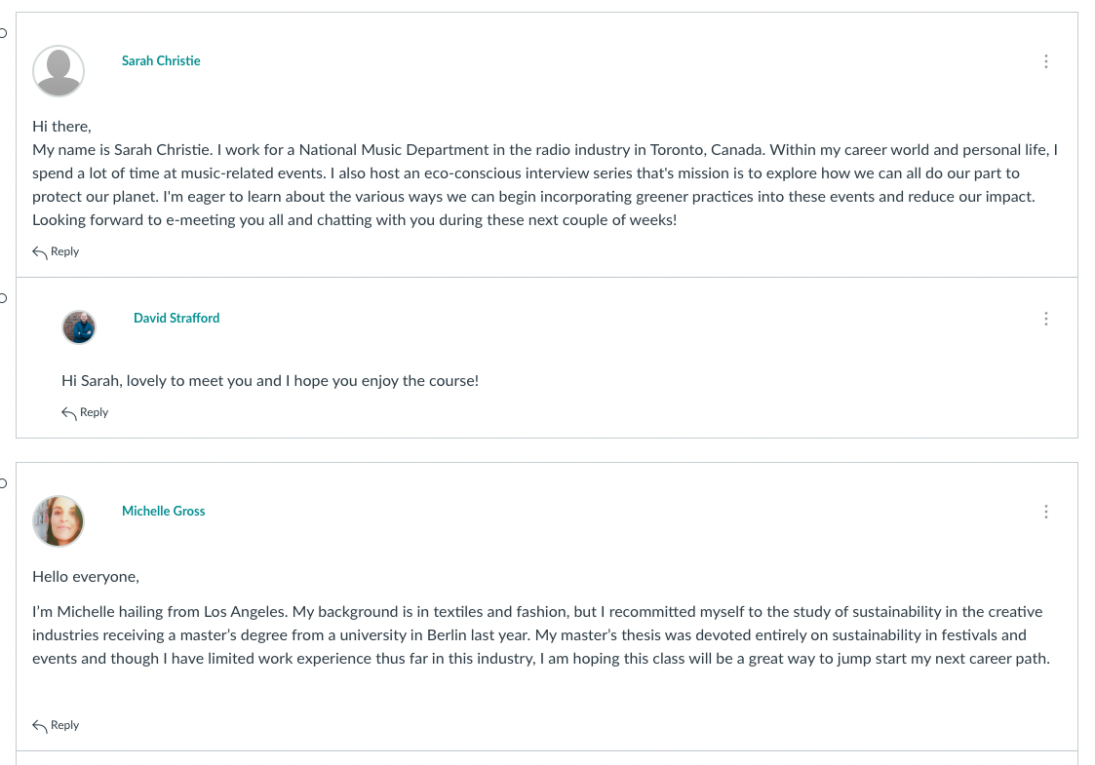
Benefits to Students
Networking, networking, networking
Specialist knowledge
Industry speakers
Employability
Confidence

Slide 9
A symbiotic relationship
Networking, networking, networking, etc
Practitioners gain an understanding of HE and may apply for our full MA Creative Events Management
Consider the benefits of working with our lovely students

Slide 10
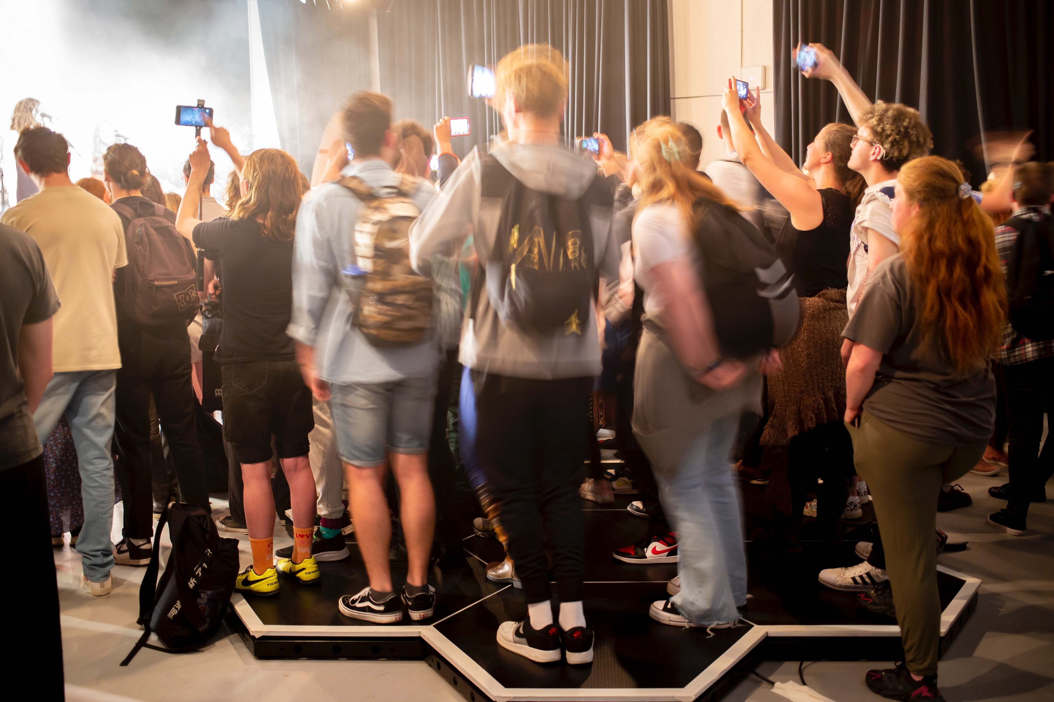
Discussion / Questions
Many thanks
Image: LAAA Deaf attendees using haptic floor CREDIT Matt Jessop

Slide 11
References
Brundtland, G (1987) Report of the World Commission on Environment and Development: Our Common Future https://sustainabledevelopment.un.org/content/documents/5987our-common-future.pdf (accessed 08/06/20) World Commission on Environment and Development. Geneva.
DWP (Department for Work & Pensions) (2010). Equality Act 2010. HM Stationary Office. London.
Finkel, R, Sharp, B & Sweeney, M (2019). Accessibility, Inclusion, and Diversity in Critical Event Studies. Routledge. Abingdon.
House of Commons Library (2022 August 23) UK disability statistics: Prevalence and life experiences https://commonslibrary.parliament.uk/research- briefings/cbp-9602/ HMSO
Office for National statistics (2018) https://www.ons.gov.uk/peoplepopulationandcommunity/populationandmigration/populationestimates/articles/overviewoftheukpopulation/novemb er2018 (accessed 09.02.19) HM Stationary Office. London

