Slide 1
Teaching and learning in User Experience
(UX) Design
Dr James Branch
School of Communication Research Seminar Series 2023-24. Falmouth University, UK, 8 November 2023
Notes:
Thanks to Abigail and Ruth for making this event happen
Good to have this platform to present and discuss my work with colleagues.
Today I’m going to talk through highlights of my recently completed PhD.
I want to put your mind at ease — I’m not going to run through the whole thing — I’ve tried to pull-out a bit that I think is most interesting and might have some cross-over for colleagues in other fields.
I’m trying to shape up some of my thinking into a paper so this session may help me towards that goal

Slide 2
Overview of this presentation
1. PhD research into UX practice and HE education
2. An element of the UX Pedagogy Toolkit outcome
3. Wider implications for learning and teaching
Notes:
Background and Context
I worked in the Creative Industries for 10 years in London then I was a lecturer at Winchester School of Art where I was Course Leader for MA Communication Design
Prior to the PhD I was already working in Higher Education

Slide 3
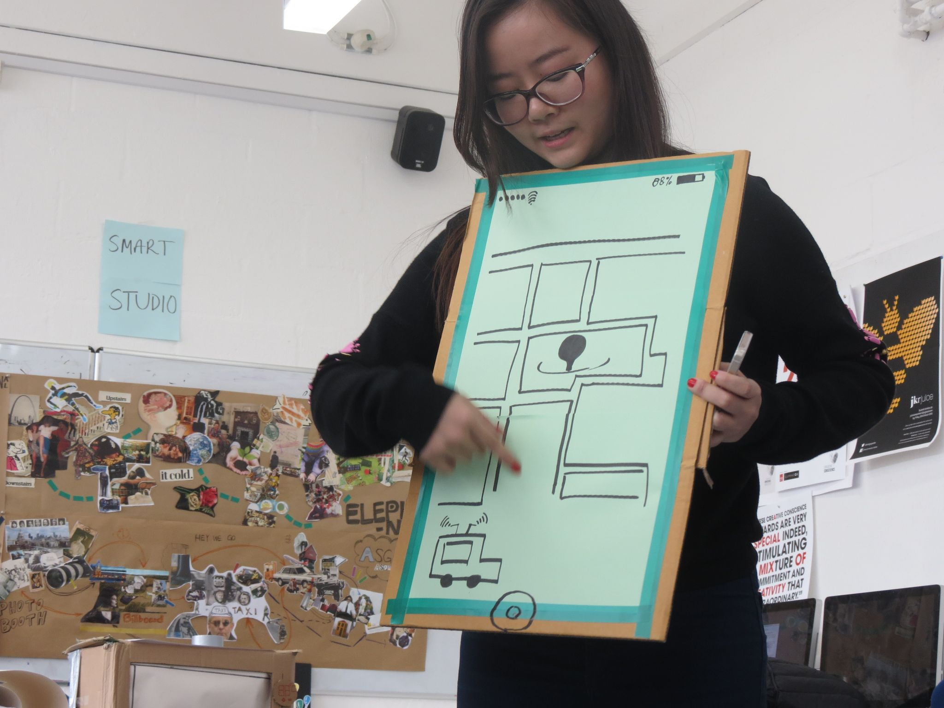

Background and context
Notes:
I would position my research as somewhere in between Design Research i.e. Research aimed at better understanding design practice
And Educational Research i.e. Research aimed at better understanding and informing teaching and learning.

Slide 4
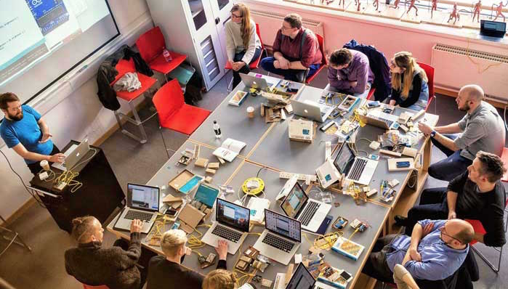
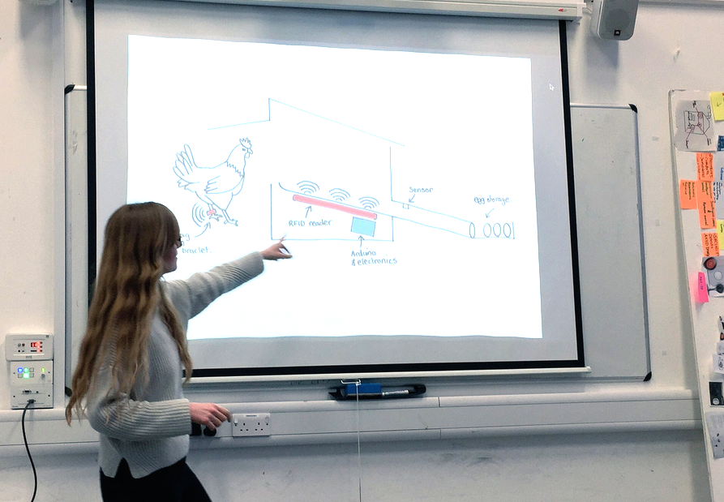
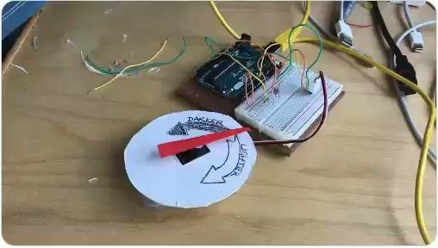
Communication design is evolving
Notes:
Very much interested in the way the discipline communication design is evolving as media changes and trying to keep up with that
And thinking about what aspects of the subject should endure and what aspects need to change
In that spirit I wanted to update my practice
Also, needed a framework and structure to develop research and be held accountable
And my supervisors definitely stepped up to that role!!

Slide 5
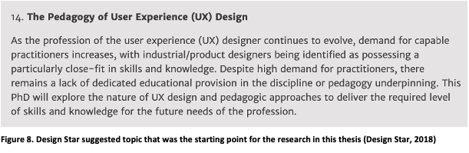
AHRC Studentship – Research Topic
Notes:
Very much interested in the way the discipline communication design is evolving as media changes and trying to keep up with that
And thinking about what aspects of the subject should endure and what aspects need to change
In that spirit I wanted to update my practice
Also, needed a framework and structure to develop research and be held accountable
And my supervisors definitely stepped up to that role!!

Slide 6
What is user experience?
Notes:
Thanks to Abigail and Ruth for making this event happen
Good to have this platform to present and discuss my work with colleagues.
Today I’m going to talk through highlights of my recently completed PhD.
I want to put your mind at ease — I’m not going to run through the whole thing — I’ve tried to pull-out a bit that I think is most interesting and might have some cross-over for colleagues in other fields.
I’m trying to shape up some of my thinking into a paper so this session may help me towards that goal

Slide 7

Difficult to use interface
Notes:
User experience is a term with a few meanings and if very ambiguous discipline a practice and an interface so I thought it might be helpful to provide a broad brush definition.
If you want to go deeper there are over a million Medium posts online dedicated to the topic.
Thinking about what UX is might be illustrated by this example so you often can’t perform the basic task you want (watch TV) with these overly complex interfaces.

Slide 8
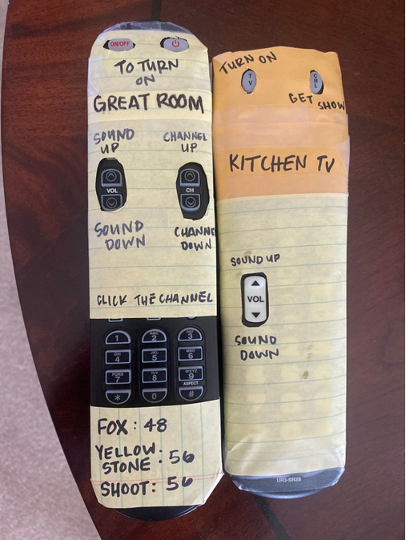
UX = User needs + technological capability + business priorities
Notes:
High level a definition — the aspiration is UX tries to make products services better, more intuitive, enjoyable to use by being the person in the room that is focussing on users and user needs alongside the technical people and business people.
This is important as more and more aspects of our lives are subject to digital transformation — Software, apps, but also now really services that span across physical and digital touchpoints

Slide 9

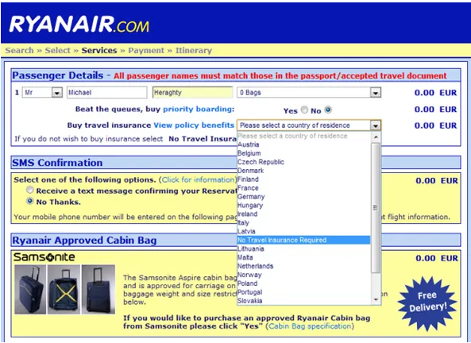
Good and bad examples of UX
Notes:
Here is a good and bad example of user experience design

Slide 10
The problem
Notes:
Thanks to Abigail and Ruth for making this event happen
Good to have this platform to present and discuss my work with colleagues.
Today I’m going to talk through highlights of my recently completed PhD.
I want to put your mind at ease — I’m not going to run through the whole thing — I’ve tried to pull-out a bit that I think is most interesting and might have some cross-over for colleagues in other fields.
I’m trying to shape up some of my thinking into a paper so this session may help me towards that goal

Slide 11
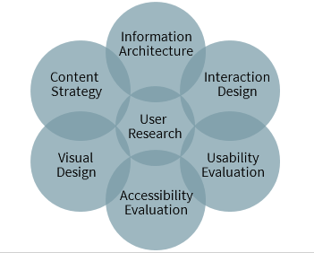
Transdisciplinary and fast changing
Notes:
User Experience (UX) is indeed transdisciplinary. It integrates methods, values, and perspectives from various disciplines to optimize design for user interaction and satisfaction.
UX draws from applied psychology (to grasp how people perceive, remember, think, and solve problems), design, information architecture, computer science, human-computer interaction, and several other fields to create products that are not only functional but also user-friendly and enjoyable to use

Slide 12


In-demand role with competitive salaries

Slide 13

UX Bootcamps
Notes:
Thinking back to pre-pandemic there was quite good salaries for entry level UX jobs.
A lot of bootcamp courses created that promised you could be a UX designer in 2-6 weeks or even 7-9 hours in this example.

Slide 14
UX started in 1993 and courses are now slowly emerging in academia
10
Dedicated UXD degree courses in UK (UCAS, 2021)
22
UXD degree related courses in UK – HCI, Interaction
Design (UCAS, 2021)
Notes:
Thinking back to pre-pandemic there was quite good salaries for entry level UX jobs.
A lot of bootcamp courses created that promised you could be a UX designer in 2-6 weeks or even 7-9 hours in this example.

Slide 15

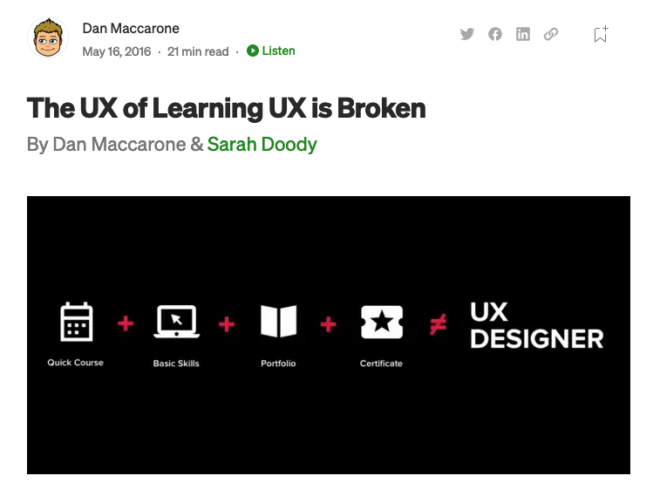
Real world problem
Notes:
Unis were slow to develop courses
UX courses developed in HE were too reliant on traditional disciplines and reflected traditional subjects and departmental biases
Bootcamps over promised and flooded the job market with learners that actually needed much more development

Slide 16
Research problem
Key concerns in scholarship:
UX Curricula (Poor alignment between academia + industry)
Research designed to inform education not grounded in practice
Less research aimed at providing practical support for academics who are building educational pathways
Notes:
Research into UX pedagogy is an emerging area of scholarship

Slide 17
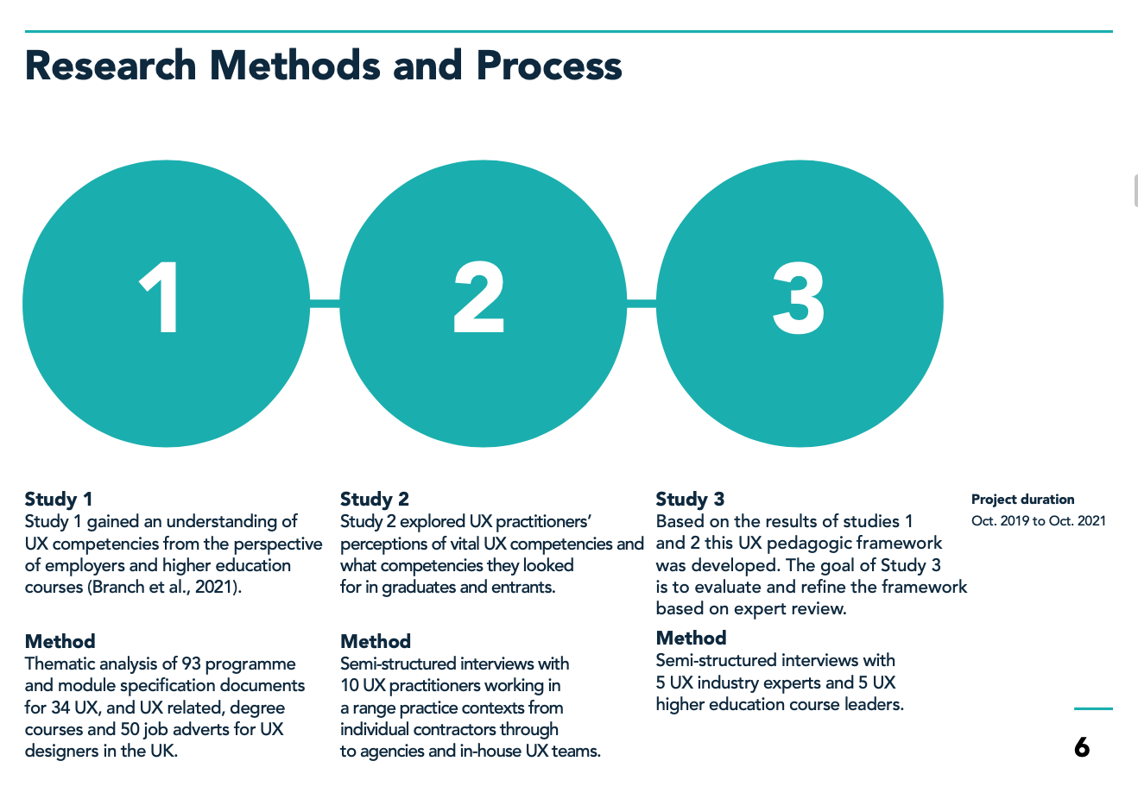
PhD Overview
Notes:
Research into UX pedagogy is an emerging area of scholarship

Slide 18
Study 2
What are UXD practitioners’ perceptions of UXD competencies
required for effective practice?
Method: Interviews with 10 UX practitioners
Notes:
Research into UX pedagogy is an emerging area of scholarship

Slide 19
Objectives
Examine UXD practitioner perceptions of their work, in order to establish vital UXD competencies.
Examine UXD practitioner perceptions of competencies needed by entrants, in order to establish vital UXD competencies needed by graduates.
Notes:
Research into UX pedagogy is an emerging area of scholarship

Slide 20
Stratified purposeful sampling strategy (n=10)
Consultants working individually or in small groups independently with external clients on a short-term basis.
Internally facing user experience agencies within a wider organisation.
Small client-facing user experience agencies.
Large client-facing user experience agencies.
Notes:
Small sample size practical reasons – exploratory study – Generalisability / Transferability — In qualitative research whether these findings are generalisable or transferable to other contexts can only be determined by other researchers who know and have access to those fields. What I have done is provide detailed pathway.
A researcher facilitates transferability by providing rich and detailed descriptions of the research context, that enable the reader to make an informed judgement as to whether the findings are transferable to their own setting (Korstjens and Moser, 2018).

Slide 21
Example interview questions
Looking at the best people in your current UXD team —
Why are they good at their job?
What competencies do entrants to UX need?
Are there specific areas of knowledge and skill that entrants commonly lack?
Notes:
Research into UX pedagogy is an emerging area of scholarship

Slide 22
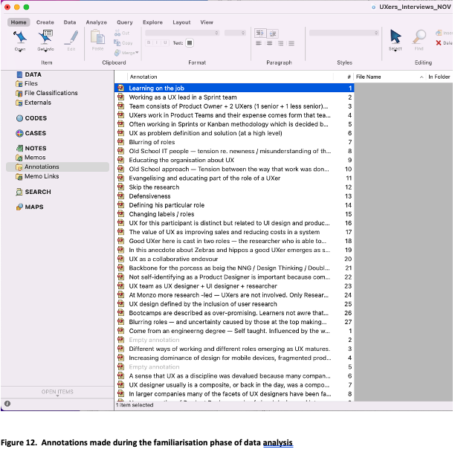
Reflexive Thematic Analysis – Themes inductively derived from dataset
Notes:
Themes were derived inductively from the dataset
Crucial to the reflexive TA approach is the recognition that the researcher has an active role in the creation of themes, rather than the idea that themes are in the data waiting to be identified (Braun and Clarke, 2019).

Slide 23
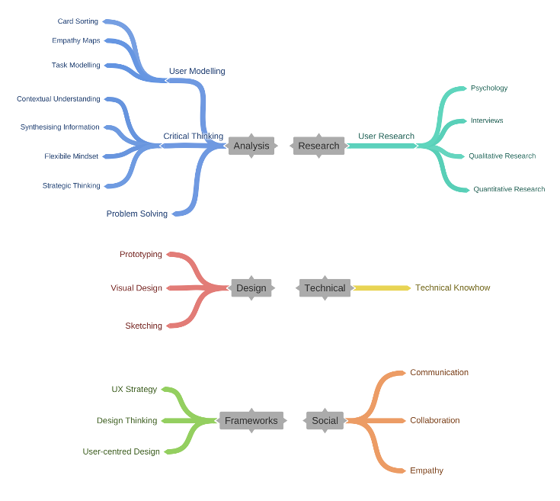
Analytical, critical thinkers, problem solvers, good soft skills
Notes:
The most crucial capability that UX workers valued was a design identity this was characterised by participants when they discussed desirable competencies, such as analytical thinking, a generalised critical and problem-solving mindset, and soft skills needed to work collaboratively

Slide 24
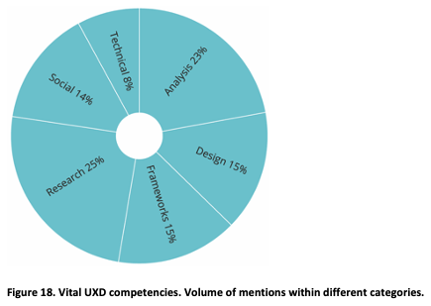
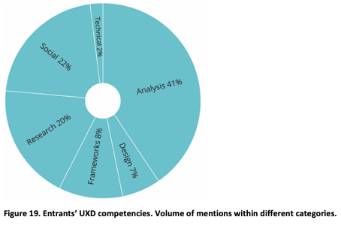
Shift to personal characteristics and social for entrant’s competencies
Notes:
Comparing UX designers most values competencies with the competencies they most desired in newcomers there was a huge swing towards analysis and interpersonal skills

Slide 25
Key quotes
“The real thing I look for is attitude and ability to solve problems and think strategically about the work”
“You can teach the other stuff but it's much harder to shift
a mindset”
“There isn't a kind of fixed view of — use these tools to do this thing — It kind of evolves based on what you need at that particular time and what other people have shared…”
Notes:
This idea of vital competencies started to break down
Research with interaction designers revealed a range of additional factors, beyond ease and efficiency, that influenced how designers selected their tools, including: “personal character, experience, and social, material and cultural context in which the design process takes place” (Stolterman and Pierce, 2012, p. 28).

Slide 26


Vital competencies = Moving target
“Less a static entity or documentable system.
Or application of tightly defined tools and methods”
(Gray, 2016).
More an emergent process dependent on practitioner
experience, organisational context, and problem at hand.
Notes:
This idea of vital competencies started to break down
Research with interaction designers revealed a range of additional factors, beyond ease and efficiency, that influenced how designers selected their tools, including: “personal character, experience, and social, material and cultural context in which the design process takes place” (Stolterman and Pierce, 2012, p. 28).

Slide 27
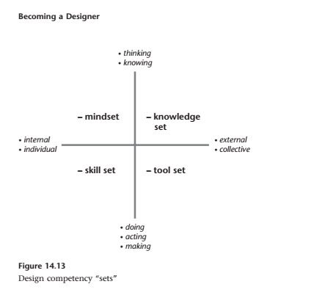
Results replicated earlier research
“For HCI students starting out in UX practice, many of the competencies that are needed for success are not content oriented, but rather are attitudes and approaches to negotiating complexity, collaborating
in corporate environments, and communicating with diverse stakeholders
in order to effectively advocate for users”.
(Gray, 2014, 2016)
Notes:
Design learning or inquiry can be seen as a process of managing competency sets that are interrelated among the quadrants. These sets — mindsets, knowledge sets, skill sets, and tool sets — must be established and filled in the process of becoming a designer
Nelson, Harold G.; Stolterman, Erik. The Design Way: Intentional Change in an Unpredictable World (The MIT Press) (p. 230). The MIT Press. Kindle Edition.

Slide 28
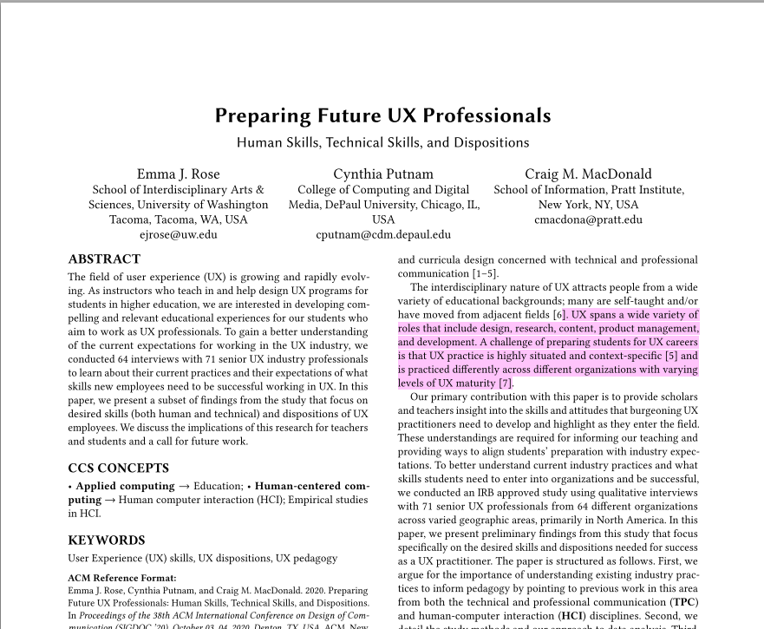
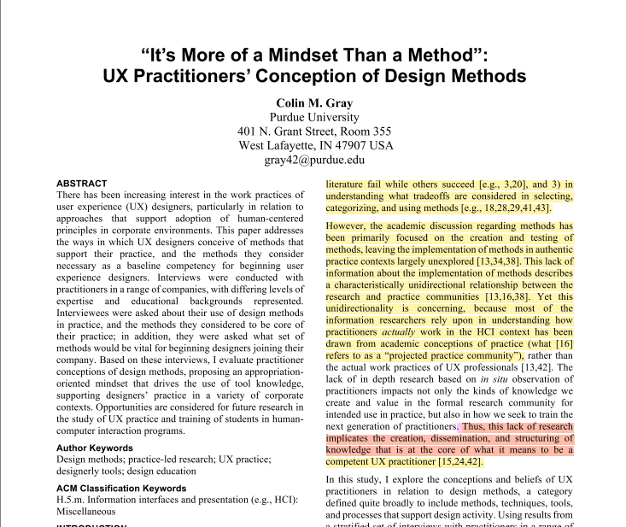
Importance of dispositions & mindsets
Notes:
My research had nicely replicated existing studies that identified importance of mindsets + dispositions
Rose, Putnam and MacDonald (2020) identified a person’s character, or personality, which they framed as “disposition”, as a critical quality for success in a UXD position.
In Gray’s (2016b) study they concluded that a designer’s judgement and mindset were crucial meta-competencies that enabled the effective use of methods (Nelson and Stolterman, 2012; Gray, 2016b).

Slide 29

Need for capabilities beyond content knowledge
Notes:
As ﻿Laurillard (2009) identifies, a focus on identity is essential for learners as a response to a changing world in which hard-won knowledge and skills can become quickly irrelevant, or outdated by changes in science, technology, politics, and culture.
For educators to prepare students for such a world, Laurillard (2009, p. 16) argues that courses must teach beyond the current horizons of knowledge and skills in a discipline to help learners develop a sense of “self”.

Slide 30
Professional identity is a personal embodiment of a professional role
Professional identity is a personal embodiment of the professional role that integrates an individual’s personal characteristics with the duties, values, and territory of the profession.
(Luehmann, 2007; Dall’Alba, 2009;
Tracey and Hutchinson, 2016)
Notes:
Like this idea of ID as a schema that is a negotiation between your individual characteristics and the duties, values, territory of the discipline or profession.

Slide 31
The Challenge
As UX is transdisciplinary and involves fast changing competencies
And our research revealed importance of mindset for entrants starting careers in UX
How can UX education develop learner’s professional identities?

Slide 32
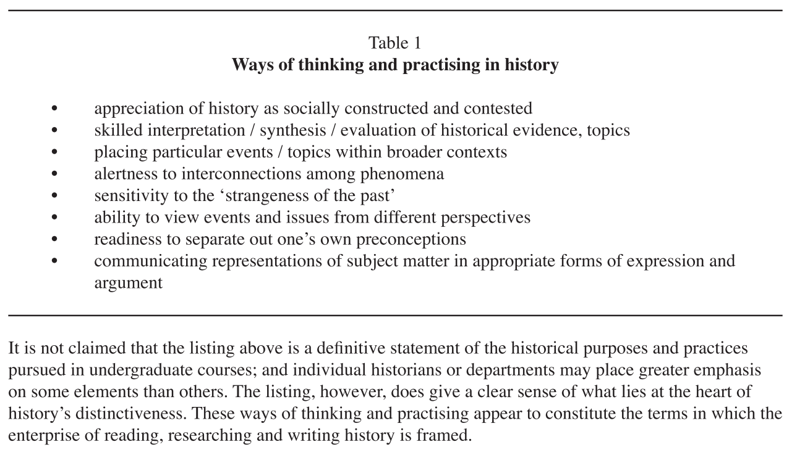
Took inspiration from ‘ways of thinking and practicing’ (Entwistle, 2003)

Slide 33
Threshold Concepts (Meyer and Land, 2003)
Transformative (essential): they change the way a student looks at things in the discipline.
Irreversible (probably): they are difficult for the student to unlearn.
Integrative (optional): they tie together concepts in ways that were previously unknown to the student.
Bounded (possibly often - though not necessarily always): they indicate the limits of a conceptual area or the discipline itself.
Notes:
“A threshold concept can be considered as akin to a portal, opening up a new and previously inaccessible way of thinking about something. It represents a transformed way of understanding, or interpreting, or viewing something without which the learner cannot progress. As a consequence of comprehending a threshold concept there may thus be a transformed internal view of subject matter, subject landscape, or even world view… Such a transformed view or landscape may represent how people ‘think’ in a particular discipline, or how they perceive, apprehend, or experience particular phenomena within that discipline (or more generally)” (Meyer and Land, 2003, p. 1)

Slide 34
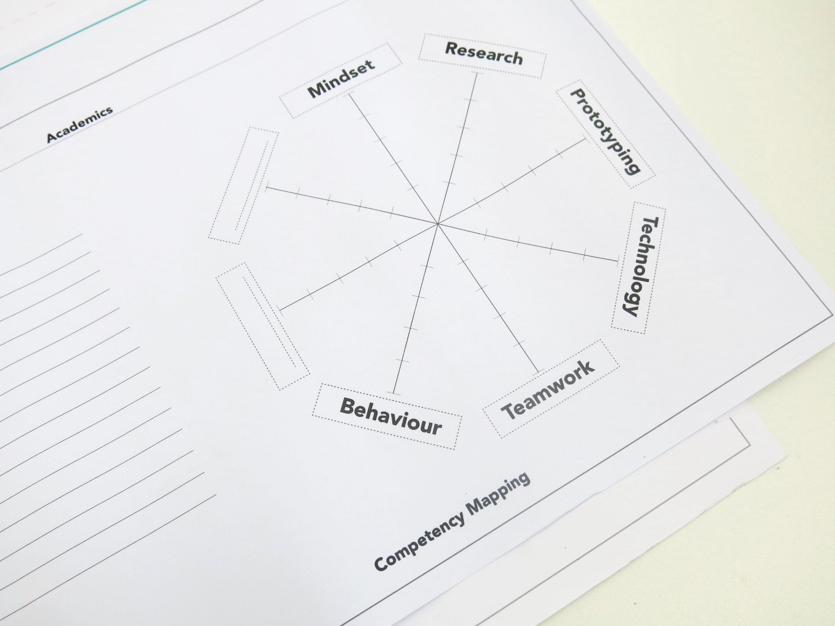
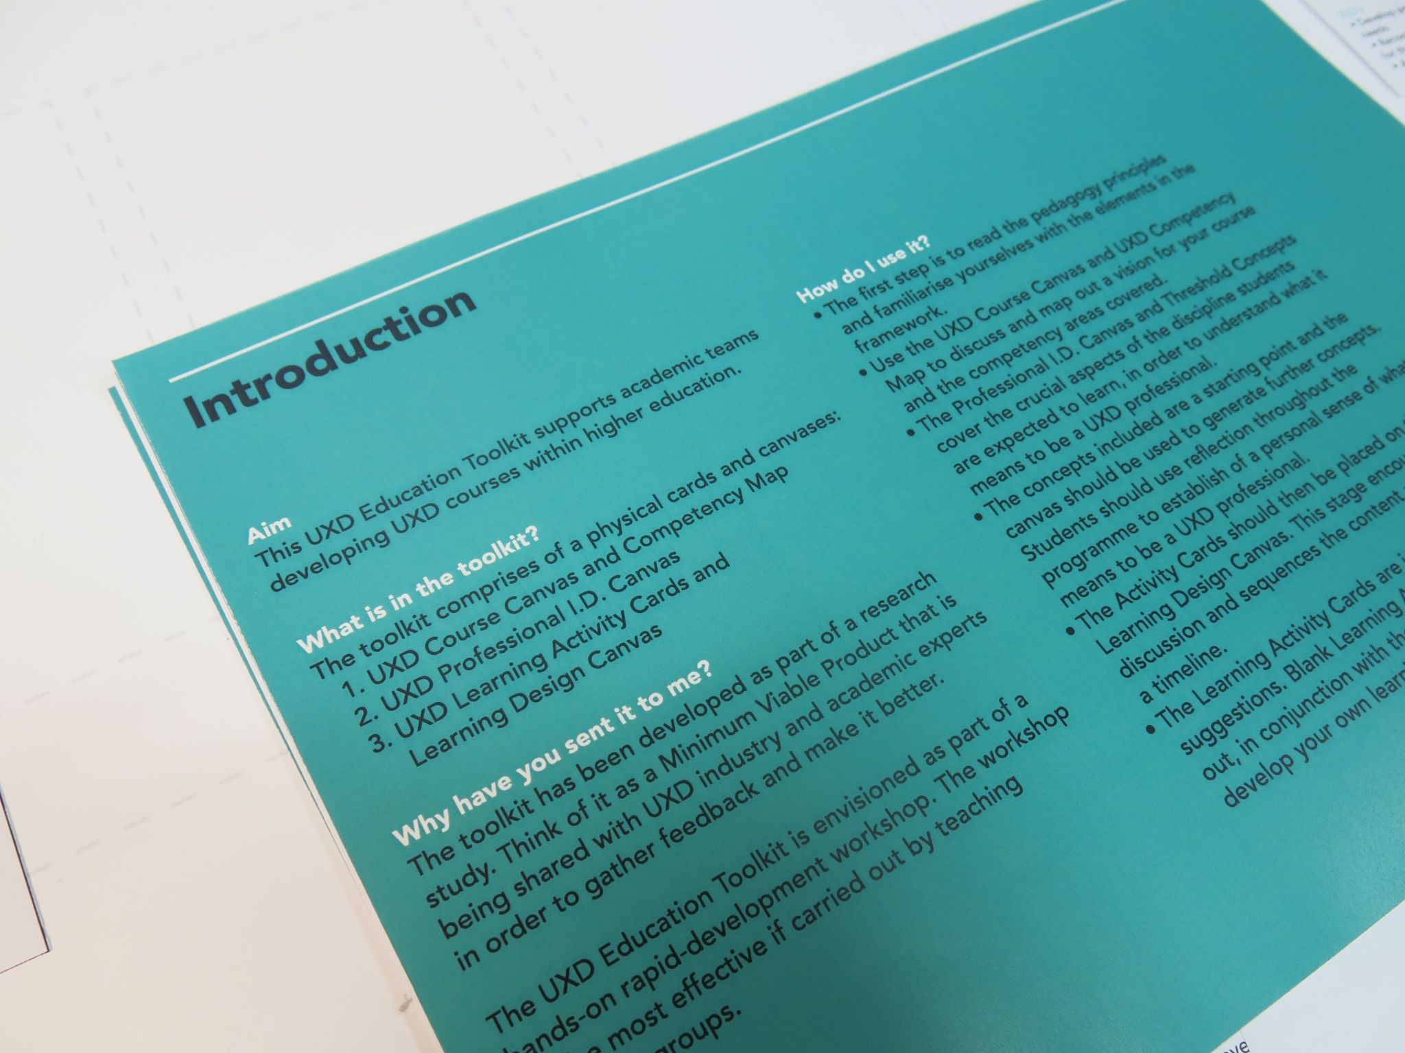

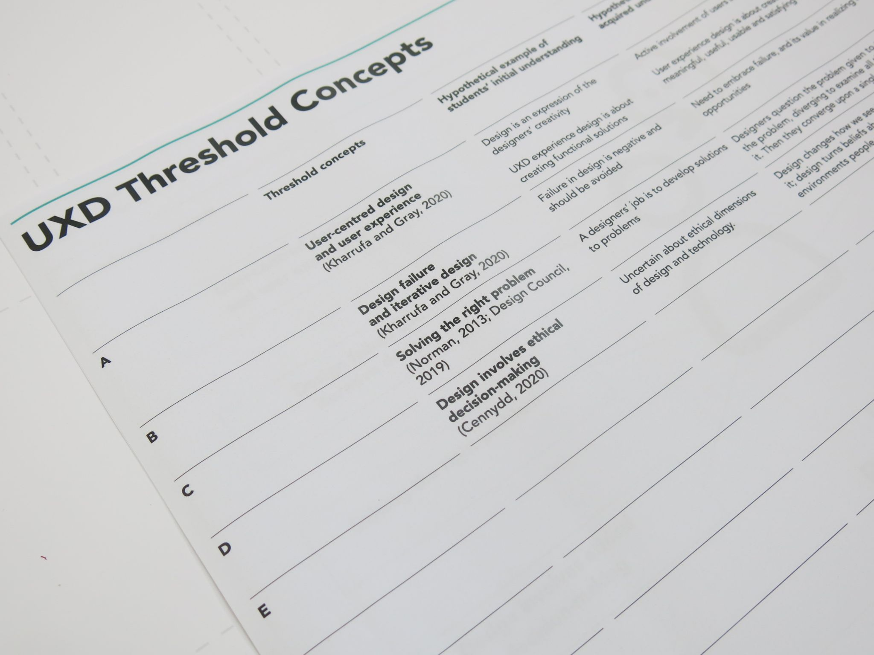
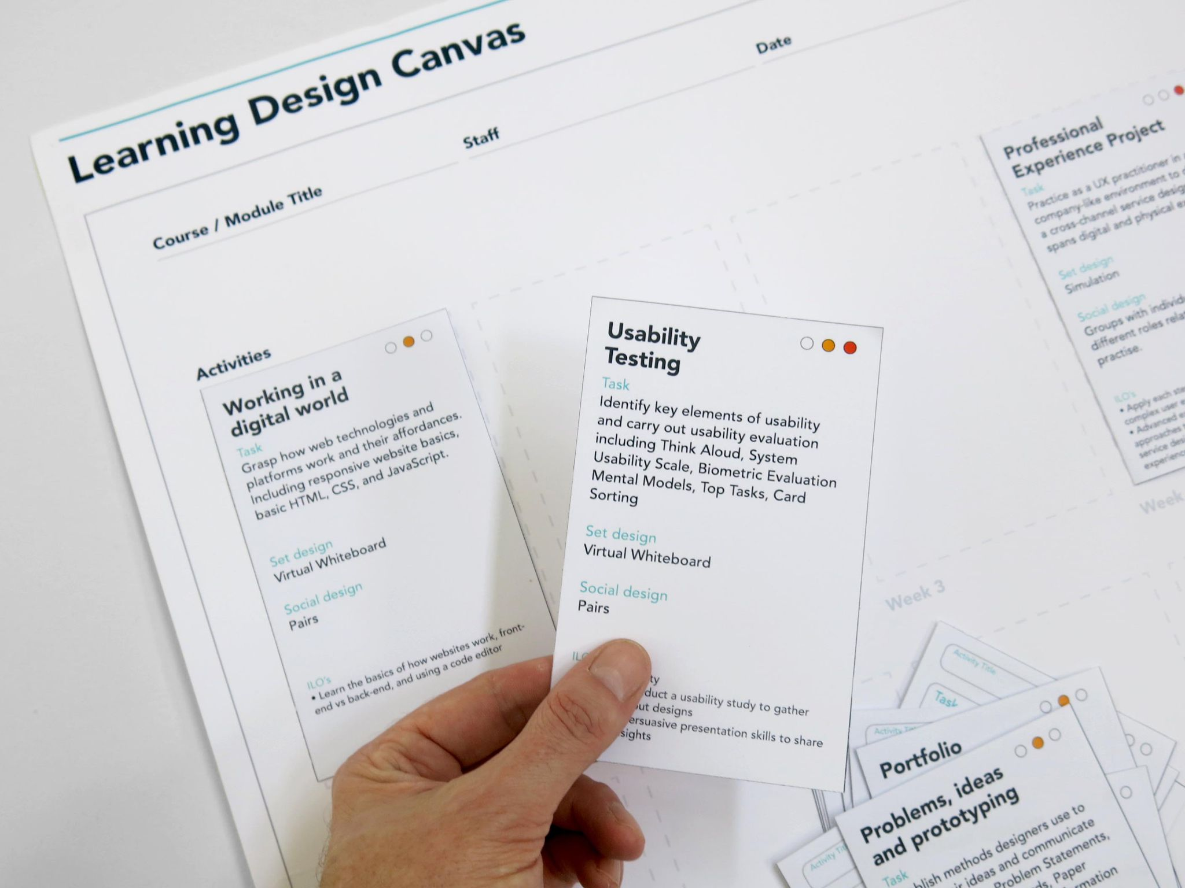
UX Teaching Toolkit

Slide 35
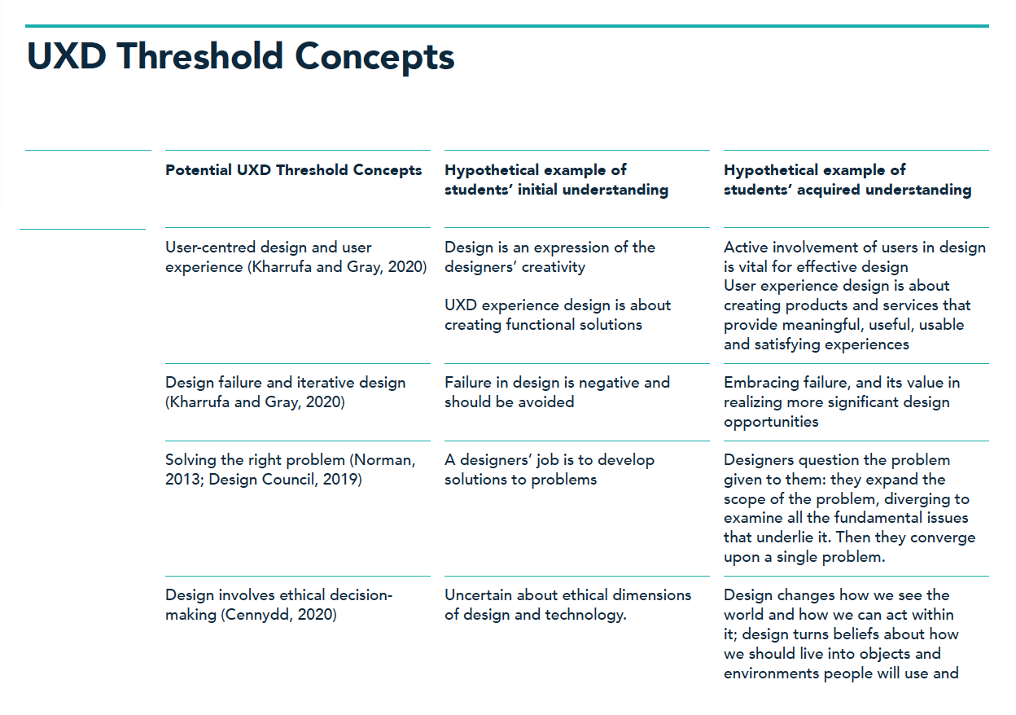
UX Threshold Concepts
Notes:
Threshold concepts are to be used alongside reflective — Reflection is a natural avenue for supporting identity development in novice designers, as it challenges students to think deeply about concepts and experiences through interpretation, evaluation, and revision. The emphasis on reflection as a means of learning extends back to Dewey (1991), while its use in the construction of professional identity was highlighted in the work of Schön (1983) and his conceptions of reflection-in-action and reflection-on-action.
Novice designers can leverage reflection to interpret and manage issues of uncertainty, instability, uniqueness, and conflicted values that are inherent in ill-structured design problems, both during and after the design experience. Thus, reflection can be an important tool in supporting novice designers as they begin the important work of constructing design precedents and establishing professional identity

Slide 36
Summary
UX and UX educational challenges
Developing professional identities alongside knowledge and skills
One tool i.e. Threshold Concepts (TC’s) and Student Reflection for helping learners develop their identities.
Next steps: TC’s need refining and learning design approach to using reflection as a tool to build identity

