Slide 1
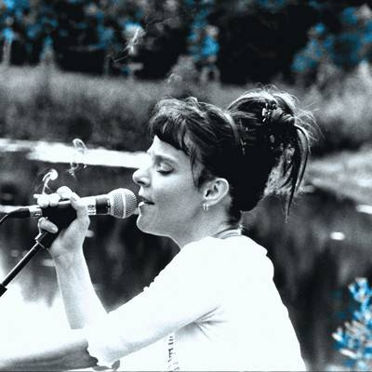
Adrian Bossey
Access to Music - Keynote

Slide 2
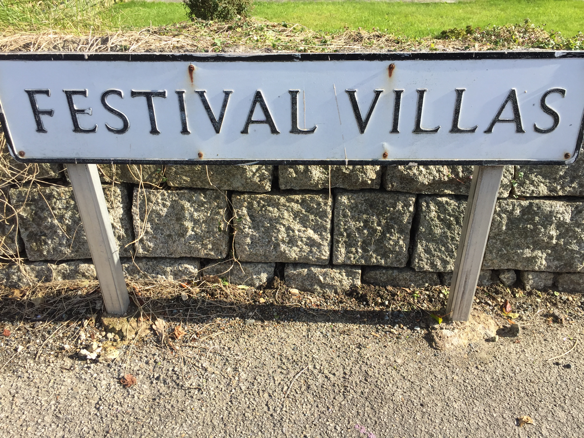
Presentation Overview
Audiences & Artists
Education & Technologies
Research & Policy
Some projects linking
Industry and Academia
Image: ‘possible level pathway to accessibility’ - CREDIT: A Bossey

Slide 3
Disability in the UK
“An individual can be classified as disabled if they have ‘a physical or mental impairment that has a ‘substantial’ and ‘long-term’ negative effect on (their) ability to do normal daily activities” (The Equality Act, 2010)
In 2020/21, 24 percent of the UK population (16 million people) had a “physical or mental health condition or illness that has lasted or is expected to last 12 months or more” (House of Commons Library 2023:1)
“More than a quarter of UK residents will be aged 65 years or over within the next 50 years” (Office for National Statistics, 2018)

Slide 4
Some more context
The music industry is exclusive, it discriminates against pretty much all the protected characteristics of the Equality Act and poverty
Accessibility refers to “measures put in place to address participation by those with impairments” Finkel, Sharp & Sweeney (2019. 2)
Attitude is Everything “connect disabled people with music and live event industries to improve access together”
The Association for Events Management Education aims “to advance events education within the UK and overseas”. Our Diversity, Equity & Inclusion SIG shares best practice, research, collaboration and support
At Falmouth University “we work towards an equitable and diverse world”

Slide 5
Audiences Project
No Climate Action Without Us – sustainability toolkit
Attitude is Everything, Julie’s Bicycle, and A Greener Future developed the new toolkit on how to make disabled people’s access to live events environmentally sustainable
Outlines practical ways in which venues, events and festivals can implement accessible solutions in climate change
‘Call to action’ to the live events industry to make access and environmental solutions equal partners.
https://attitudeiseverything.org.uk/no-climate-action-without-us-toolkit/

Slide 6
Education Project
On-line training
Attitude is Everything: Disability Equality for the Live Events Industry
Next start date 1 July 2024
shortcourses@falmouth.ac.uk
A Greener Festival: Assessing Sustainability for the Live Events Industry
Next start date 2 June 2024

Slide 7
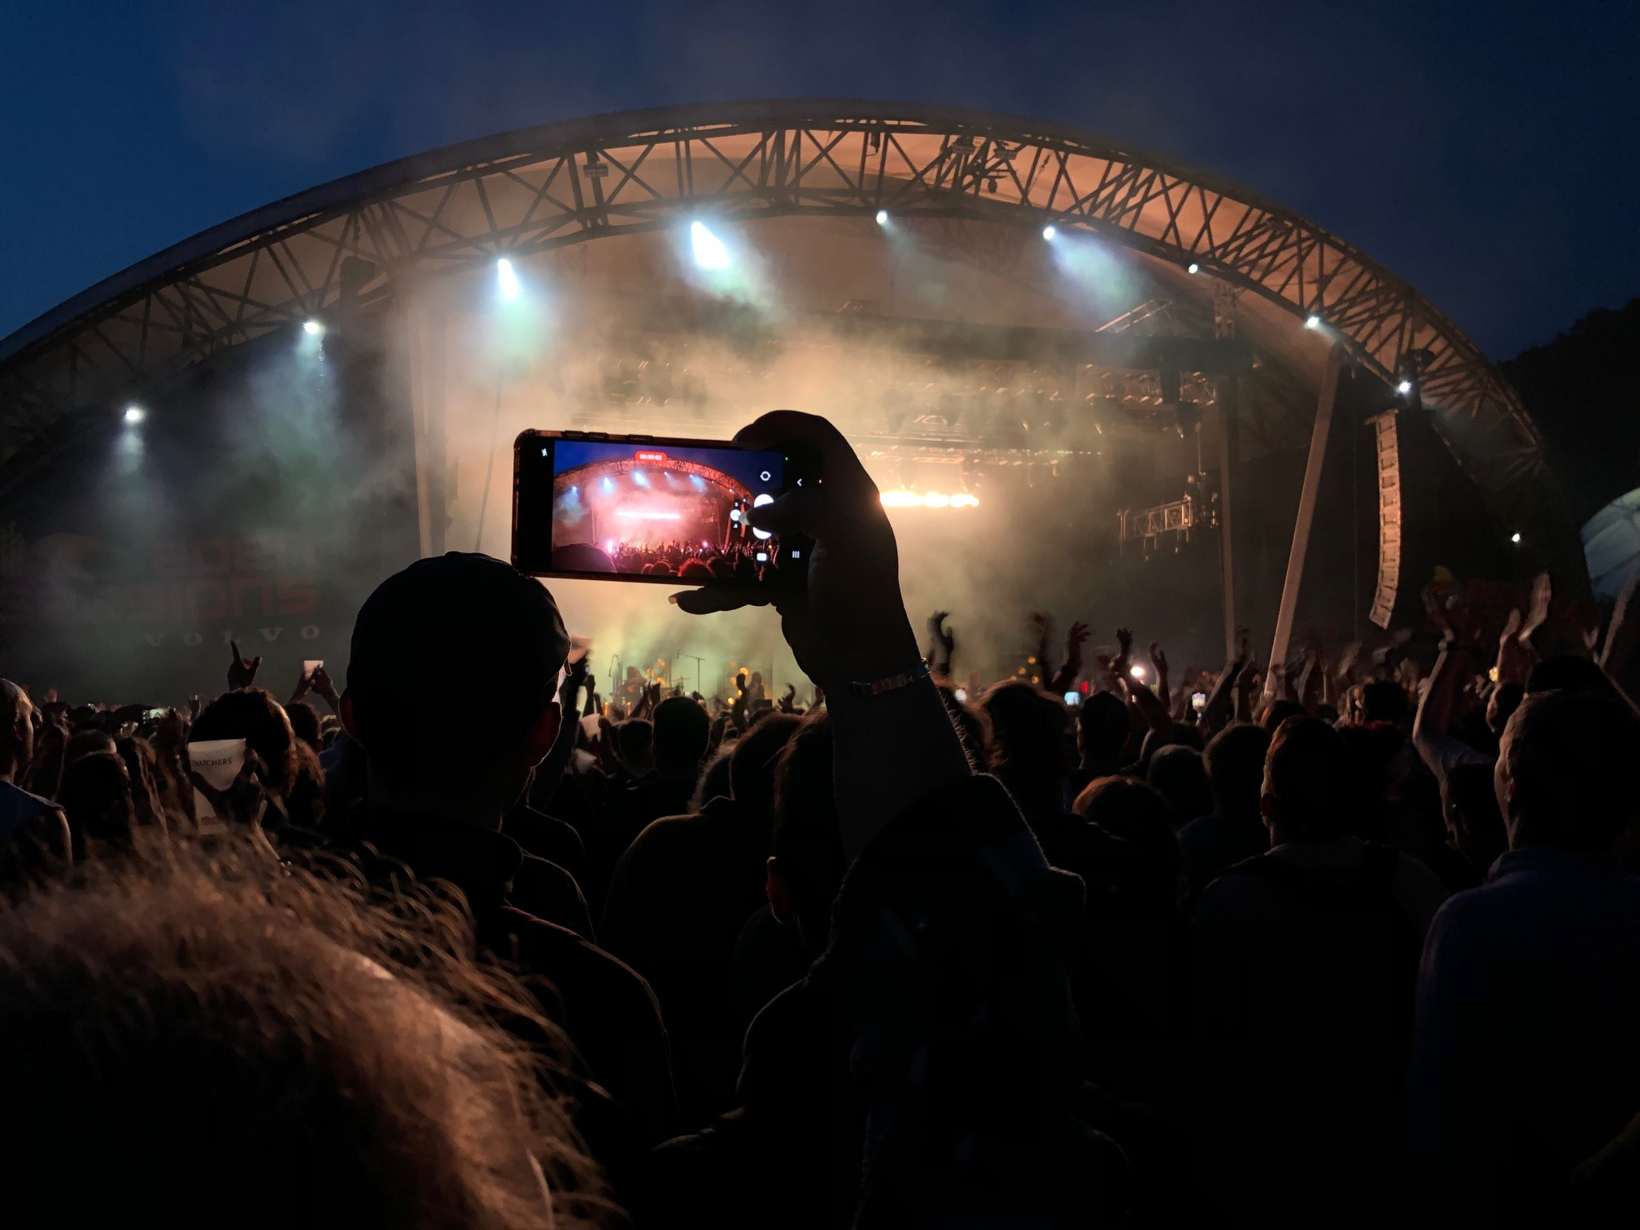
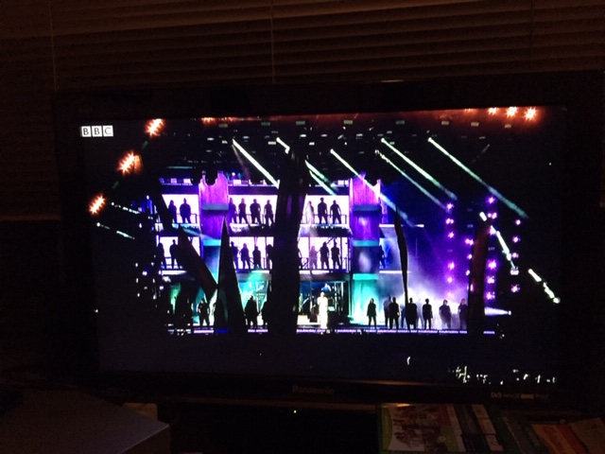
Research Project(s)
My research considers ‘liveness’, haptic technology and potential digital futures for accessible live performances for people who are d/Deaf, disabled or neurodivergent at music festivals
Image: Attendees at NIN at Eden Sessions 2022 – credit Adrian Bossey
Image: Stormsy live at Glastonbury 2019, ‘live’ on BBC; on my TV
– credit Adrian Bossey
https://orcid.org/0000-0002-9874-6323

Slide 8
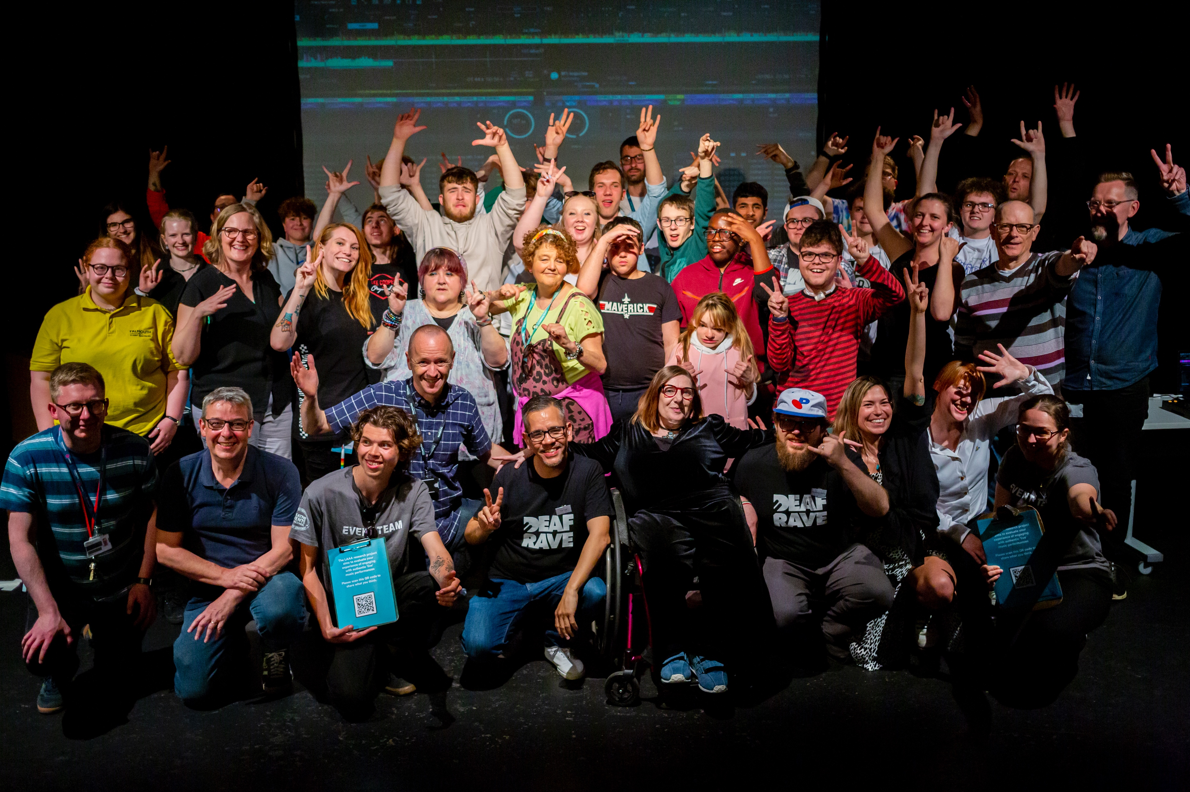
Live Audience Accessibility & Augmentation Project
Image: Attendees at LAAA Project using BEAT BLOCK haptic floor CREDIT Matt Jessop
IMAGE: Attendees at LAAA Project DEAF RAVE DJ Workshops CREDIT: Matt Jessop

Slide 9
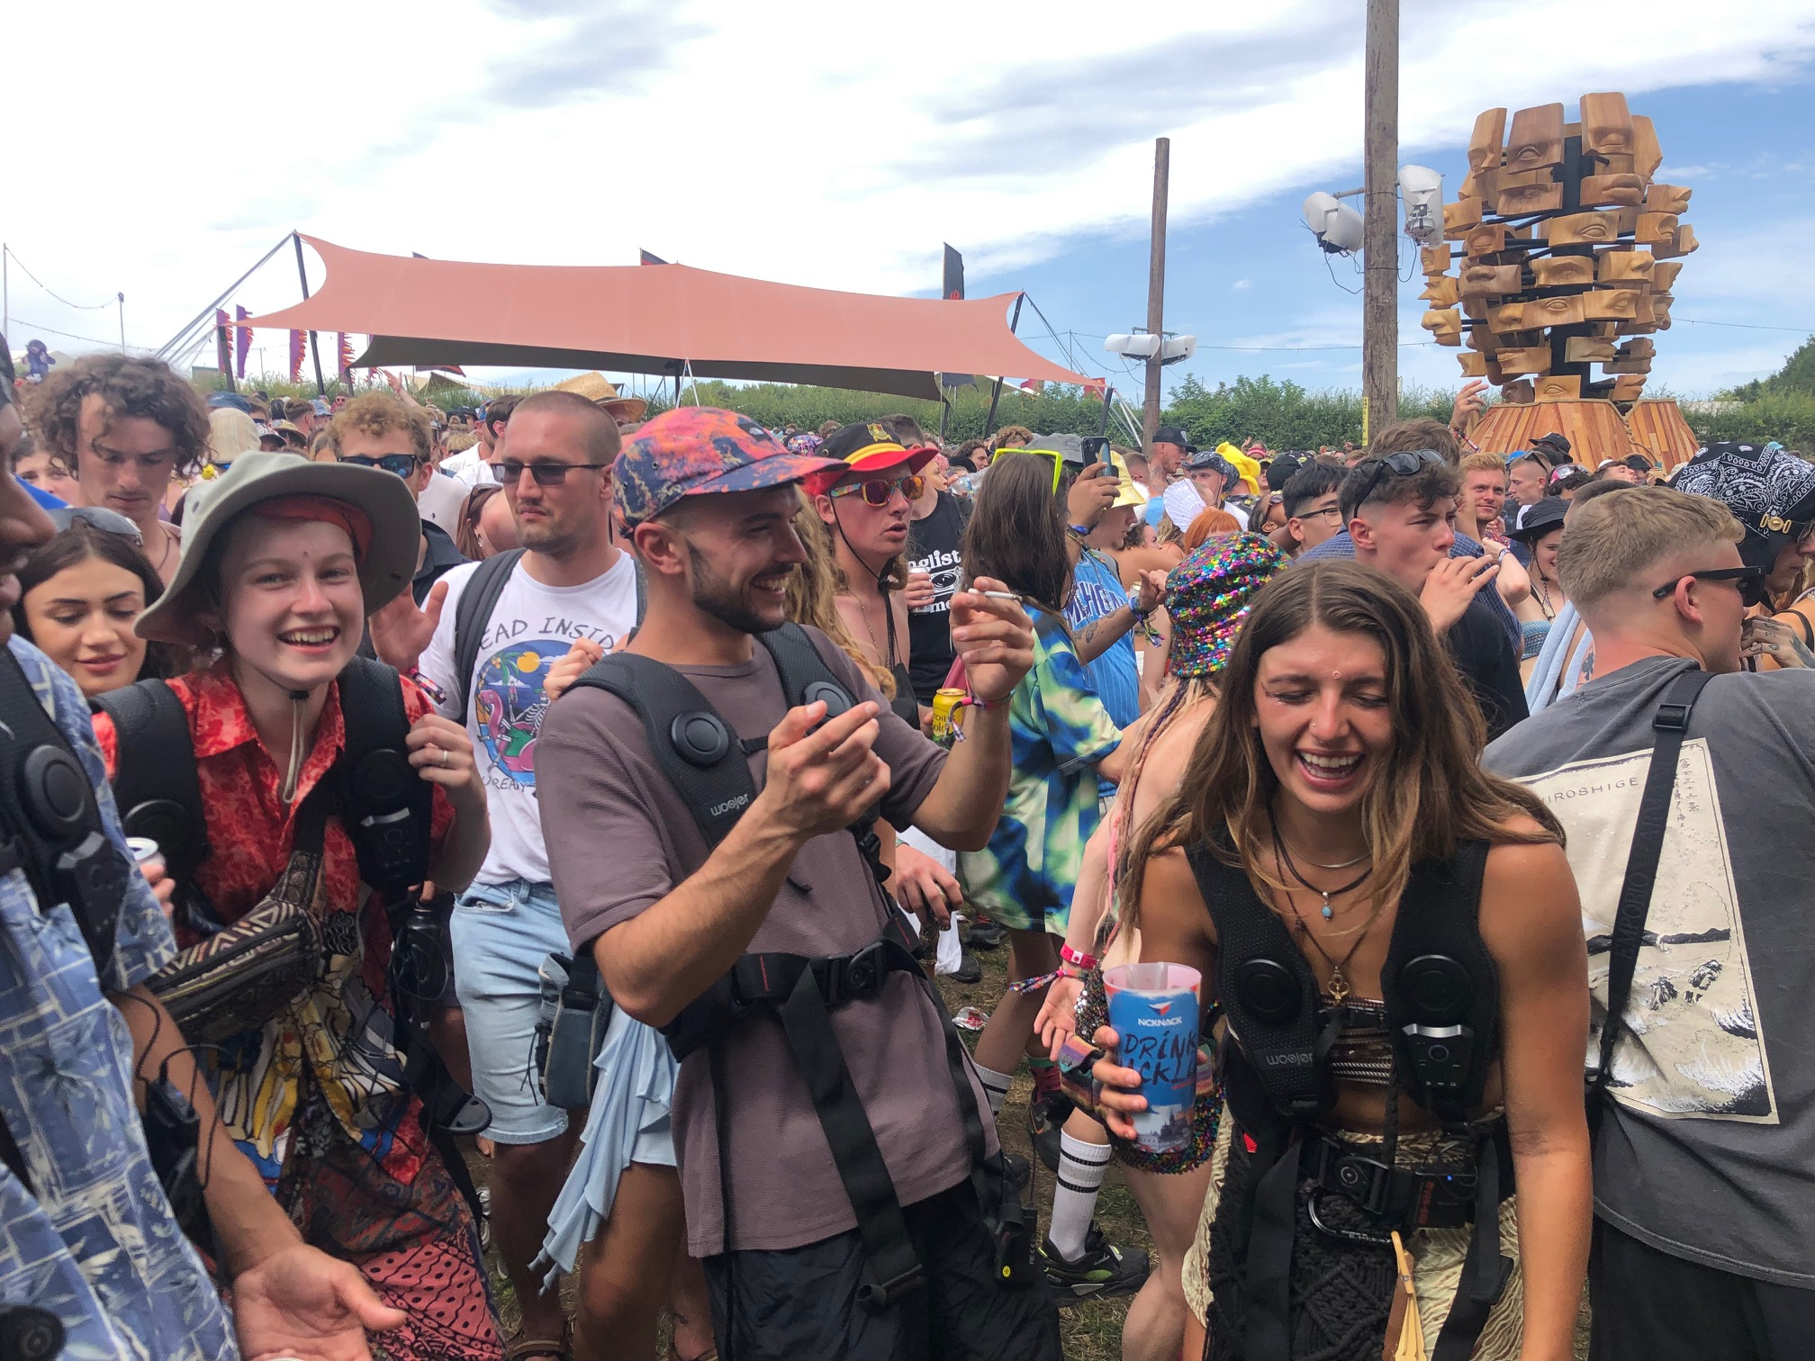
Live Audience Accessibility & Augmentation 2 Project(s)
Image: Attendees at Boomtown Fair 2023 Deaf Rave takeover – credit Adrian Bossey
Image: Attendees using BEAT BLOCKS haptic floor CREDIT Rah Petherbridge .
PLEASE NOTE: This could be you today!!

Slide 10
Please let us know what you think
Try out the BEAT BLOCKS haptic floor today during Bellatrix
Complete a questionnaire

Slide 11
References
Equality Act (2010) Equality Act 2010 https://www.legislation.gov.uk/ukpga/2010/15/contents The National Archives.
Finkel, R, Sharp, B & Sweeney, M (2019). Accessibility, Inclusion, and Diversity in Critical Event Studies. Routledge. ISBN 9781032338897
House of Commons Library (2022 August 23) UK disability statistics: Prevalence and life experiences https://commonslibrary.parliament.uk/research-briefings/cbp-9602/ HMSO
Office for National statistics (2018) https://www.ons.gov.uk/peoplepopulationandcommunity/populationandmigration/populationestimates/articles/overviewoftheukpopulation/november2018 (accessed 09.02.19) HM Stationary Office.

